Slide 1


The OCP Market & Supply Chain
Steve Helvie
VP of Channel Development
steve@opencompute.org

Slide 2






The Market
OCP Solution Providers - Resellers
OCP Marketplace

Slide 3
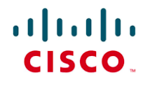











The move toward Open Source
By 2020 – 30% of strategic relationships will change
Source: IDC

Slide 4
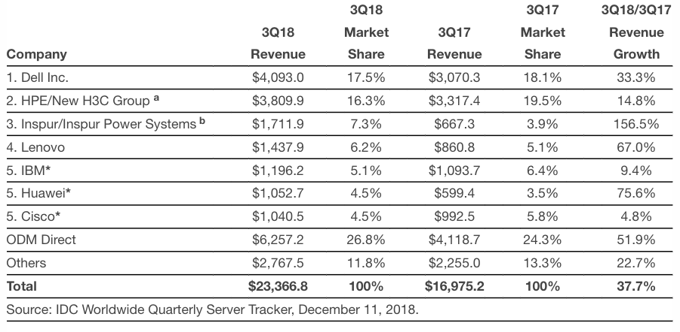
Worldwide Server Revenue Grew 37.7% YoY
5 consecutive quarters of double digit growth

Slide 5
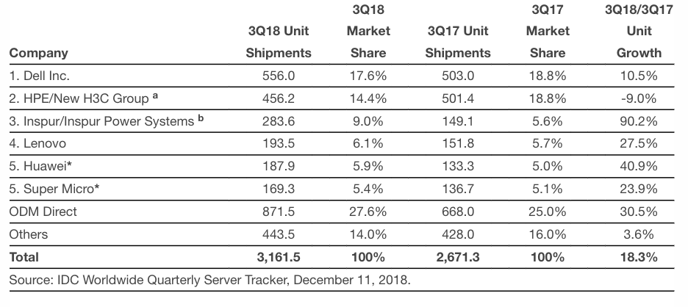
Worldwide Server Shipments

Slide 6
Data Center Market in the Rest of Asia
Big investment in data centers across Southeast Asia the last 2 years
Thailand data center industry target - 40% for renewable energy by 2030.
Digital India and growing need for data centers
Japan data center market is opening up to competition
Vietnam new data privacy laws impact local data centers

Slide 7

OCP Market Growth

Slide 8
APAC CAGR = 103%
America’s CAGR = 47%
EMEA CAGR = 70%
$Billion USD
2017
2018
2019
2020
2021
Source: HIS Markit

Slide 9
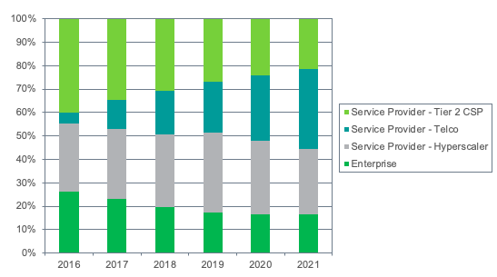
Double Digit Growth through 2021
America’s CAGR = 47%
APAC CAGR = 103%
EMEA CAGR = 70%
Who ?
Telcos increase POCs in 2017, production trials ramp in 2018, scale deployments 2019+
Telco and Tier 2 CSP largest OCP switches customers thru CY21
Source: HIS Markit
Note: Revenue reflected is for non OCP Board Member Companies
Source: IHS Markit

Slide 10
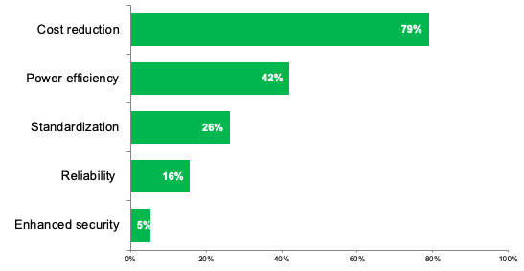
Double Digit Growth through 2021
America’s CAGR = 47%
APAC CAGR = 103%
EMEA CAGR = 70%
Why OCP ?
Cost reduction and power efficiency biggest drivers for OCP servers
Standardization is a big influence of OCP adoption for switches
Source: HIS Markit
Note: Revenue reflected is for non OCP Board Member Companies
Source: IHS Markit

Slide 11


Double Digit Growth through 2021
America’s CAGR = 47%
APAC CAGR = 103%
EMEA CAGR = 70%
OCP in the Enterprise
New hardware layer and more suitable Citrix environment
35% Reduction in TCO 30% Reduction in OPEX
ING Bank Poland
London Internet Exchange
First IXP in the world to adopt a disaggregated model
Booking.com
40% less energy compared to blades
Source: https://www.opencompute.org/events/past-summits
Note: Revenue reflected is for non OCP Board Member Companies
Source: IHS Markit

Slide 12
Double Digit Growth through 2021
America’s CAGR = 47%
APAC CAGR = 103%
EMEA CAGR = 70%
OCP in the Rest of Asia
26% of their servers are OCP. 8% more power efficient. Most hardware parts can be replaced in 3 minutes or less.
Source: https://www.opencompute.org/events/past-summits
Note: Revenue reflected is for non OCP Board Member Companies
Source: IHS Markit

Slide 13
Who sells OCP Solutions?
Where can I see OCP Solutions?

Slide 14


The OCP Solution Provider program is our reseller channel

Slide 15
















Who sells OCP Solutions?
https://www.opencompute.org/sp/open-compute-project-solution-providers

Slide 16


2 types of OCP Products
Detailed Design Files
No Design Files

Slide 17
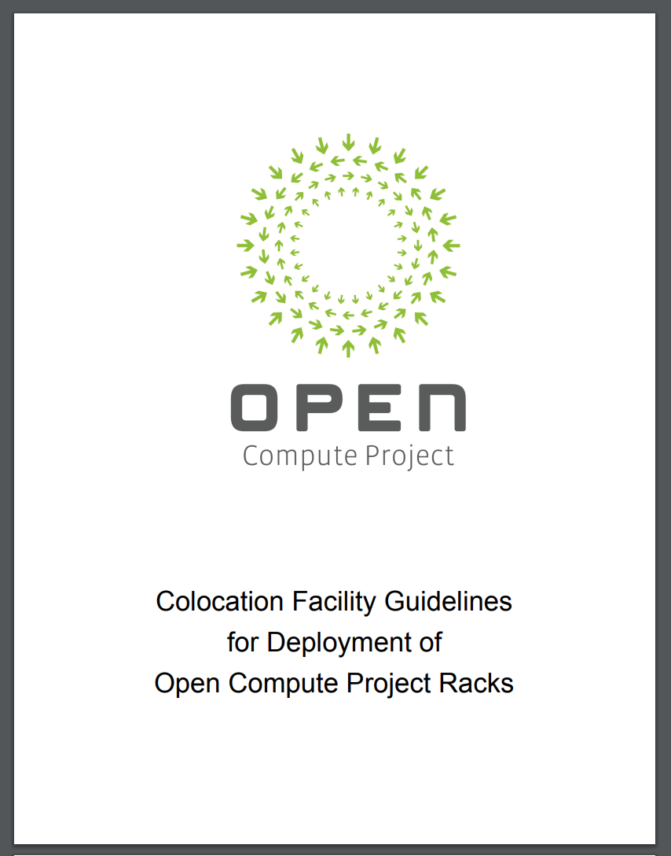
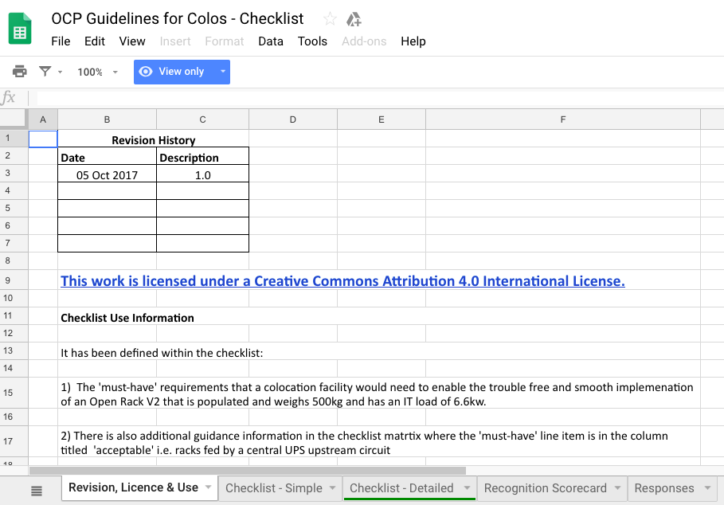

Data Center Facilities “ready” for OCP Solutions
https://www.opencompute.org/contributions

Slide 18
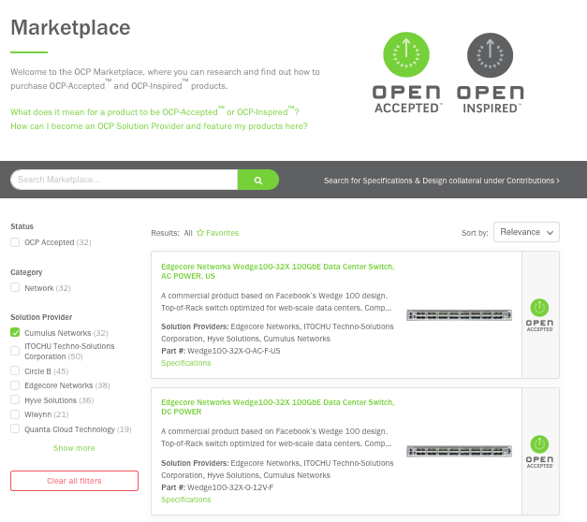
You can see a list of products and facilities on the OCP Marketplace
https://www.opencompute.org/products
https://www.opencompute.org/sp/open-compute-project-solution-providers

Slide 19
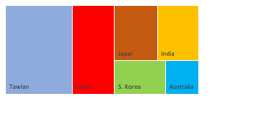
> 2,000 visits per month from APAC
APAC = 5 of top 10 Countries visiting our website

Slide 20



In China...what OCP products do people view?
Server
Storage
Networking

Slide 21
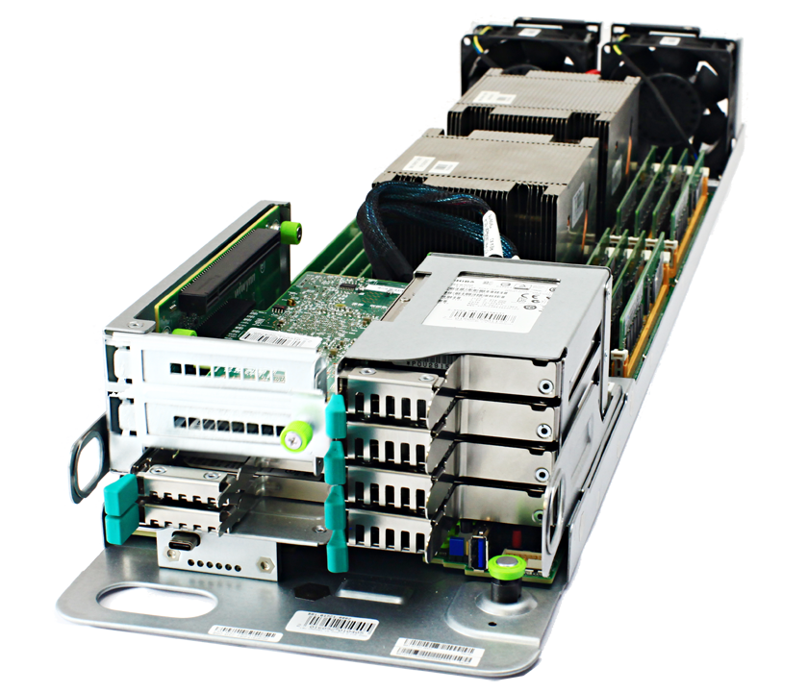
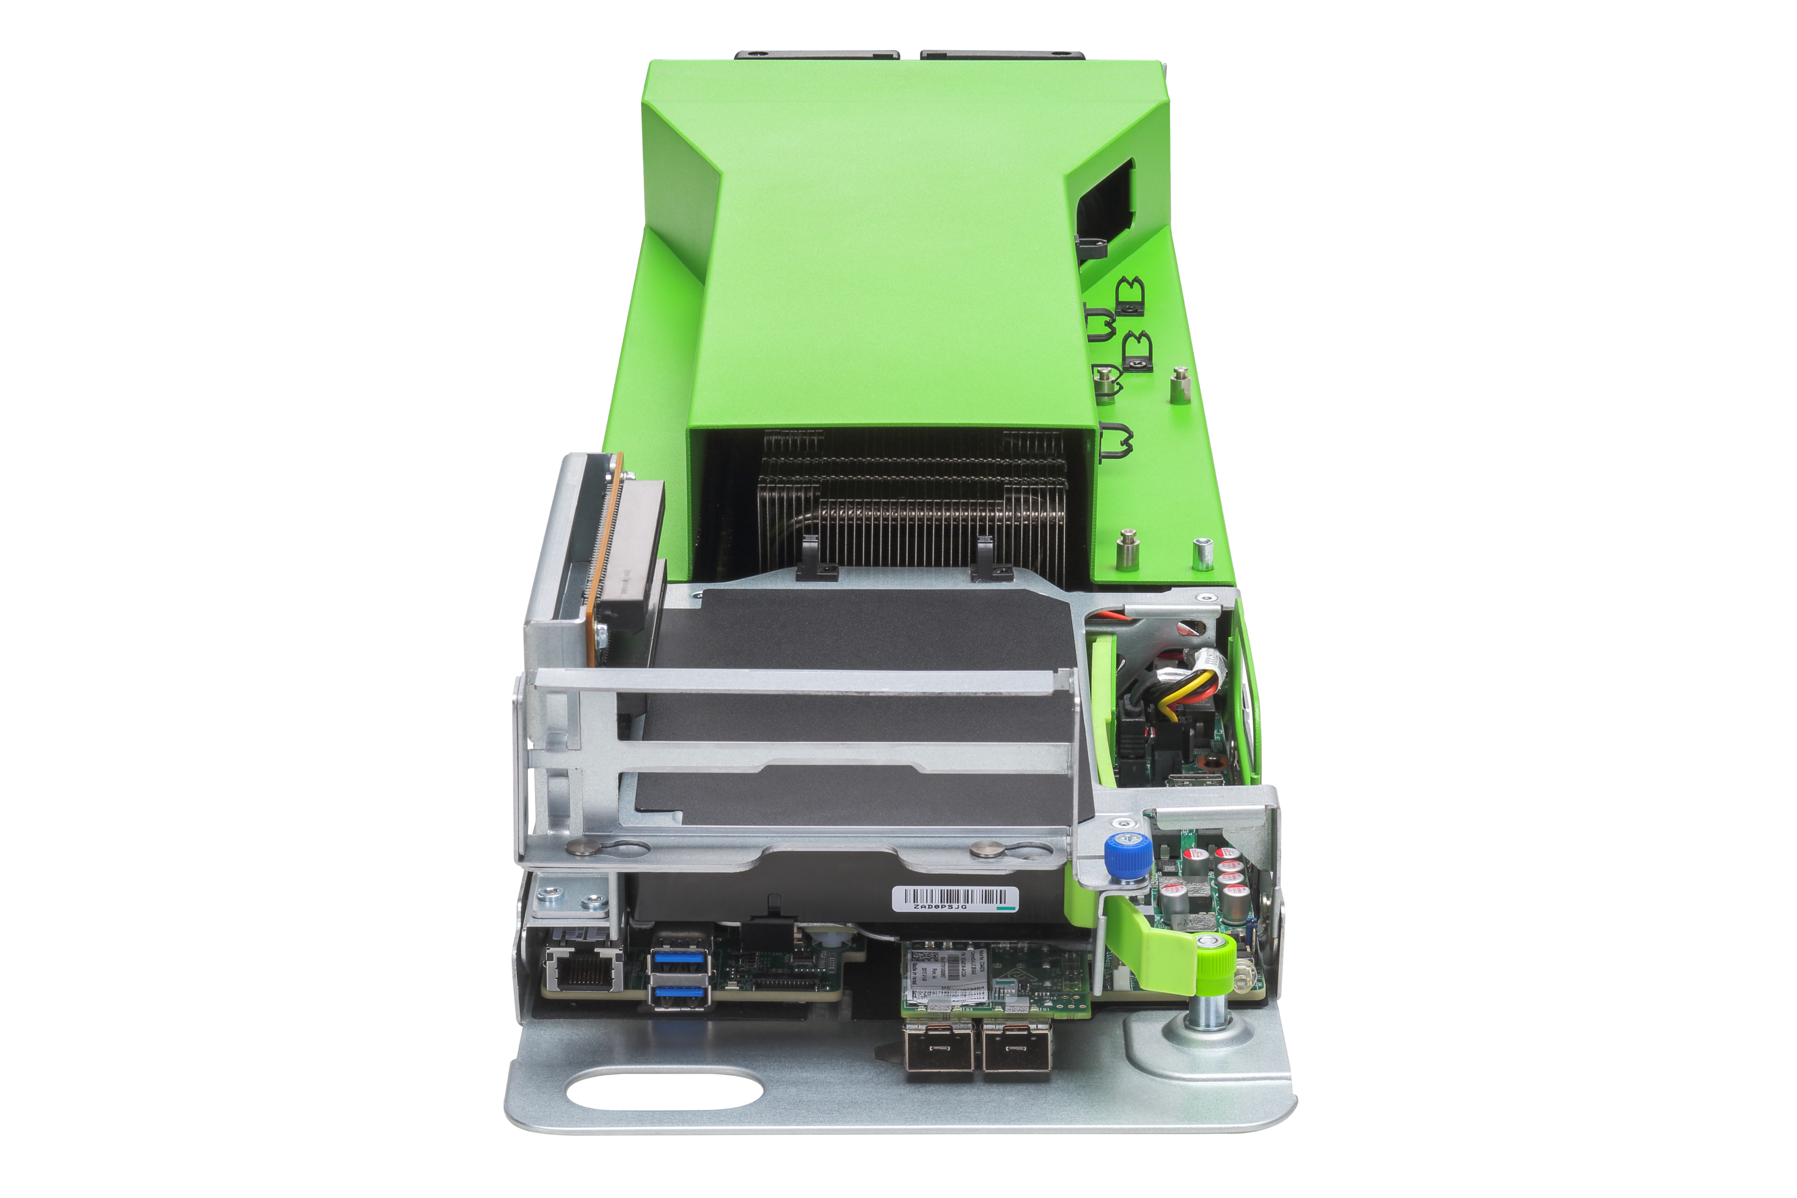
Wiwynn Leopard Compute Sled
Inspur Open Rack v2 San Jose Compute Sled

Slide 22
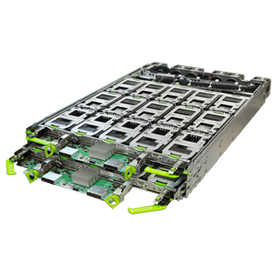
Wiwynn Lightning NVMe JBOF

Slide 23
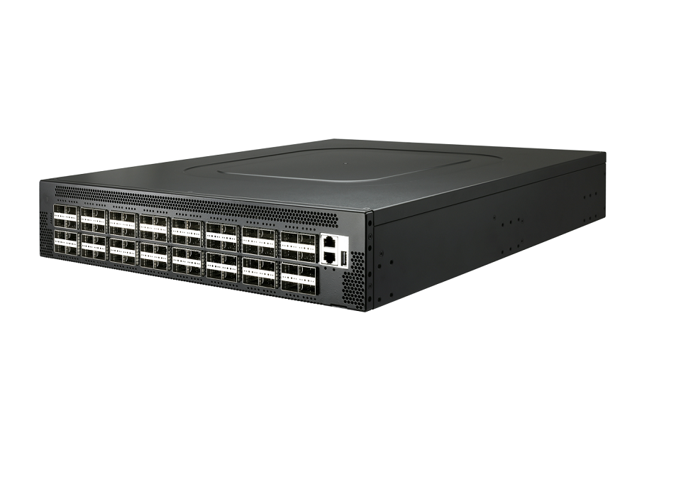
Edgecore Networks AS7816-64X 100GbE Data Center Switch

Slide 24
The OCP Market is Growing !!
Asia is using OCP Hardware
Please visit with Solution Providers and visit the Marketplace

Slide 25
THANK YOU

