Slide 2

Standalone Rack Level Liquid Cooling Solution
Yin Hang, Thermal Engineer, Facebook
Albert Li, Thermal Engineer, Wiwynn
ACS

Slide 3

Standalone Rack Level Liquid Cooling
ADVANCED COOLING SOLUTIONS
IT
Gear
  Standalone Rack Level Liquid Cooling
  Requires no facility change
  Key elements are compatible for ORV3
  High serviceability
  Independent rack level cooling control
Air
Air
Active Rear Door
Heat Exchanger
Liquid
CDU

Slide 4
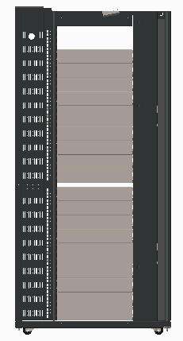
Thermal Architecture
Air Side
Pump
ADVANCED COOLING SOLUTIONS
Cool Air
Warm Air
Rear Door Heat Exchanger
Hot Air
Fan Wall
Fan
Fan
CDU
CDU
Coolant Side
Air assisted liquid cooling (AALC): heat dissipated from the high power chips is transferred to the rear door heat exchanger through cold plate and the rest of the heat from the IT gears is cooled by air directly

Slide 5
Heat Dissipation Path- Coolant Side
Liquid Out
ADVANCED COOLING SOLUTIONS
Rack
Cold Plate
Cooling capacity
Active RDHx
(with Fan)
Cold Plate
TDP of Chip
Qty of Chip/Cold plate
CDU
Liquid In
Total heat of chip is transferred by coolant side 🡪 RDHx Cooling capacity

Slide 6
Heat Dissipation Path- Air Side
Liquid Out
ADVANCED COOLING SOLUTIONS
CFM per W
Whole Rack Power
Air Flow Rate
Active RDHx
(with Fan)
Cold Plate
T_{in,RDHx}
T_{ambient}
CDU
Liquid In
Total rack power and CFM/W requirement🡪 RDHx Max. air flow rate
Rest of heat is transferred by air 🡪 Air Tin of RDHx

Slide 7
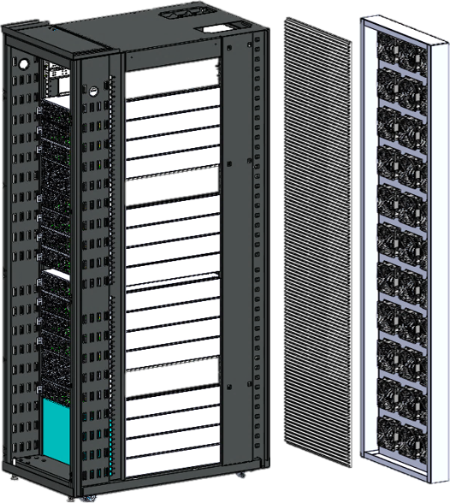
Standalone Rack Level Liquid Cooling
Standalone rack level cooling solution
- Without any facility change
- Independent rack cooling control system
Prototype ready in Q3, 2020
Contribution in Q1, 2021
ADVANCED COOLING SOLUTIONS
RDHx
FAN
Working L11 ready in Q3, 2020
Contribute design and test result to OCP
Q3, 2020
Q4, 2020
Q1,2021
CDU
Test data collection in Q4, 2020

Slide 8
Design Factors
Performance
RDHx cooling capacity (request no facility water)
Cold plate performance
Serviceability
Cold plate assembly and maintenance
Blind-mate liquid cooling interfaces implemented
Control
CDU serves as brain of rack level liquid cooling
Compatible Design
Key element is compatible to ORV3 and EIA 19” rack

Slide 9
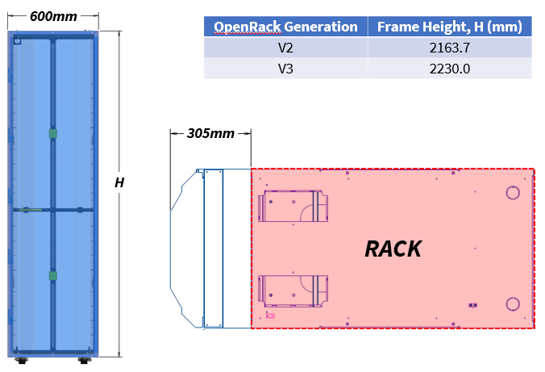
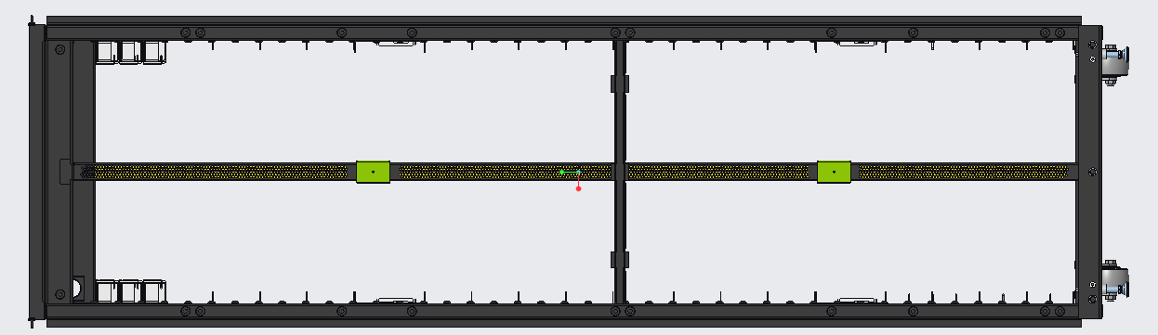
Performance- Active RDHx
ADVANCED COOLING SOLUTIONS
Meet OCP Door Heat Exchanger specification
Support up to ORV3 rack power
RDHx Design Target for ORV3
Dimension | L2230*W600*D305 (mm)
Maximum Weight (with coolant) | 150kg
Max. Air Flow Rate Usage | ≤3300CFM N+1 rotor/fan redundancy
Nominal Capacity | ≥23kW
70% rack power from main chip

Slide 10
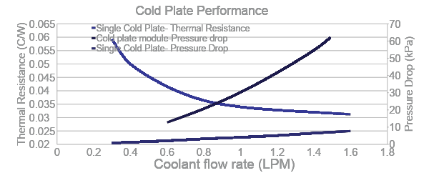
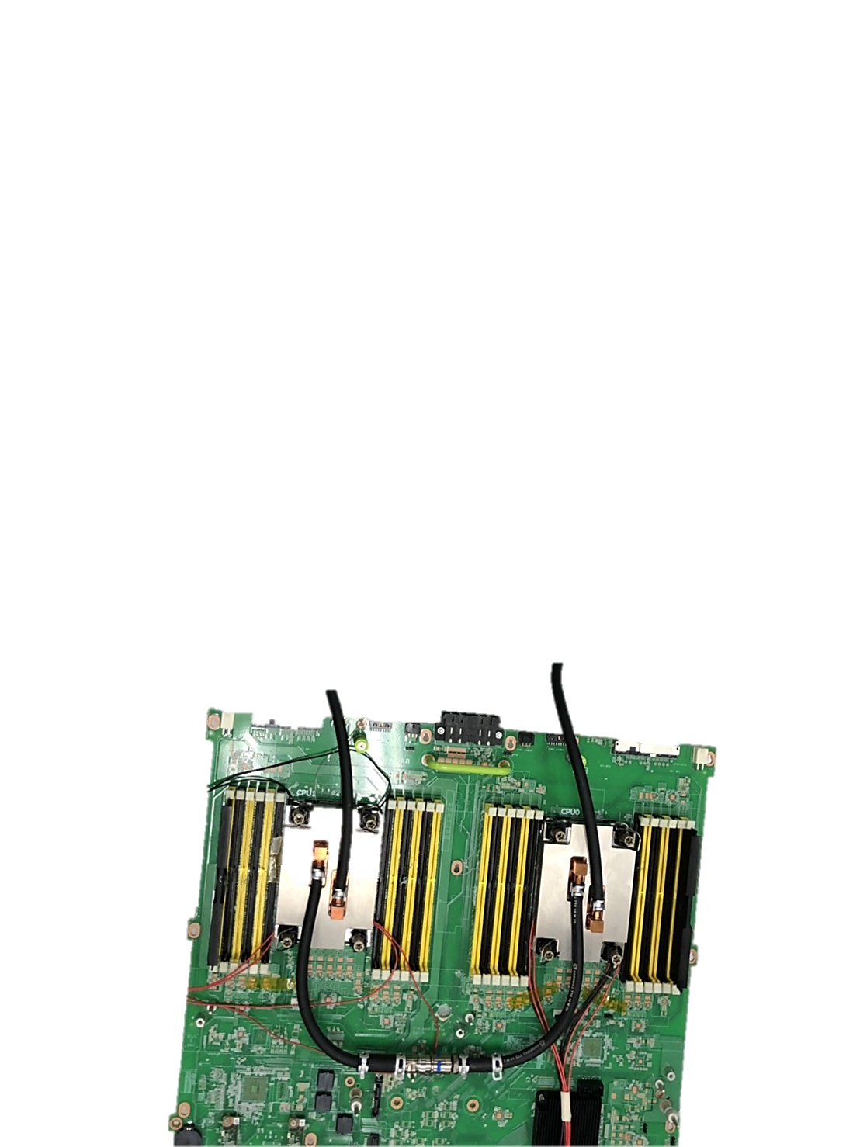
Performance- Cold Plate
ADVANCED COOLING SOLUTIONS
Cold Plate Module Test
Test with water and 250W TTV
Single cold plate performance at 1LPM
Thermal Resistance: 0.036 C/W ; Pressure drop: 4.2kPa
Module Pressure drop at 1LPM- 30.2kPa ( including 3 sets SCG03 QDs)

Slide 11
Content
Performance
RDHx cooling capacity (request no facility water)
Cold plate performance
Serviceability
Cold plate assembly and maintenance
Blind-mate liquid cooling interfaces implemented
Control
CDU serves as brain of rack level liquid cooling
Compatible Design
Key element is compatible to ORV3 and EIA 19” rack

Slide 12
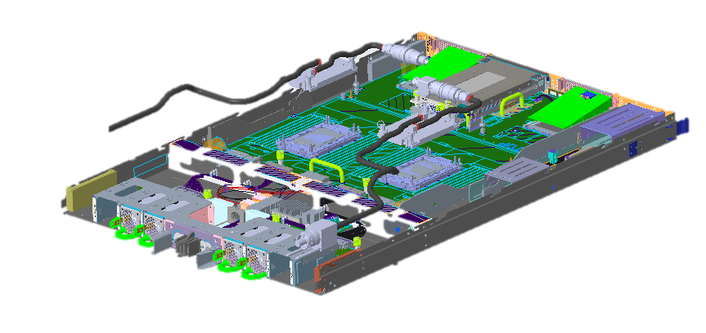
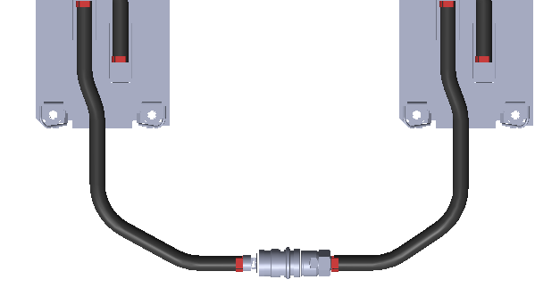
Serviceability- Cold Plate
Cold Plate
Cold Plate
ADVANCED COOLING SOLUTIONS
QD(s)
Internal QDs design for serviceability and maintenance
Soft tube is flexible for system assembly and disassembly separately
Chassis design for pipe routing and straightly assemble

Slide 13
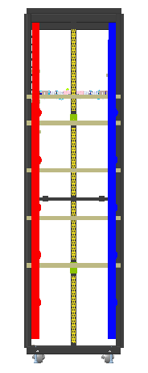
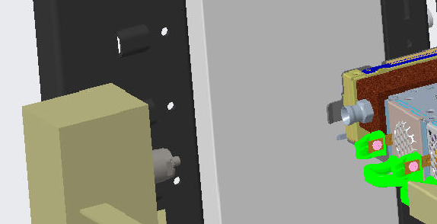
Serviceability- Rack Manifold
BUSBAR
ADVANCED COOLING SOLUTIONS
Cold manifold
Blind Mate QDs
Server
Rack Manifold
Hot manifold
Blind mate, self-align QDs as coolant interface with L10 system
Manual mate QD as coolant interface with RDHx and CDU
Separated manifold design
CDU
Rear View

Slide 14
Content
Performance
RDHx cooling capacity (request no facility water)
Cold plate performance
Serviceability
Cold plate assembly and maintenance
Blind-mate liquid cooling interfaces implemented
Control
CDU serves as brain of rack level liquid cooling
Compatible Design
Key element is compatible to ORV3 and EIA 19” rack

Slide 15
Control-CDU Serve as Brain of Rack Cooling Solution
System
Fans
Active
RDHx
IT Gear
ADVANCED COOLING SOLUTIONS
Monitor (CDU)
Coolant Temp. sensors ( in& out)
Coolant Flow Rate
Pressure sensor (in & out)
Power consumption
Reservoir level
Leak detection
Pump speed
Pump power consumption
Monitor (Active RDHx)
In/Out Temperature sensors
Pressure sensors
Fan power consumption
Fan speed
System workload
BMC
Fan Speed
Control (Active RDHx)
Fan PWM
CDU
(Control Algorithm)
Control(CDU):
Pump PWM
Pump Power
PUMP
Pump Speed
Coolant temperature
Fan Speed
CDU will serve as center of control and sensors reporting

Slide 16
Content
Performance
RDHx cooling capacity (request no facility water)
Cold plate performance
Serviceability
Cold plate assembly and maintenance
Blind-mate liquid cooling interfaces implemented
Control
CDU serves as brain of rack level liquid cooling
Compatible Design
Key element is compatible to ORV3 and EIA 19” rack

Slide 17
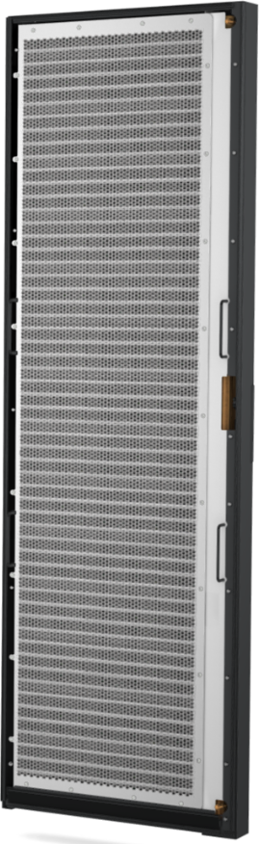
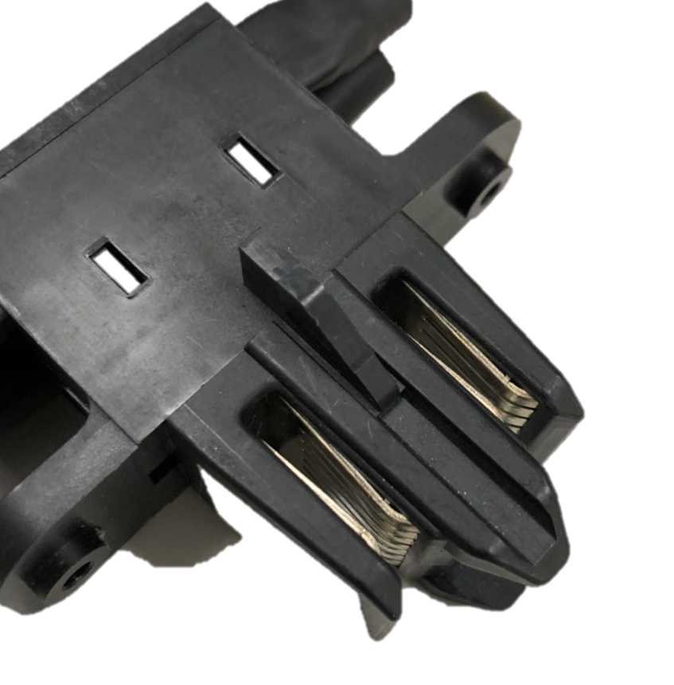
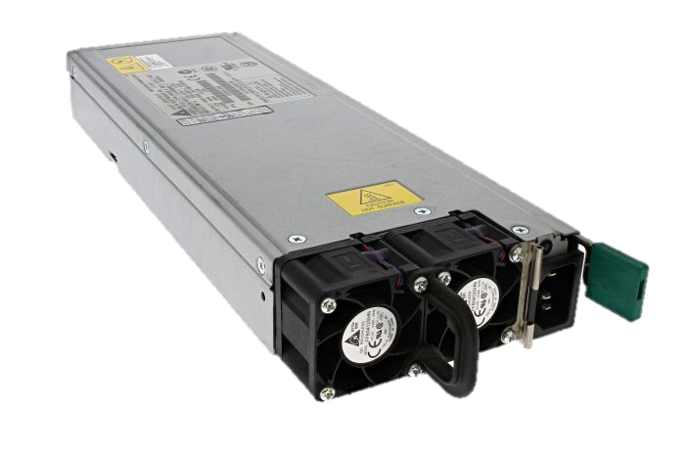
Compatible Design- CDU
CDU
Control Board
ADVANCED COOLING SOLUTIONS
Power Clip
Or
External PSU
Pump
PDB
Pump
Heat Exchange
Fan Door
4U 19” CDU compatible to ORV3/19” rack
Support 48V/12V power bus bar or external PSU

Slide 18
Optimization
Cold plate serviceability
Coolant Leakage detection
CDU functionality
ADVANCED COOLING SOLUTIONS

Slide 19
Call to Action
How to get involved the ACS Cold Plate
https://www.opencompute.org/projects/acs-door-heat-exchange-sub-project
How to get involved the ACS Door Heat Exchange
https://www.opencompute.org/projects/acs-door-heat-exchange-sub-project

