Slide 2

90kW MDC Design Package Submission
Rob Coyle, Director, PCX Corporation
Jason Ball, Engineering Manager, PCX Corporation
DCF/MDC

Slide 3

Contribution
Design Package for a 90KW MDC in accordance to the
90KW MDC spec contributed in Feb 2019 by SE
This Design Package was contributed under the OWF CLA
PCX is requesting OCP Accepted recognition from the IC
The design package contains the following items:
Materials detailing electrical design and composition,(Single line diagram)
Materials detailing HVAC design and composition, (diagram and supported heat loads)
A CAD-generated system layout (floor plan, facades including measurements, 3D view of the MDC with all equipment in place)
Bill of Material (Product description, Manufacturer and Part numbers)
MODULAR DATA CENTER

Slide 4

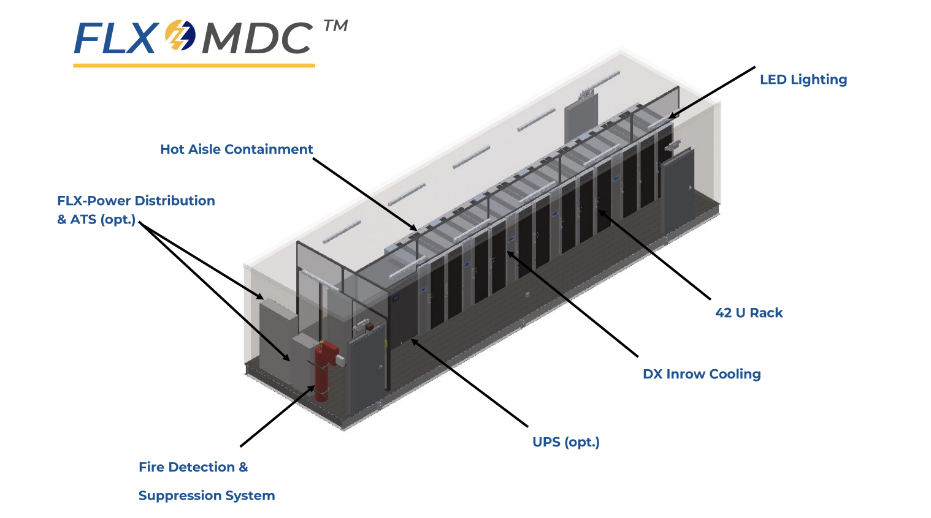
Product Info
Notes:
This prefabricated modular data center is a flexible solution designed for sites with a requirement for up to 14 racks.

Slide 5
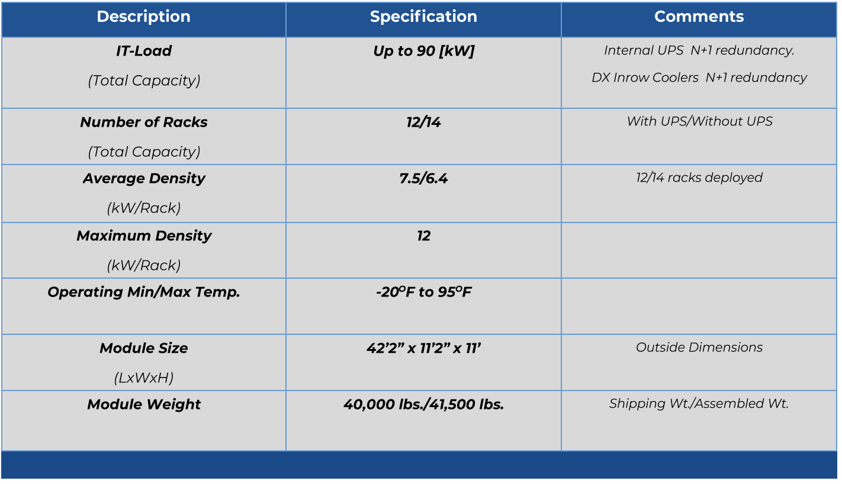
Product Info
Notes:
This prefabricated modular data center is a flexible solution designed for sites with a requirement for up to 14 racks.

Slide 6
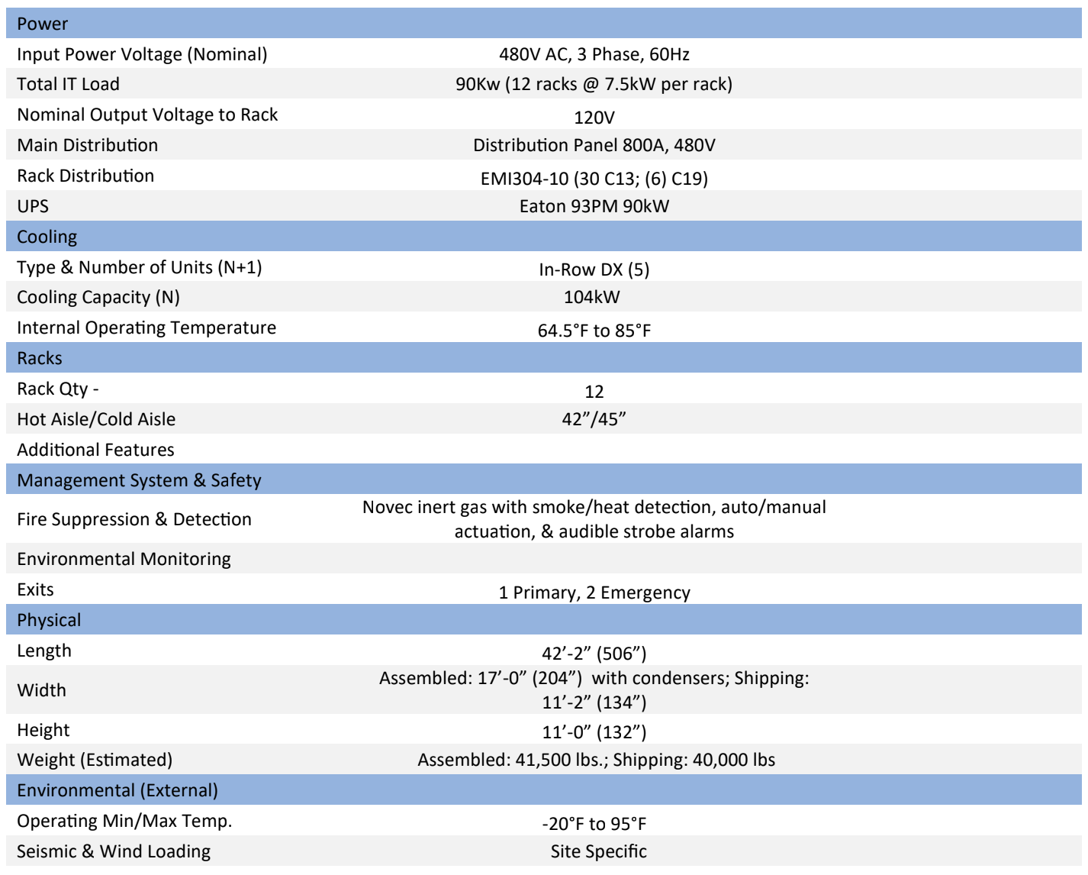
Product Info

Slide 7
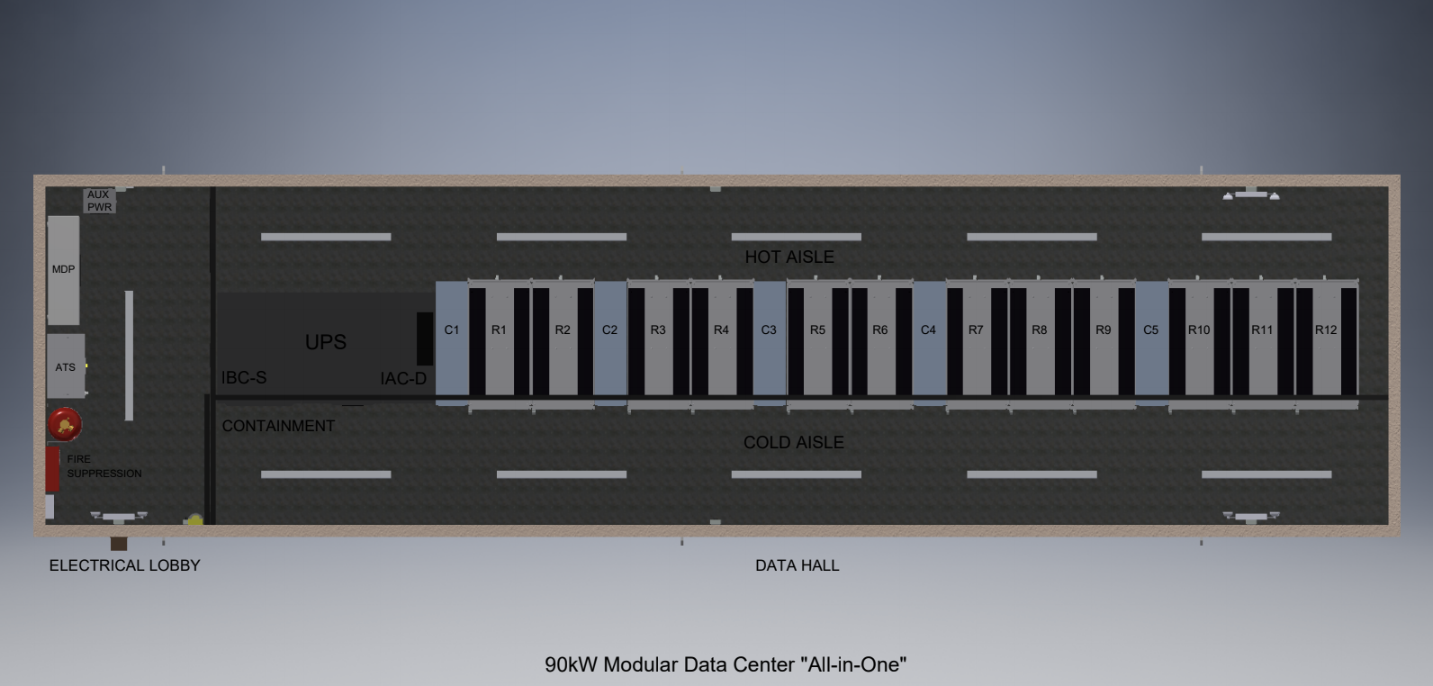
Product Info

Slide 8
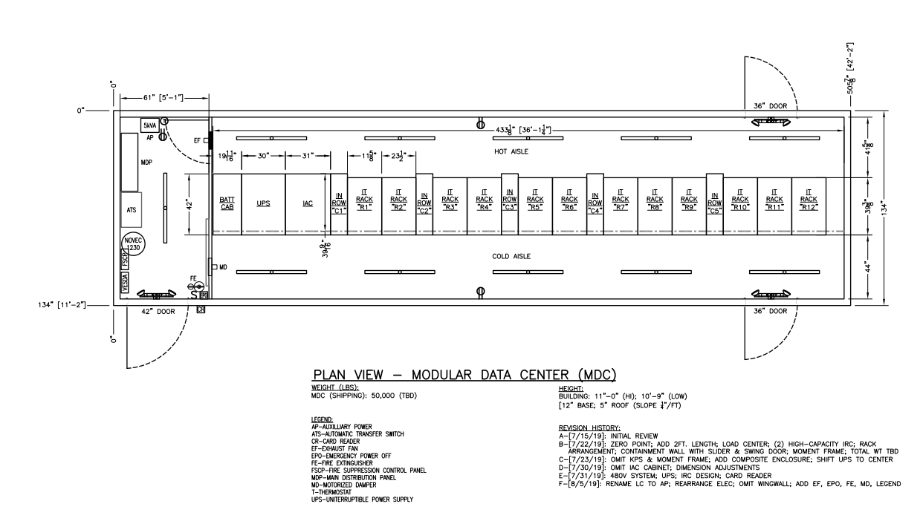
Product Info

Slide 9
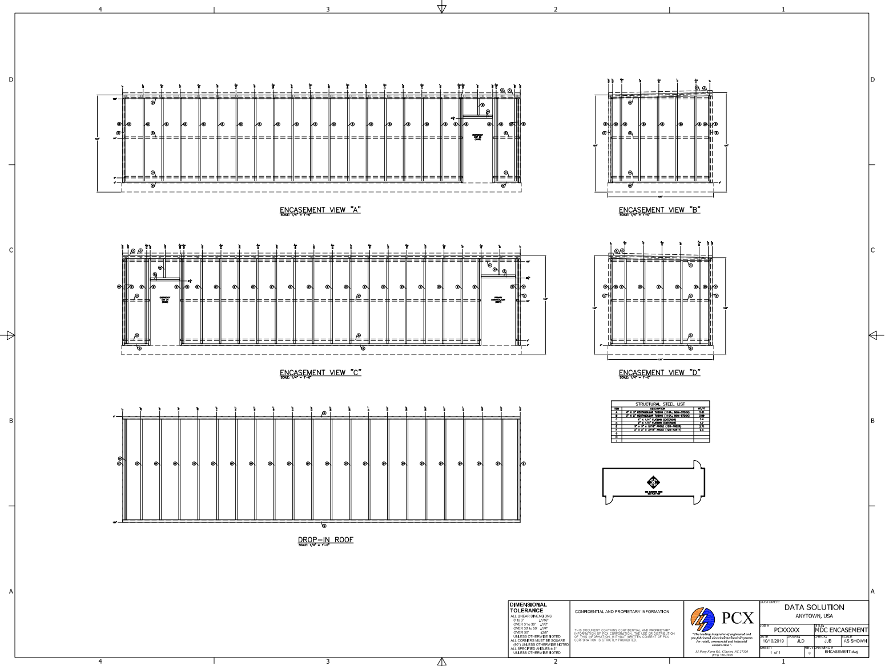
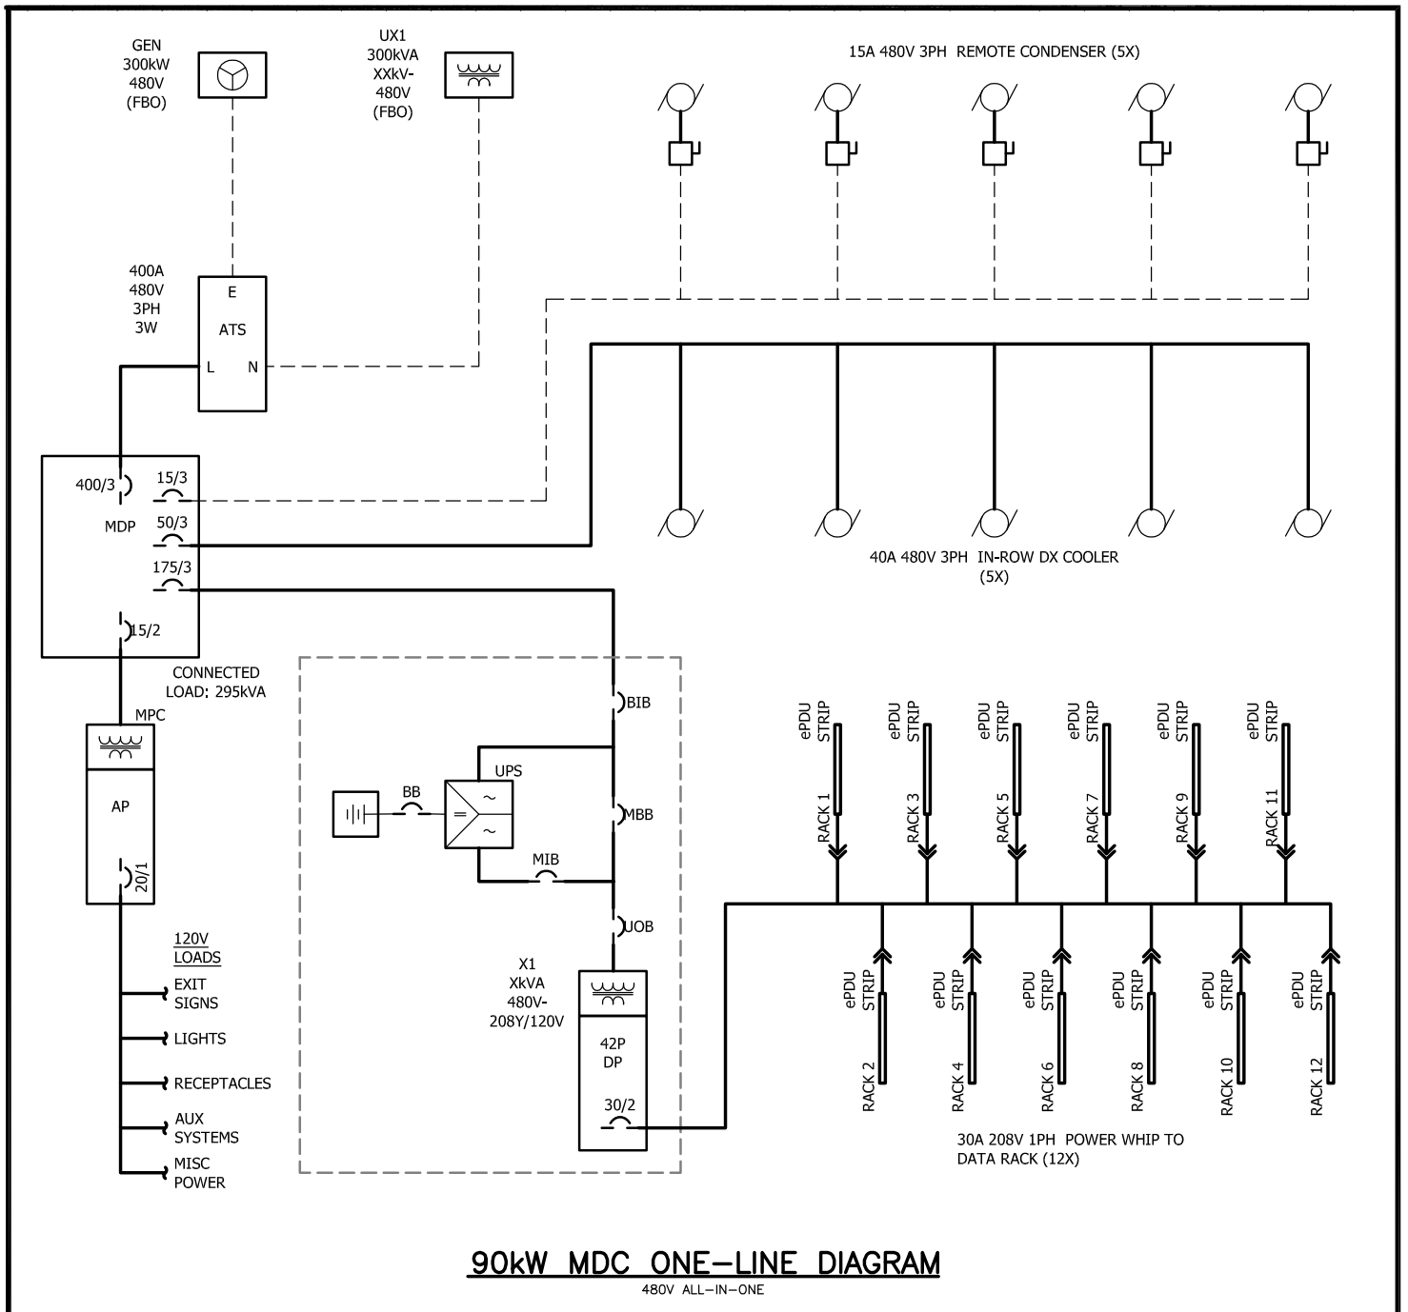
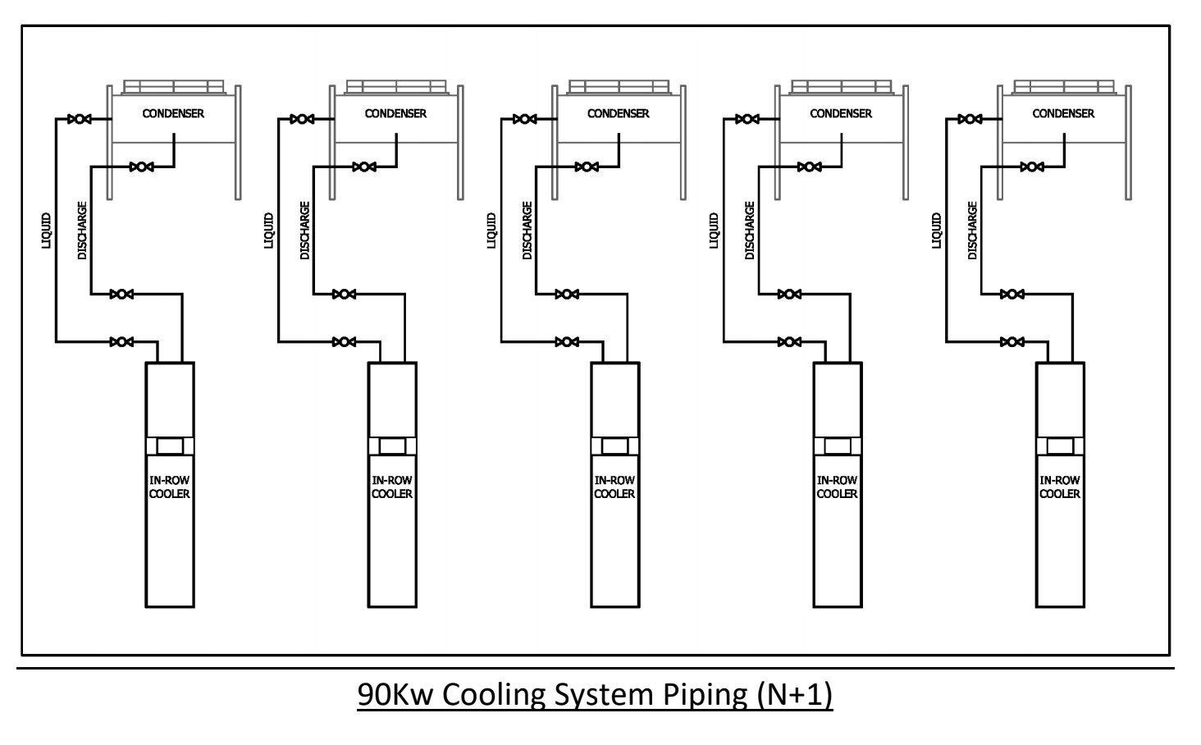
Product Info

Slide 10
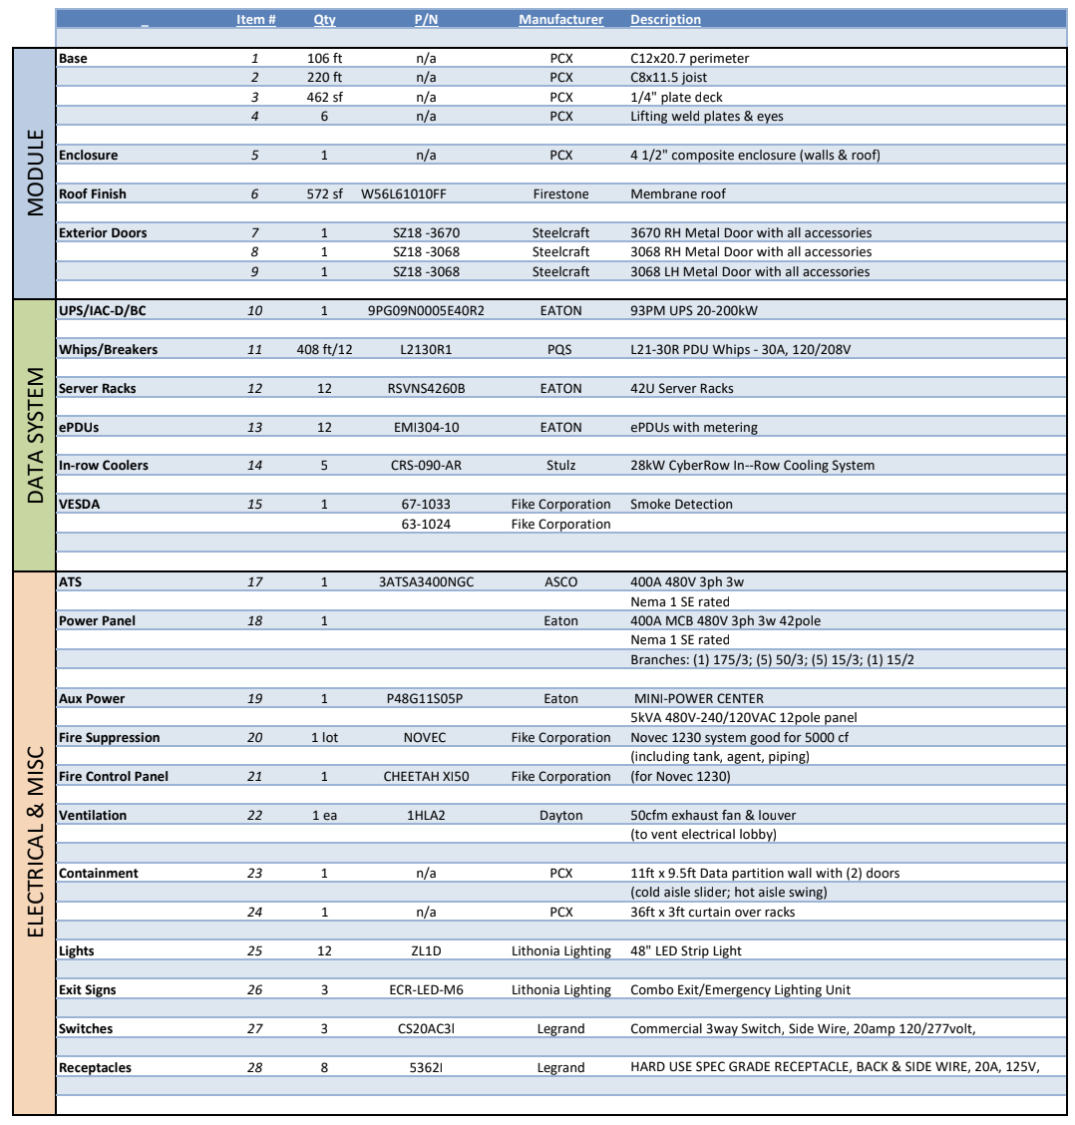
Product Info

Slide 11
OCP Tenets
Efficiency
Prefabricated modules allow for manufacturing and deployment efficient, minimizing the amount of work and waste onsite. The base design of this module is in row to reduce stranded capacity with hot aisle containment.
Scalability
This design is for Data Centers for up to 14 racks and it scales well below that requirement, for customers who look for “pay as you grow” solutions additional modules are easily added.
Openness
This specification will allow multiple vendors to bid on the same concept, giving users choice and supply chain redundancy.
Impact
This effort is the industry’s first attempt to standardize how prefabricated MDCs are described. If adopted and further developed, it will vastly improve the efficiency in which customers and vendors specify MDCs.

Slide 12

Find it!
Where to find:

Slide 13
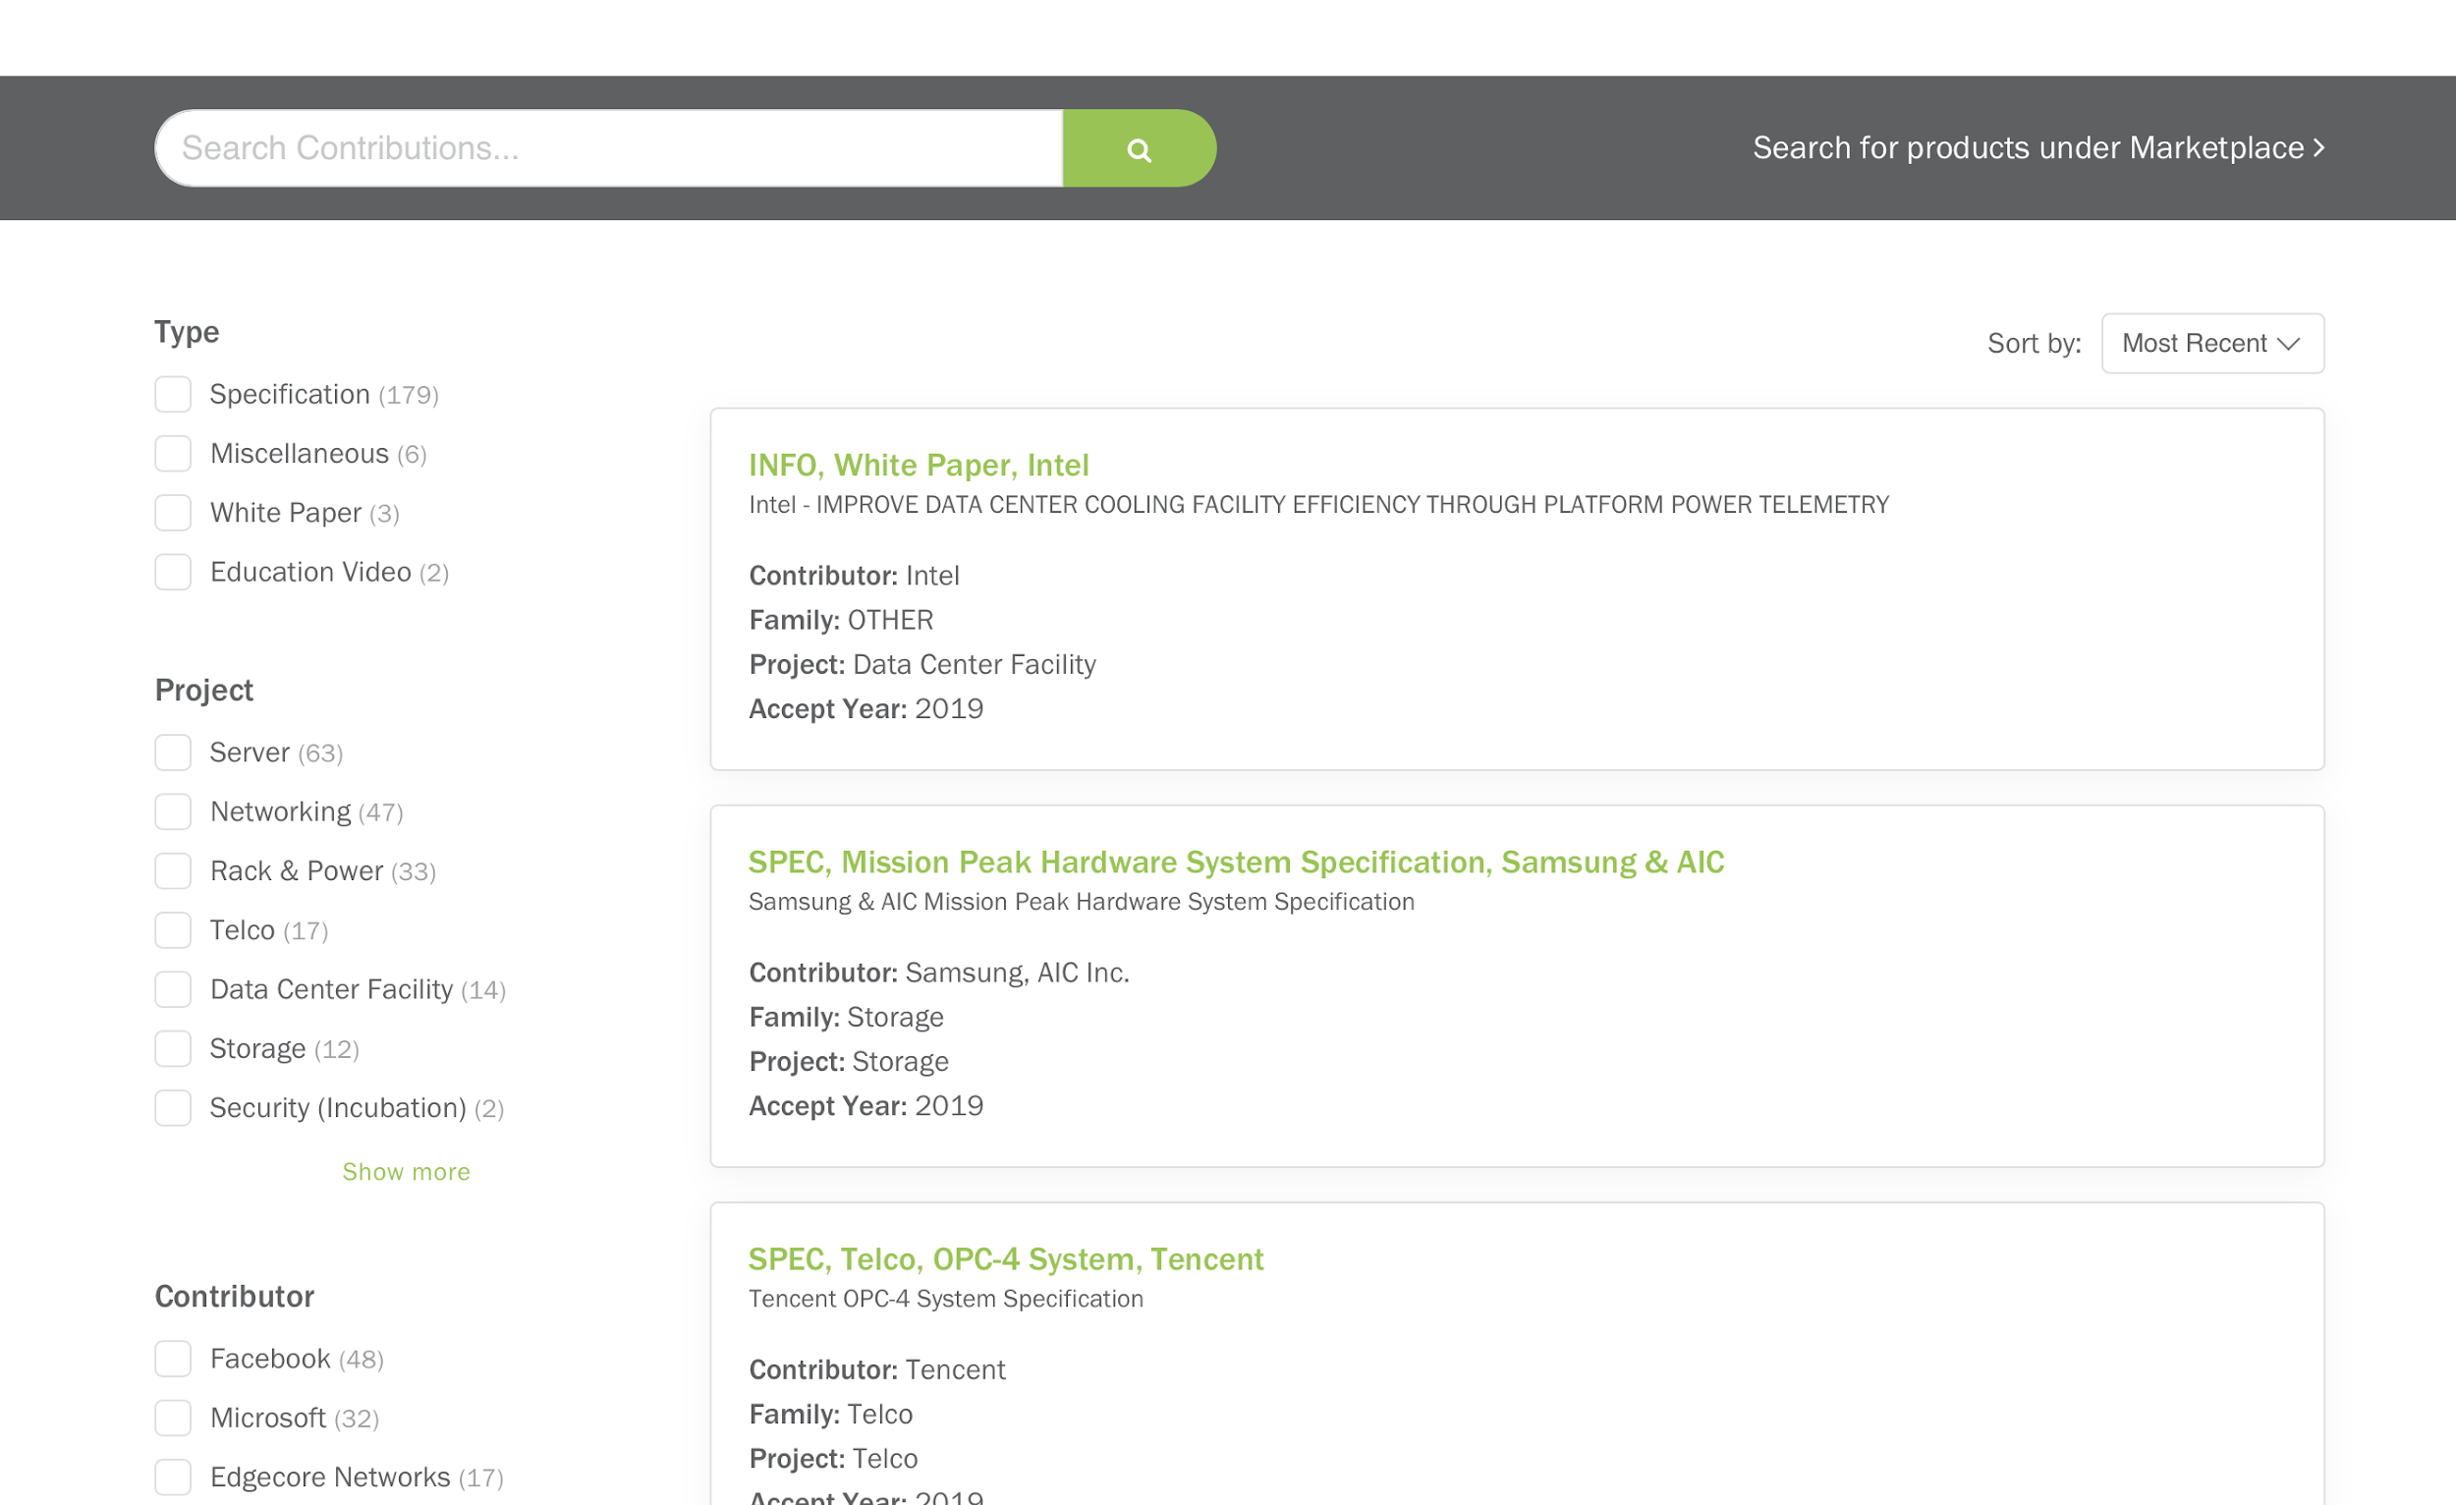
Find it!

Slide 14

Evolve MDC with us!

Slide 15
Evolve MDC with us!
PCX Corp Site: https://info.pcxcorp.com/introducing-the-flx-mdc-90kw
MDC Mailing List: https://ocp-all.groups.io/g/OCP-MDC
Design Files: https://www.opencompute.org/documents/90kw-mdc-rev-f-package-pdf
Specification: https://www.opencompute.org/documents/schneider-electric-standalone-90kw-modular-data-center-specification

