Slide 1


Recent Developments in Immersion Cooling with Fluorochemical Fluids by Open Compute Community
Phillip E. Tuma, Application Development Specialist, 3M EMSD, petuma@mmm.com
Jimil M. Shah, Application Development Engineer, 3M EMSD, jshah2@mmm.com
ADVANCED COOLING SOLUTIONS

Slide 2
Outline
Immersion Cooling in OCP
Comparison of Hydrocarbon and Fluorochemical Fluids
Comparison of Single-Phase and Two-Phase
Real World Examples
2-Phase TCO Merits for Hyperscale
Enabling Immersion Cooling with Fluorochemicals
Summary

Slide 3
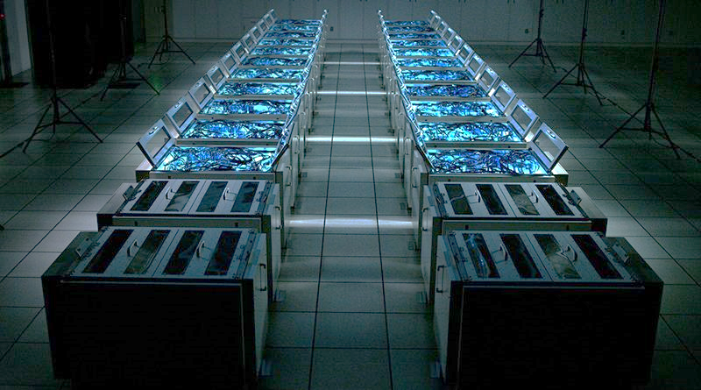
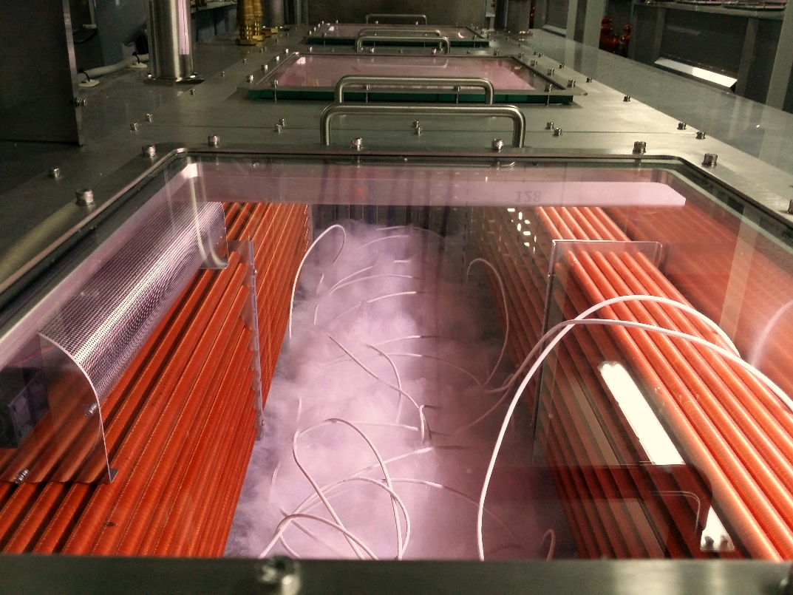
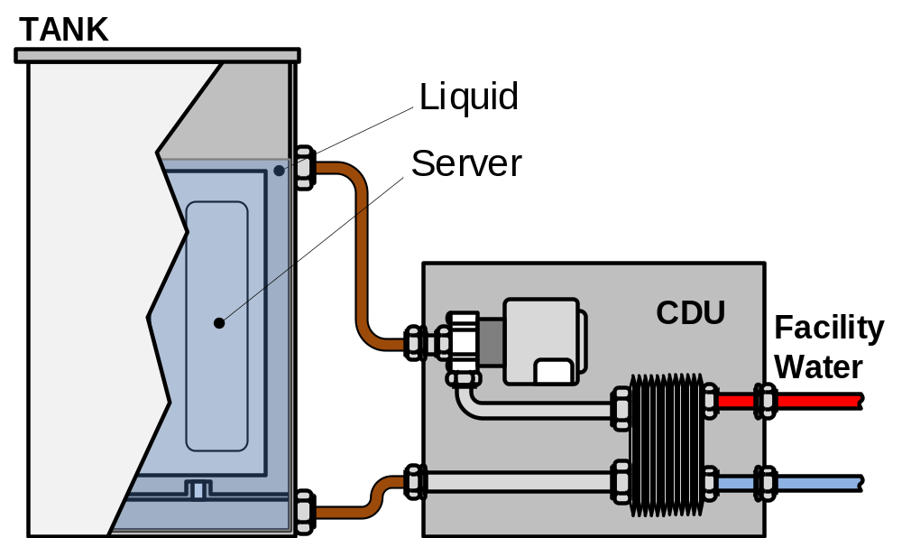
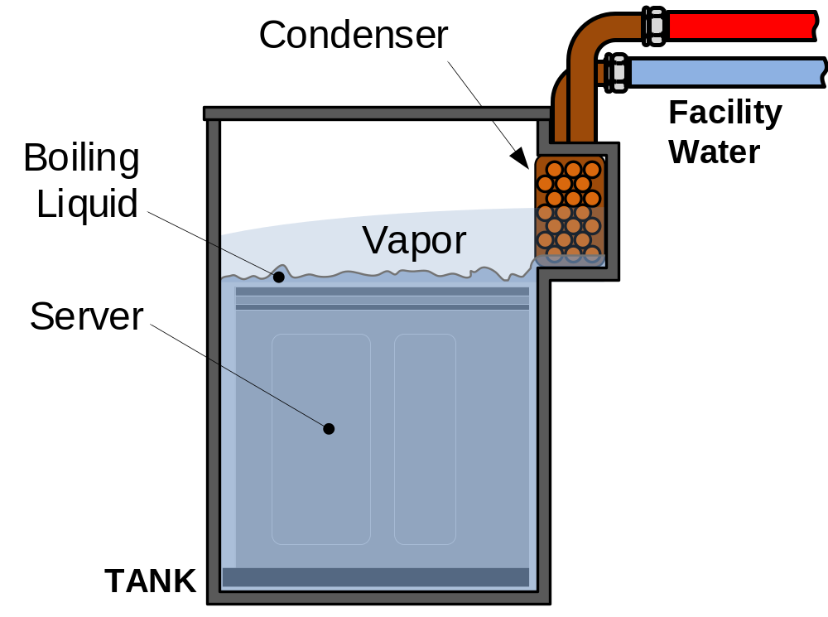
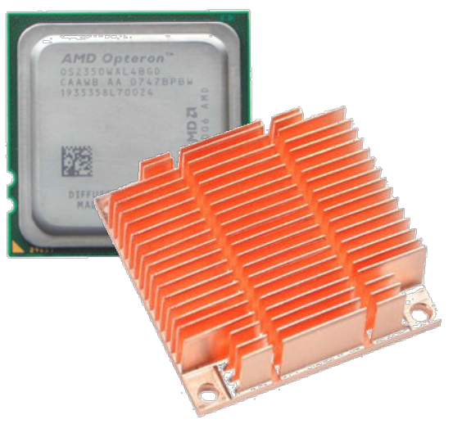
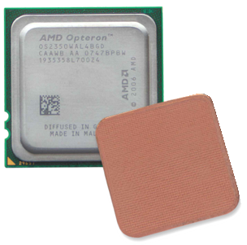
Immersion Cooling in OCP
Cold Plate
Door Heat Exchange
Immersion
OCP Projects
Rack and Power
Advanced Cooling Solutions (ACS)
Table 1 – Matrix of Immersion Cooling Technologies
Heat Transfer Mode*
Convection Mode
Containment Method
Fluid Chemistry*
GOAL: Define inclusive standards to allow immersion technologies in OCP
Single Phase
Passive
Clamshell
Hydrocarbon
Two Phase
Forced (Pumped)
Tank
Fluorochemical
* More in subsequent slides
Dominant Today
FIGURE 1 - Pumped Single Phase 120kW Tank
Courtesy Exascaler
1φ
2φ
FIGURE 2 - Passive 2-Phase 250kW (capacity 500kW) Tank
Courtesy Allied Control/Bitfury

Slide 4
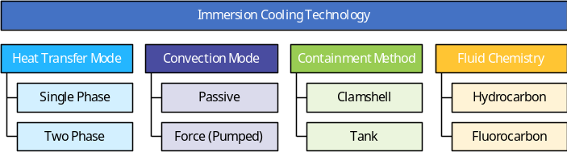
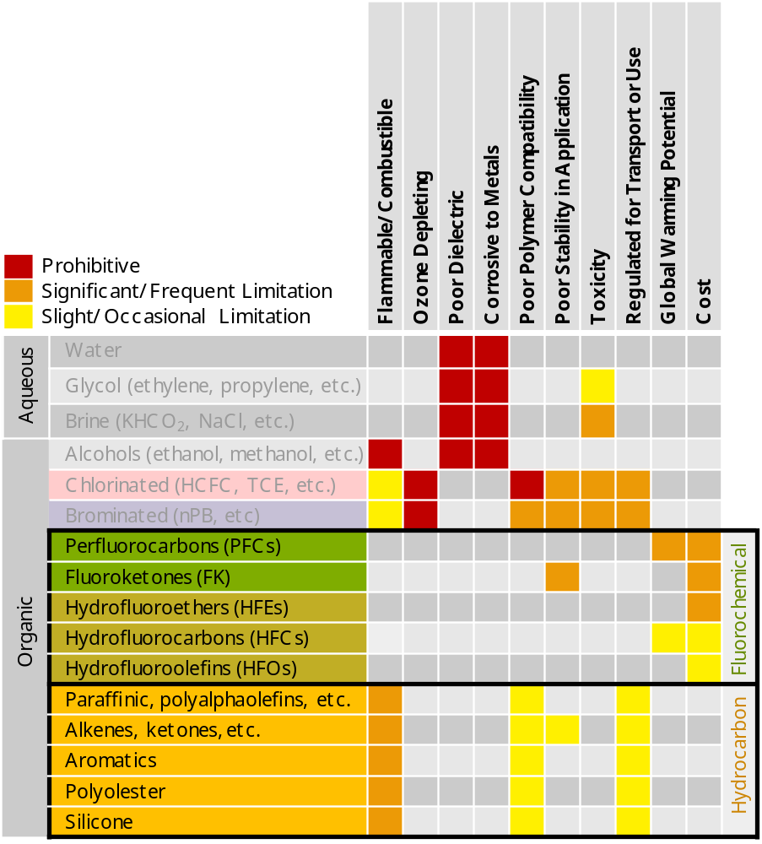
Comparison of Hydrocarbon and Fluorochemical Fluids
TABLE 2 – Immersion fluid chemistries
Of the most common commercial heat transfer fluids, only organics are dielectric and therefore suitable for immersion.
Chlorinated or brominated organics excluded for ozone depletion and solvency.
Fluorine imparts stability and inertness but adds cost.
Hydrogen imparts flammability and solvency toward hydrocarbon polymers that comprise electronics.

Slide 5
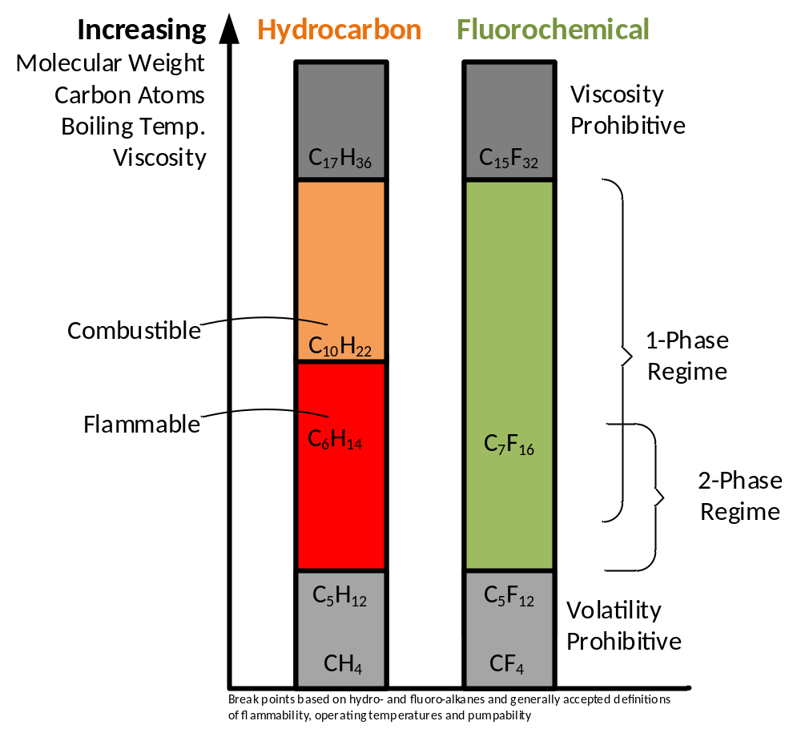
Comparison of Hydrocarbon and Fluorochemical Fluids
Hydrocarbons suitable for immersion cooling are characterized as “Oils”
Low vapor pressure means easier containment but slower evaporation.
Cannot be used for 2-phase applications.
Environmental fate: groundwater partitioning
Fluorochemicals are typically pure compounds with higher vapor pressure
Can be used safely for 2-phase immersion.
Reduced viscosity and higher density reduces single-phase “dragout.”
Evaporate cleanly but more challenging to contain.
Environmental fate: partition to atmosphere with Global Warming Potential (GWP): 0 - 10,000
FIGURE 3 - Effect of molecular weight in hydrocarbon and fluorochemical fluid categories

Slide 6
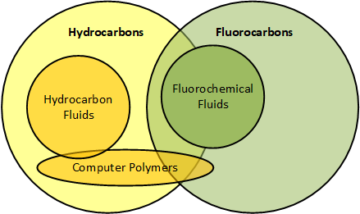
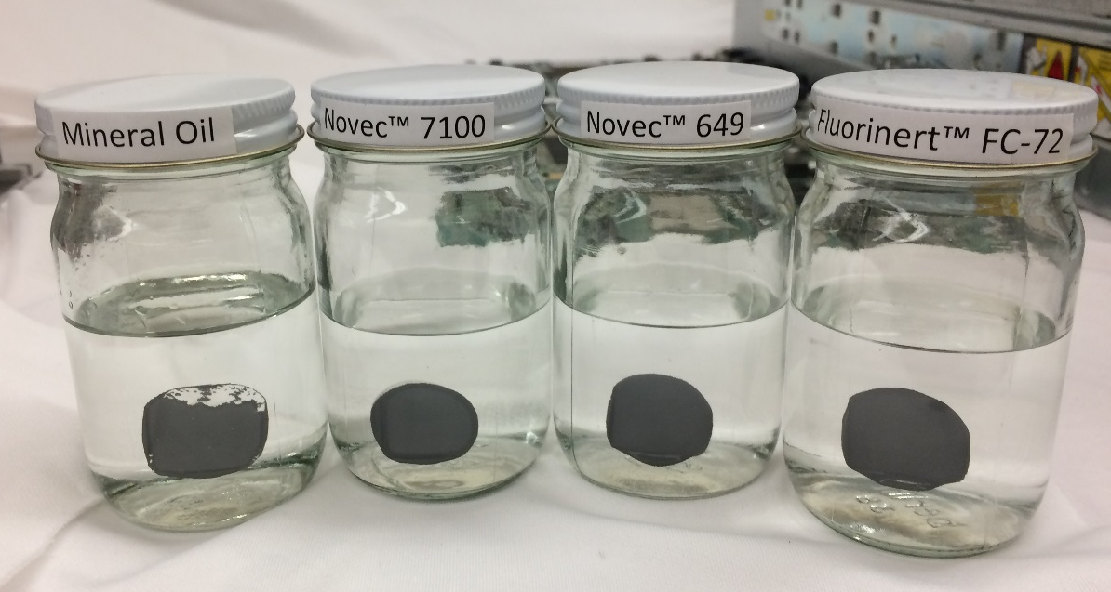
Comparison of Hydrocarbon and Fluorochemical Fluids
Material compatibility
Physical Chemistry Principle – Like dissolves Like
Hydrocarbon fluids typically have an affinity for the hydrocarbon polymers used in computers.
Fluorochemical fluids have affinity only for highly fluorinated polymers which are rarely used in computers.
Hydrocarbon compatibility assessments focus on fluids’ effect on materials.
Fluorochemical compatibility assessments focus on materials’ effect on fluid and on each other.
Hydrocarbon
Fully Fluorinated
Fluid hygiene and purity
Both fluid classes pick up contaminants (plasticizers, etc.) from hardware.
Fluorochemicals are easily scrubbed in situ with activated carbon so that fluid remains very pure.
Thermal Grease Soak Test – few hours
FIGURE 4 – The polymers used to fabricate computers are predominantly hydrocarbon in nature. Common thermal greases can be used in fluorochemical fluids.

Slide 7
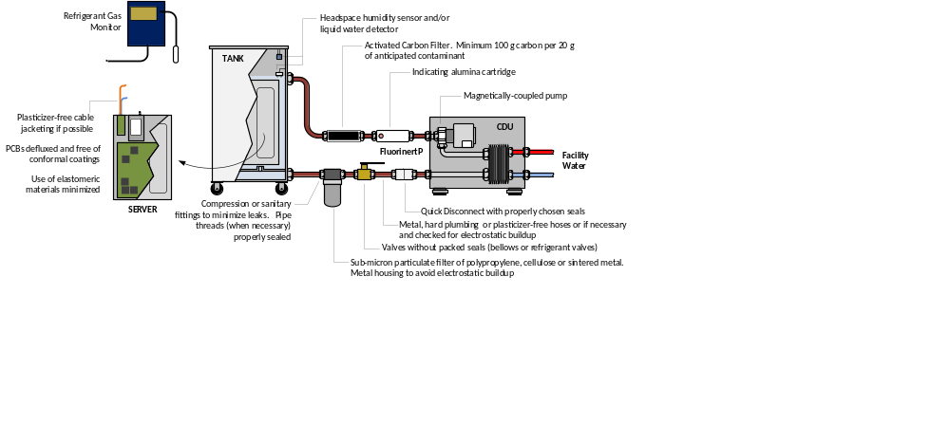
Comparison of Single-Phase and Two-Phase
Single phase design uses traditional methodologies
  Finned heatsink design and modelling familiar to thermal engineers. Air cooling is immersion cooling.
  Traditional methods used to model, instrument and control flow fields within server.
  Fluid containment facilitated by low volatility of fluids used.
  Fluorochemical design focuses on maintaining fluid purity to prevent materials affecting each other.
FIGURE 5 – High level design guidelines for single phase immersion with fluorochemicals

Slide 8
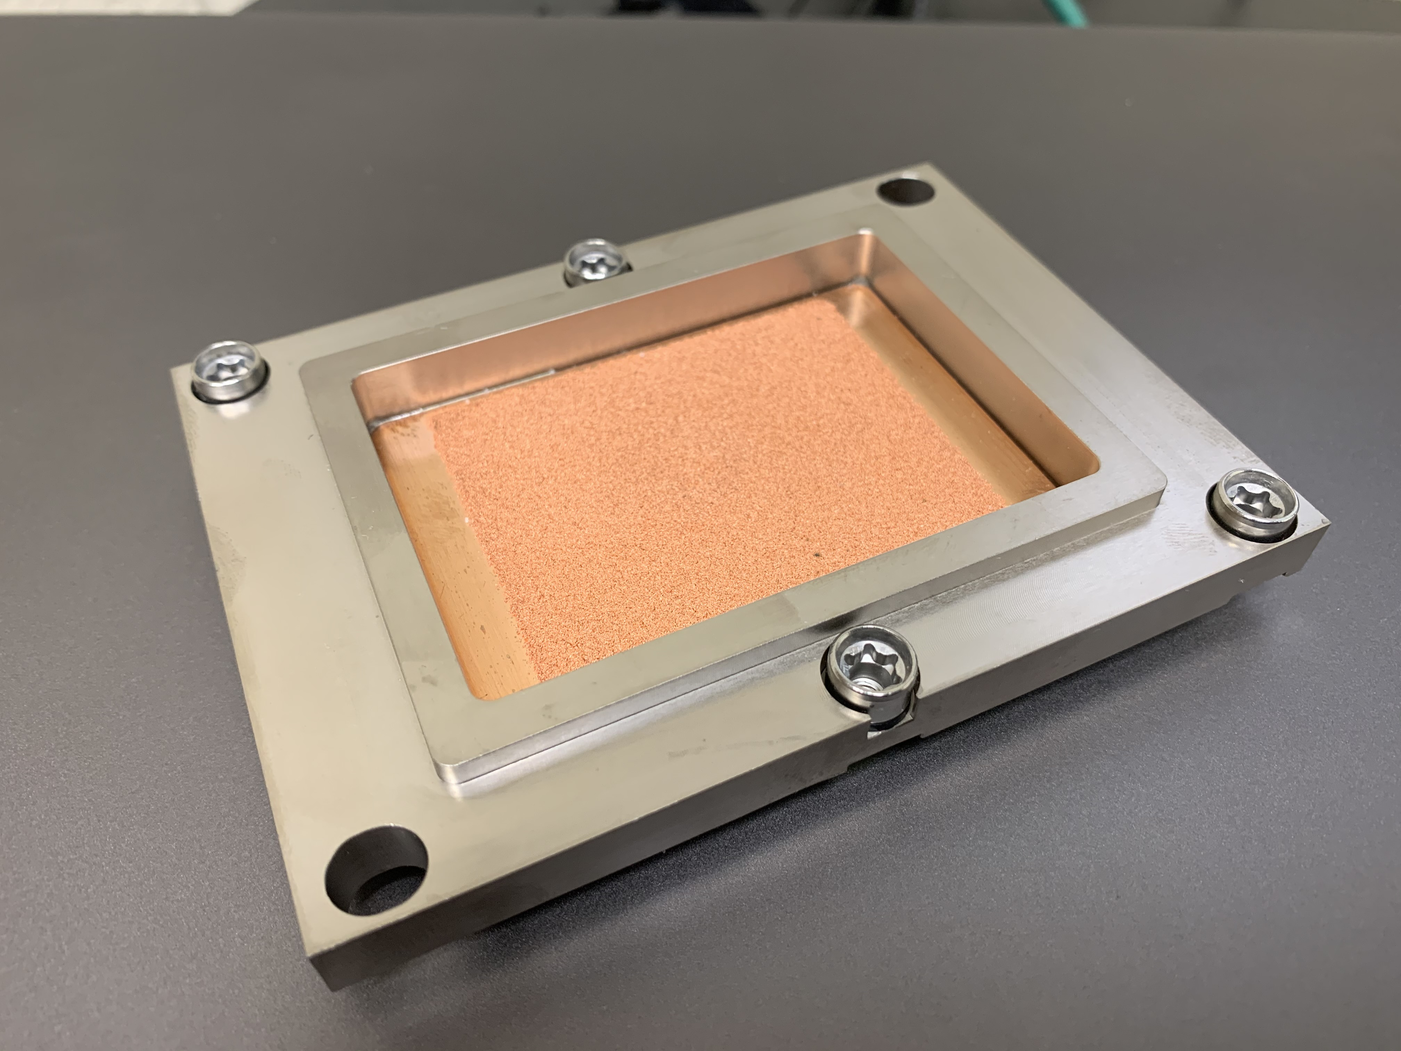
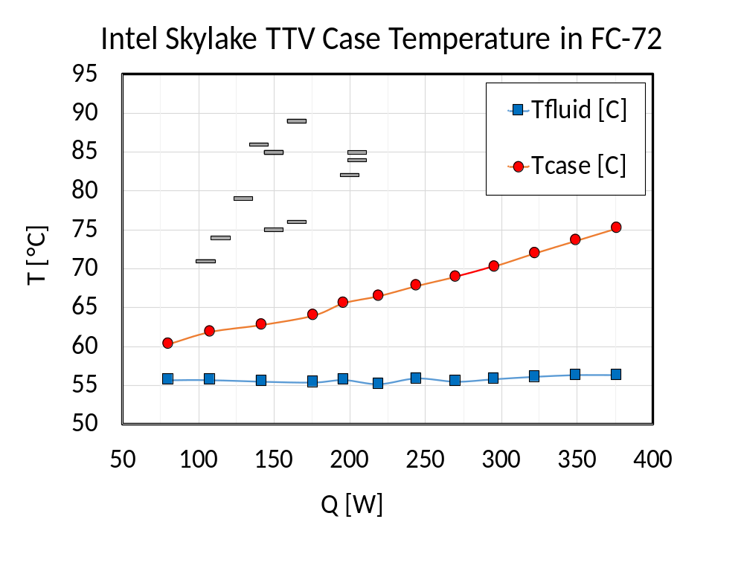
Comparison of Single-Phase and Two-Phase
Two Phase design not familiar to most
  Primary heat sources like CPUs/GPUs use boiler plates, not finned heat sinks¹.
    Boiler plate design uses empirical correlations and simple conduction models.
    Thermal design simplified: no flow field or temperature dependence.
  Fluid containment is more challenging.
    Requires knowledge of thermodynamics, phsychrometrics, etc.
  Material compatibility
    Simplified by inertness of fluorochemicals.
    Complicated by distillation mechanism not found in single phase.
      Requires rigorous filtration of hydrocarbon contaminants
2φ
T_{fluid}
T_{case}
FIGURE 6 – A boiler assembly and test data on Intel Skylake thermal test vehicle (TTV)¹
  Tuma, P., et al, “Proper use of Boiling Enhancement in 2-Phase Immersion Cooling of Computers,” presentation SEMI-THERM® Thermal Technologies Workshop, November 4-6, 2019, Microsoft Corporate Conference Center, Redmond WA USA.

Slide 9
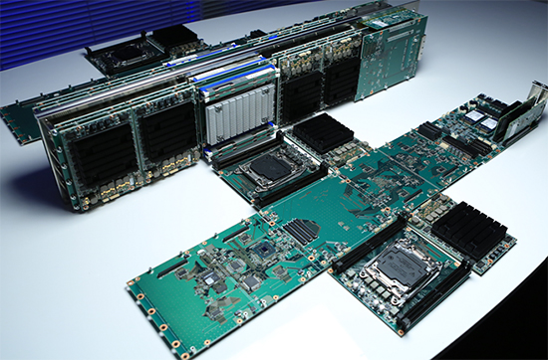
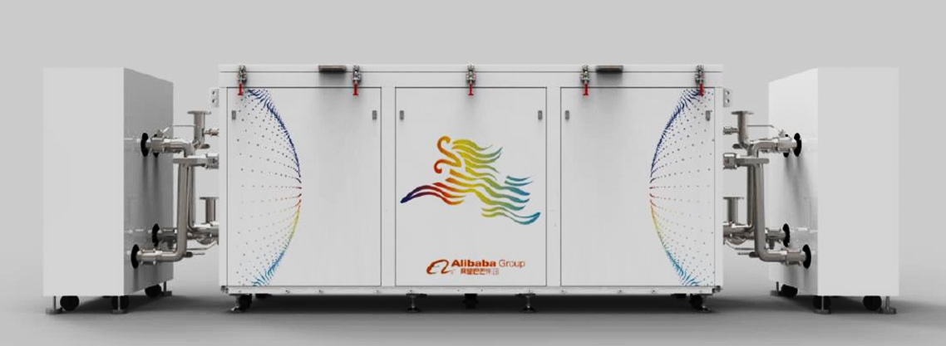
Real World Examples: Single Phase HPC and Cloud
  Pezy/Exascaler built several single phase immersion cooled supercomputer systems totaling many MW².
    They reached unprecedented power density, eventually facing thermal challenges similar to those involved when pushing the limits of immersion cooling in air.
  Alibaba deployed 2,000 servers in a single phase deployment^{3,4}
    A 20,000 server deployment is planned.
1φ
Courtesy Exascaler
Courtesy Exascaler
1φ
FIGURE 7 – A tank from Alibaba’s 60 tank deployment showcasing the efficiency, noise and reliability merits of fluorochemical immersion at statistically meaningful scale
Courtesy Alibaba
FIGURE 8 – 120kW Supercomputer tanks (top) used very specialized hardware (bottom) eventually reaching 2 liters/kW, exhausting the capabilities of single phase immersion.
  Torii, S., Ishikawa, H., “ZettaScaler: Liquid immersion cooling Manycore based Supercomputer,” presentation (and later whitepaper) CANDAR’17, The Fifth International Symposium on Computing and Networking, Aomori, Japan, Nov. 19-22, 2017.
  Fangzhi, W., “Immersion Cooling for Green Computing” presentation at the Open Compute Summit, San Jose, CA, USA, March 20-21, 2018.
  Zhong, Y., “Experiences with Immersion Cooling in Alibaba Datacenter” presentation at the Open Compute Regional Summit, Amsterdam, NL, September 26-29, 2019.

Slide 10
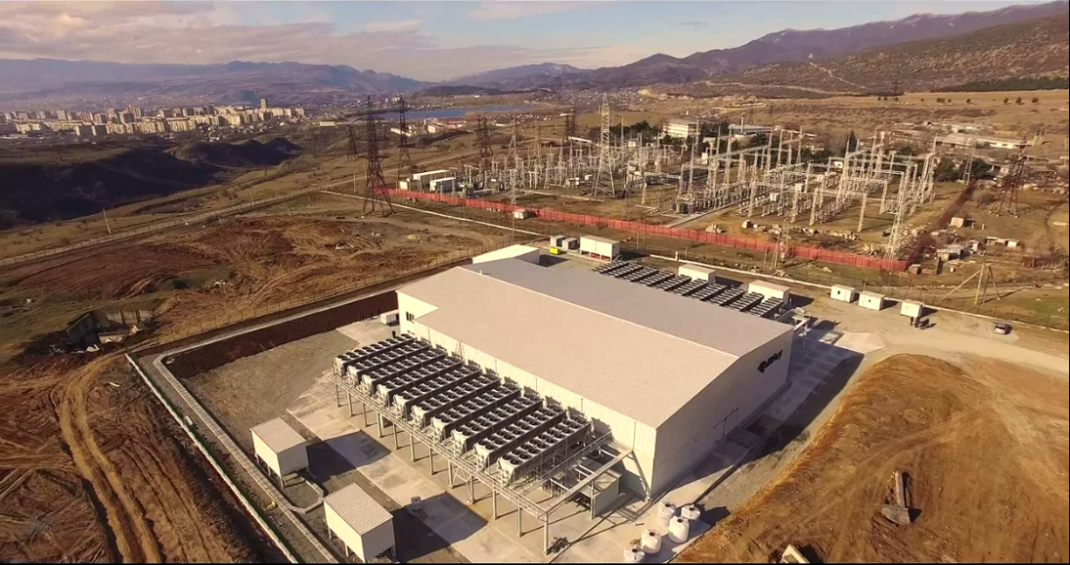
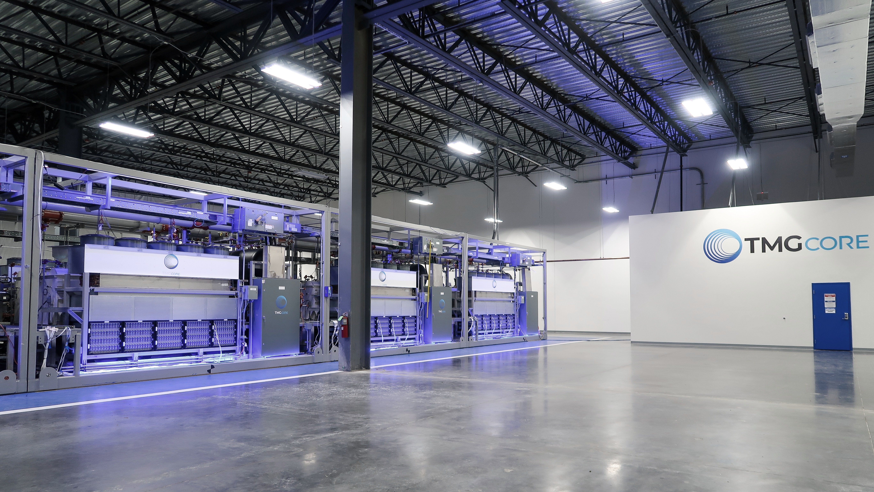
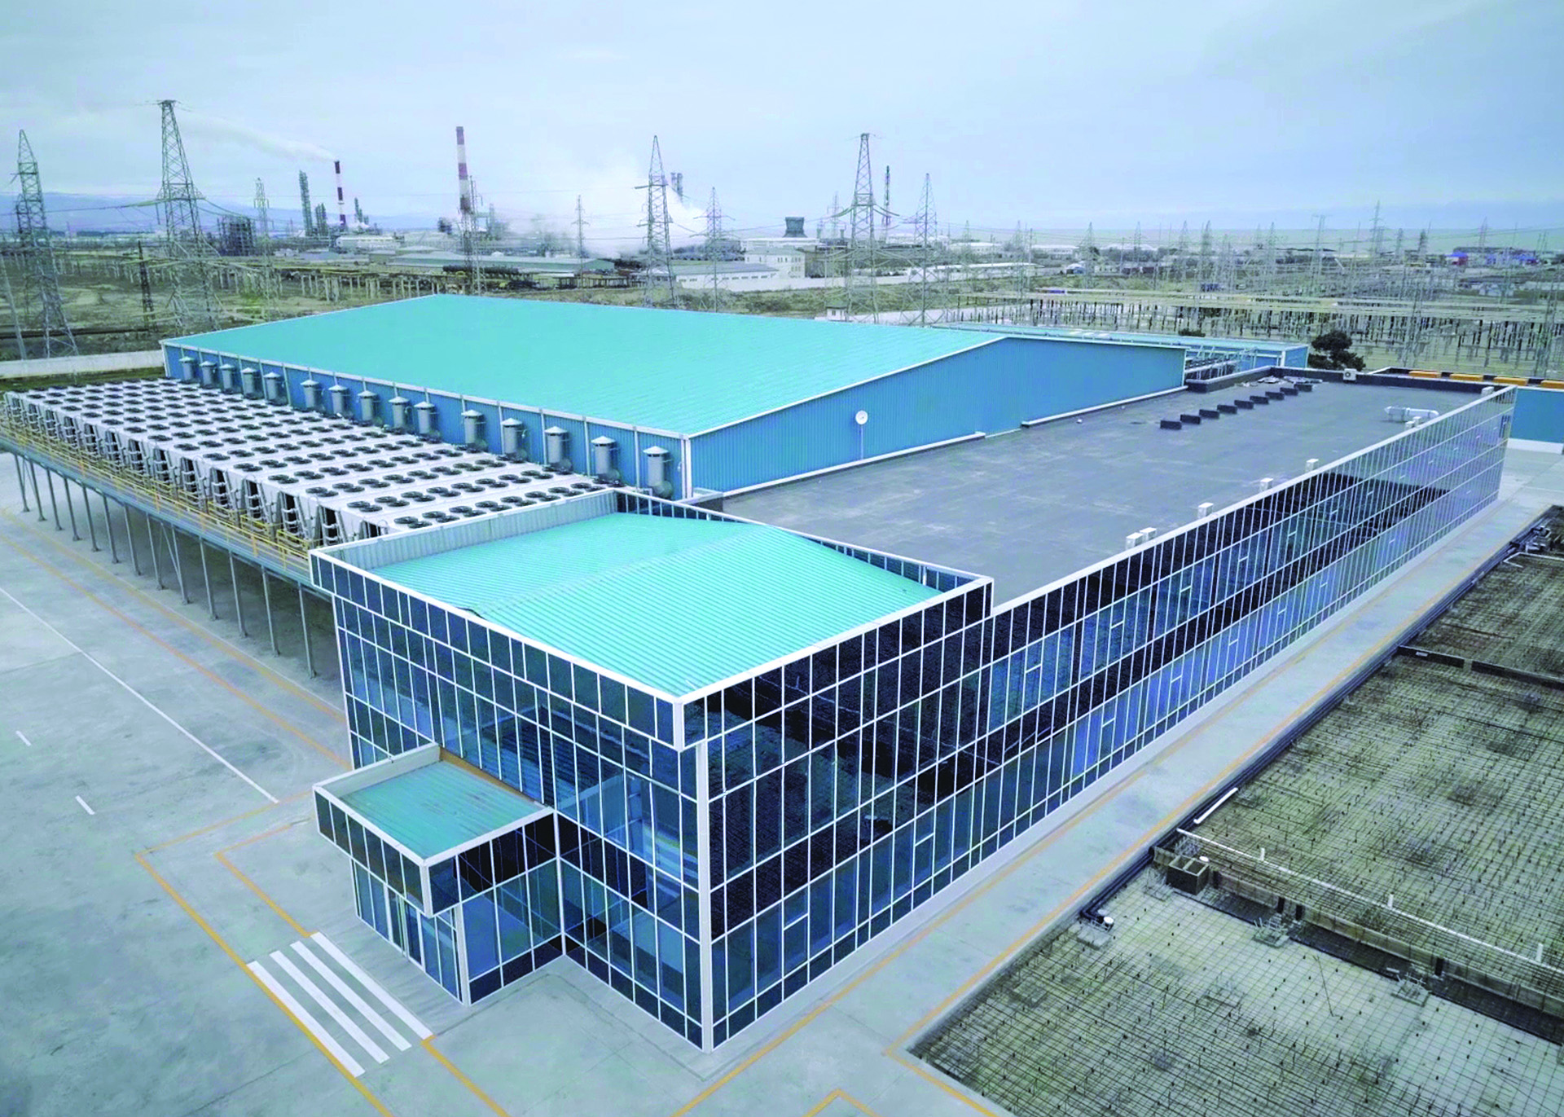
Real World Examples: 2-Phase Culmination in Bitcoin, Harbinger of Hyperscale
  The vertical integration of industrial miners allowed them to extract value from a technology commonly perceived as expensive^{5,6}
    40MW Bitcoin mining facility was built in 6 months in 2015
    120MW facility was completed in 2018
    PUEs of 1.02 were demonstrated with 40C ambient
    Densities as high as 1 liter per kW with >35kW/m² floorspace
Courtesy Allied Control/Bitfury
2φ
2φ
FIGURE 9 - TMGcore’s 1MW skids (3 shown here) reached 1 liter/kW.
Courtesy Allied Control/Bitfury
FIGURE 10 – Bitfury-Allied Control’s 40 MW facility in Tiblisi Georgia (top). 120MW facility with dry coolers at Summer temperatures as high as 40°C (bottom)
Courtesy TMGcore
  Tuma, P., et al, “Recent Developments in Computer Immersion Cooling with Fluorochemical Heat Transfer Fluids,” presentation SEMI-THERM® Thermal Technologies Workshop, November 4-6, 2019, Microsoft Corporate Conference Center, Redmond WA USA.
  Tuma, P.E., “Passive 2-Phase Immersion Cooling (P2PIC) of Bitcoin Hardware and Implications for other Computing Applications,” presentation IMAPs ATW on Thermal Management, Los Gatos, CA, USA, Sept. 22-24, 2015.

Slide 11
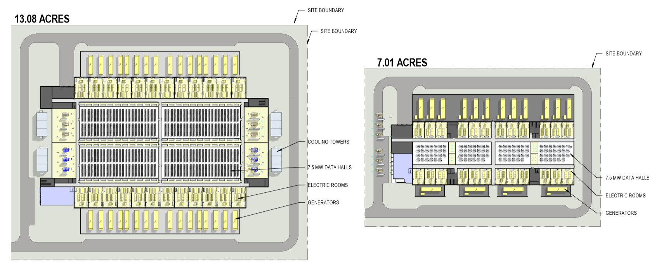
2-Phase TCO Merits for Hyperscale
  According to a detailed cost of ownership analysis⁷, the advantages demonstrated in crypto are compelling for hyperscale:
30MW Hyperscale Project Assumptions:
Des Moines, IA
(4) 7.5 MW data halls
10 kW avg. air-cooled rack vs. 150 kW avg. tank
Tier III data center
Air
2φ
FIGURE 11 - Footprint comparison of the 30MW traditional Tier III, free air cooled datacenter (left) and its immersion cooled equivalent (right)
Tuma, P., et al, “30MW Immersion Cooling Datacenter,” Presentation, Datacenter Dynamics 2017 Cloud + Colo, Dallas, TX, Sept. 26, 2017
Notes:
Air vs. Immersion
Racks & PDUs: $18M vs. $0M ($18M improvement)
Low Voltage Cabling: $18.8M vs. $3.9M ($14.9M improvement)
Tanks/Fluids: $0M vs. $21.5M ($21.5M increased cost)
Mechanical (Immersion):
No chillers, cooling towers, or heat exchangers (replaced by dry coolers)
No CRAH/CRAC units in data center space
No humidifiers
Electrical (Immersion):
No PDUs, busway

Slide 12
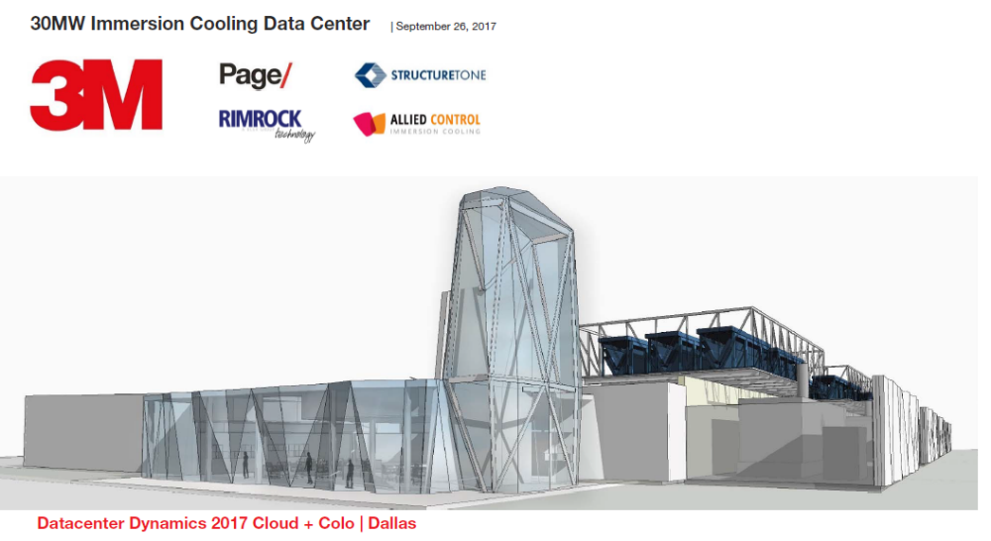
2-Phase TCO Merits for Hyperscale
Capex reduced 44% to $6.5M/MW
Annual savings of $1.64M in electricity costs
Water consumption eliminated
$348
$19.4
Other
Cooling
Electricity
Racks & PDUs
$16.9
Low Voltage
Mechanical
$194
Water
Usage
IT
Electricity
Electrical
& Fire Alarm
0
Air Cooled
Immersion Cooled
Air Cooled
Immersion Cooled
Air Cooled
Immersion Cooled
FIGURE 12 - Summary of the TCO advantages of 2-phase immersion for a 30MW Tier III datacenter⁷
Tuma, P., et al, “30MW Immersion Cooling Datacenter,” Presentation, Datacenter Dynamics 2017 Cloud + Colo, Dallas, TX, Sept. 26, 2017

Slide 13
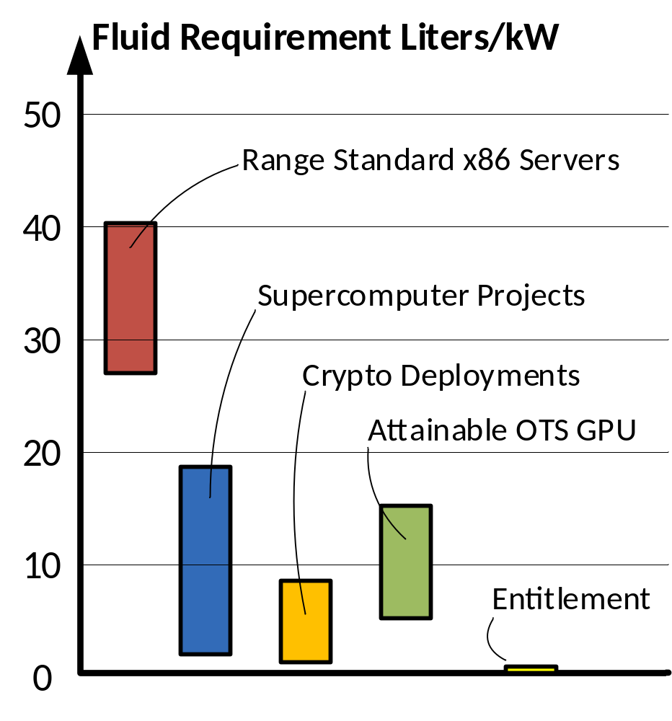
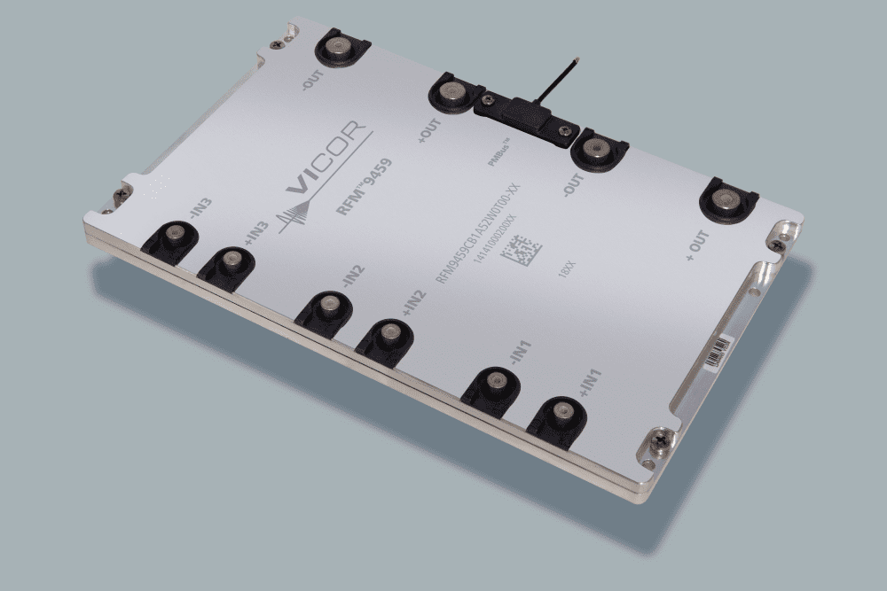
Enabling Immersion Cooling with Fluorochemicals
Design Considerations
FIGURE 13 - The limited power density of available hardware remains an obstacle for fluorochemical immersion cooling.
Reducing Fluid Usage
    Many servers are 90+% air by volume
    Requires densification of hardware (IT, PSUs, etc.) toward fluid performance entitlement
Hardware Cleanliness
    While fluorochemicals are in general quite compatible with electronics…
    Adjuncts like cable insulation, TIMs, solder flux and potting compounds, contain extractable organics that contaminate the fluid and can foul boiling surfaces in two-phase applications.
    Vendors should seek cleaner insulations and eliminate contaminating materials that are unnecessary in immersion cooling.
FIGURE 14 – A 6kW rectifier is the size of a handheld computer, ideal for immersion cooling.
Fluid Loss Mitigation
    Engineering refinements such as regenerable adsorbent-based vapor traps are already pushing fluid loss well below 1% per year in 2-phase applications.
Courtesy Vicor

Slide 14
Enabling Immersion Cooling with Fluorochemicals
TABLE 3 – Common sources of fluid contamination in fluorochemical immersion cooling
Material Source of Contaminant | PSU | Server | Cabling | Tank | Component Containing Contaminant | Mitigation/Comment
PVC insulation |  |  |  |  | Wiring: ethernet, power, etc. | Eliminate where possible. Alternative?
Silicone RTV |  |  |  |  | FET potting, vibration dampening | May not be necessary
Hot melt adhesive |  |  |  |  | Wire retention | May not be necessary
Thermal interface grease |  |  |  |  | Low power BGA dvices | Not necessary in 2PIC
Thermal grease |  |  |  |  | CPU, GPU and ASIC heat sink attach | Can be used. Alternatives available
Thermal pads |  |  |  |  | Heat sinks for FETs, diodes, etc. | Not necessary in 2PIC
Conformal coatings |  |  |  |  | Often applied to PSU PCB | Not necessary
Electrical isolation pads |  |  |  |  | Used on PSU FETs and diodes | Not necessary
Solder flux |  |  |  |  | PSU PCB, motherboard | Clean by vapor degreaser.
Heat shrink tubing |  |  |  |  | Wiring, cable assemblies | Minimize
Elastomers |  |  |  |  | Tank O-rings, seals, etc. | Minimize or preclean
Foam Rubber |  |  |  |  | Airflow guides | Not necessary

Slide 15
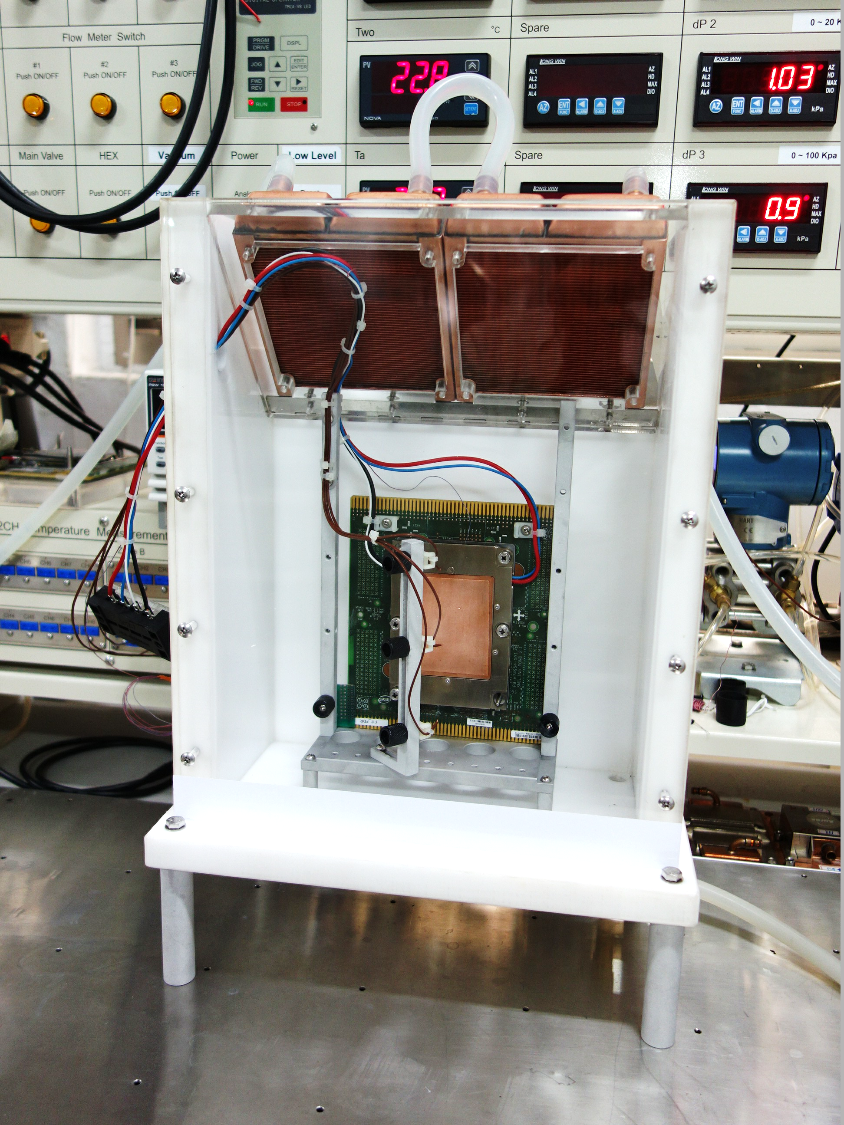
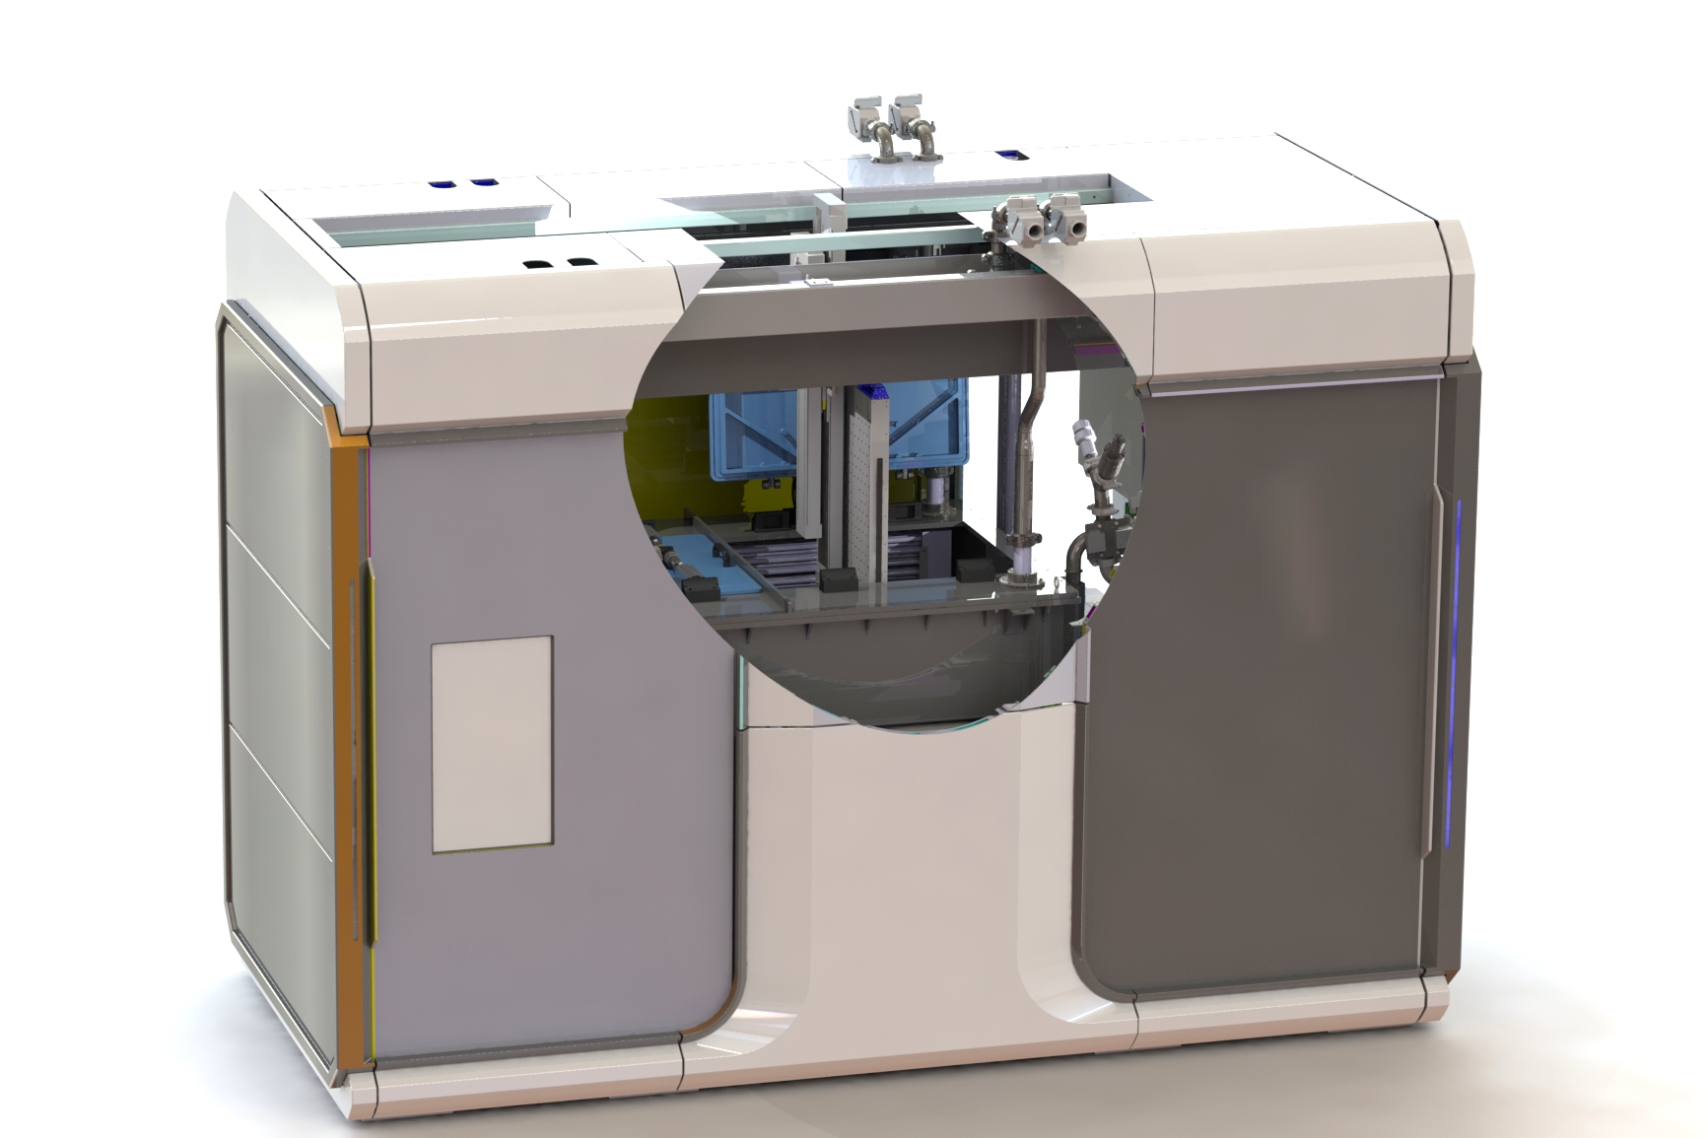
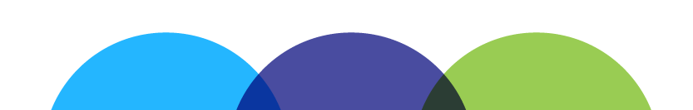
Enabling Immersion Cooling with Fluorochemicals
Implementation Considerations
Maintenance and
Ergonomics
    Accessibility and ergonomics require manageable server masses and possibly robotics.
Production Testing
    The path from production to deployment will require unique methods of thermal test, burn-in, etc.
FIGURE 15 – TMGcore’s OTTO platform uses robotics to swap hardware in and out of the tank.
2φ
Courtesy LonGwin
FIGURE 16 – Vendor LonGwin is providing test stations of the type needed to validate thermal performance of 2-phase boiler assemblies.

Slide 16
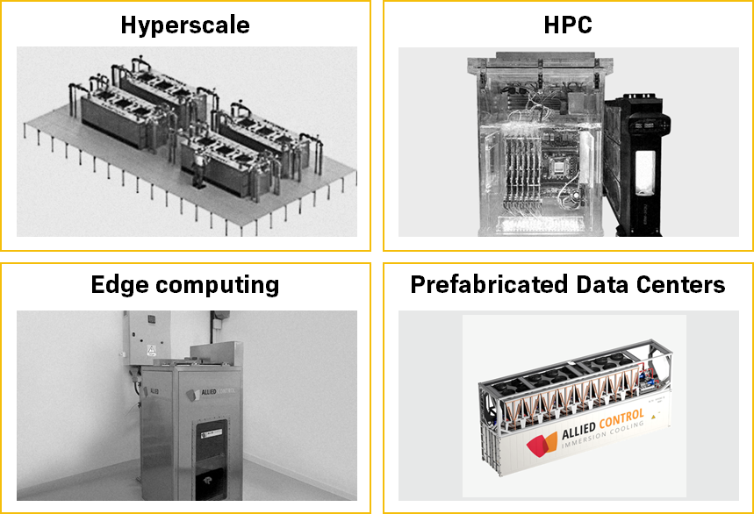
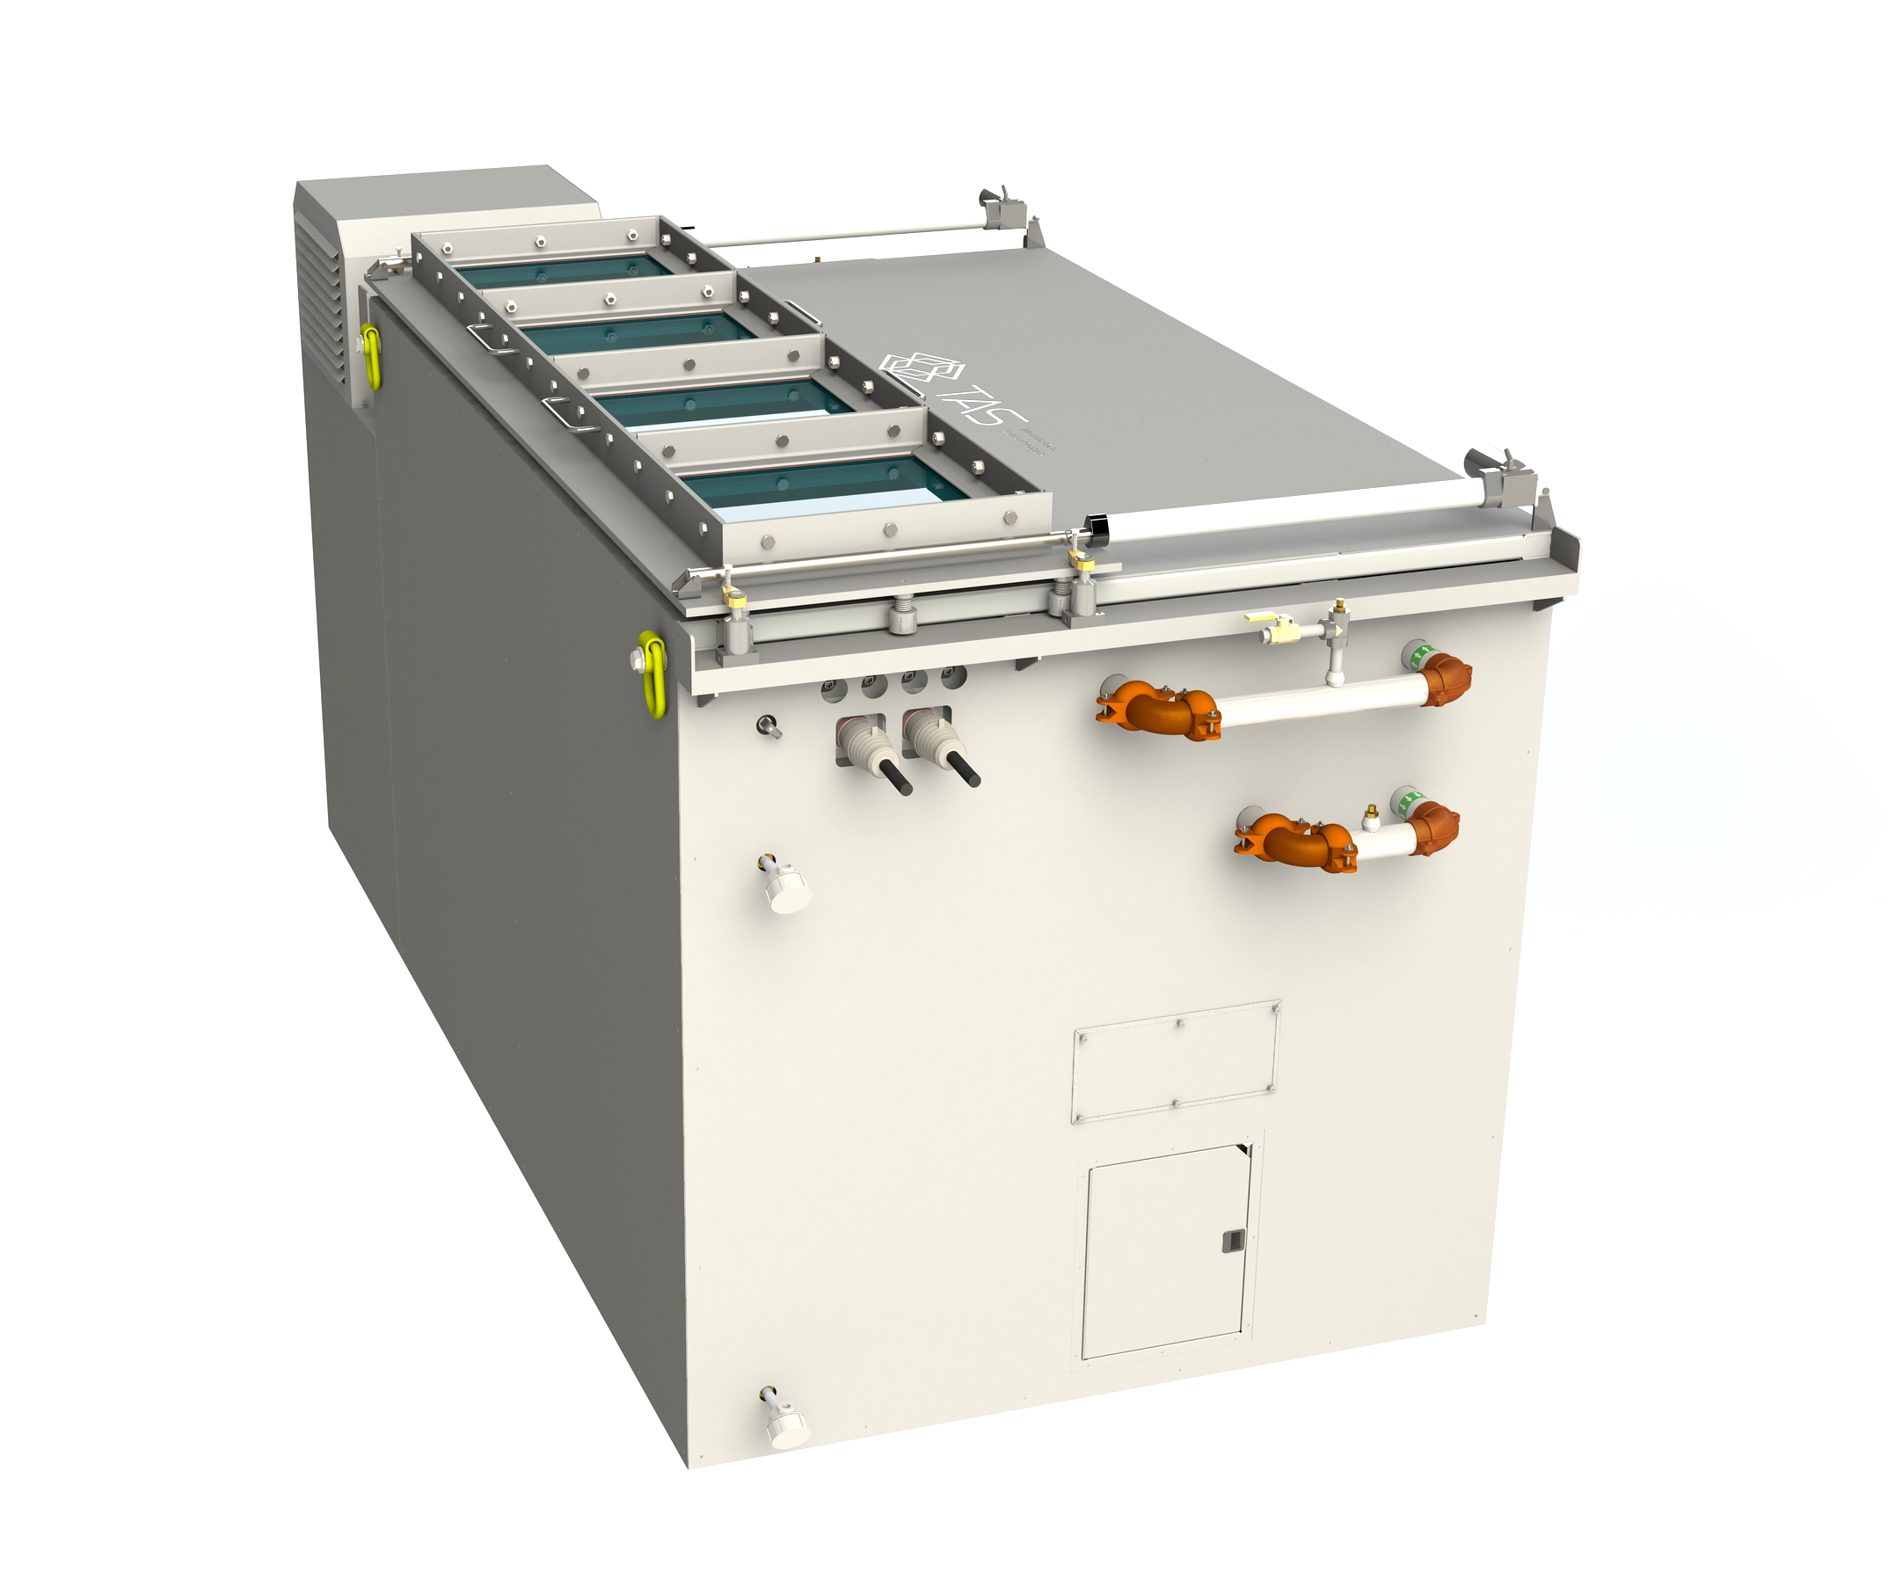
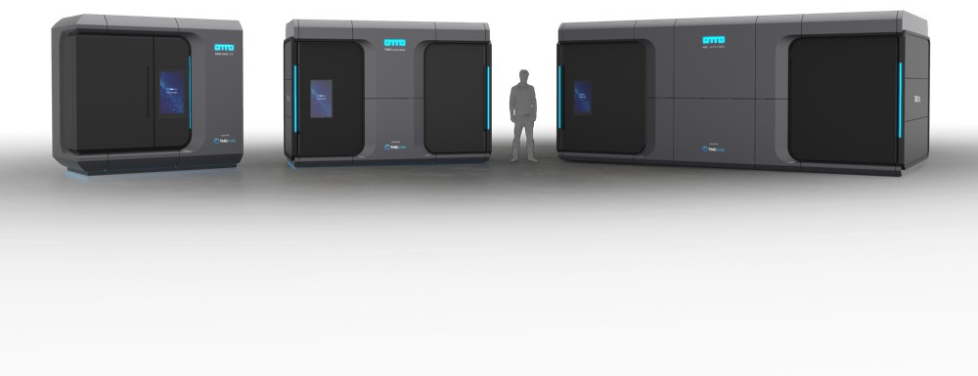
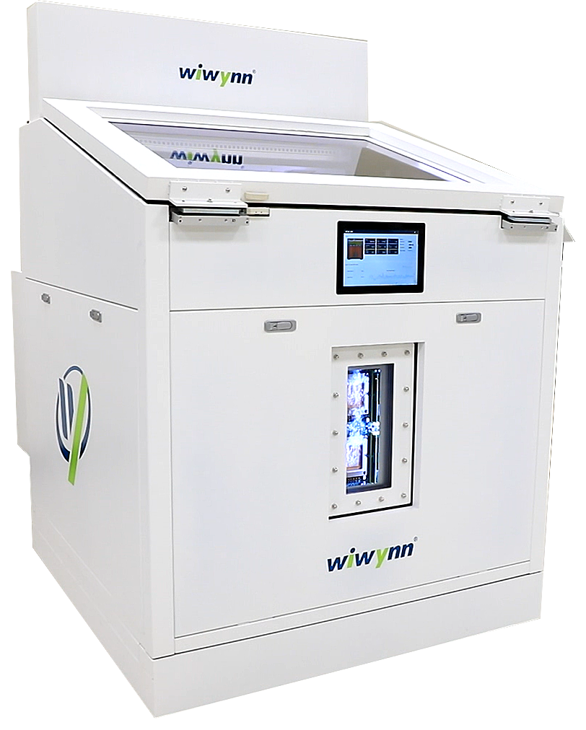
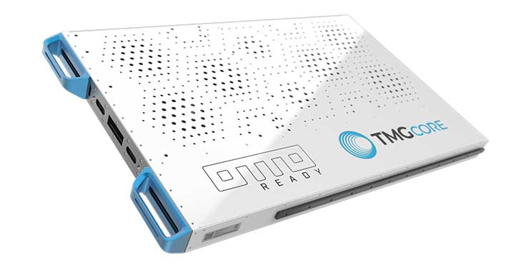

Enabling Immersion Cooling with Fluorochemicals
a. Bitfury-Allied Control
b. TMGcore
c. Wiwynn⁸
d. Turbine Air Systems
OTTOEDGE 600L
600kW
OTTOEDGE 120M
120kW
OTTOEDGE 60XS
60kW
Cooling Capacity: 6-500kW per tank
Power Input: 3-phase; 50 & 60 Hz
Form Factors: 2-48U, prefab DCs
Rack Config: 19’’, 21’’, OCP, OpenRack, custom
OTTO 600L: 600kW in 160 SqFt
OTTO 120M: 120 kW in 60 SqFt
OTTO 60XS: 60 kW in 35 SqFt
OTTO 60 OTE: 60kW “Over The Edge”
IT Power: 60 kW
LxWxH: 1.2m x 1.2m x 1.25m
Motherboard: 100x OCP Tioga Pass
Power: 48 VDC to board
Cooling Capacity: 6-500 kW per tank
Power Input: 3-phase; 50 & 60 Hz
        12VDC available
Rack Config: 19’’, 21’’, OCP, Custom
FIGURE 17 – Emerging turn-key x86 immersion systems
  Pai, L., “Service Oriented Immersion with 48V Power Solution” presentation at the Open Compute Summit, San Jose, CA, USA, March 14-15, 2019.

Slide 17
Summary
  Opportunity for Advanced Cooling Solutions (ACS) Rack and Power/Immersion Subgroup to educate the broader market on differences in immersion fluids and system design considerations
        Fluorochemical and Hydrocarbon fluids behave differently from a material compatibility standpoint
      Single and two-phase system design considerations are quite different
Fluorochemical Immersion Cooling Today
      Singe-phase immersion deployments for hyperscale and supercomputing exceed 13MW
      Two-Phase popular for crypto mining where deployments have reached 165MW but also compelling for hyperscale and other x86 applications
Fluorochemical Immersion Cooling Tomorrow
      Supply chain materializing and turn-key solutions emerging
      Remaining challenges to OCP supply chain: density and cleanliness

Slide 18
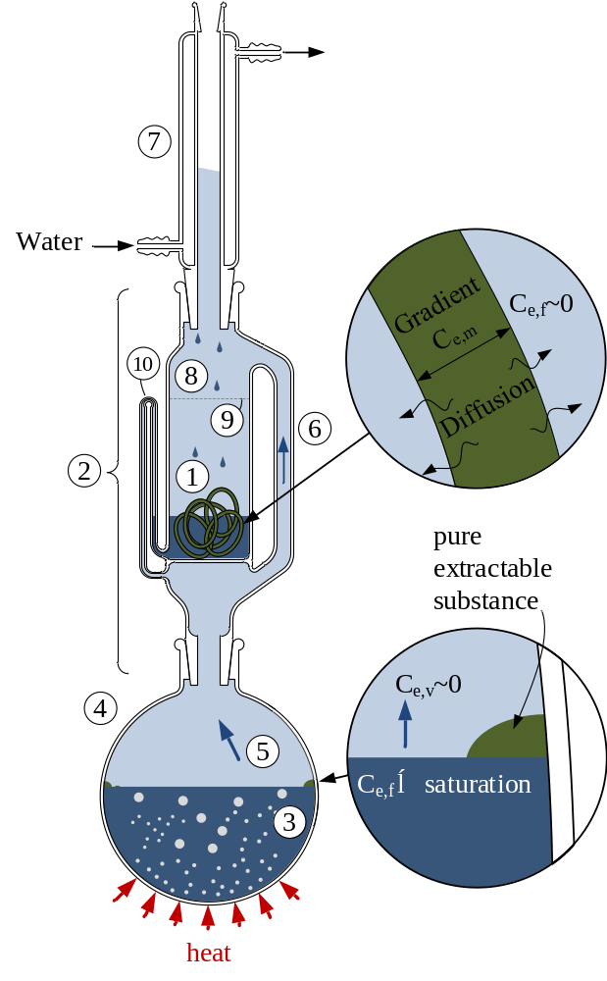
Call to Action
Join the immersion workstream and contribute!
              Invite supply chain partners to learn about the Soxhlet extraction technique. It is the preferred method of accelerated aging and testing for compatibility in fluorochemical fluids but provides information that is useful for all immersion fluids.

