Slide 1



Slide 2

Air-assisted Liquid Cooled Olympus rack/server using A-L RDHX
Husam Alissa, Sr. Data Center Architect, Microsoft
Robert Lankston, Sr. Server Architect, Microsoft
Brandon Rubenstein, Director of Engineering, Microsoft

Slide 3


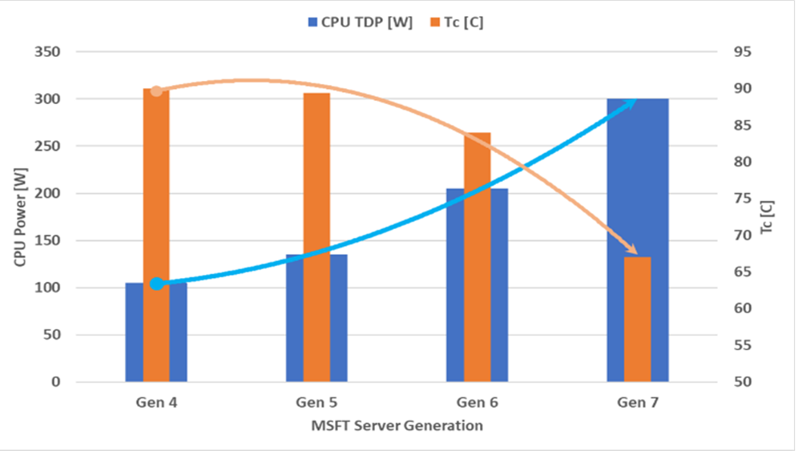
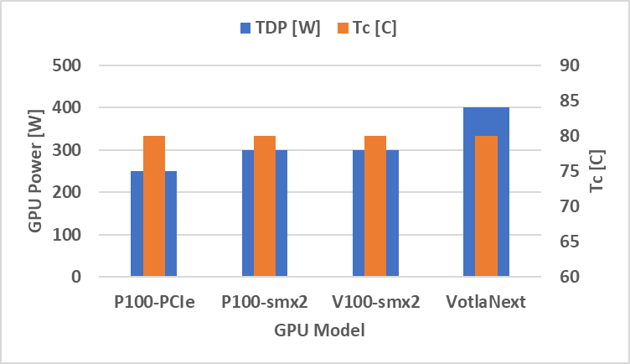
Chip Power and Temperature Requirements Trends
CPU Trends
1
2
3 3
4
CPU Generations
GPU Trends
1
2 3
4
GPU Generations

Slide 4
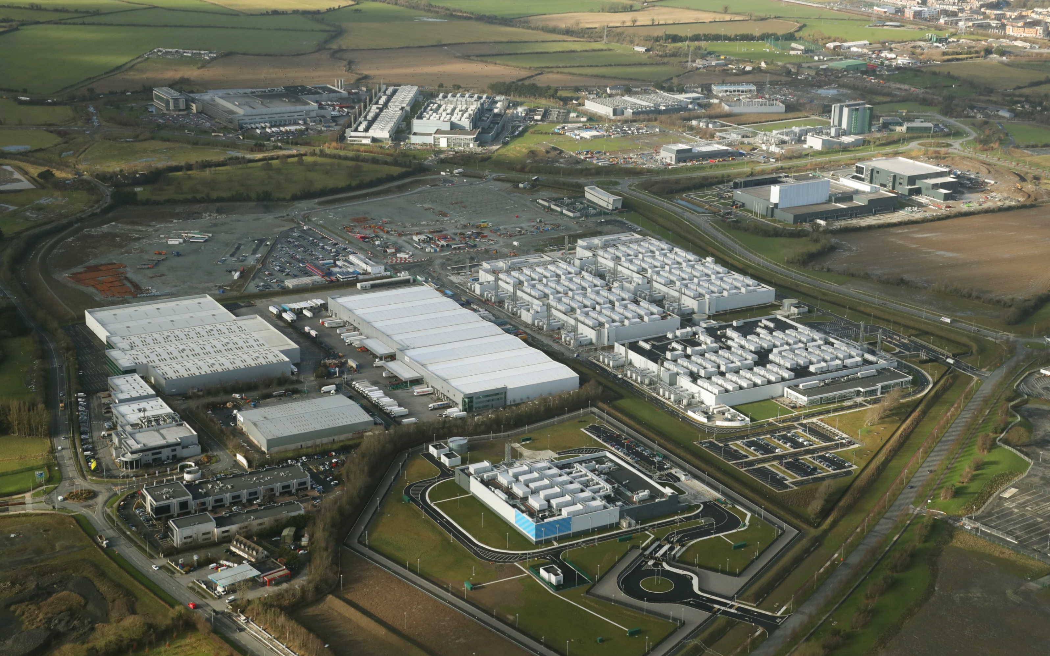
Hyperscale Aircooled Data Centers
Mega
Efficient
Scalable
Optimized

Slide 5
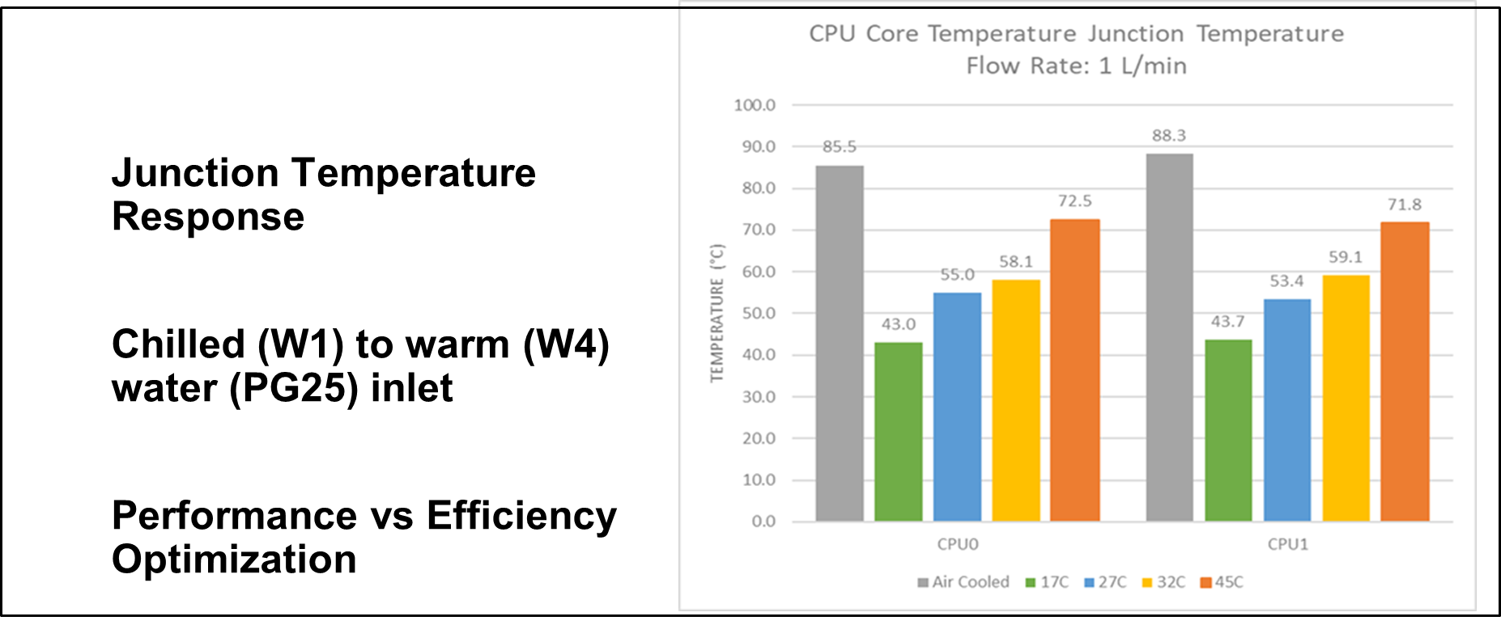
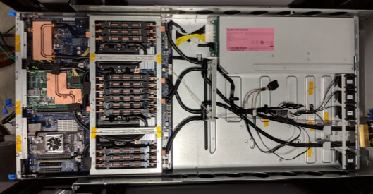
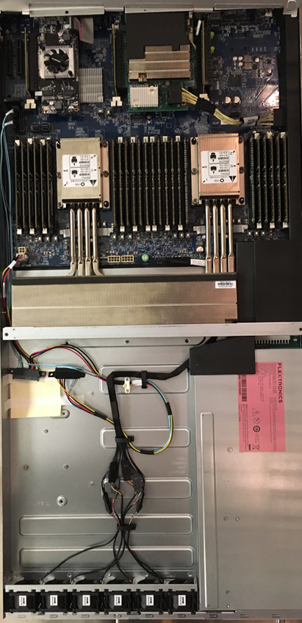
Olympus Server- CPU

Slide 6
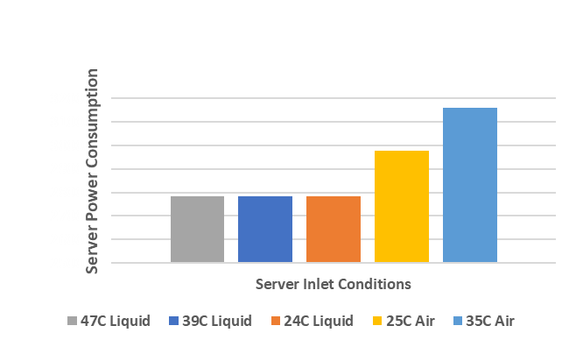
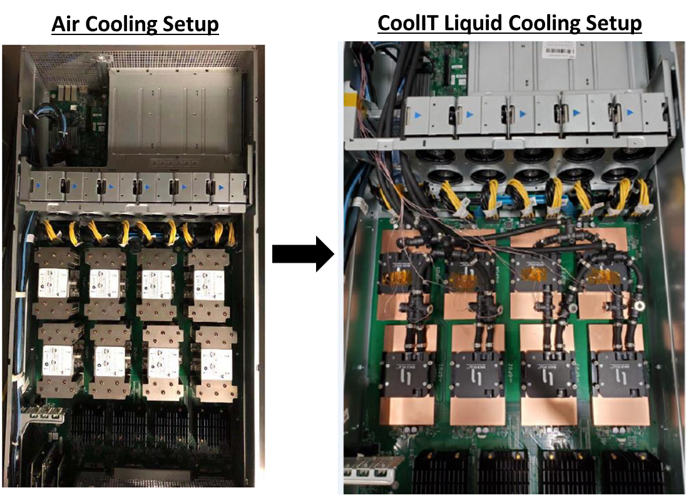
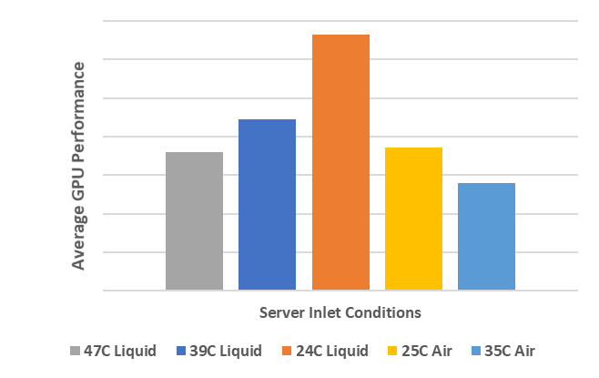
Olympus expansion Chassis- GPU

Slide 7
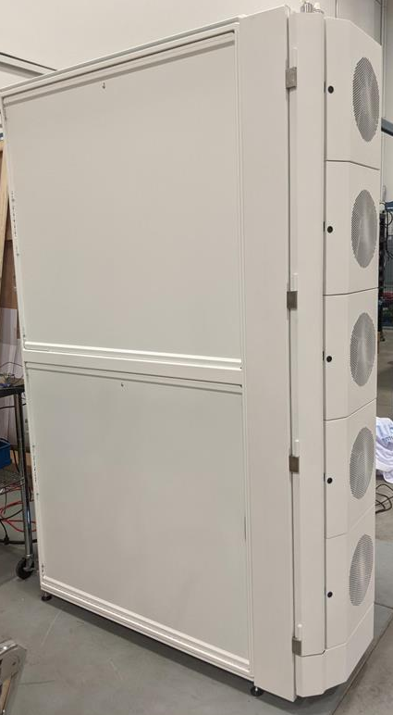
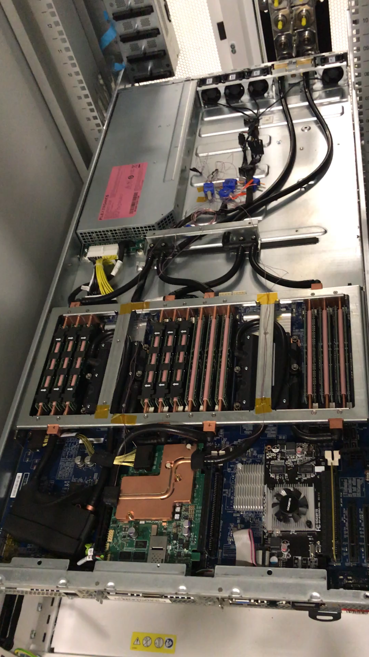
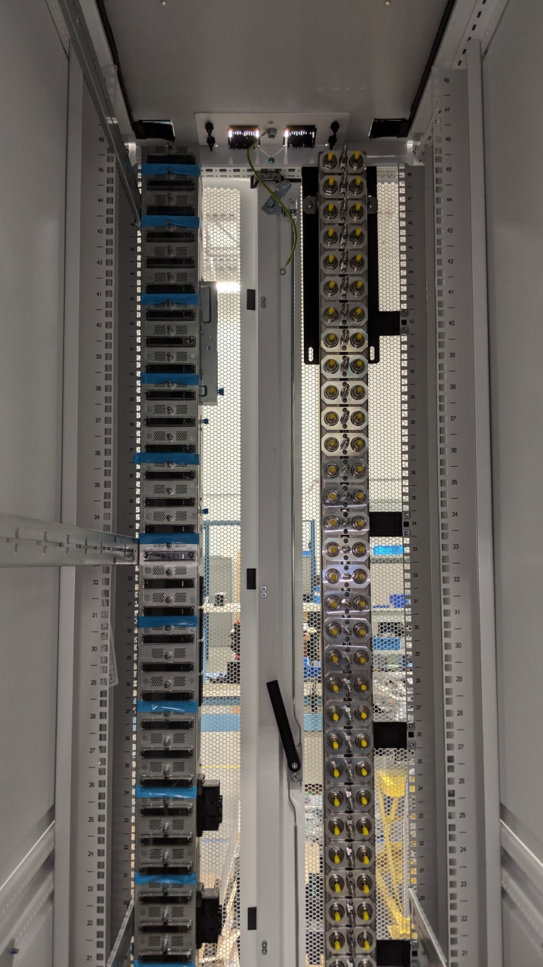
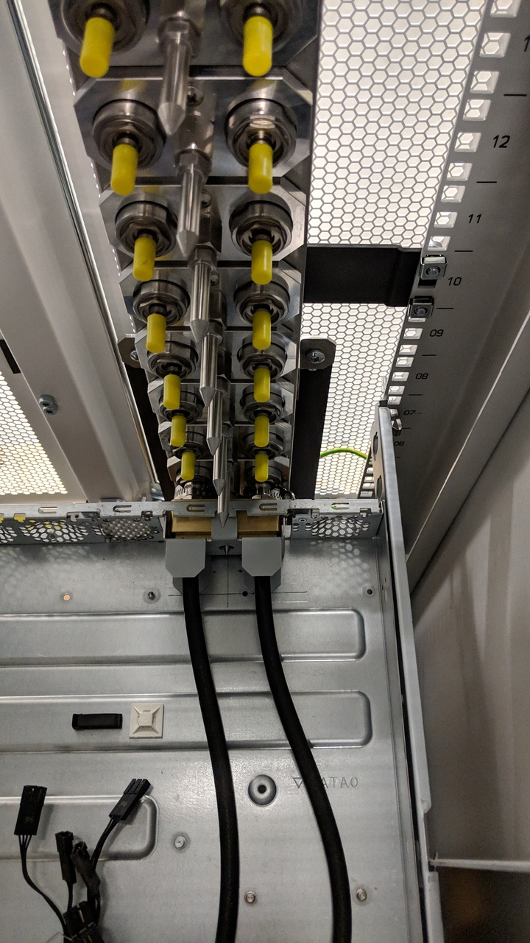
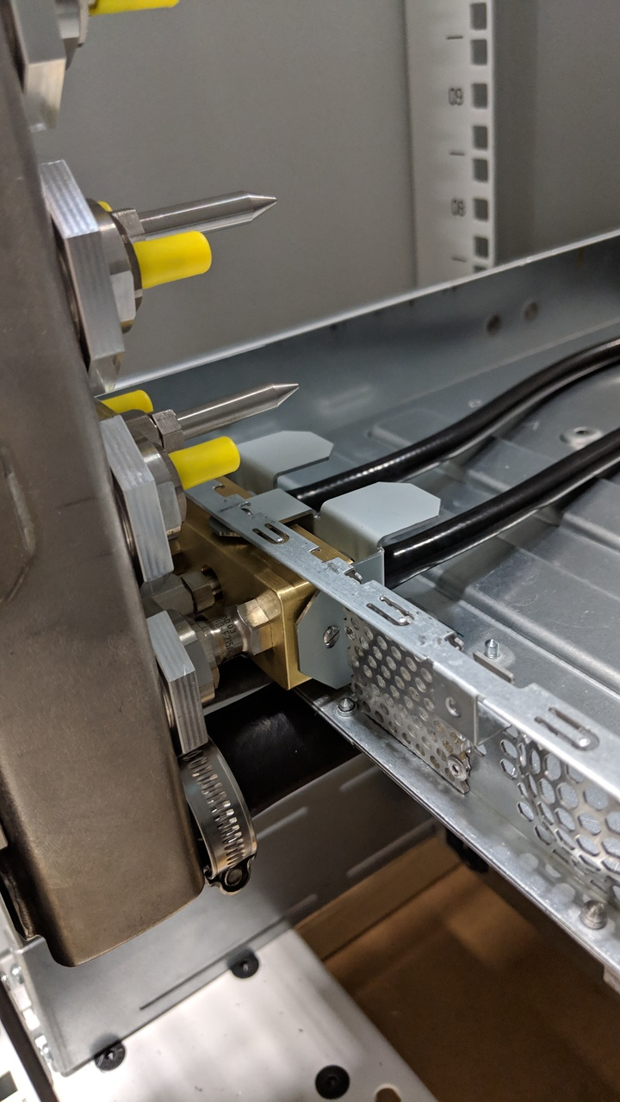
Liquid Cooled Olympus Rack

Slide 8
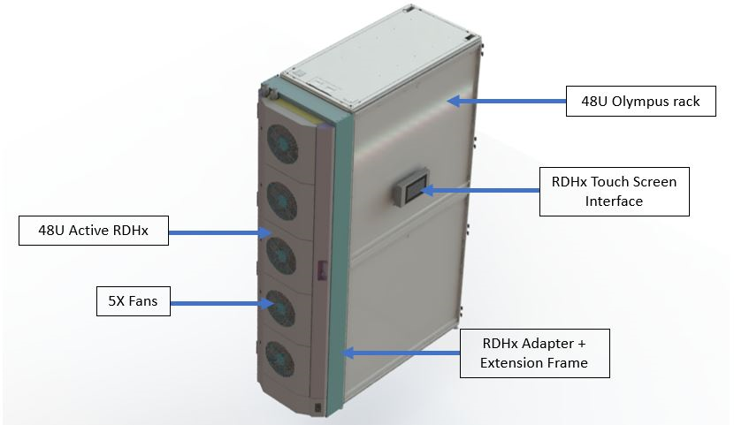
Air Assisted Liquid Cooled Olympus Rack
Air Assisted Liquid Cooled Rack enables efficient cooling for higher flux chips at higher rack densities
Liquid heat pickup ration (LHPR) can vary depending on chassis solution
X% of heat is picked up by the liquid loop and is circulated to the RDHX where L-A heat rejection takes place
(1-X)% of server heat is picked up by the air stream
100% of the heat is eventually rejected into the facility air.
<5% Cooling overhead
Both Olympus and ORv3 compatible

Slide 9
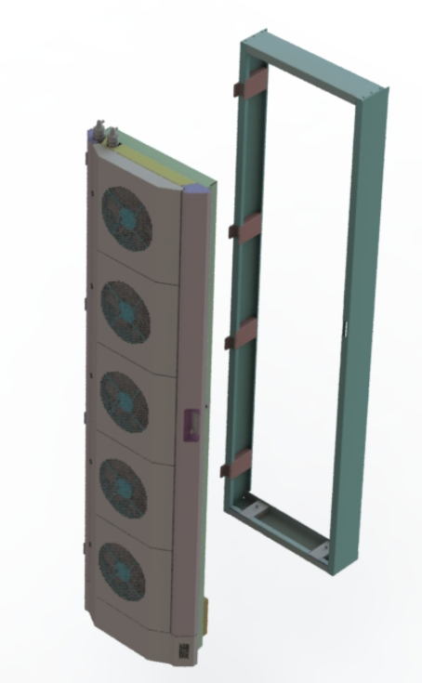
Components-RDHX
RDHx to fit the 48u Olympus rack.
5x 280mm Axial Fans capable of 4800 CFM
Mounting bracket to rack allows for easy replacement of RDHx
Stand-alone Control System for PoC?
Telemetry sensors include differential Pressure, air on and air temperatures, individual fan speed control and tach.

Slide 10
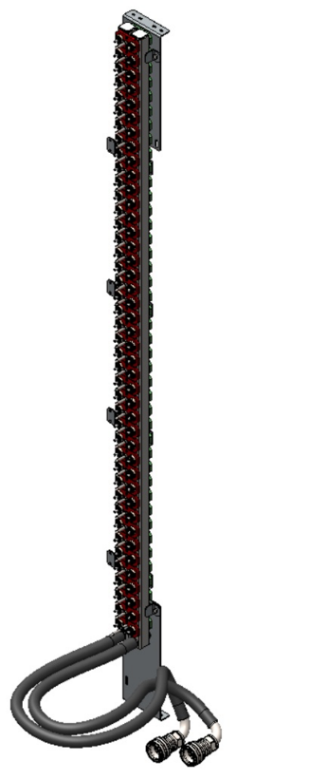
Components-Manifold
Blind-mate Vertical Rack Manifold
Olympus rack compatible
42 Station manifold features Staubli CGD03 blind-mate
CGB20 manual-mate Dry-break QDs,
Automatic air bleeder valve.

Slide 11
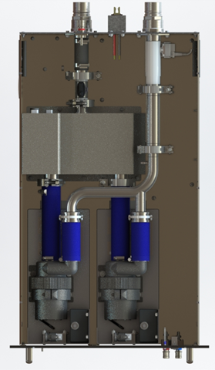
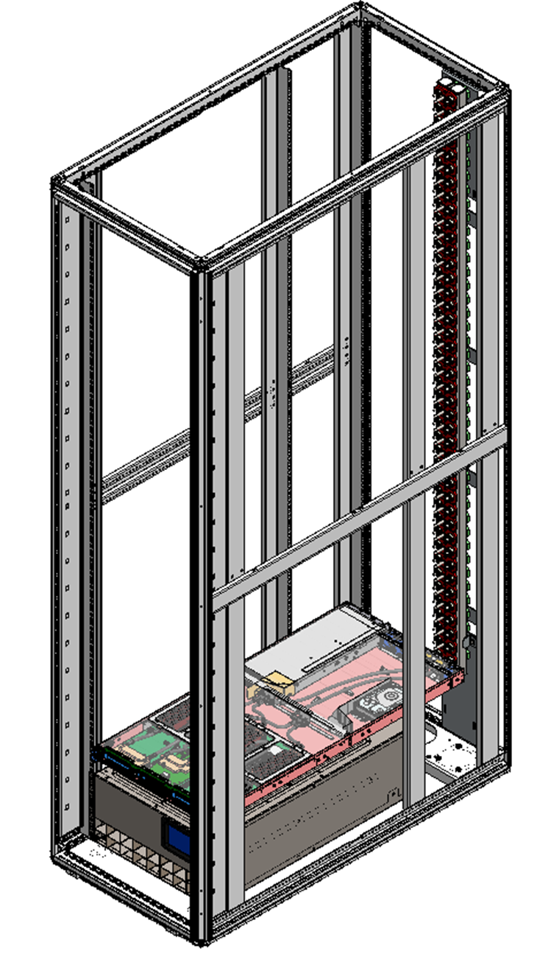
Components- Reservoir and Pumping Unit (RPU)
Fixed pump design (PoC)
Custom GRI pumps
Controls and monitors the remote Liquid-to-air HX​
Interface with Rack level management system
Compatible with OpenRack V2, V3
MSFT and Facebook collaboration on common RPU specs refer to” Air-Assisted Liquid Cooling: Cold Plate Enablement in Air-Cooled Facilities”
Max (one-pump) performance:
    50 LPM @ 25 PSI
Return QD
Supply QD
Busbar Connector
Pressure/Temp/Flow
Pressure/Temp
Reservoir
Pump
Pump

Slide 12

TCO Tuning
Design For.. | Efficiency | Performance
Total Rack Power | 40 | 40
Liquid Load kW | 30 | 36
Air Load kW | 10 | 4
Ambient Air C | 35 | 35
Airflow CFM | 4700 | 5800
Liquid Coolant Flow LPM | 40 | 40
RDHx Air In C | 39 | 36
RDHx Air Out C | 51 | 47
Manifold Supply C | 48 | 44
CFM/kW | 117 | 145
Power Overhead | Lower | Higher

Slide 13
Next Steps
Hot swappable pumps and fans
Control and monitoring scheme built in the door for both water and air sides
Optimized RDHX for improved/redundant performance
More sources for pumps

Slide 14
Call to Action
Create eco system for Air assisted liquid cooled rack components:
    Standardization of specification and interfaces:
        RDHX, manifold, RPUs, pumps, Coolants
    Consistent guidelines of Deployment, Serviceability, Control
    Vendor and end user collaboration on monitoring
    Leakage and risk mitigation
Project Wiki with latest specification: https://www.opencompute.org/wiki/Rack_%26_Power/Advanced_Cooling_Solutions
ACS Door Heat Exchange
ACS Cold Plate
ACS Immersion Cooling
Please join the group and help develop the harmonization standards that will enable advanced cooling solutions for OpenCompute solutions.

