Slide 1

Quick Disconnects for Liquid Cooling -- Design, Specification & Implementation
Elizabeth Langer, R&D Engineering Manager
Thermal Business Unit, CPC
Advanced Cooling - ACS
Contact for more information:
Elizabeth Langer, R&D Engineering Manager
elizabeth.langer@cpcworldwide.com or 651-603-2544
Barry Nielsen, Applications Dev Manager
barry.nielsen@cpcworldwide.com or 651-999-1813
Notes:
About the presenter:
Elizabeth Langer R&D Engineering Manager for the Thermal Management Business Unit at CPC, and also an active member of the OCP ACS Cold Plate Workstream
A little about CPC, we design and manufacture connectors for a variety of industries and applications, and specifically here specializing in quick-disconnects for thermal management and liquid cooling of electronics

Slide 2


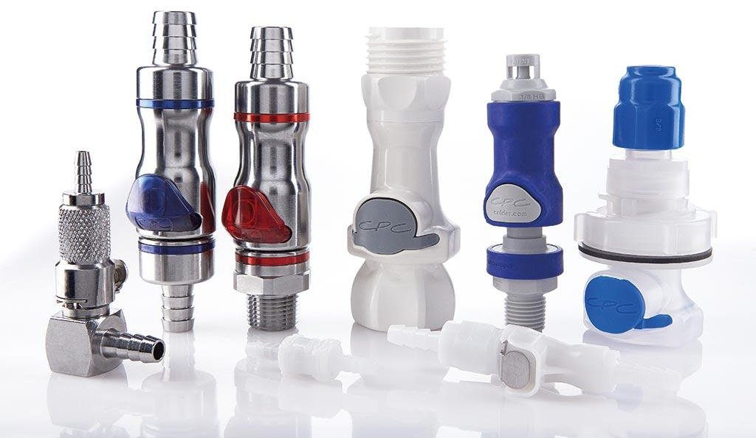
Agenda
RACK & POWER
ACS
Introduction to Liquid Cooling
  Technology scope and benefits
  Key components
Quick Disconnects
  Anatomy and design
  Performance and implementation
Notes:
The goal of this presentation today is to provide a high level understanding of the current state of liquid cooling technology in the industry; benefits, methods, and key considerations for successful implementation and reliable deployment.
And then QDs being an integral component of data center thermal management, we’re going to introduce and discuss some of the fundamental considerations for designing and optimizing QD performance in cooling systems. Touching on materials of construction, chemical compatibility, valve design and pressure loss, should provide a good baseline to help enable engineers during the specification process.

Slide 3
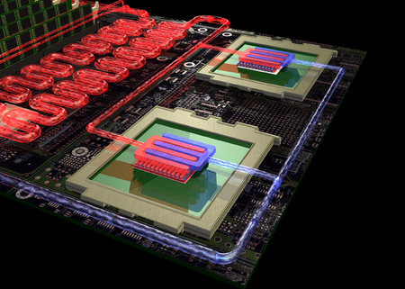
Why liquid cooling?
Energy savings
ACS
Cost savings
Liquid cooling can provide:
Liquid cooling
of hot server components has a long and storied history; IBM water-cooling in 1964, Cray FC cooling in 1980’s, and even more today!
Density increases
Noise reduction
Notes:
Why liquid cooling and why liquid cooling NOW?
We’ve seen with advancements in semiconductor technology over the years, shifts in power consumption and consequently associated cooling requirements. but now in recent years we’re yet again in a place where compute power and certainly densities have reached the limits of efficient thermal management with traditional air cooling approaches.
Now liquid cooling is becoming more widely considered, data center and colo providers can begin to realize a number of benefits in the form of
Energy savings, improved PUEs
Cost savings
Ability to dramatically increase densities
And noise reduction; if you’ve ever been in an air cooled facility you know the fans have a significant impact on the working environment

Slide 4
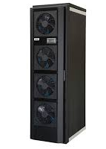
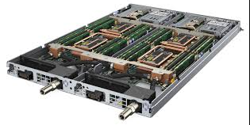
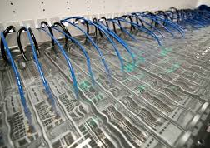
OCP ACS architecture
ACS
RDHx
Cold Plate
Immersion
Notes:
Within OCP, there’s been quite a bit of activity over the last few years to educate and develop best practices across the industry around liquid cooling technologies for data centers.
Here we have the liquid cooling architecture scoped by OCP ACS workgroup. Goal here is to facilitate architecture harmonization to promote accessibility, consistency, reliability. Interesting to note intent that these technologies are not mutually exclusive, on a case by case basis, a facility might require one over another, or potentially a hybrid approach implementing multiple cooling technologies; an RDHx in tandem with a direct contact cold plate structure.

Slide 5
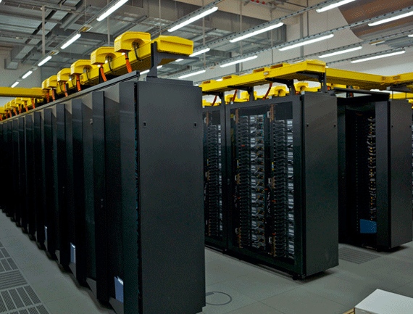

System component selection
Coolant
ACS
QDs
Pumps
Every component within a liquid cooling system matters
Think holistically throughout the design process
Tubing
Manifolds
Cold Plates
Hx
Notes:
Supporting the ACS architecture are a variety of subsystems and components that are critical to successful and reliable operation of the cooling system. The components themselves, as well as interactions and dependencies between them warrant detailed analysis during design and specification.
Considerations
Coolant - Corrosion, biofouling, etc
Viscosity & Specific Gravity
Pump power, Reliability, redundancy
Manifolds/hx/cold plates - flow rate(s) and pressure
Filtration, debris
Materials and compatibility

Slide 6
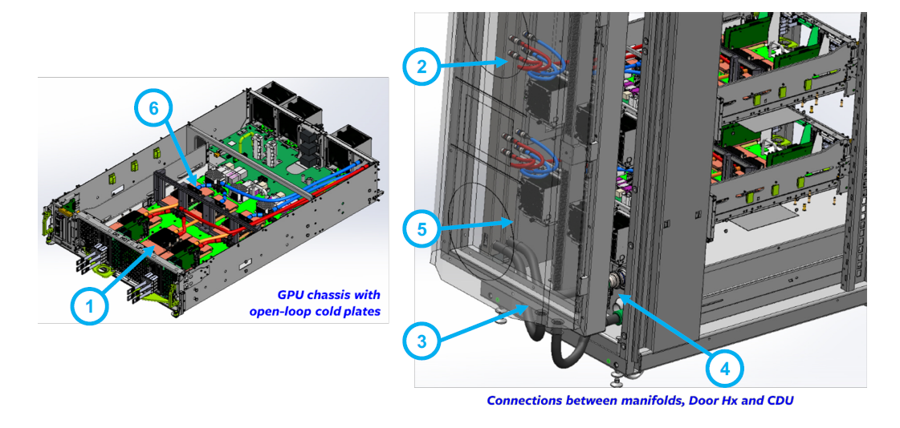
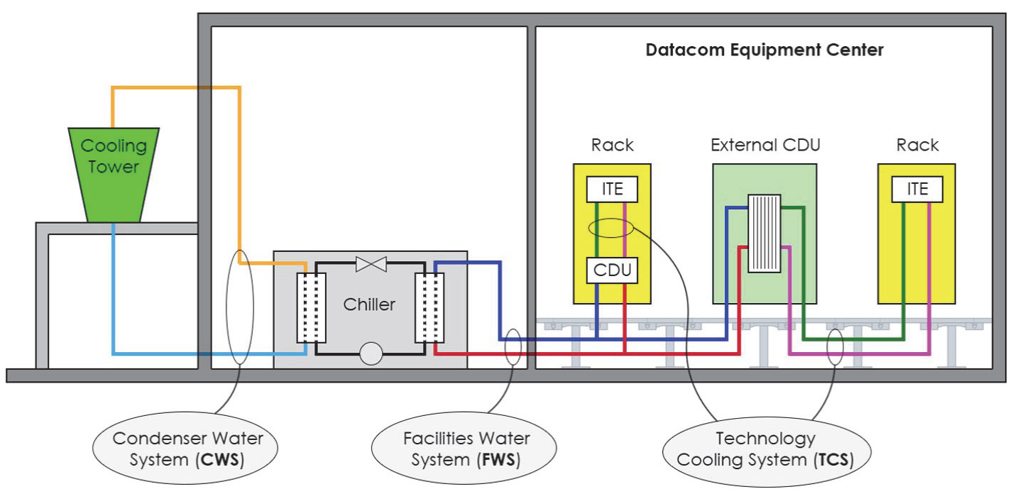
QD points of connection
ACS
FWS – Facilities Water System
TCS – Technology Cooling System
  RDHx
  Cold Plate
  Immersion
The closer to ITE, the more critical the QDs’ performance and reliability
Ref: ASHRAE TC9.9 – Water Cooled Servers
Notes:
With a data center facility typically there will be two fluid circulating loops, with a CDU barrier between them. On the FWS side there may be fewer connections, large plumbing and fittings to support high volumes of fluid. On the TCS side where the ITE resides, ACS architecture such as RDHx, cold plate, immersion will utilize many more connections, and require more detailed consideration around specifications. The closer to the ITE the more critical the QDs performance and reliability.
Ex. RDHx and cold plate connections; CDU, manifolds, RDHx, blade or chassis

Slide 7
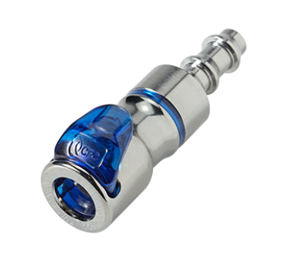
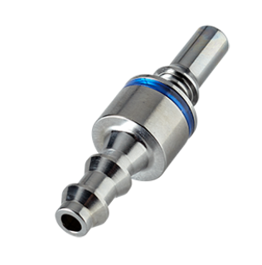
Anatomy of a QD
Materials
  Structural
  Wetted
Configurations
  Mating
  Mounting
SMALL component with BIG influence
Valves and Shutoff
  Nonspill
  Flow sizing
ACS
Notes:
Now with an understanding of where QDs might be installed within a data center facility, and the importance of their performance and reliability as they get closer and closer to the ITE, we can dig in a little deeper and understand some of the key parameters of importance for specification.
When thinking about the anatomy of a QD, we can identify 3 high level categories for consideration when selecting the right QD for a specific application.
Material selection is a very important factor to consider early on; both from a structural and mechanical viewpoint, but equally important with regard to chemical compatibility. Ensuring that all wetted materials, materials that will be in contact with the coolant, as well as other component materials within the loop that may have an interaction.
Understanding of and visibility to various configuration options related to mating and mounting will enable designers to fully optimize the performance as well as provide flexibility in promoting usability and serviceability of the system
And finally, valving and shutoff characteristics of the quick disconnect are really imperative for designing an efficient and reliable system.

Slide 8
Materials of construction
ACS
Metals
PRICE
Commodity Plastics
Engineered Plastics
Metal Alloys
High Performance Metal
Engineered Plastics
Elastomers
  PPSU
  PEEK
  Brass, Aluminum
  Stainless
CORROSION RESISTANT
LIGHTWEIGHT
PERFORMANCE CHARACTERISTICS
HEAVY
CORROSION SUSCEPTIBLE
Notes:
QDs may be comprised of a variety of materials, metals or polymers, and can be effective with any combination
Metals
Alloys – corrosion resistant, strength
Surface treatments, plating, heat treatment, oxidative, etc
plastics
Mechanical strength
Chemical compatibility
Flame retardance
Hydrolytically and thermally stable
Lightweight

Slide 9
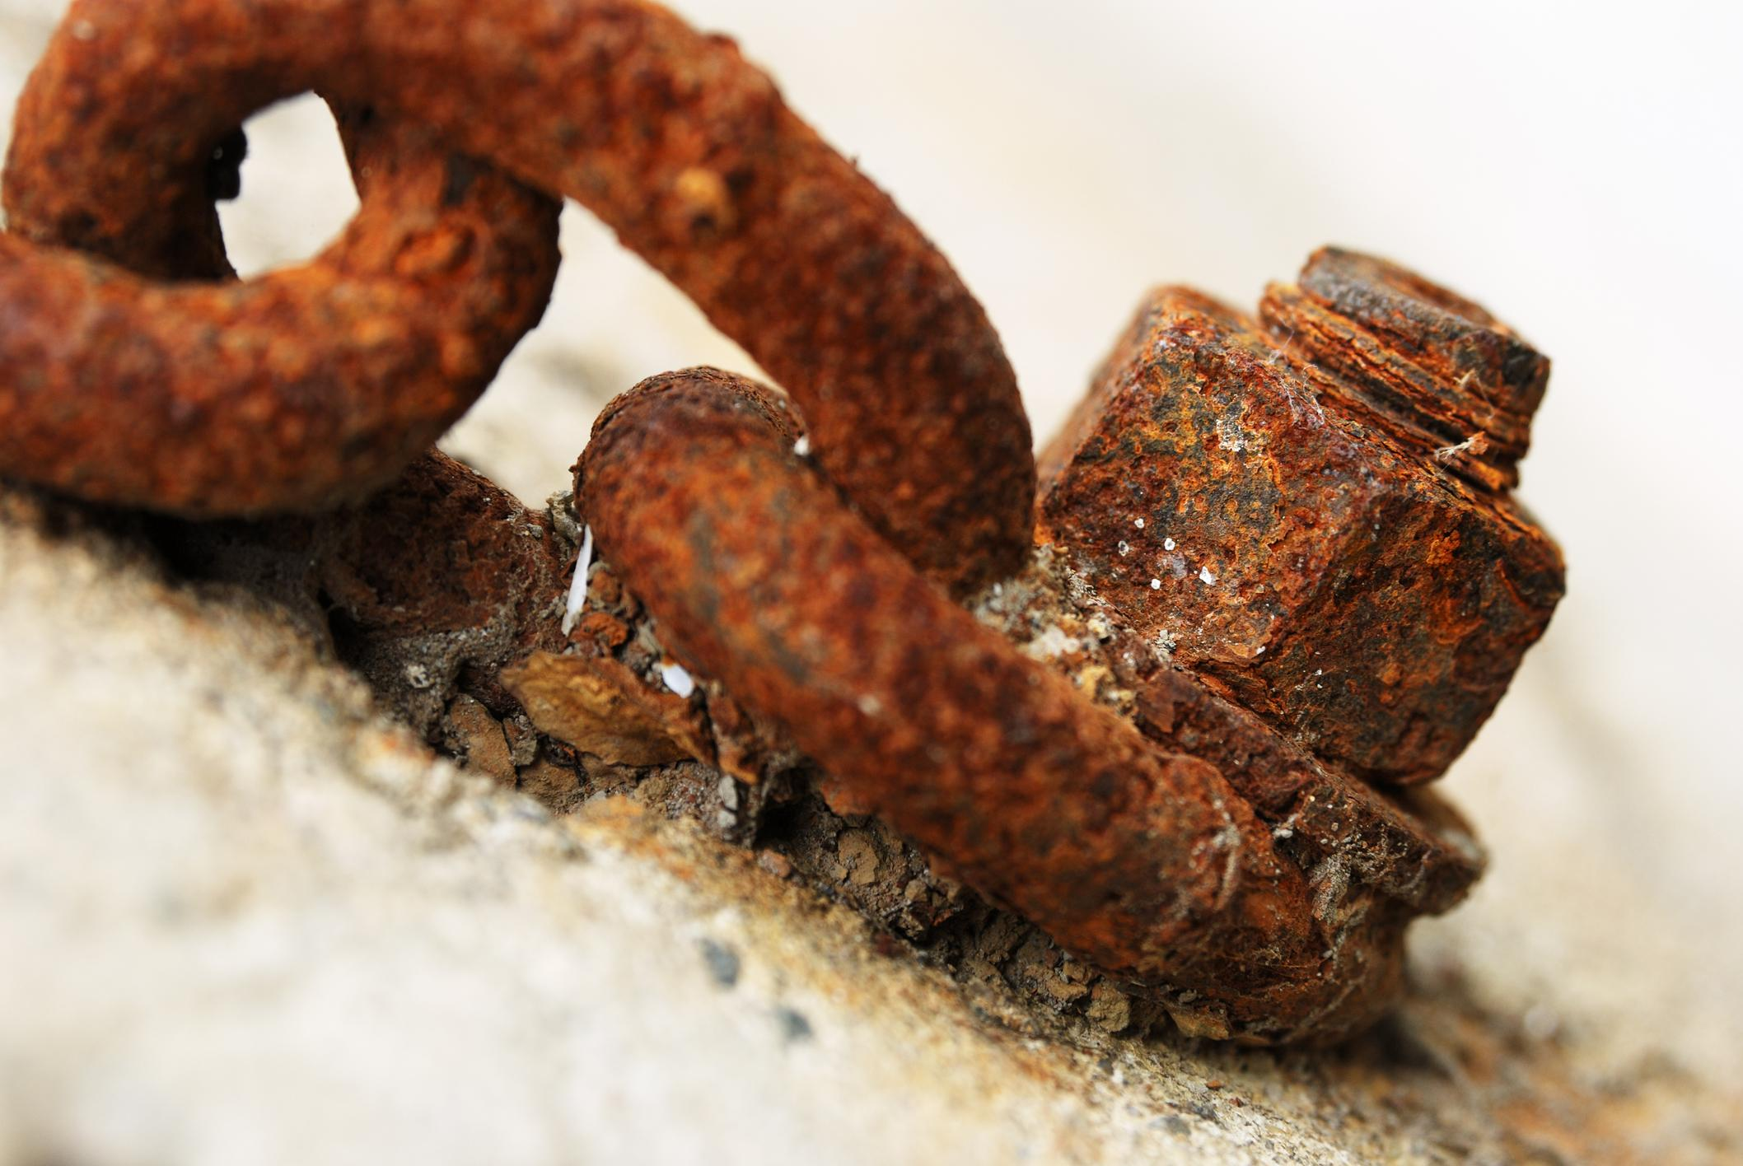
Materials of construction
ACS
Chemical compatibility, corrosion, erosion
  Coolant compatibility
    Elastomeric seals
  Galvanic corrosion
  Flow path erosion
  Environmental exposures
Consider all materials within wetted fluid loop, and interactions they may have
Notes:
In addition to structural characteristics it’s important to understand other physical characteristics such as

Slide 10
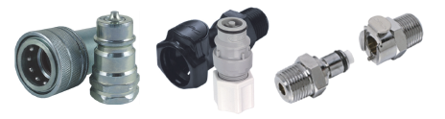
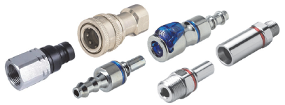
Configurations
ACS
Blindmate vs. handmate
Ball vs. latch
Non-spill vs. wet break
Terminations
Notes:
Many QD configurations exist on the market, and can often be customized to fit unique needs of an application

Slide 11
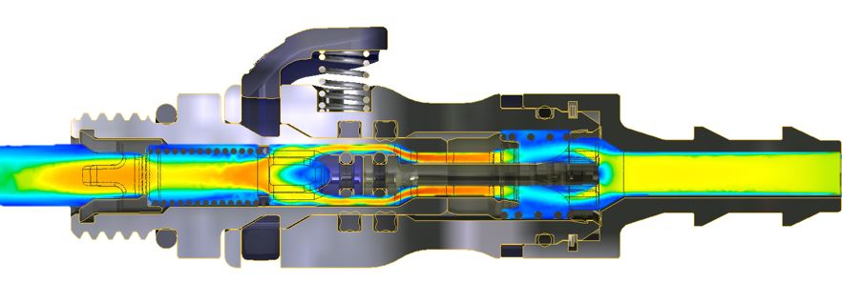
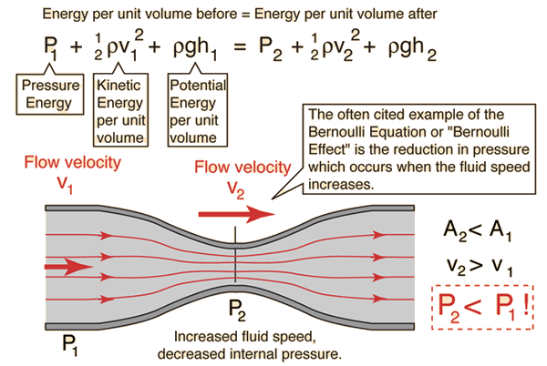
QD flow sizing
ACS
Achieve increased cooling
efficiency with properly spec’d devices throughout the system
Sizing a QD for optimal performance – reduce pressure loss, consider physical size
Notes:
Alongside manifolds, tubing/piping, cold plates; QDs are a key consideration when analyzing a flow network model, they can have a critical impact on system flow and pressure loss.
If you’re from more an electronics background, we can consider the hydraulic analogy to describe some of the considerations for optimizing fluid flow – voltage can be likened to fluid pressure, directly relating to capacity and ability to do work. Current can be likened to fluid flow rate; how fast can we do the work. We know that the rate of heat transfer is directly related to the mass flow rate, so higher flow means more heat can be moved.
That being said, it is not always practical from a system efficiency and safety standpoint to simply increase pressure and flow, and so careful analysis upfront of the impact of the QD on overall system performance is critical.
<<click animation>>
Additionally, as we see on the right hand side, and from our friend Bernoulli, we can understand the relationship of fluid velocity to fluid pressure. As the fluid velocity increases, for example when flow through tight spaces and orifices, the fluid pressure will decrease, contributing to the overall system pressure loss. And vice versa, as the flow path becomes less restrictive, the fluid velocity will decrease and pressure will stabilize. This concept is fundamental to understanding and being able to optimize flow paths within QDs to produce the least possible pressure loss across the set.

Slide 12
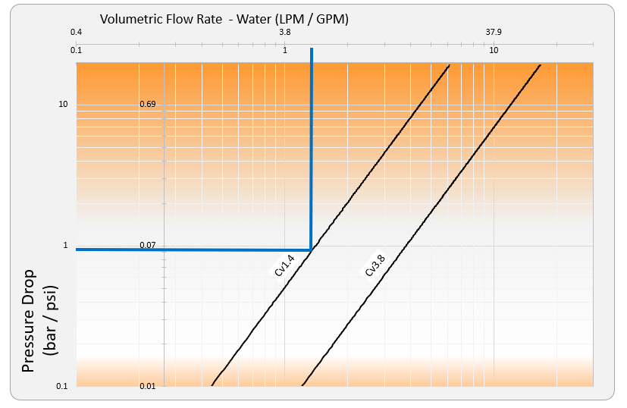
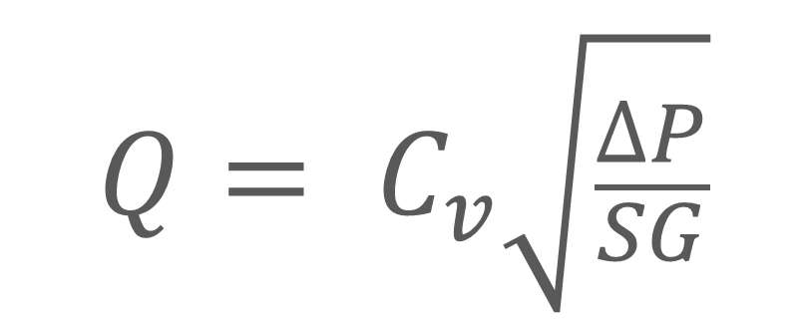

Fluid flow & pressure loss
ACS
Flow coefficient – Cv
  Volumetric flow rate for 1psi loss
  Balance flow and pressure for optimal performance and efficiency
Published and catalog Cv is typically reported with water (SG = 1)
Use correction factors and correct SG when using coolants other than water

Slide 13
QD functional requirements
Spillage
ACS
  Volume of fluid upon disconnect
Inclusion
  Volume of air introduced into fluid loop on connection
Leaks
  Unintentional fluid discharge
  Potentially catastrophic
  Multilobe seals (vs. standard o-rings) for redundant protection against leaks
Notes:
Now that we’ve got a handle on the anatomy of a QD, I want to introduce some of the key functional requirements
Some ways to mitigate and enhance seal efficacy and reliability are multilobe and redundant seals

Slide 14
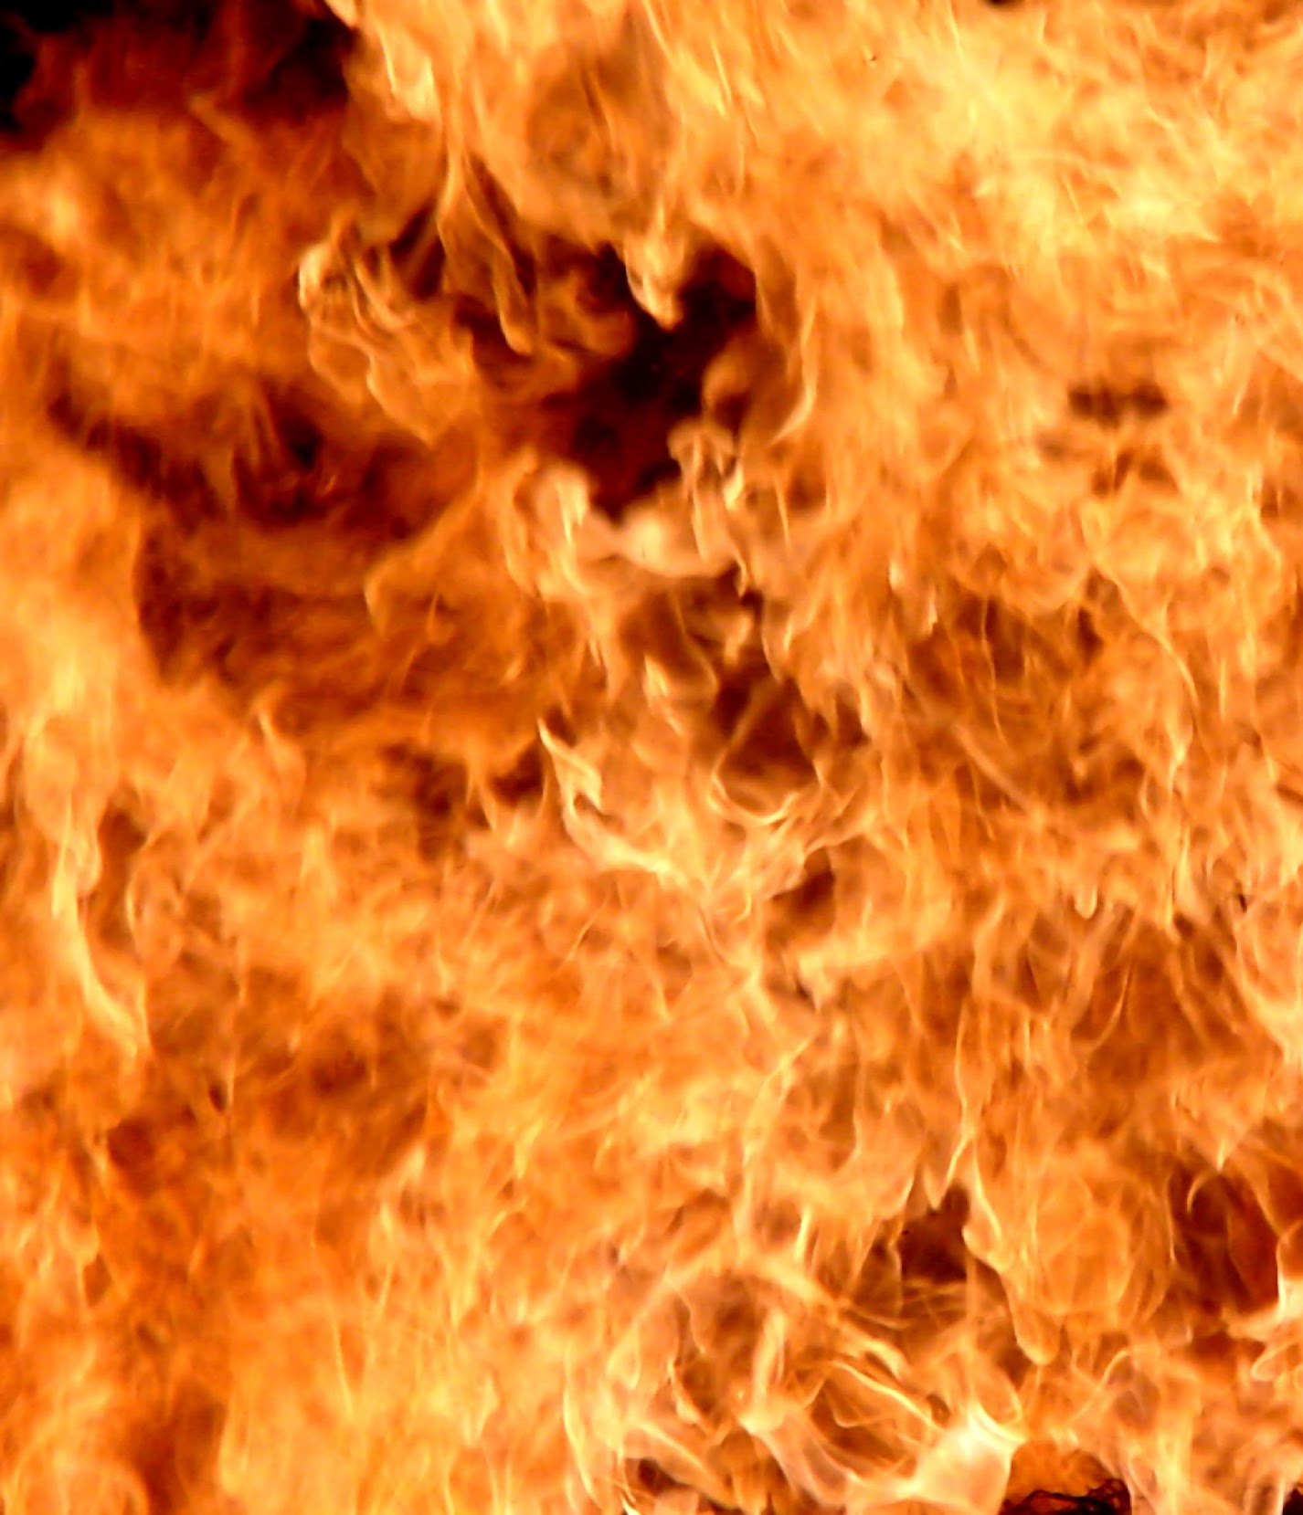
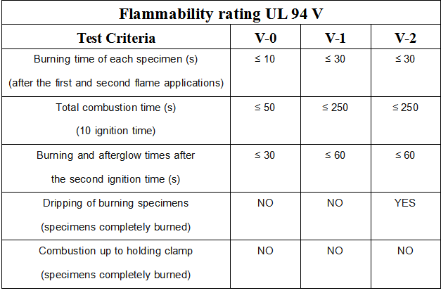
QD functional requirements
ACS
Temperature
  Resistance and stability
Flammability
  UL94V
Conductivity
  Metal QDs can be hot to the touch
  Consider location and operator
  interaction
Chemical Compatibility
  Wetted materials in fluid loop
  Long-term service and exposure
*PPSU is flame retardant – UL94 V-0 Rating
Notes:
Temperature – consider during operation as well as storage and shipping
Consider UL94V flame rating, if using plastics look
PPSU is inherently flame retardant, nonhalogenated (no bromine, chlorine, etc)
Thermal conductivity of metal QDs can be a risk to operators

Slide 15
QD functional requirements
ACS
Pressure
  Operating and burst pressure
  Industry standardization around
  system testing - 3X operating pressure
Flow
  Volumetric, mass, erosional velocity
Notes:
Thermal runaway creates tension in
the system
Go hand in hand, back to hydraulic analogy

Slide 16
Summary
Parameter | Metrics
Flow Rate | L/min, gpm
Flow Coefficient | Kv, Cv
Operating Pressure | Pa, psi
Burst Pressure | Pa, psi
Pressure drop | Pa
Spillage (liquid expunction) | mL, cc
Inclusion (air introduction) | mL, cc
Temperature – Operating, Storage / Shipping | °C, °F
Connection Force | N, lbf
Connection Cycles | Mechanical cycles / connect and disconnect
QD style and hydraulic diameter | Inches (eg. Blind mate, hand mate, threaded, mounting configuration)
Terminations | Barbed, compression style, threaded
ACS
Parameters of Importance – ref OCP ACS Cold Plate Liquid Cooling Requirements
Recommendations
System requirements locked
  Ref checklists and
  guidance from ACS
Engage with experts early
Notes:
All packaged nicely in the OCP ACS Cold Plate paper available on the website

Slide 17
Call to Action
ACS
Advanced Cooling Solutions: https://ocp-all.groups.io/g/OCP-ACS
Cold Plate Work Stream: https://ocp-all.groups.io/g/OCP-ACS-Cold-Plate
Project Wiki: https://www.opencompute.org/wiki/Rack_%26_Power/Advanced_Cooling_Solutions
Call Calendar: https://www.opencompute.org/projects/rack-and-power
Contact for more information:
Elizabeth Langer, R&D Engineering Manager
elizabeth.langer@cpcworldwide.com
Learn more on our website or contact us for quick disconnect samples:
CPC https://www.cpcworldwide.com/Contact-Us
Barry Nielsen, Applications Dev Manager
barry.nielsen@cpcworldwide.com
Notes:
Thanks for attending, hopefully this presentation provided some valuable insights to use when specifying QDs for liquid cooling. If you want to get involved, there are various workstreams through OCP and specifically the ACS – follow the links here to get involved
For questions or more information feel free to reach out to myself or colleague etc

