Slide 2

OCP V3 Cooling,
Door HEX Step3
Timothy Shedd, Director Product Management, Zuta Core
Resul Altinkilic, Project Management Global Key Account IT, Rittal
ACS
Notes:
Resul

Slide 3

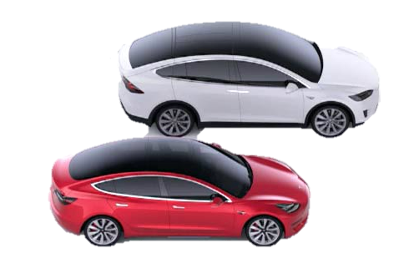

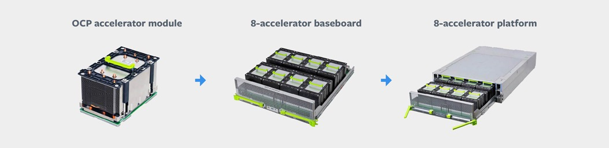

Market Forces + Physics =
Liquid Cooling
Lifesaving Medical Technology as well as weather and climate modeling push the scale of high performance computing
ADVANCED COOLING SOLUTIONS
Autonomous mobility and Fintech demand more compute exponentially year on year
Consumer products driving machine learning both in the data center and to the Edge
Liquid cooling enables continued progress in compute and technology
IT rises to the challenge, driving compute and power density at the chip
Latency limits drive density at the rack and data center
Costs to cool with air go up exponentially with increased density
Notes:
Tim

Slide 4

A Solution for Today’s Data Center
ADVANCED COOLING SOLUTIONS
The Challenge:
Many existing data centers need to incorporate higher chip powers and rack densities …
… but they don’t have the infrastructure to provide water to the racks
Notes:
Resul

Slide 5
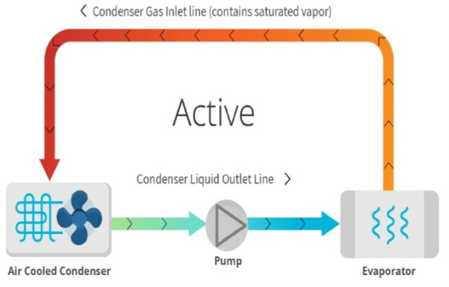
A Solution for Today’s Data Center
ADVANCED COOLING SOLUTIONS
Solution:
Two-Phase, direct contact cooling
Single – Loop, Low Pressure, on Demand
Immediate response Time
Non-conductive liquid
Notes:
Resul

Slide 6

A Solution for Today’s Data Center
ADVANCED COOLING SOLUTIONS
Notes:
Resul

Slide 7
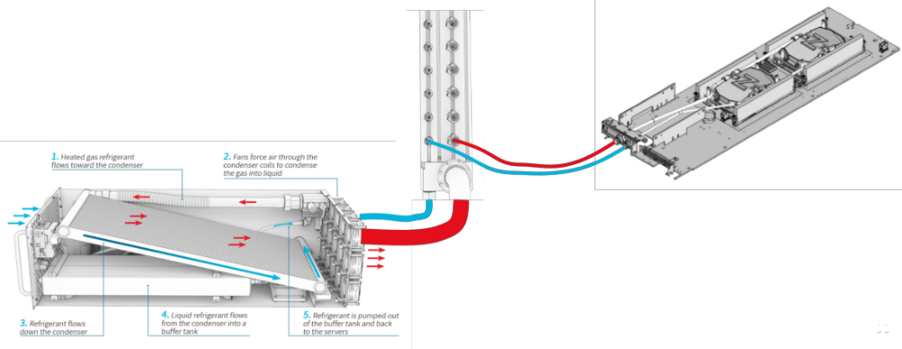
A Solution for Today’s Data Center
ADVANCED COOLING SOLUTIONS
Solution:
Efficiently collect heat from dense chips and servers and reject that heat to existing data center air cooling systems
Collect heat efficiently by boiling a low-pressure liquid refrigerant at 50 ºC
Reject heat efficiently to air by condensing the low-pressure refrigerant vapor at 50 ºC
Notes:
Tim

Slide 8
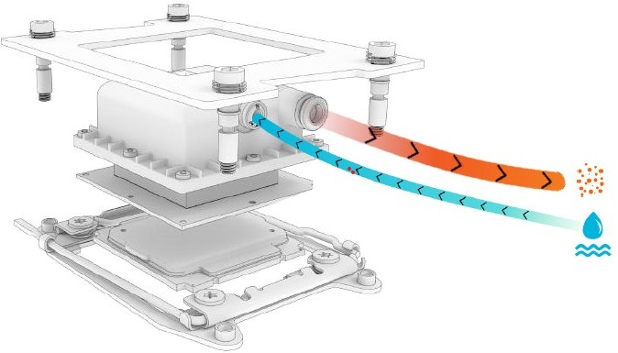
A Solution for Today’s Data Center
ADVANCED COOLING SOLUTIONS
Enhanced Nucleation Evaporator - ENE:
The ENE is installed directly on the hot component
Liquid refrigerant flows into the ENE and evaporates using the heat from the cooled component
Heat is transfers to the external heat rejection unit (HRU) via the vapor coming out of the ENE
Notes:
Tim

Slide 9
A Solution for Today’s Data Center
ORV3 combined with RDA (Rear Door Air)
ORV2 combined with 6HRU-A (Heat rejection Unit Air)
ADVANCED COOLING SOLUTIONS
Roll this solution into existing data centers without modifying infrastructure
No Water connection needed
Scales to high chip package powers (750+ W) and rack densities (up to 55 kW)
Notes:
Resul

Slide 10

OCP V3 Cooling, Door HEX Step 3
ORV3 combined with RDA (Rear Door Air)
Rear Door HEX, Air to Air Cooling unit
55 kW total Cooling Capacity
Airflow: ~3000 – 8830 m³/h
Inlet air temp for secondary device cooling: 86 °F
Outlet Air temp: 115 °F (max)
Fluid stays constant at about 122 °F no matter the load
Notes:
Resul

Slide 11
Call to Action
How to get involved:
https://ocp-all.groups.io/g/OCP-ACS-Door-Heat-Exchange
Link Bi-weekly call
https://global.gotomeeting.com/join/600541373
Project Wiki with latest specification:
https://www.opencompute.org/wiki/Rack_%26_Power/Advanced_Cooling_Solutions
Mailing list: https://ocp-all.groups.io/g/OCP-ACS-Door-Heat-Exchange
Notes:
Resul

