Slide 2

Air-Assisted Liquid Cooling: Cold Plate Enablement in Air-Cooled Facilities
Husam Alissa, Sr. Engineer, Microsoft (hualissa@microsoft.com)
John Fernandes, Thermal Engineer, Facebook (jfern@fb.com)
Cam Turner, Director, CoolIT Systems (cam.turner@coolitsystems.com)
Rack & Power
Notes:
Sam

Slide 3

Driving Factors
  Component power and density pushing limits of air-cooling
      Driven by use-case/application
  Current hyperscale DC designs
        Maximizes cooling efficiency
        Count > 500 as of 3Q19 [1]; large proportion designed for energy-efficient air-cooling
  Facility water integration may not be as rapid as component power/cooling trends
      Differing impact of enabling facility water between greenfield and existing facilities
      Trends in specific components will be outlined in MSFT presentation
[1] - https://techblog.comsoc.org/2019/10/19/synergy-research-group-hyperscale-data-center-count-500-as-of-3q-2019/
Notes:
Sam

Slide 4
Evolution of Air-Cooled DCs
Water/Air Cooled Chillers
Chiller+ Eco Mode
Indirect Evap
Direct Evap
PUE
WUE
Capex
Opex
Maintenance
Air Quality
Reliability
Climate
Notes:
Sam

Slide 5
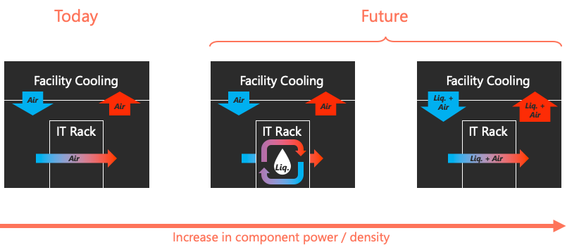
Stretching Limits
Extend life of air-cooled facilities & permit smooth transition
Air-assisted Liquid Cooling
Notes:
Sam

Slide 6
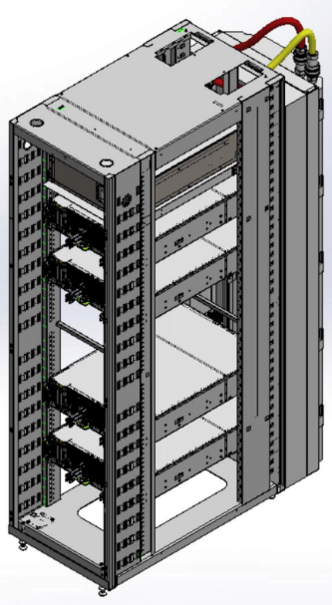
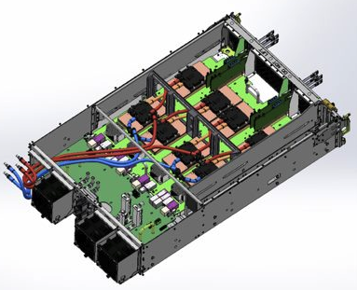
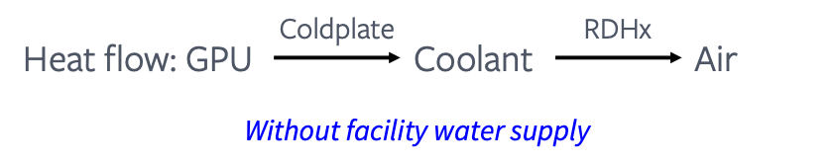
Case Study
Modified CDU
ORv2
GPU shelf
Rear door HX
Adapter frame + manifolds (hidden)
Compute sleds + blanking pizza boxes not shown
Notes:
John

Slide 7
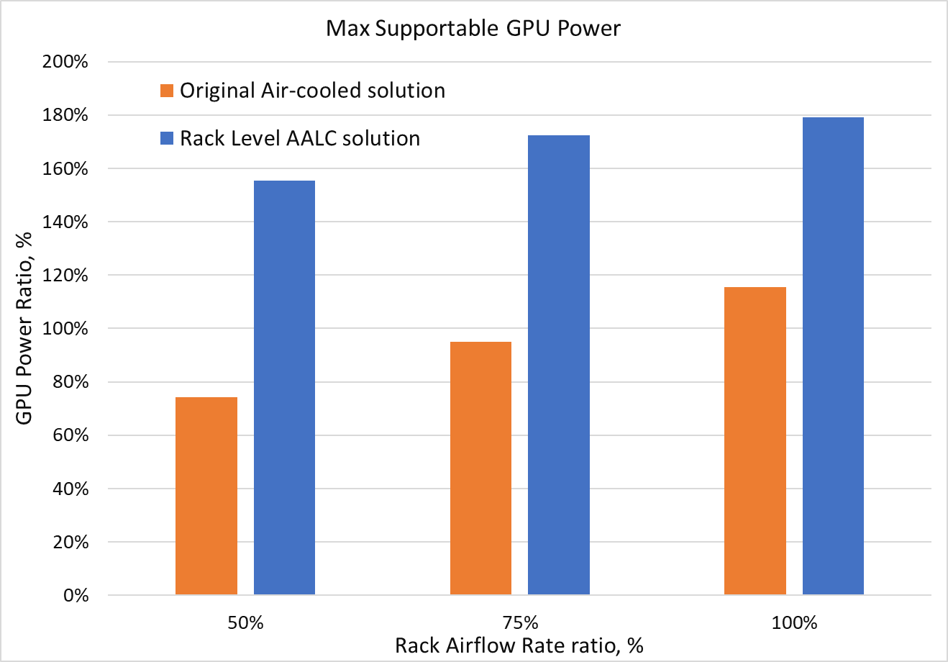
Case Study: Performance
Promising: +50% power compared to original air-cooled solution
Notes:
John

Slide 8
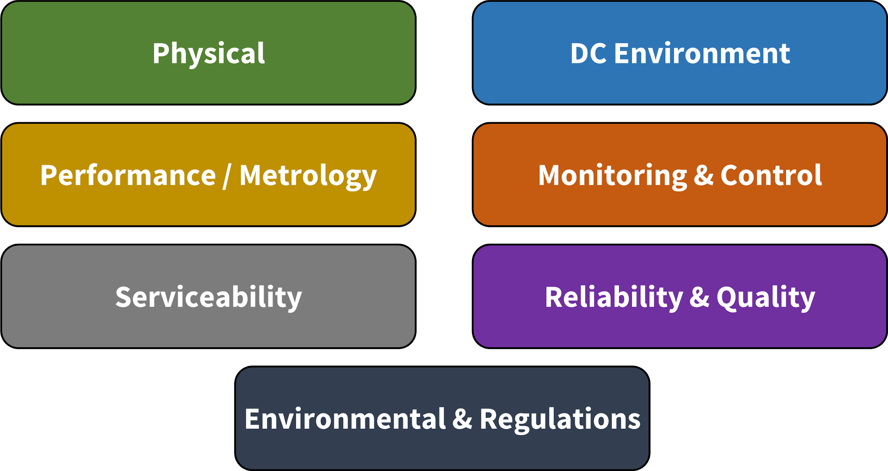
Alignment: ACS Door HX Sub-Group
Specification being updated with community
Notes:
John

Slide 9
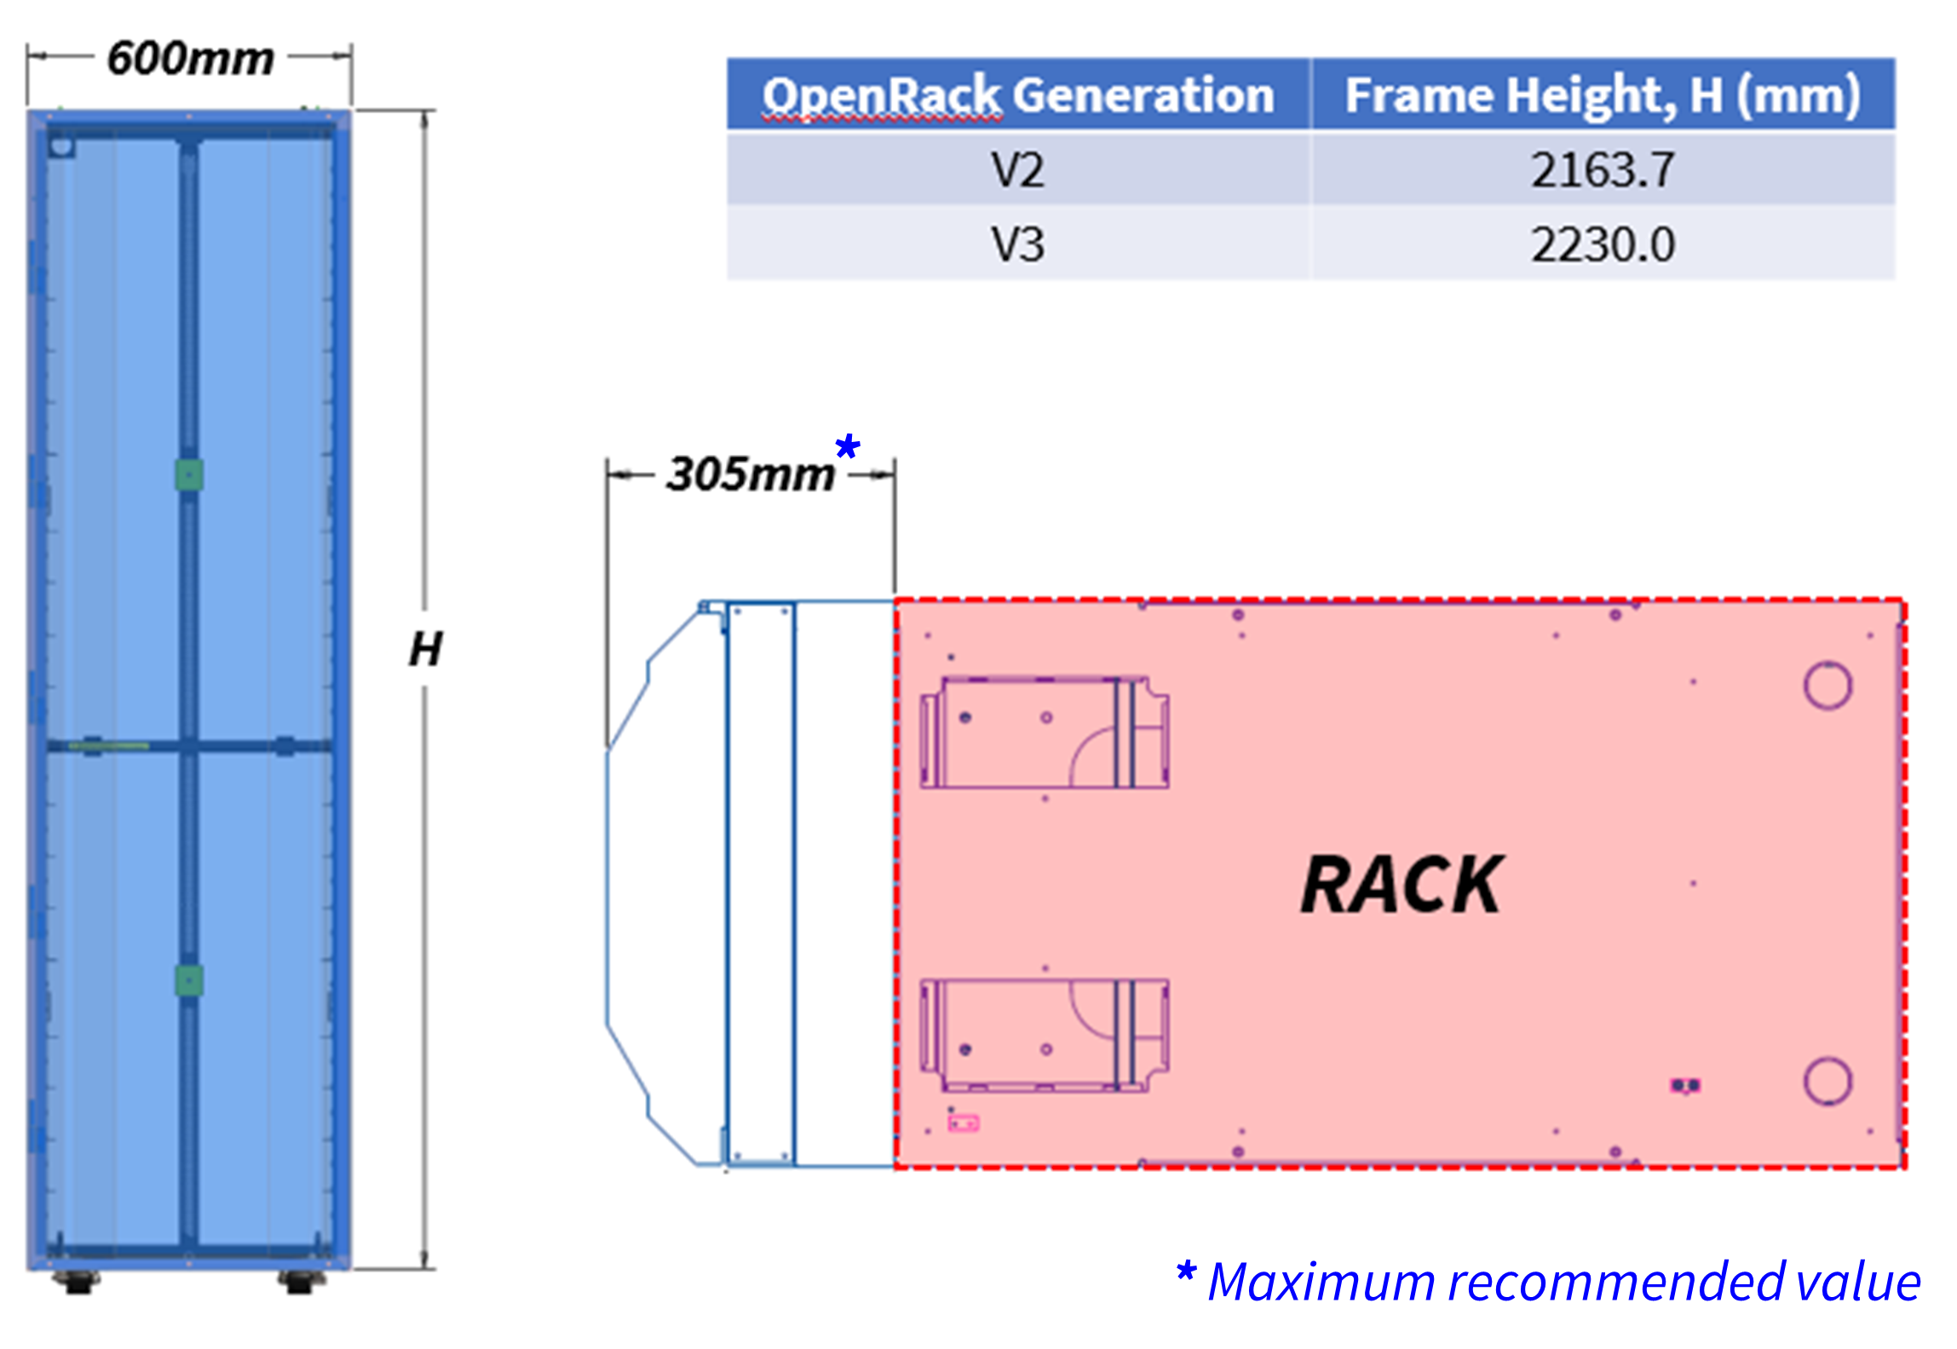
ACS Door HX: Specification
Physical
Notes:
John

Slide 10
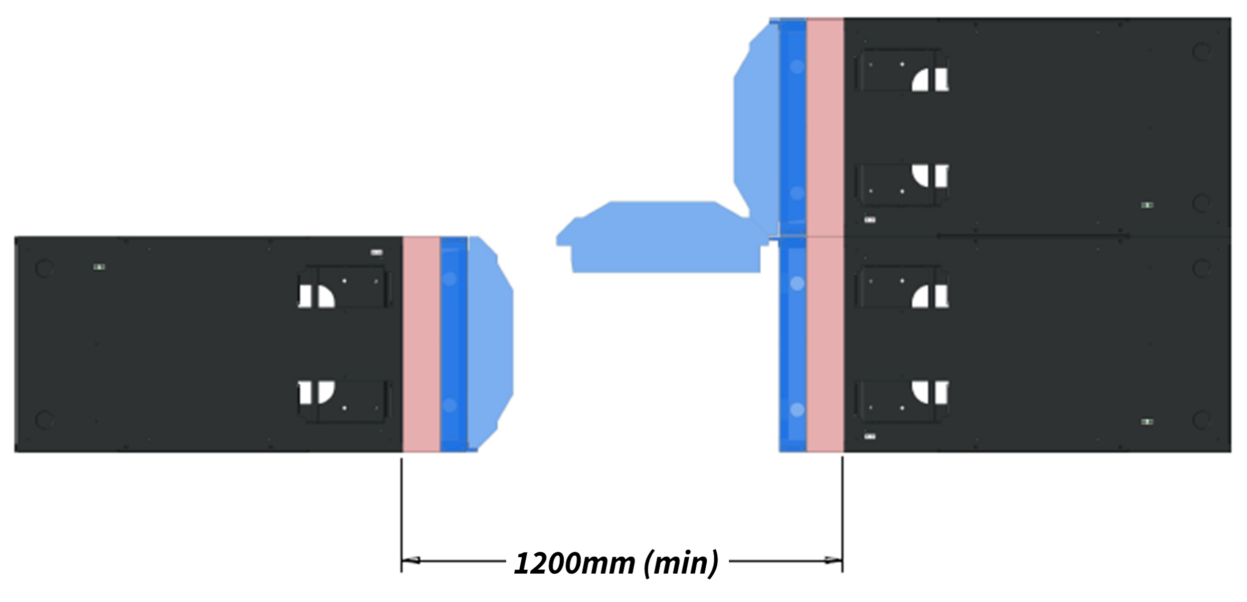
ACS Door HX: Specification
                Weight (with coolant): ≤ 100kg (preferred); ≤ 150kg (maximum)
                Hinged solution should permit opening of door by 90°
Physical
Notes:
John

Slide 11
ACS Door HX: Specification
                For active variant, N+1 rotor redundancy is a must
                Face area of heat exchanger within supporting frame should be maximized for performance and minimal back-pressure
                Low air-side pressure drop to minimize impact to server fans
                ΔP of passive cooler ≤15Pa at rated air flow
                Total power consumption should be ≤2% of rated heat rejection capacity
                Low water-side pressure drop to minimize impact to facility
                ΔP of complete cooling assembly ≤100kPa at rated coolant flow rate
                Coolant supply pressure: ≤600kPa (nominal); ≤1000kPa (max. allowable)
Performance/Metrology
Can be directly leveraged to enable AALC
Notes:
John

Slide 12
ACS Door HX: Specification
                Sensors, alarms and control loop types have been outlined
                REQUIRED
                OPTIONAL
                REDFISH mockup being prepared for review; structure and sensor definitions
Air Temperature, In * | Fan Speed **
Air Temperature, Out * | Number of Fans Installed **
 | Total Input Power **
Monitoring & Control
Air Differential Pressure ** | Water Flow Rate
Water Temperature, In | Water Pressure
Water Temperature, Out | Humidity
Can be directly leveraged to enable AALC
* More than one sensor preferred
** Specific to active door HX only
Notes:
John

Slide 13

ACS Door HX: Specification
                PRESSURE / LEAK TESTING
                Checks at manufacturer (required)
                Pressure decay method
                Checks at integrator or end-user (recommended)
                Leak detection in operation (recommended)
                AIRFLOW SEALING
                Sealing of adapter frame/door to rack; within rack is equally critical
Leak definition (seal quality) | Helium leak rate (mbar.l/s)
Water-tight | 10⁻²
Vapor-tight | 10⁻³
Bacterial-tight | 10⁻⁴
Fuel-tight | 10⁻⁵
Virus-tight | 10⁻⁶
Gas-tight | 10⁻⁷
Insulator seal-tight | 10⁻¹⁰
Reliability & Quality
Can be directly leveraged to enable AALC
Notes:
John

Slide 14
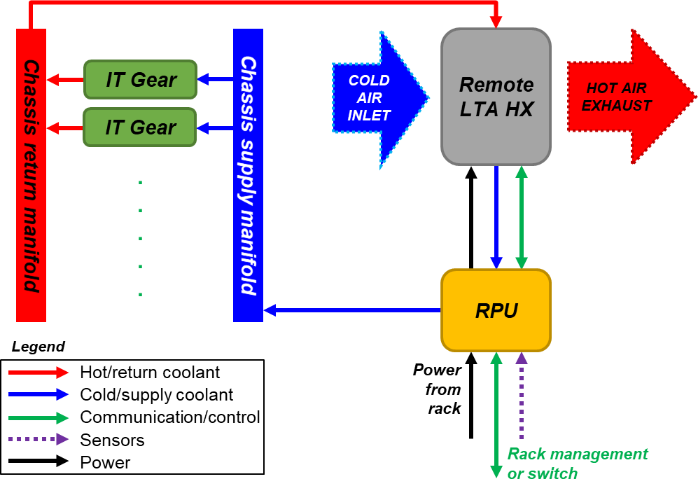
AALC: At-a-Glance
Generate above-ambient temperature coolant for LC needs
Reservoir and pumping unit (RPU): Standardize & optimize (performance and cost)
Liquid-to-air heat exchanger (HX): Flexible, optimized for performance/efficiency & reduced overhead
Notes:
John

Slide 15
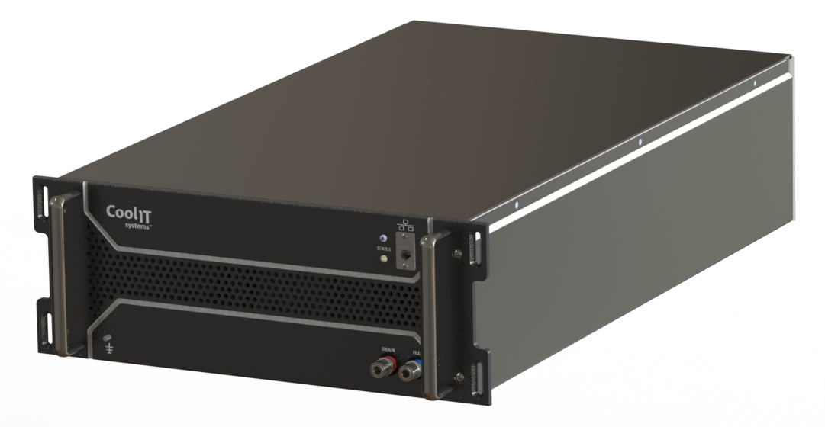
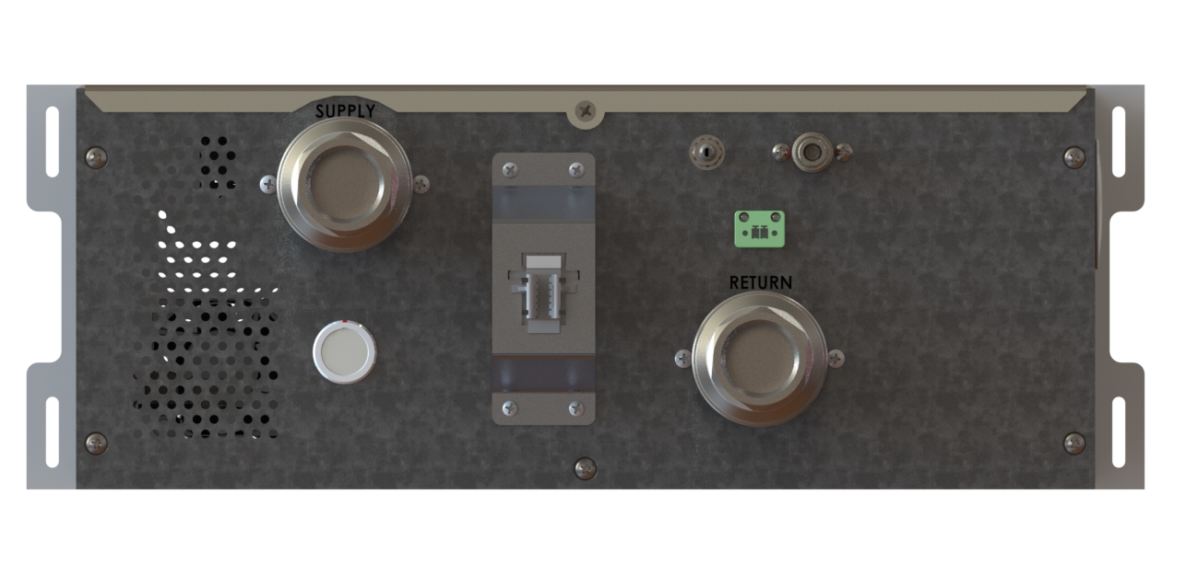
Reservoir and Pumping Unit
  4RU chassis designed to fit in 19” Rack
  Compatible with ORv2 and ORv3 racks using an adapter frame
  Cost optimized for AALC solution
  Standardized electrical and liquid connectors (TBD)
  Standardized controls and reporting interface for rack level / data center level management systems (TBD)
Notes:
Cam

Slide 16
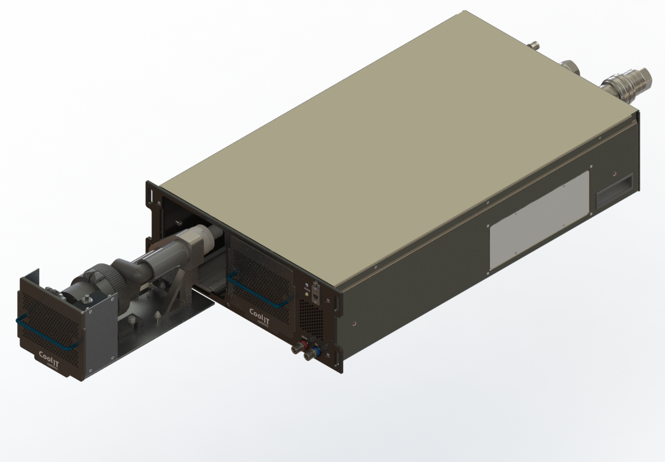
Reservoir and Pumping Unit
  Hot-swappable, N+N redundant pump design
  Strong pumps capable of higher pressure requirements of AALC system
  48VDC (ORv3), 12VDC (ORv2), 110/230 VAC (Olympus) variants
  Supply power to Remote Liquid-to-Air HX (VDC)
  Controls and monitors the Remote Liquid-to-Air HX
Notes:
Cam

Slide 17
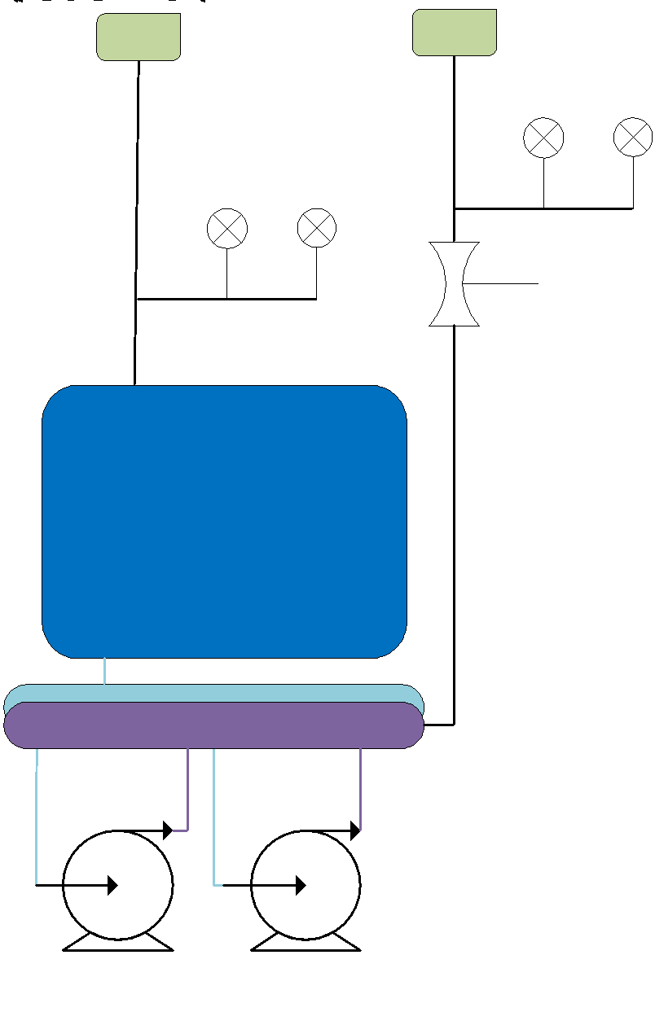
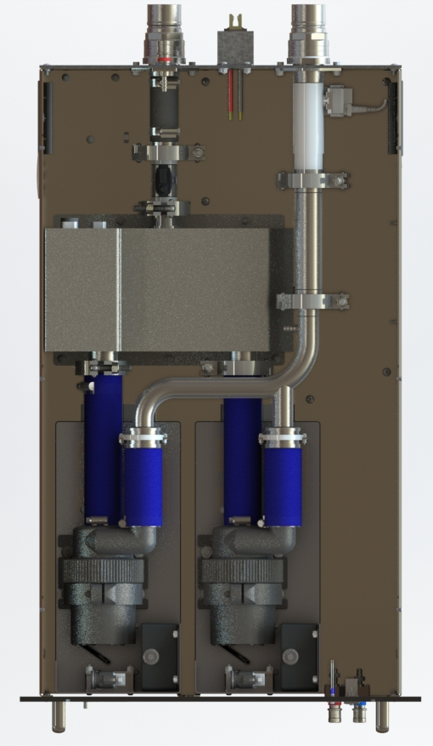
Reservoir and Pumping Unit
  20 – 70 L/min
  Consumes ≤5% of rack IT power (including LTA HX)
  Internal telemetry includes: coolant temperature, pressure, flow meter, reservoir level, leak detection, power consumption, pump speed
  External telemetry includes: fan control and tach, multiple zone air temperature, coil differential pressure
Notes:
Cam

Slide 18


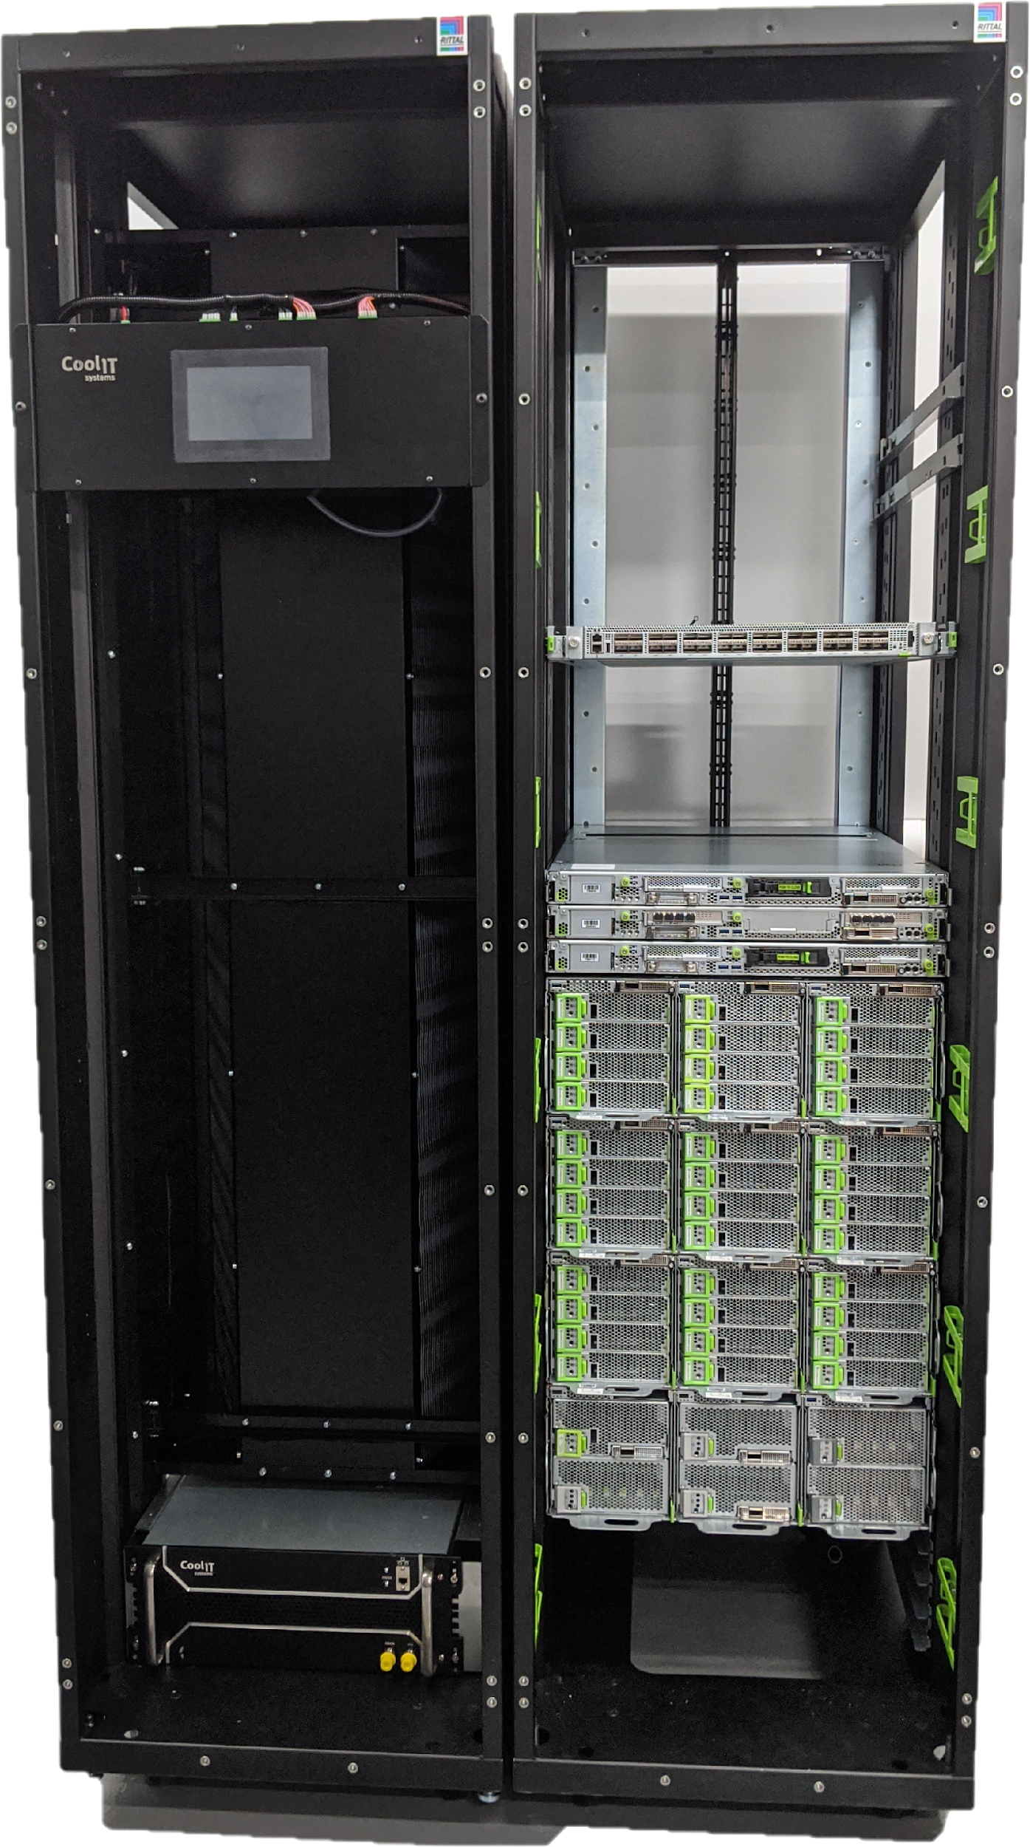
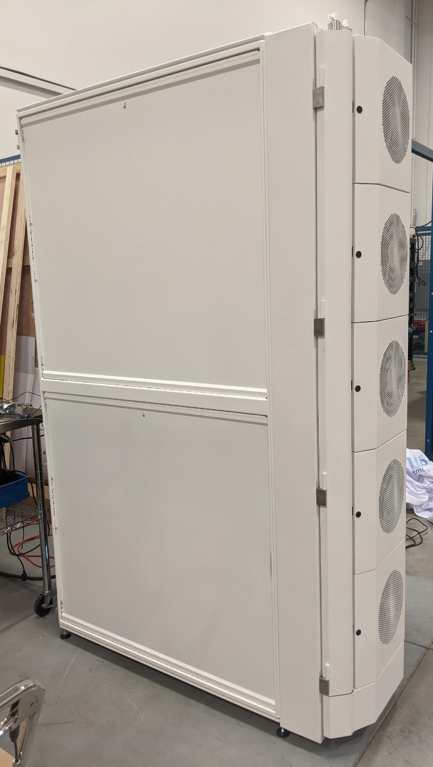

Facebook & Microsoft Demos
Adjacent Rack LTA HX
Rear Door LTA HX
Notes:
Cam

Slide 19
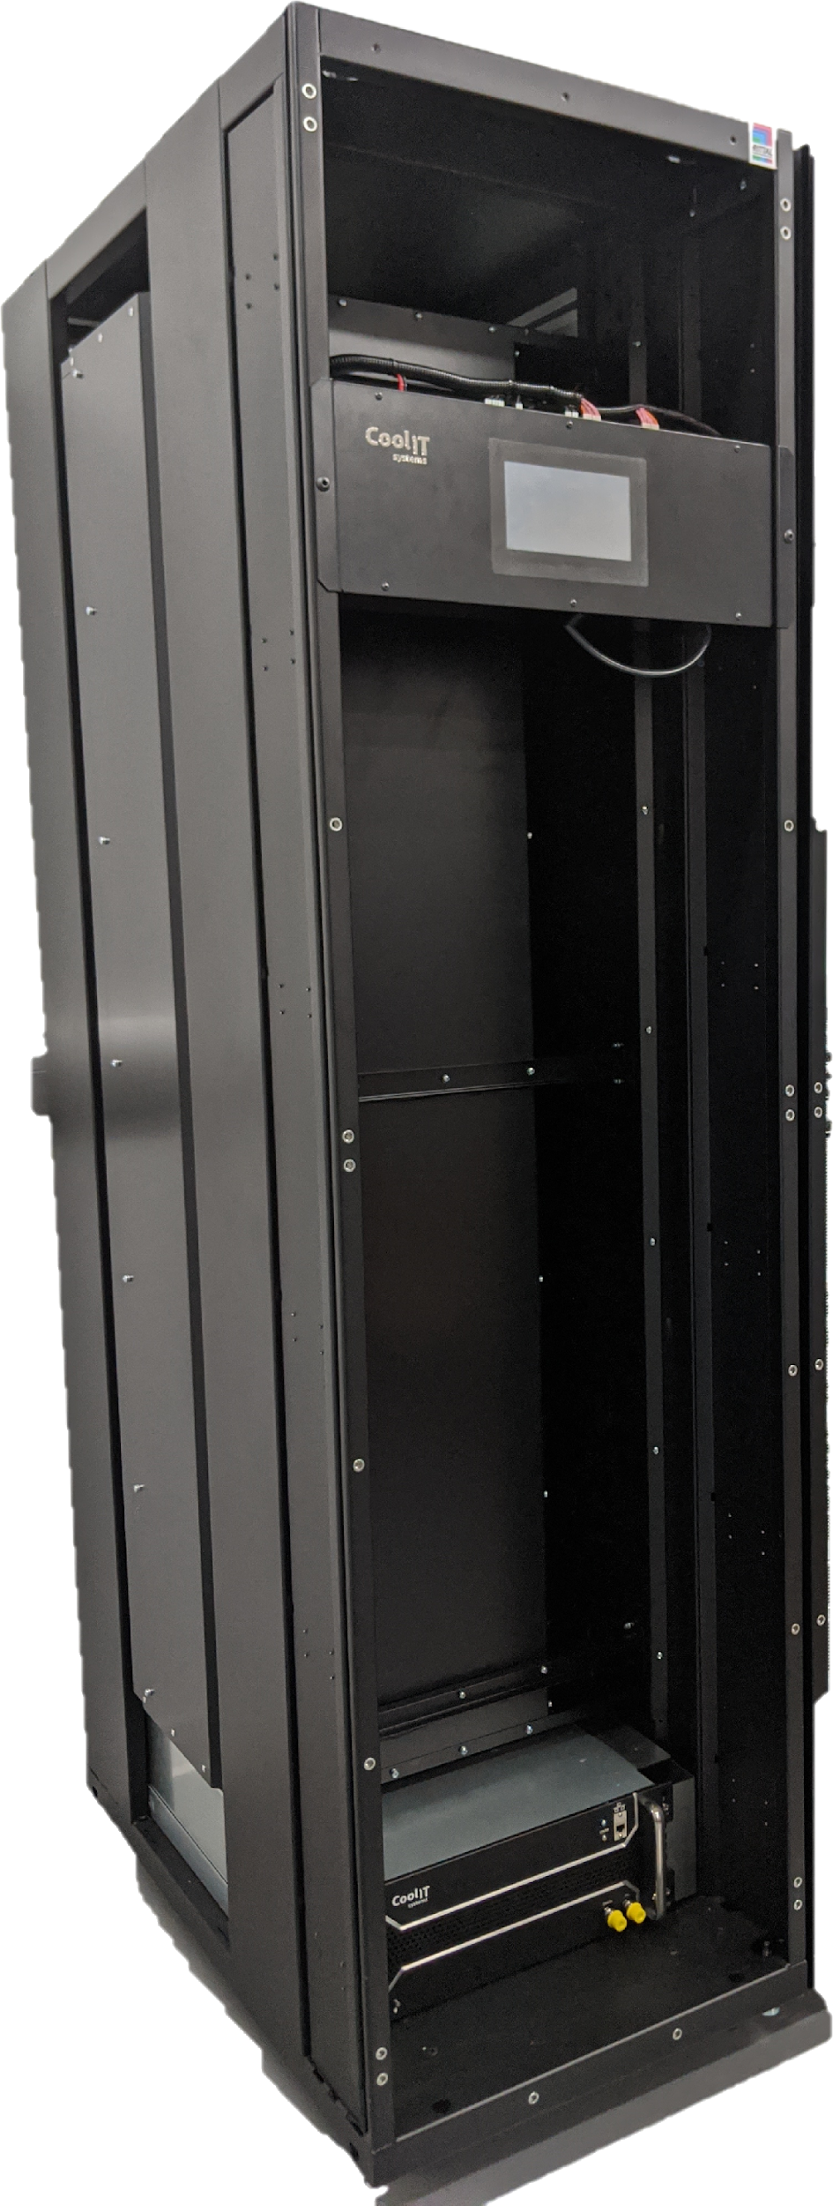
Commentary
Door HX vs Adjacent Rack HX
Airflow
Control
Preheat
Flexibility
Serviceability
Deployment
Notes:
Sam

Slide 20
Call to Action
Create robust ecosystem of solutions through community engagement
                Standardization of Door HX, manifolds, pumps, coolants
                Consistent guidelines of deployment, serviceability, control
                Vendor and end-user collaboration on monitoring
                Leakage and risk mitigation
Where to find additional information (URL links)
ACS wiki : https://www.opencompute.org/wiki/Rack_%26_Power/Advanced_Cooling_Solutions
ACS mailing list: https://ocp-all.groups.io/g/OCP-ACS
ACS Door HX mailing list: https://ocp-all.groups.io/g/OCP-ACS-Door-Heat-Exchange
ACS Cold Plate mailing list: https://ocp-all.groups.io/g/OCP-ACS-Cold-Plate
Notes:
Sam

