Slide 2
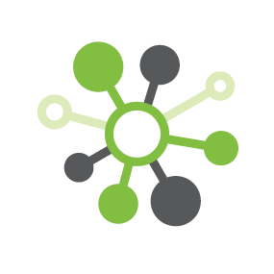
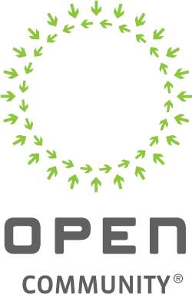
Re-imagining the Multi-tenant DC Gateway Router using Open Whitebox Switches
Andreas Falkner, Sales Engineering Director EMEA, Pluribus Networks
NETWORKING

Slide 3
NETWORKING
This presentation is discussing an alternative way to build cost-efficient high performance multi-tenant routing for cloud interconnect with whitebox switching

Slide 4
New Bandwith Requirements ahead
Hyperscale Public Cloud, AI and Edge Computing in 5G Era
Adoption of 5G , AI, and Edge Computing will drive new expectations for
  Always-on
  Low latency
  High quality network
  High-performance, cost optimized
  Services
Leads to operational efficiency (OPEX reduction) and boost intelligent applications
Routing requirements from regional public cloud providers, managed service providers, private cloud hosts and colocation providers to hyperscale public cloud providers and internet service providers
To honor the promise with the right CAPEX it is vital to have the proper compute infratructure in place, aligned to the right strategy like
OPENESS - WHITEBOX – DISAGGREGATION - WHITEBOX
NETWORKING
Notes:
With the rise of hyperscale public cloud providers and the growing importance of direct interconnection has come a simultaneous demand to enable high-performance yet cost-optimized routing from regional public cloud providers, managed service providers, private cloud hosts and colocation providers to hyperscale public cloud providers and internet service providers. In many cases, these regional providers host many tenants on their infrastructure or in their facilities and need to provide this interconnect routing on a per-tenant basis.

Slide 5




OPEN – DISAGGREGATED NETWORKING
Fabric Manager
Management, Automation
Orchestration
Analytics
Monitoring + Analytics Platform
NETWORKING
Telemetry
Every Port, Every End Point, Every Flow
Integrated TCP Flow visibility
without separate probes and without packet brokers
SDN Fabric
SDN Cloud Adaptive Fabric
Multi site overlay, Network Slicing, Virtual Wires
Distributed SDN Fabric for unified control and
provisioning of fabric services across multiple sites
Network OS
Feature Rich Layer 2/3/VXLAN Switching
NOS
L2/L3 NOS based on open, standard protocols
for easy insertion in brownfield networks
and into any existing topology (incl. rings)
OCP compliant Bare Metal Switch

Slide 6

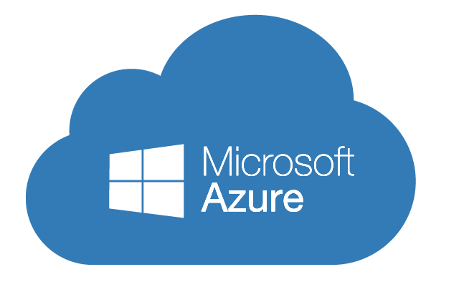


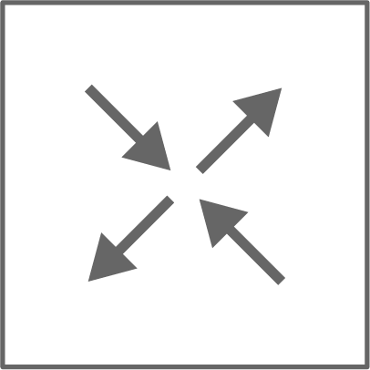
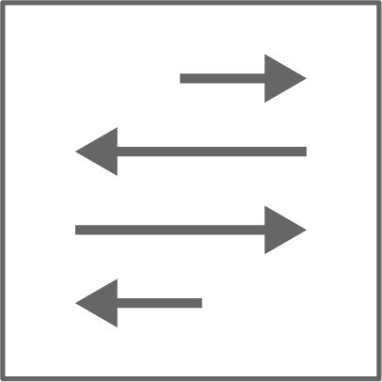

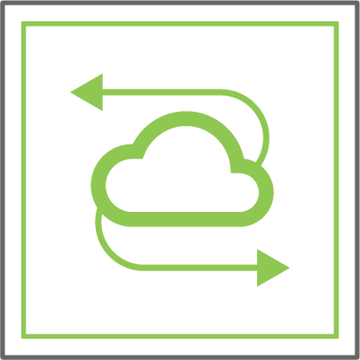
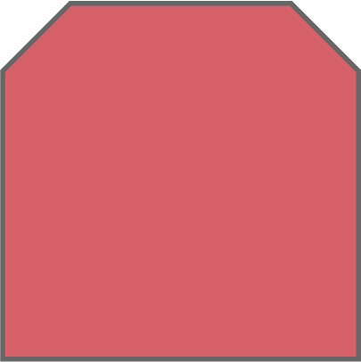
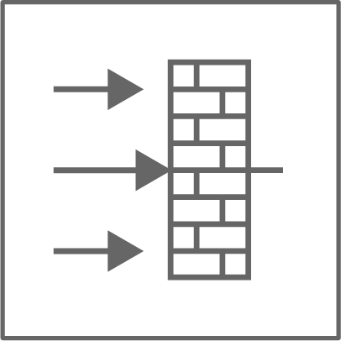
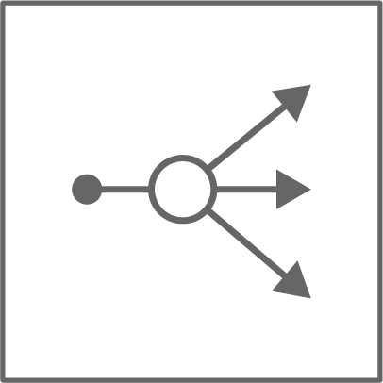
Typical DC architecture
ISP 1
ISP N
Nx10/100GE
Data Center Facility
DC Gateway Routers
For North-South Traffic
Require high BW pipes to public cloud providers, N x 10G/100G
Today typically internet routers w/ custom ASICS
Lots of memory to hold the entire internet routing table
Spine
DC_GW
DC_GW
Leaf / TOR
Border leaves
(no compute)
Firewall
Load Balancer
Notes:
Filter routes according to your geography
When you travel – do you carry an atlas or do you use a local map ?
800000 prefixes in Internet routes

Slide 7
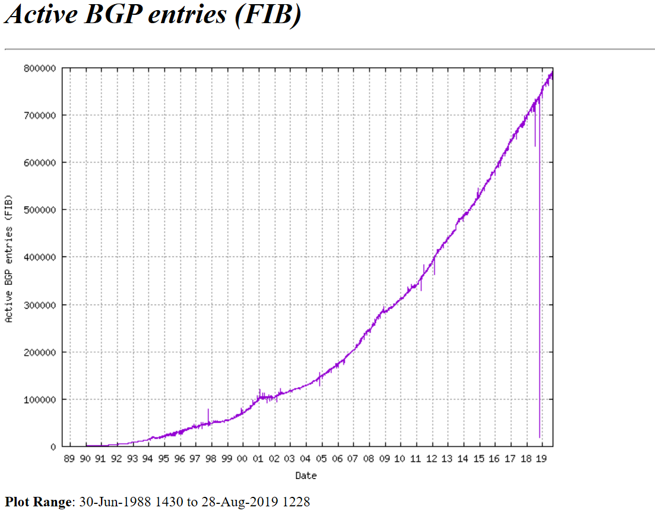
Internet Routing table approaching 1Mio entries
Currtn DCGW Routers designed to handle full internet table ~800K routes
DCGW needs <10K routes
https://www.cidr-report.org/
Notes:
typically only need a default route to the hyperscaler over a private connection”. Or you can verbalize that point. Basically with the increasing trend to go with Microsoft Azure Express Route, AWS Direct Connect, etc and the fact that you are connecting to a

Slide 8
Problem with current DC GW Routers –
Expensive, Thousands of features, lots of memory
Question:
If we are only using a small number of routes per tenant to interconnect to public cloud or ISP do we need a specialized internet router with full route table?

Slide 9
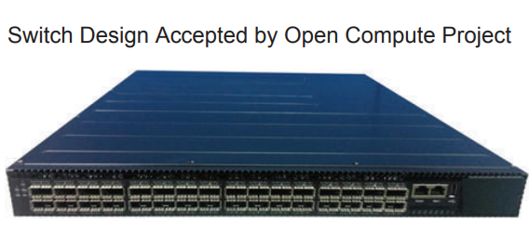
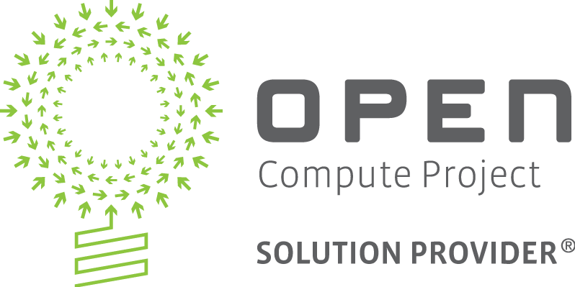
A white box with additional memory could hold enough routes to serve in this role
Example using a white box typically positioned for spine
Tomahawk 32 x 40/100GbE or 128 10/25GbE
Higher powered processor like Intel Xeon D-1518 quad-core 2.4GHz
Bit more memory than usual
  32GB RAM
  1x64G SSD
  2x10G internal NIC
Enough to support up to 128K routes, plenty for DC GW
Very cost effective

Slide 10
Next-Gen Whitebox Switch Architecture Leveraging Server Design Elements
CPU Module
Powerful multicore x86 CPU Xeon architectures
2 x 10 Gig Lanes is an OCP Design
Rear-facing NICs to improve the control plane bandwidth for multiple vRouter instances
High speed lanes used efficiently - Analytics, Routing and Firewall (offload IPSec)
Onboard solid state storage to host third party services in containers or KVM
Baseboard management controller (BMC)
Trusted platform module (TPM)
FLASH
BMC
SSD
DDR
TPM
Multi-core x86
PCIe
2 x 10G - high speed lanes
Switch ASIC
Whitebox Switch Architecture
32x100G / 1U
Notes:
128k of Virtual Routers (!!) – normal 5-10 vRouter deployments
CPU and y memory could provide us Z number of vRouters (estimating for instance w number of BGP+BFD connections)
Rear-facing ports could be used for adding extra-bandwidth for control-plane packets that need to reach the CPU
Advanced CPU Protection mechanism can be implemented, which mixed with the containerized approach, provide a super secure and segmented control-plane

Slide 11
Most data center operators and cloud providers have multiple tenants running on their infrastructure. Today we use VRFs for isolation.
Question:
Can we provide better isolation / network slicing?

Slide 12
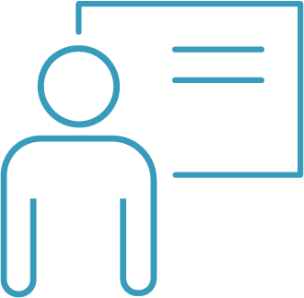


Multi-tenancy with VRFs
ISP 1
ISP N
Tenants
Nx10/100GE
Multi-tenancy
Multiple tenants running on shared network infrastructure
N-S isolated via L3 VRF at data plane
E-W data typically isolated via VLAN or VXLAN at data plane
VRF
VRF
VRF
VRF
VRF
DC_GW
DC_GW
VRF
VRF
Hosting DC
Notes:
Show colors for the vRouters – each a different color
Explain vRouters
Control & Management plane isolation
Linux, Container based
Highlight our VNET and slicing, show VNET on gateway as local object, dedicated port or subport per customer – up to 128 uplinks
– 1 VNET maps to each vrouter

Slide 13
Our approach:
Dedicate distinct containers running a FRR stack to each tenant to provide a deeper level of isolation, flexibility and security; these routing instances could then be sliced once again by the use of traditional VRFs.
This approach could still makes full use of the cost-effective merchant silicon switches, allowing hw-based routing at Tbps speed

Slide 14




Routing Multi-Tenancy by running independent FRR stacks in dedicated Containers (vRouters)
Orchestration / Automation
FRR based vRouters running in distinct containers ensuring full isolation among tenants
Wirespeed L3 routing – up to ~128K L3 LPM routes in merchant silicon
Enhanced control plane bandwidth and segmentation
Support 3rd party virtual services,
e.g. t-shark/wireshark for packet capture
Tenant_1
Tenant_X
Network OS
Standard features
Tenant_2
3rd party Apps
eg: vFW
PCIe
10G
10G
32 x 100G ports wire-speed routing with high scale multi-tenancy in one rack unit, at a fraction of the cost of a router blade
Linux-based OS
Whitebox Switch Architecture
32x100G / 1U
Notes:
Each Tenant’s N/S routing can be served by a distinct container/containers (vRouters)
Tenants’ routing could have full distinct attributes (protocol, parameters)
The containers (vRouters) could be provisioned and destroyed with zero effect on the other Tenants
Limits can be imposed on the resources allowed to one or another container (vRouter)
Each vRouter could be segmented one more time by internal “traditional” VRFs

Slide 15
Multi-tenancy via vRouter
ISP 1
ISP N
Tenants
Nx10/100GE
vRouter Approach
Leverage higher power merchant silicon to support a large number of vRouters
Fully isolated data, control & mgmt plane per customer for N-S traffic
Per tenant API – bring any tool
Easy to provide per-tenant portal
VR
VR
VR
DC_GW
DC_GW
VR
VR
VR
Hosting DC
Notes:
Show colors for the vRouters – each a different color
Explain vRouters
Control & Management plane isolation
Linux, Container based
Highlight our VNET and slicing, show VNET on gateway as local object, dedicated port or subport per customer – up to 128 uplinks
– 1 VNET maps to each vrouter
IPSEC tunnel connection
Limited route capacity - route filtering (!!) – dedicated slide ?
Analytics – BGP filtering table created – dynamic - automatic filter - configure default routes …
se sFLOW - the data can be more easily parsed and code is already available for most of it
The way it would work is, you download the entire table in software (RIB) and have a default route present and then download subnets once every few days to reach a Max of 50-80% of utilization of the TCAM
You could even expose this via UNUM and make this a very fancy Internet/SD-WAN router….You could make this work on even Dell Switches

Slide 16
How does this apply in a mixed hosted-public cloud environment, where the infrastructure needs to be sliced and shared by a high number of tenants?

Slide 17
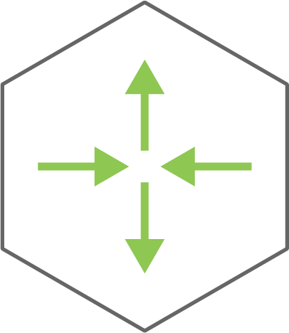
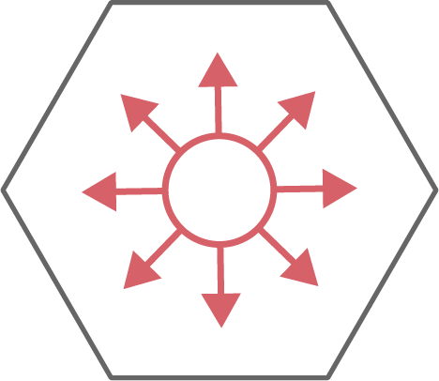
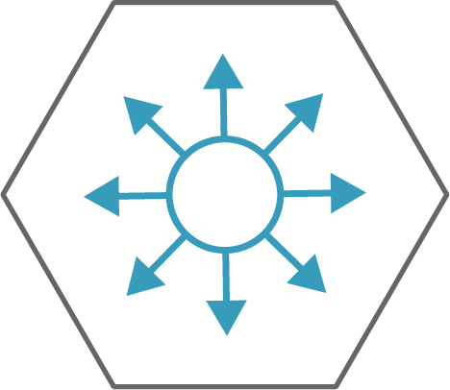
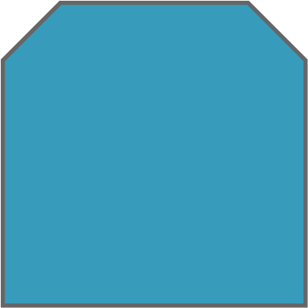
“Hardware vRouter” Based Multi-tenancy for DC Gateway Service
ISP_1 router
ISP_2 router
ISP_N router
ISP_1 router
ISP_N router
BGP
BGP
DC_GW
DC_GW
NOS
NOS
VLAN, MLAG, LLDP, REST, ACLs, etc
VLAN, MLAG, LLDP, REST, ACLs, etc
Ubuntu
Ubuntu
Tenant _1
Tenant _X
Distinct containers running FRR stack with traditional VRFs inside
Notes:
Local ISP - ISP last mile reachability

Slide 18
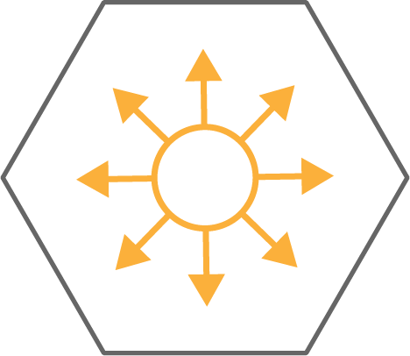
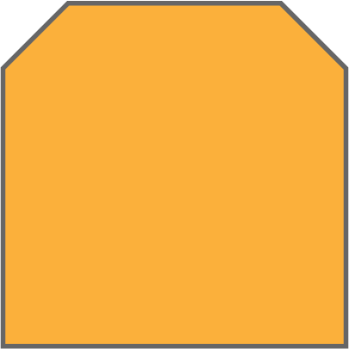
Edge Computing Environments: Cost, Space, Power at a Premium
Collapsing the DC Gateway in the Switching Fabric
ISP_1 router
ISP_2 router
ISP_N router
ISP_1 router
ISP_N router
BGP
BGP
NOS
NOS
Ubuntu
Ubuntu
Tenant _1
Tenant _X
Distinct containers running FRR stack with traditional VRFs inside
Distributed VRFs for E/W traffic inside the DC
Notes:
Smaller deployments
Smaller sites
- NFVi Ercsson ?

Slide 19
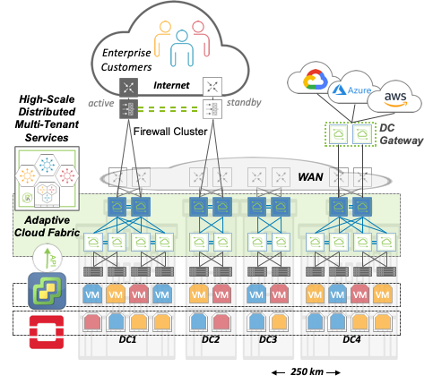
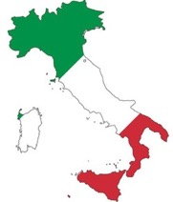
CSP/MSP: Italy
“360-degree digital transformation” services
€3B revenue – 18 countries – 40 years experience
Any Cloud, Any Service
Pricate Cloud
+ public clouds
Comprehensive
Multi-tenant Slicing
Data – Control – Management
4 DCs expanding to 6
“The programmability, performance and economics of our software-defined infrastructure is critical to our success and the foundation of our customer experience.”
VMware, OpenStack
Notes:
Paolo Bombonati, COO of Econocom International Italia, which recently launched the Naboo Cloud, says this: “We already have a Pluribus leaf and spine network deployed across four distributed data centers, expanding to six, with full network slicing for east-west traffic. With the addition of the white box multi-tenant data center gateway router, we can now increase our footprint while delivering better control and security at a lower price to our customers – making us more competitive in the market.”

Slide 20
Conclusions
Radical Economics $/Gbps
By leveraging whitebox switching based on merchant silicon and open networking software, it is possible to build wirespeed hardware vRouters for a fraction of the cost of conventional hardware.
Tenant Routing Improved Isolation and Security
Dedicating independent tenant containers for the routing function on the data center gateways, with strict control of allocated resources, provides a new level of security and isolation among tenants sharing the same infrastructure.
Tenant Routing Improved Flexibility
By having completely isolated routing instances, each tenant has full freedom in provisioning/updating/terminating its own connectivity method to the desired providers with no constraints (overlapping IP space, BGP AS numbers, etc.).
Ideal for Edge Computing Environments
When cost, power and space are at a premium, collapsing the DC gateway in the switching fabric is now an option with whitebox switches.
Improved Mobility
The containerized routing instances could be also migrated from one physical box to another, opening the way for more efficient methods of replacing/upgrading the hardware or even the whole topology.

Slide 21
Call to Action
Product specifications
https://www.pluribusnetworks.com/products/white-box-multi-tenant-data-center-gateway-router
Blog
https://www.pluribusnetworks.com/blog/
Where to find additional information
https://www.pluribusnetworks.com/blog/improving-network-performance-and-lowering-costs-for-managed-service-providers-and-cloud-service-providers/
My contact details
Andi.Falkner@pluribusnetworks.com

