Slide 2


Ampere for the openEDGE
Shannon Hollas
Senior Director Worldwide Business Development
Ampere Computing
openEDGE

Slide 3
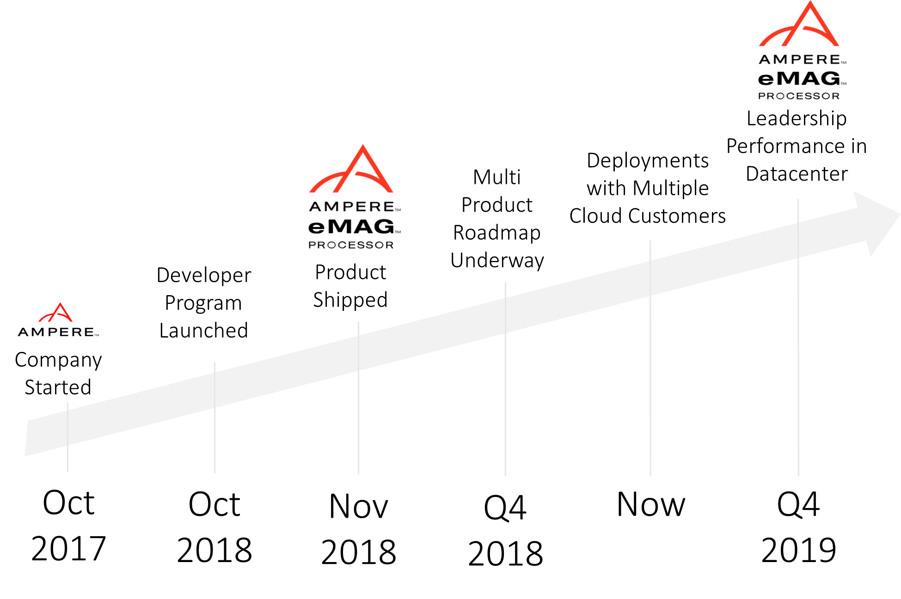
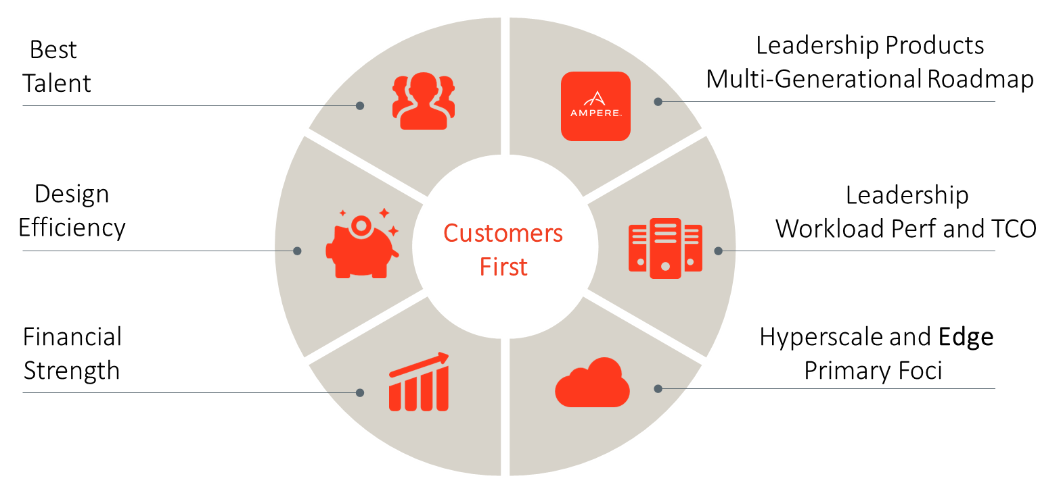
Ampere Overview
We are a passionate, experienced team committed to building & delivering what comes next for Cloud and Edge Computing

Slide 4
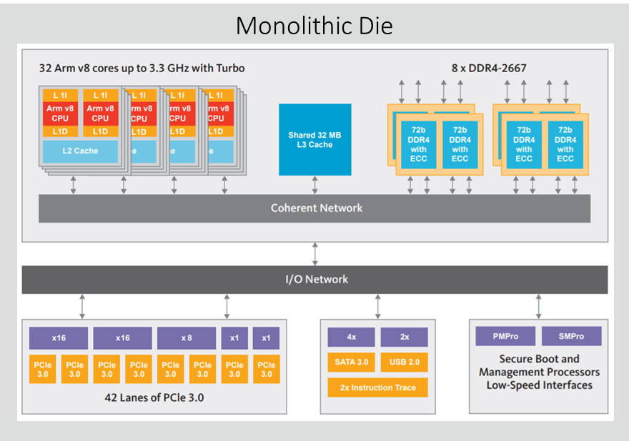
Ampere Arm v8 Processors
eMAG delivers High Performance CPU, Memory and I/O in Low Power Solutions
eMAG
32 Ampere-designed 64-bit Armv8 cores running at consistent 3.3 GHz
8 DDR4-2667 memory controllers maximize memory bandwidth
Ampere eMAG2
Node: 7nm
More Cores, Memory Bandwidth, IO
Higher power efficiency across wider TDP range
Ampere eMAG++
2018
2019
202x
202x
Ampere eMAG™
Node: 16nm
Ampere eMAG+
eMAG SKU | Cores | TDP | SPECrate2017_int_base est.*
8140 | 16 | 75W | 34
8180 | 32 | 125W | 60
42 lanes of PCIe 3.0 enable networking and storage for Telco / Edge
* Estimated based on measured Ampere 8180 and 8140 using gcc 8.2 -ofast, lto, jemalloc

Slide 5
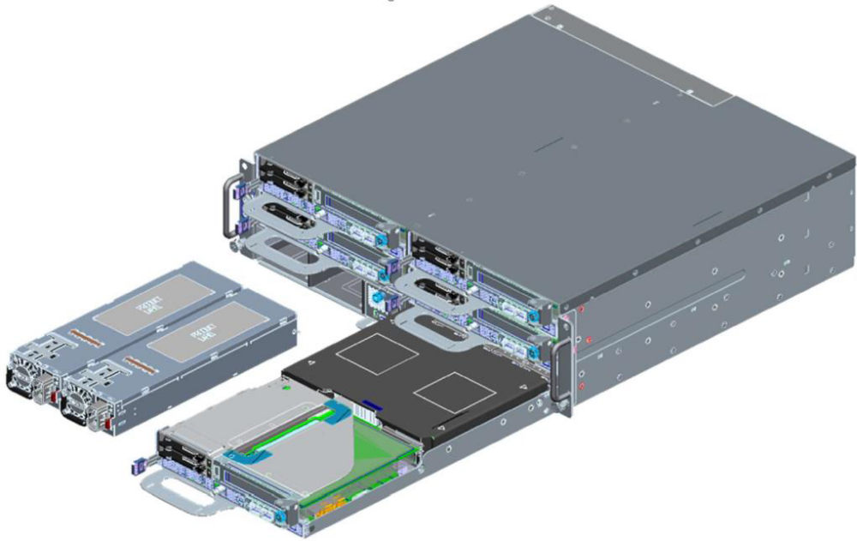
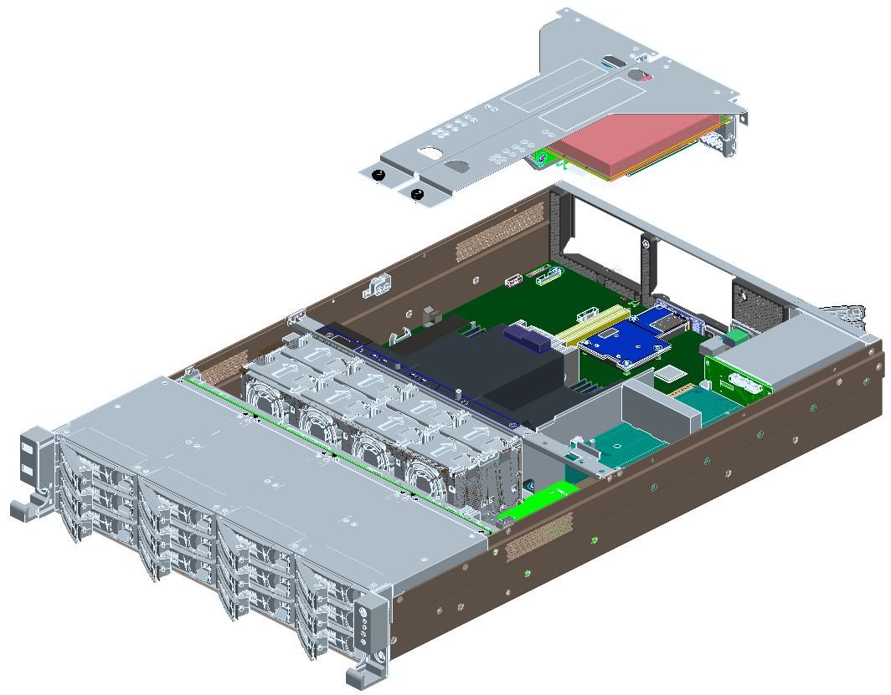
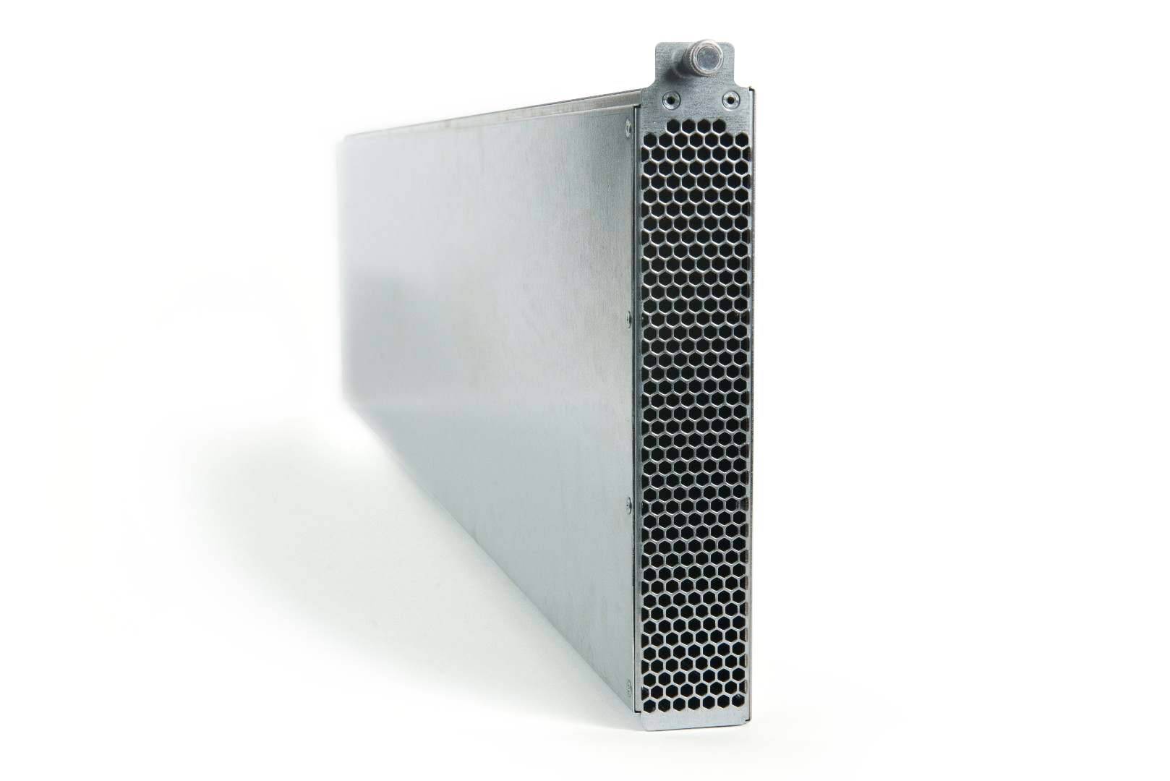
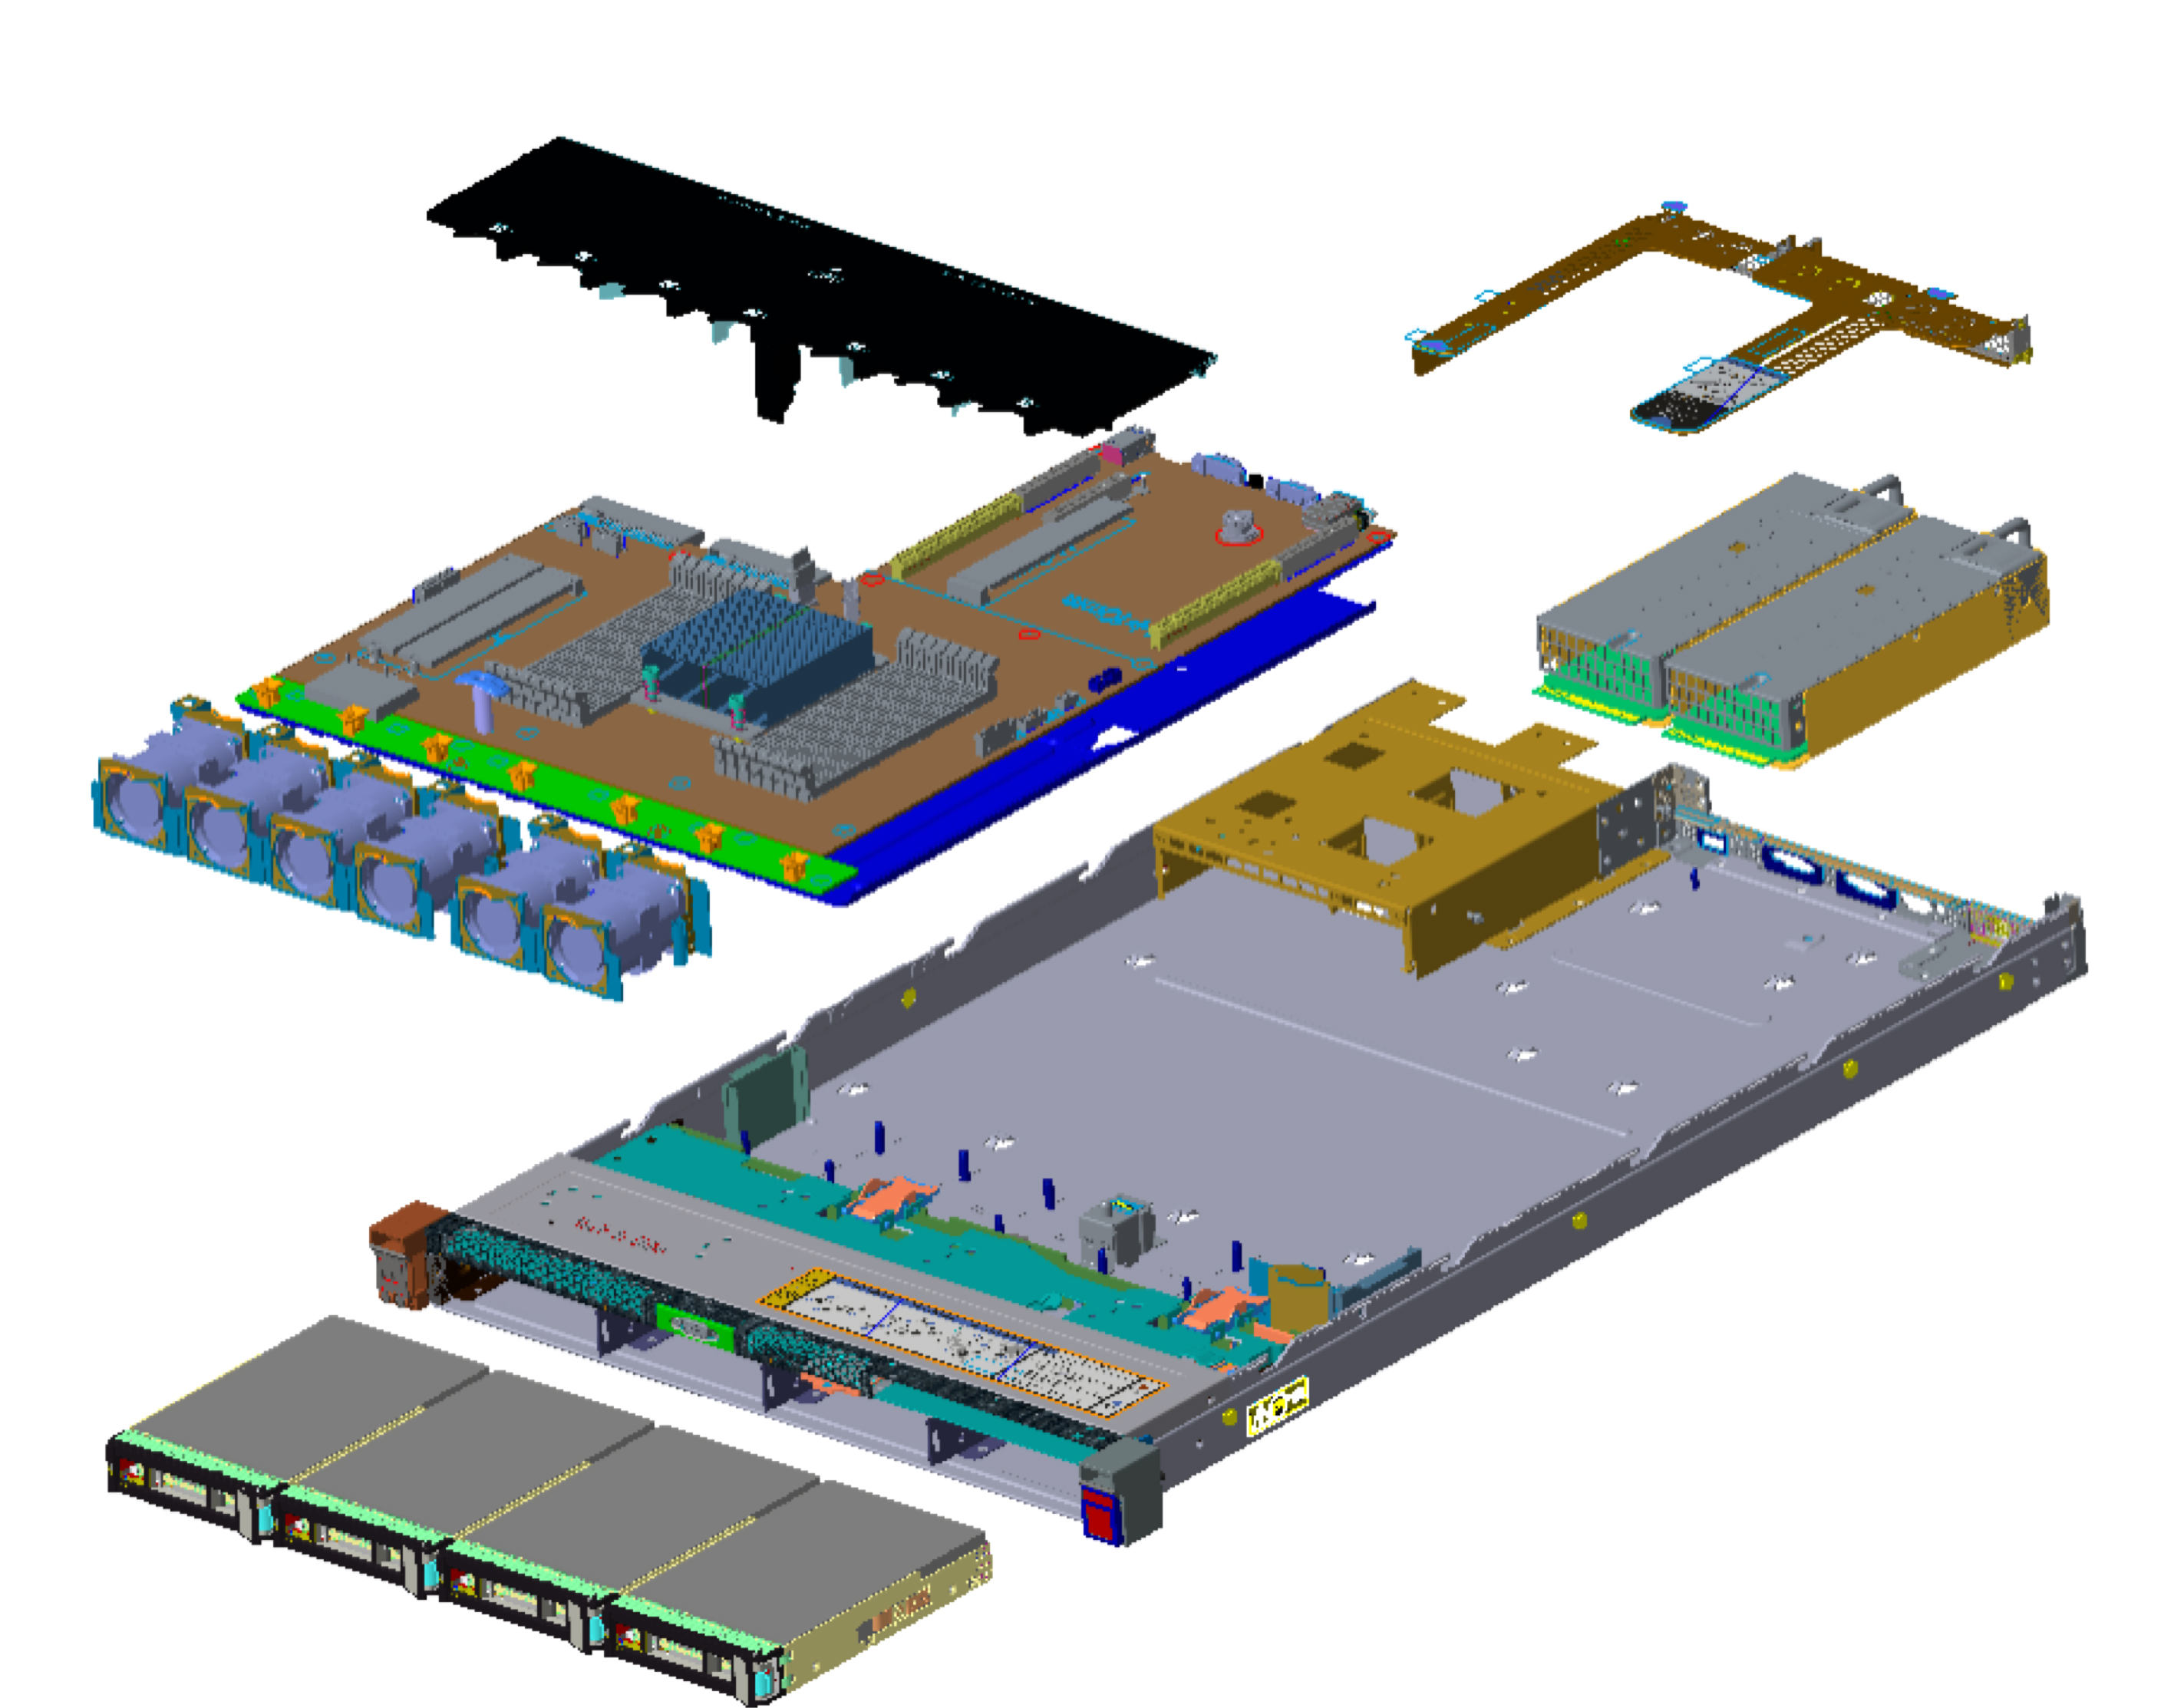
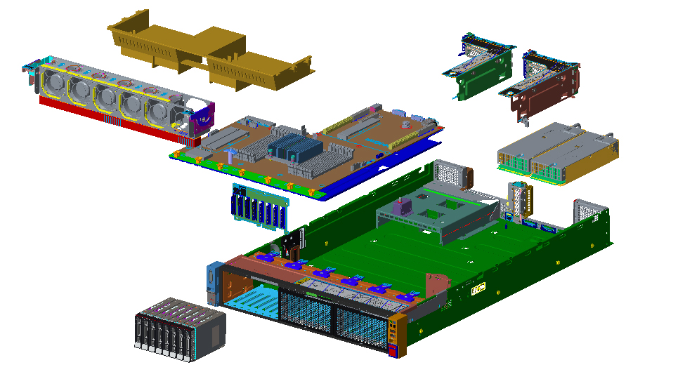
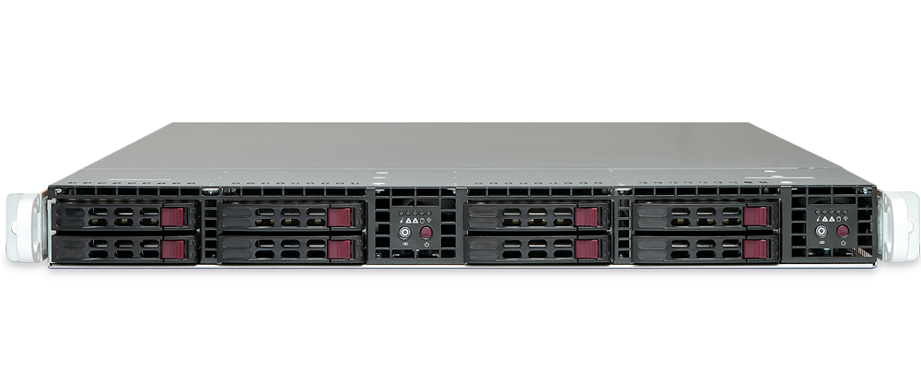
Ampere Edge Platforms
1U Lenovo HR330A
2U Lenovo
HR350A
Raptor
Twin Server
Open19
Brick
OCP openEDGE Enclosure
  Lenovo and Raptor platforms available today in production volume
  Standard 19”, Open19, and OCP configurations available for Edge, Telco, and Storage
  openEDGE platform sampling in Q4 with production volume in Q1’20
  Design collateral available for custom designs
  Available through Ampere via sales@amperecomputing.com

Slide 6

Ampere for SEBA Applications
SEBA
SEBA: SDN Enabled Broadband Access
Manages wireline customer broadband services
Ported to scalable and versatile eMAG Arm processor
Source code and demo available
ONOS APPS
WORKFLOW
VOLTHA
RUNTIME CONFIG / SERVICES
ONOS
Grafana
ELK
Kafka
Prometheus
XOS
PROFILE
KUBERNETES
OS
OS
OS
BARE METAL
ARM SERVER
BARE METAL
ARM SERVER
BARE METAL
ARM SERVER

Slide 7
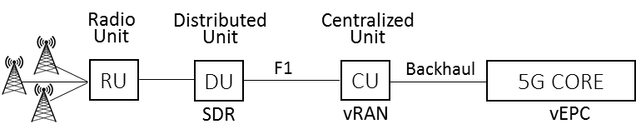
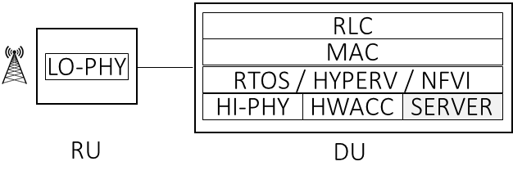
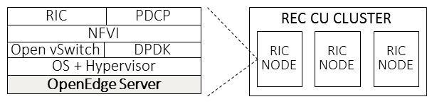
Ampere for 5G Applications
MME
PGW
SGW
Guest OS
Guest OS
Guest OS
Hypervisor
Hypervisor
Hypervisor
Host OS
Host OS
Host OS
openEDGE
Server
openEDGE
Server
openEDGE
Server
eMAG + FPGA Hardware Acceleration
Development platform available
Akraino REC Blueprint
3-node server cluster running on eMAG
Source code and demo available today
In Development for eMAG2
eMAG2 provides optimal fit
High core count, performance, throughput

Slide 8
Ampere VNF Ecosystem
Ampere is partnering with industry leaders to provide a complete UCPE software stack
Ampere eMAG processor enables more VNF’s in uCPE power and cost envelope
Ampere plans to contribute Arm based uCPE spec to OCP
NFVI | Enea, Telco Systems
SD-WAN | FatPipe
Firewall | Checkpoint, Clavister
Routing | 6WIND
Security | Trend Micro
Deep Packet | Trend Micro, Enea
Telco | SEBA, RIC/REC
VIRTUAL MACHINE
VIRTUAL MACHINE
VIRTUAL MACHINE
VIRTUAL MACHINE
VNF
VNF
VNF
VNF
VNF
VNF
VNF
VNF
VNF
VNF
VNF
VNF
CONTAINERS
CONTAINERS
CONTAINERS
CONTAINERS
GUEST OPERATING SYSTEM
GUEST OPERATING SYSTEM
GUEST OPERATING SYSTEM
GUEST OPERATING SYSTEM
NFVI MANAGER
VIRTUAL SWITCH (OVS-DPDK)
SECURE BOOT
DATA PATH (DPDK)
HYPERVISOR (KVM)
LINUX BASED HOST OPERATING SYSTEM
eMAG ARM PROCESSOR

Slide 9
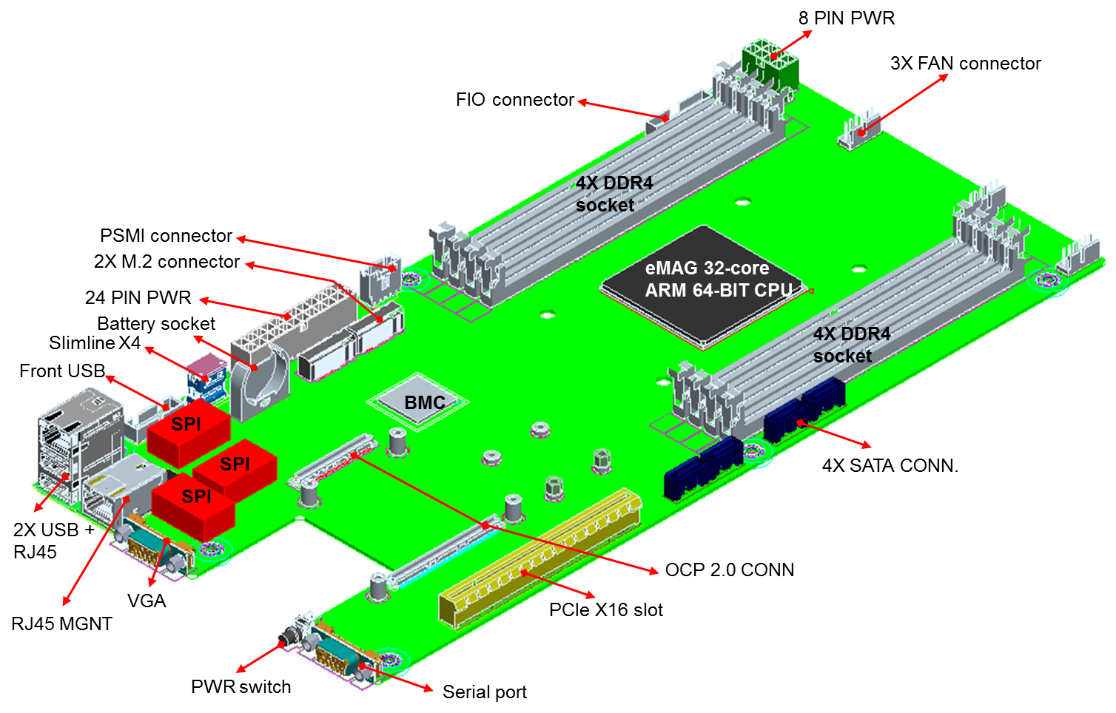
Ampere Hawk Motherboard
Overview | Compatible with OCP openEDGE Chassis CPU sled 6.5" x 13.85" 32 and 16 core eMAG SKUs 32bit and 64bit Support TSMC 16 nm FinFET
Processor | 32/16 Ampere Armv8 64-bit CPU cores @ 3.3 GHz Sustained Turbo 32 KB L1 I-cache, 32 KB L1 D-cache per core Shared 256 KB L2 cache per 2 cores 32MB globally shared L3 cache
Memory | 8x 72-bit DDR4-2667 channels Up to 16 DIMMs and 1 TB/socket ECC, ChipKill, and DDR4 RAS features
I/O | OCP Mezzanine v2 (Conn. A/B) 10/40/100 GbE NIC 1 x16 PCIe slot 2 x M.2 x4 NVME 4 x SATA3 2 x USB 2.0
Power | 125W TDP for 32 cores 75W TDP for 16 cores Advanced Power Management
Performance | SPECrate2017_int_peak: 68* SPECrate2006_int_peak: 502*
Availability | Sampling: Q4’19 Volume Production: Q1’20
7"
14"
* Estimated based on measured Ampere 8180 and 8140 using gcc 8.2 -ofast, lto, jemalloc

Slide 10
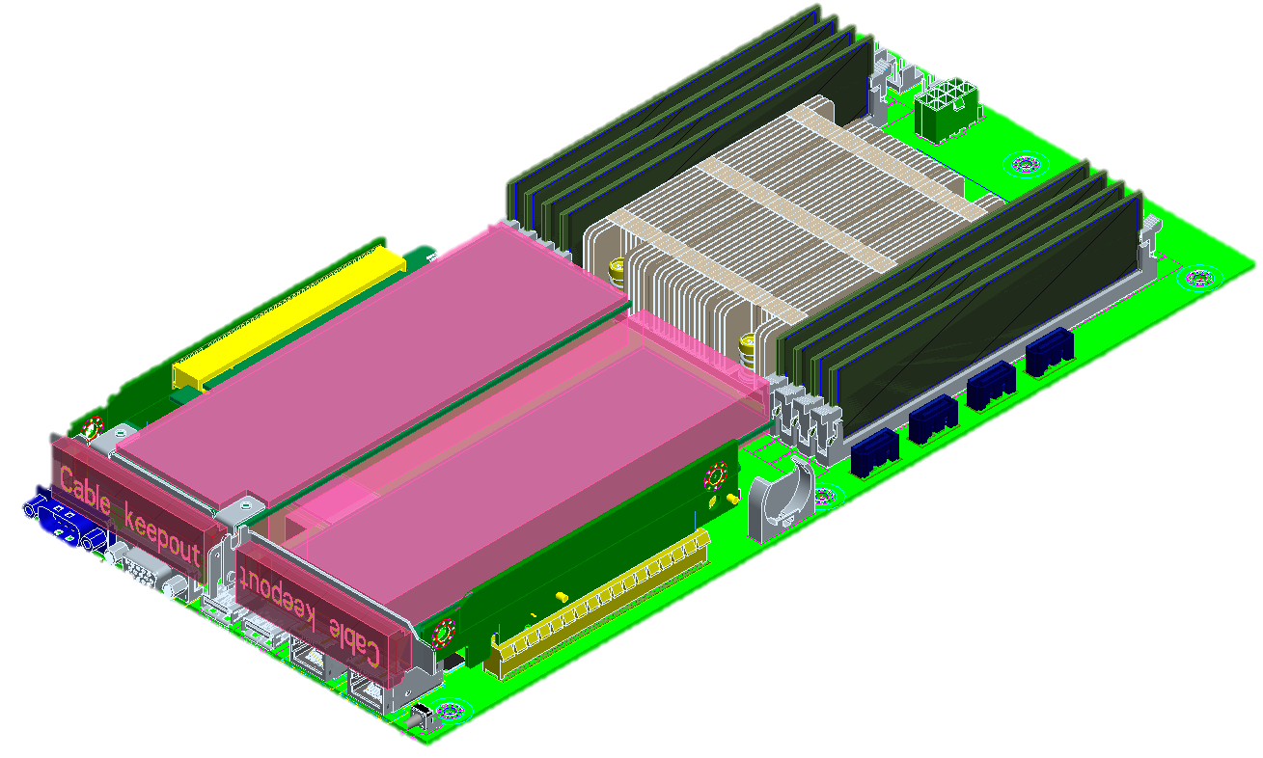
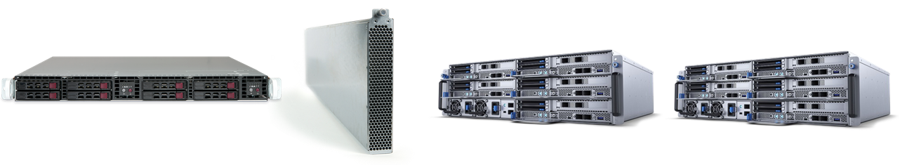
Hawk Edge Platforms
Twin Server
Open19
CPU Brick
OCP openEDGE CPU Sled
Nokia AirFrame/
Wiwynn EP100

Slide 11
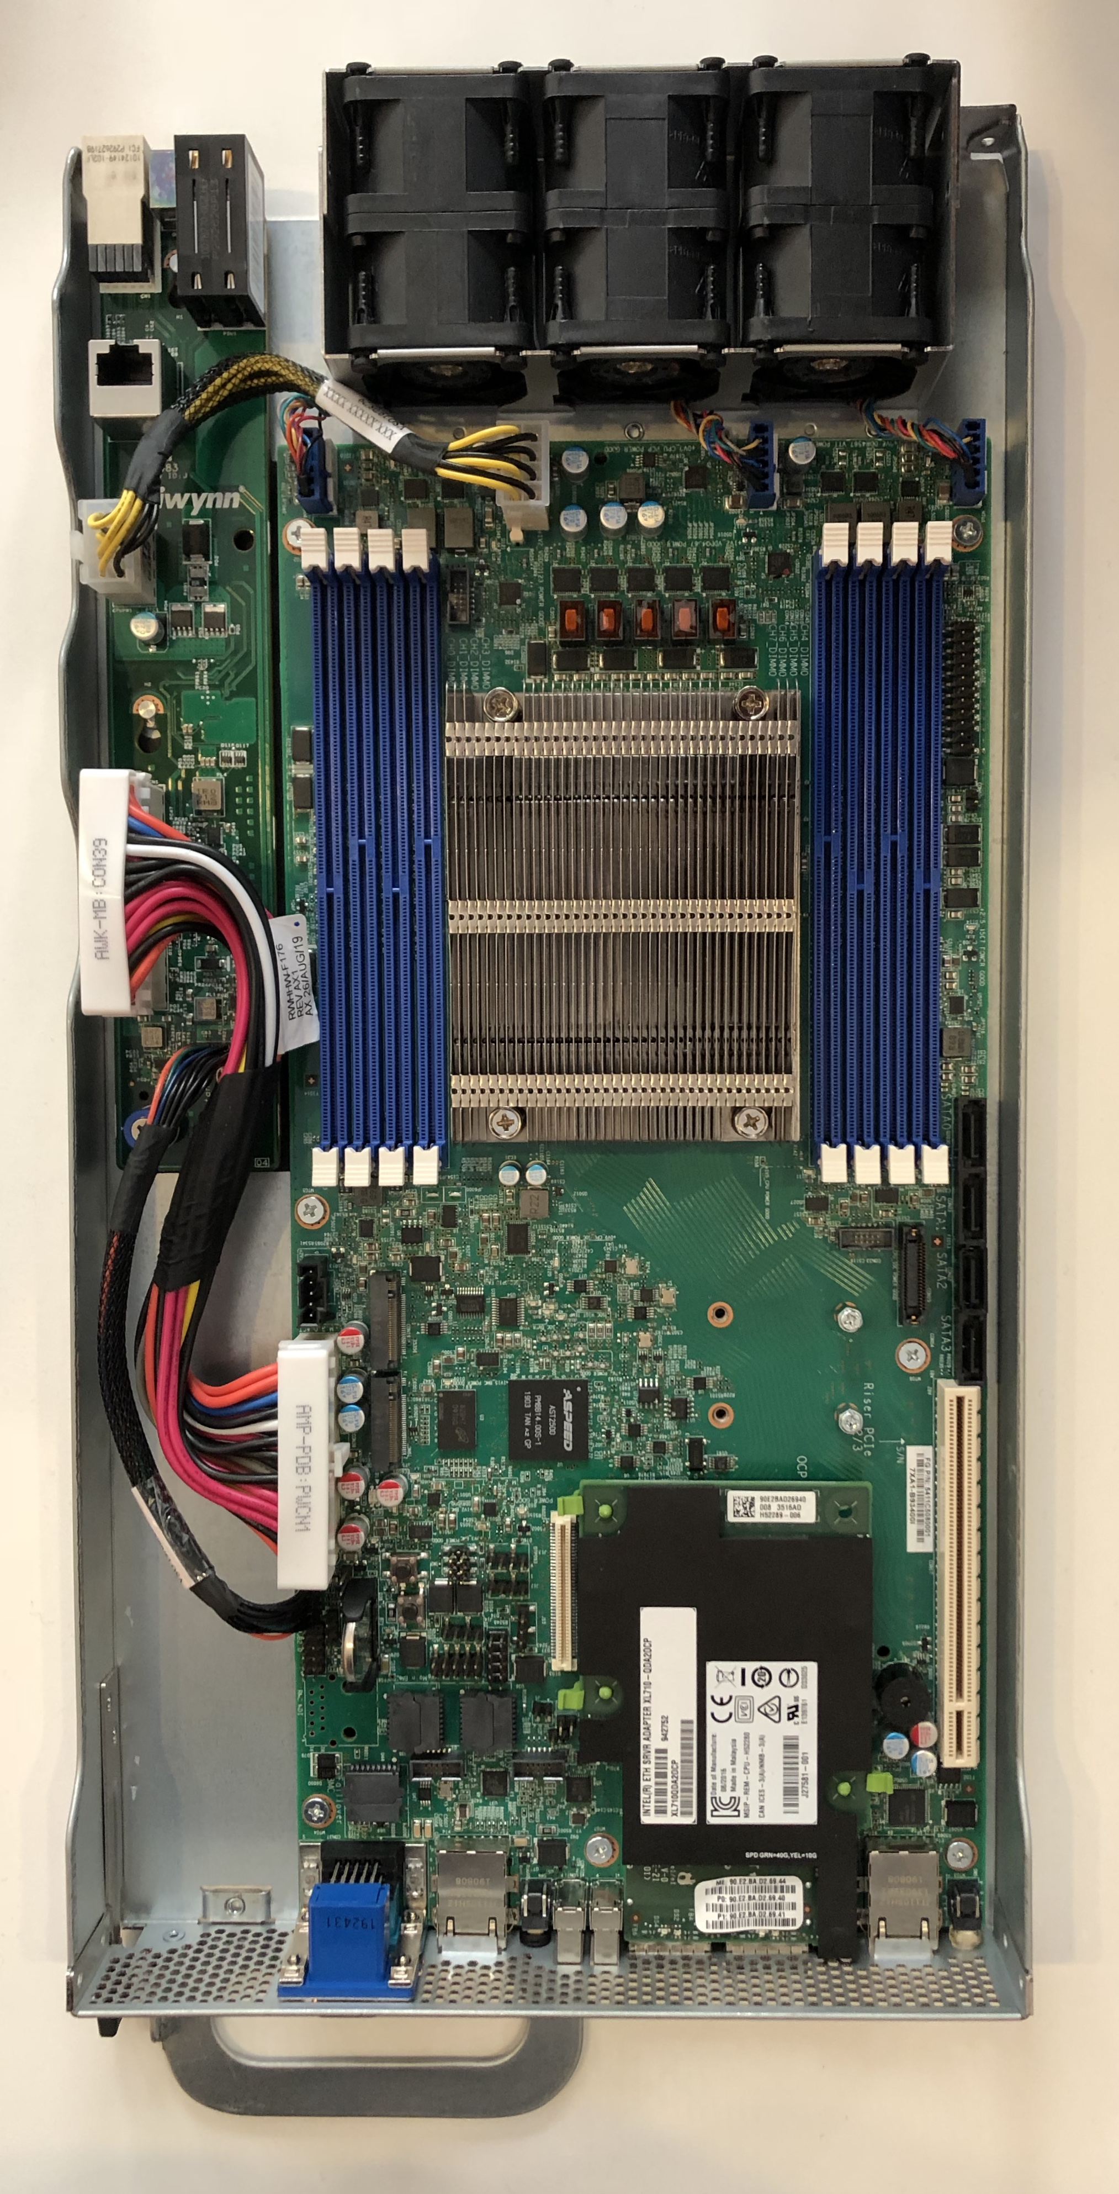
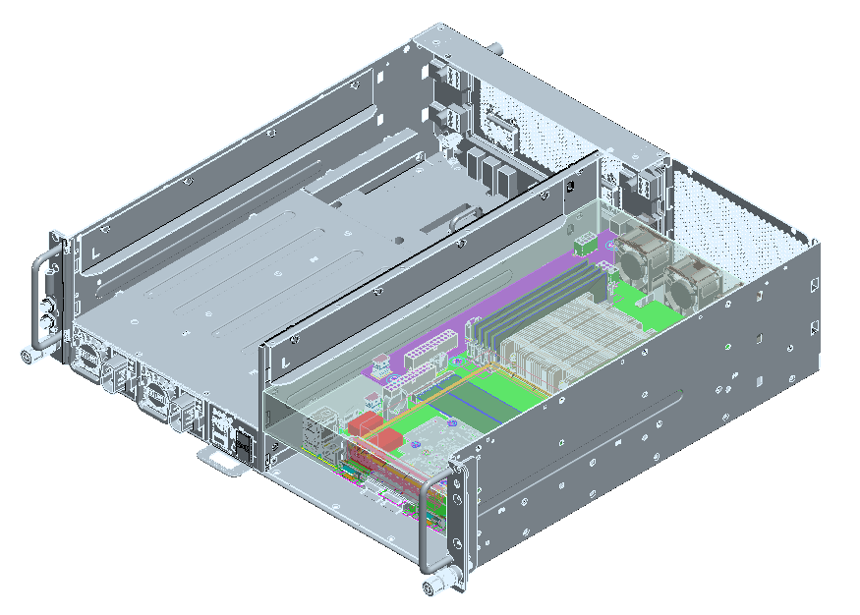
Hawk in openEDGE CPU Sled
Demo available at openEDGE Experience Lab and Wiwynn booth

Slide 12
Call to Action
Ampere 100% committed to OCP
Bring demo/POC opportunities to us
Ampere believes openEDGE enclosure has potential beyond Telco and Carrier
Project Wiki with latest specification : https://www.opencompute.org/wiki/Telcos/openEDGE
Follow-up or availability questions : sales@amperecomputing.com

