Slide 1
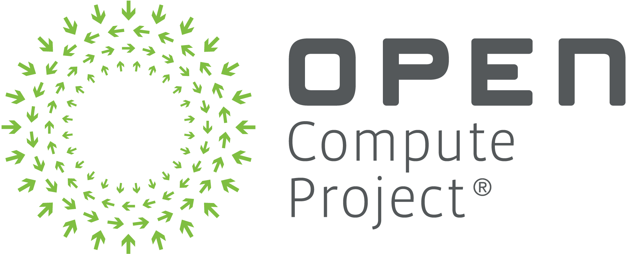
AI TRAINING
FABRIC RA
AT A GLANCE
1,024
OCP OPEN CLUSTER DESIGNS · REFERENCE ARCHITECTURE
xPUs at the top tier, from 64
20
composition variants, ready to deploy
An open, SONiC-based scale-out Ethernet fabric with a Kubernetes-native control plane
512
Art Fewell, Hedgehog · Arun Solleti, Celestica · production reference: FarmGPU
B200 xPUs in production at FarmGPU
v1.2 · April 2026 · CC BY-SA 4.0
Notes:
This is the OCP Open Cluster Designs Aligned AI Training Fabric Reference Architecture, version 1.2 from April 2026, authored by Art Fewell of Hedgehog and Arun Solleti of Celestica, with steering committee feedback incorporated. It is the network-centric complement to the OPG-M and XOC-N system architecture papers from January 2026. The short version: an open SONiC fabric, managed by Hedgehog as a Kubernetes-native control plane, on OCP-compliant 51.2T switches like the Celestica DS5000. It scales from 64 to over 1,024 xPUs, ships 20 composition variants in a companion repo, and FarmGPU runs an XOC-512 B200 cluster on this exact Hedgehog/Celestica topology.

Slide 2



HOW THE FABRIC IS BUILT
ARCHITECTURE
INTENT
Wiring CRDs: switches, servers, links
VPC CRDs: tenants, subnets, peering
Git · kubectl · hhfctl
OBSERVE
watched by
Alloy on every switch
CONTROL
Hedgehog Fabric Controller · Kubernetes-native, reconciling desired state continuously
Fabric Proxy pod
gNMI
Fabric Agent on every switch
TH5 ASIC · DS5000 51.2T
Loki · Grafana · Tempo · Mimir
SWITCH
SONiC Config DB
Controller offline? Switches keep forwarding on their last config.
EVPN + VXLAN, L3VNI on TH5
RoCE in one toggle: PFC, ECN, DSCP, QPN hash
FABRIC
Non-blocking leaf-spine
SONiC on OCP 51.2T switches · Hedgehog AI Network, Apache 2.0 · OoB network stays outside the control plane
02
Notes:
One picture of the whole RA. Operators declare intent as Kubernetes custom resources: the Wiring API for physical topology (Switch, Server, Connection) and the VPC API for tenants, subnets and peering, kept in git and applied with kubectl or hhfctl. The Hedgehog Fabric Controller, running in Kubernetes, watches those resources, computes desired state and continuously reconciles it, correcting drift. It talks gNMI to a Fabric Agent on every switch, which writes the SONiC Config DB, and the Tomahawk 5 ASIC in the Celestica DS5000 forwards. The fabric itself is a non-blocking leaf-spine with EVPN and VXLAN; on TH5, Broadcom Enterprise SONiC has no L2VNI, so overlays are all L3VNI. RoCE is one toggle: lossless class, PFC, ECN thresholds, DSCP class selection and queue-pair-aware ECMP hashing. On the right, observability: Alloy on each switch, the Fabric Proxy pod, into an LGTM stack. And the resilience property worth stating: control and data planes are separate, so if the controller is down, the only thing you lose is the ability to change config. This is why OCP needed this paper: OPG-M and XOC-N defined the building blocks but left switch management, tenancy, QoS and lifecycle to every implementer.

Slide 3
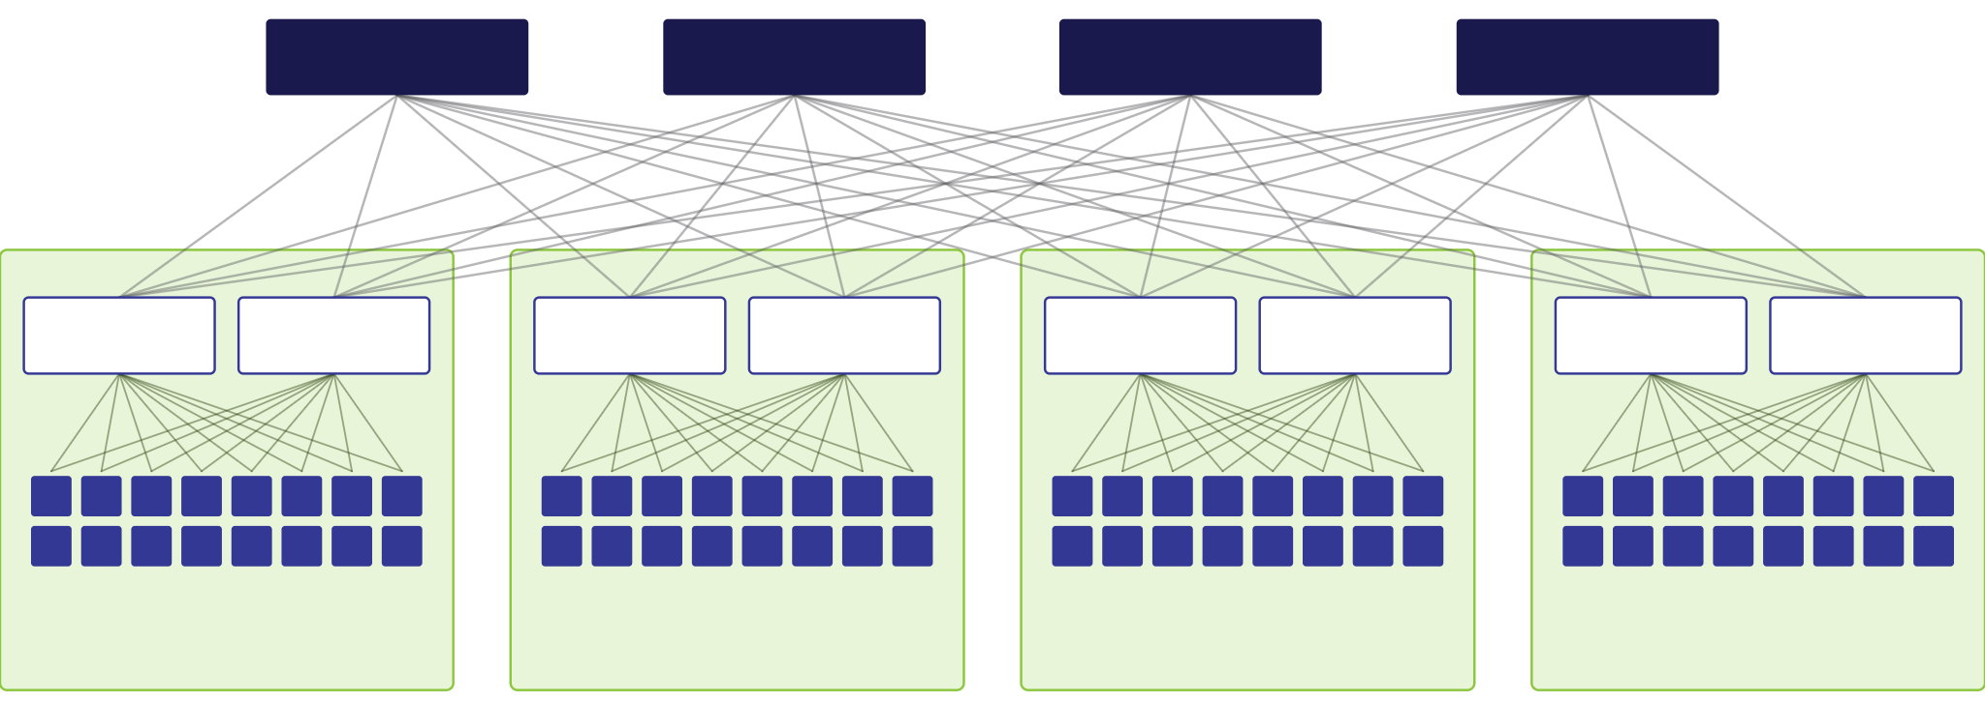
XOC-512: FOUR PODS, ONE SPINE LAYER
ARCHITECTURE
Spine 1
Spine 2
Spine 3
Spine 4
Leaf 1
Leaf 2
Leaf 3
Leaf 4
Leaf 5
Leaf 6
Leaf 7
Leaf 8
OPG-128 · pod 1
16 nodes · 128 xPUs
OPG-128 · pod 2
16 nodes · 128 xPUs
OPG-128 · pod 3
16 nodes · 128 xPUs
OPG-128 · pod 4
16 nodes · 128 xPUs
XOC-512 = 4 × OPG-128 · single-plane 1×400G · 8 leaves, 4 spines, 64 nodes · the tier FarmGPU runs in production
03
Notes:
This is what the OPG and XOC vocabulary means on the floor. An OPG-M, Open Pod Group for M xPUs, is the building block: xPU-node servers plus their network, storage and management. OPG-128 is 16 eight-xPU servers on two leaves at single-plane 1x400G. An XOC-N, xPU Open Cluster for N xPUs, composes pods under a shared spine layer and adds north-south connectivity. Here, XOC-512: four OPG-128 pods, eight DS5000 leaves, four spines, every leaf connected to every spine, 64 nodes and 512 xPUs. Half of each leaf's ports go up, so the fabric is non-blocking. Each node connects to both of its pod's leaves, split by rail in the rail-optimized variant. An OPG is not a standalone deployment; it needs the XOC spine and external connectivity. XOC-512 is exactly the tier FarmGPU operates with NVIDIA B200s on this Hedgehog and Celestica design.

Slide 4
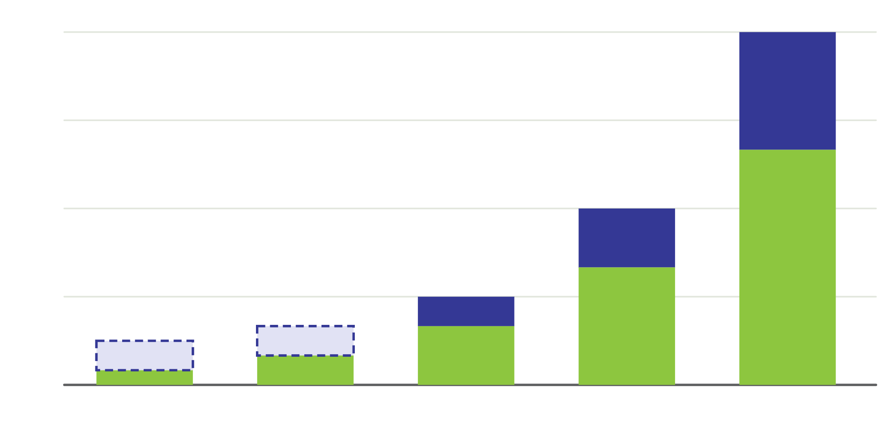
SWITCHES SCALE WITH XPUS
ARCHITECTURE
24
SWITCHES PER TIER
24
Leaves: one per 64 xPUs
18
Spines: one per two leaves
12
Optional: mesh 1–3 leaves, no spines
12
6
6
4
50%
3
of each leaf's ports go up, so every tier is non-blocking
XOC-64
XOC-128
XOC-256
XOC-512
XOC-1024
Single-plane, 1×400G per NIC · DS5000 64×800G, 128×400G or 256×200G · other NIC speeds change counts
04
Notes:
The tier table as a chart. At single-plane 1x400G, one DS5000 leaf has 64 downlinks, so leaves are one per 64 xPUs, and spines are one per two leaves for a minimum non-blocking Clos. XOC-64 is one leaf, XOC-128 two, and both can either use two spines or have Hedgehog mesh the leaves directly with no spine switches; that is the dashed segment. XOC-256 is four leaves and two spines, XOC-512 eight and four, XOC-1024 sixteen and eight: 24 switches for 1,024 xPUs. Switch count grows linearly because half of every leaf's ports are reserved as uplinks, which gives full bisection bandwidth in the scale-out plane. Dual-plane and other NIC speeds change the breakouts and counts; the companion repo has exact topology for every variant.

Slide 5
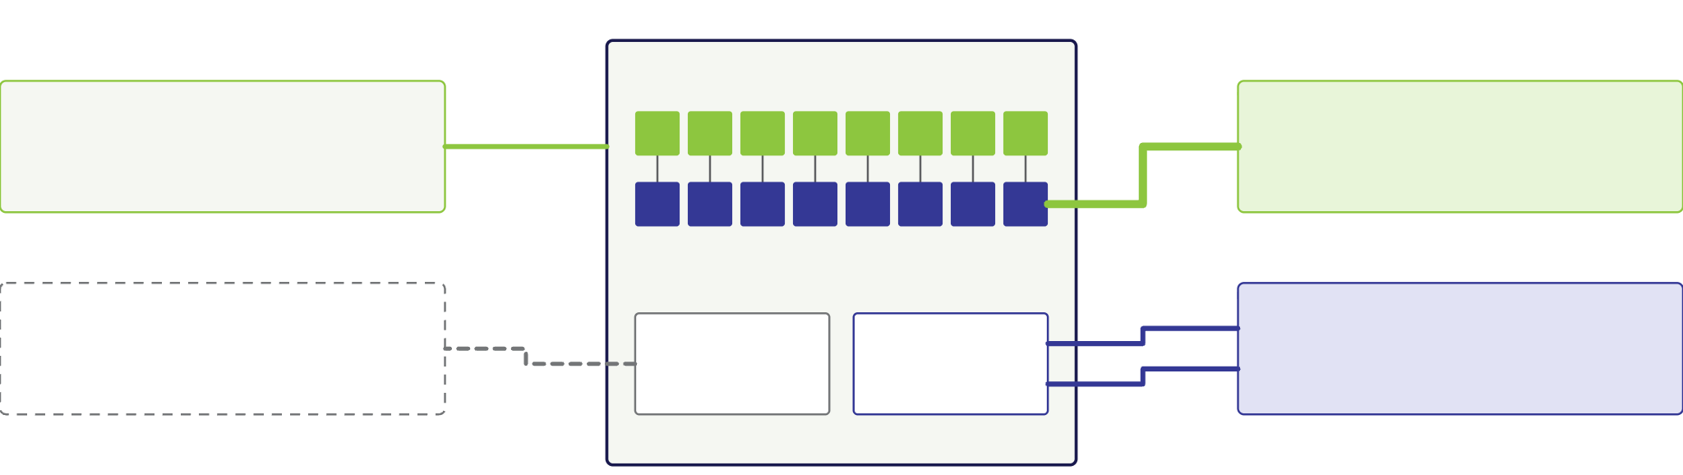
ONE NODE, FIVE NETWORKS
ARCHITECTURE
XPU-NODE · 8 XPUS
In-band management
Hedgehog-managed · DS2000
Scale-out back-end
Rail leaves · lossless RoCE
8 × 400G NICs, one per rail
8 × 400G
Out-of-band
BMCs only · DS1000
Front-end + storage
HostBGP to two leaves
BMC
BF-3 2×200G
Not Hedgehog-managed
2 × 200G
Minimal profile: front-end and storage converged · 4 networks
Full profile: separate · 5 networks
Each NIC is GPU-affinitized over the node's internal PCIe switches · scale-up NVLink stays inside the chassis
05
Notes:
Every xPU-node attaches to the fabric the same way. Eight xPUs, each with a GPU-affinitized scale-out NIC, which is where rails come from: xPU n has its shortest PCIe path to NIC n. Those eight 400G NICs go to the scale-out back-end, lossless RoCE. A BlueField-3 at 2x200G goes to the front-end and storage network, multi-homed with Hedgehog HostBGP: a host FRR container peers over unnumbered eBGP with two leaves and advertises its VIPs as /32s, so ECMP handles failover with no L2 protocols. In-band management is Hedgehog-managed, DS2000 in the examples. The BMC goes to out-of-band management on DS1000 switches, and that network is deliberately outside Hedgehog, because the tool managing the network must not depend on the network it manages. The minimal profile converges front-end and storage into four networks; the full profile separates them into five. NVLink and NVSwitch scale-up stay inside the chassis and are out of scope.

Slide 6
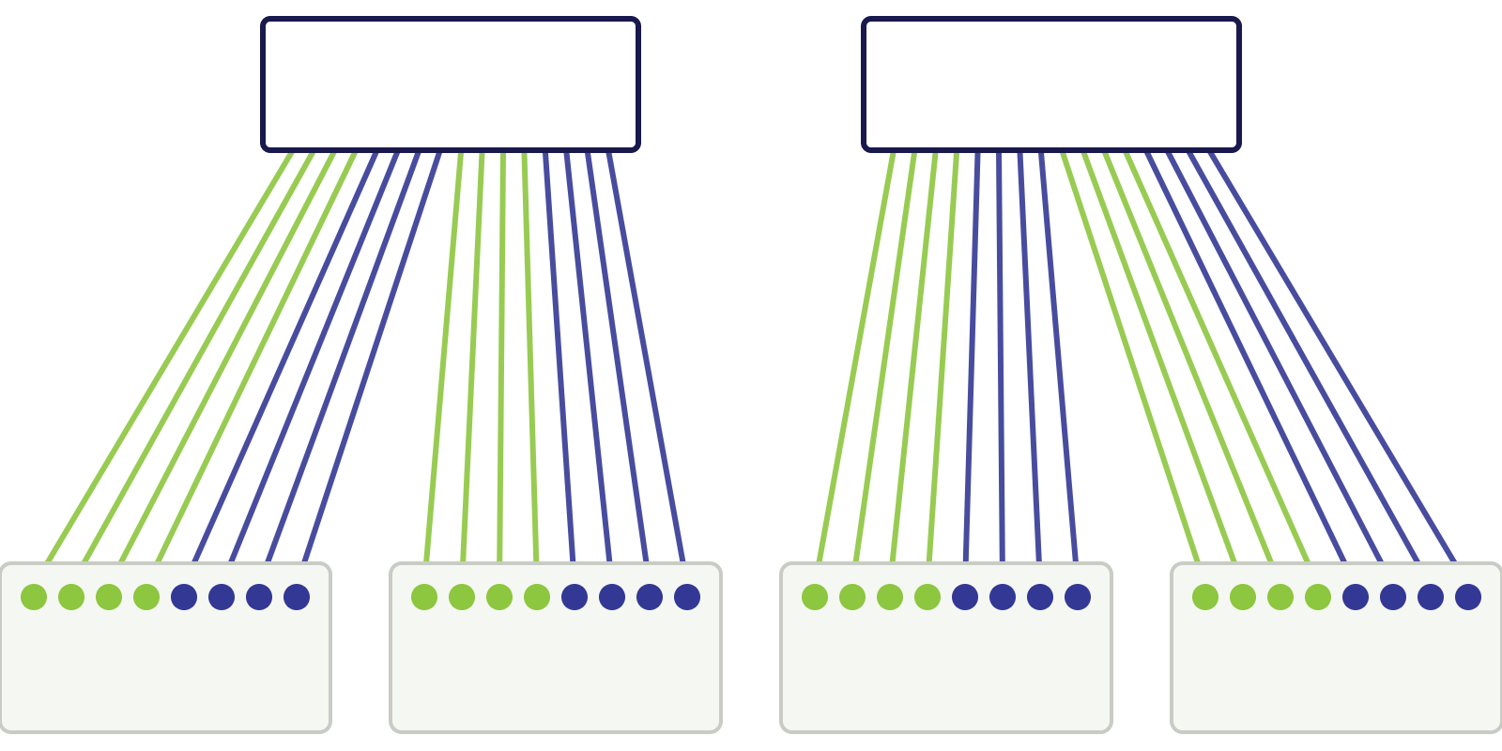
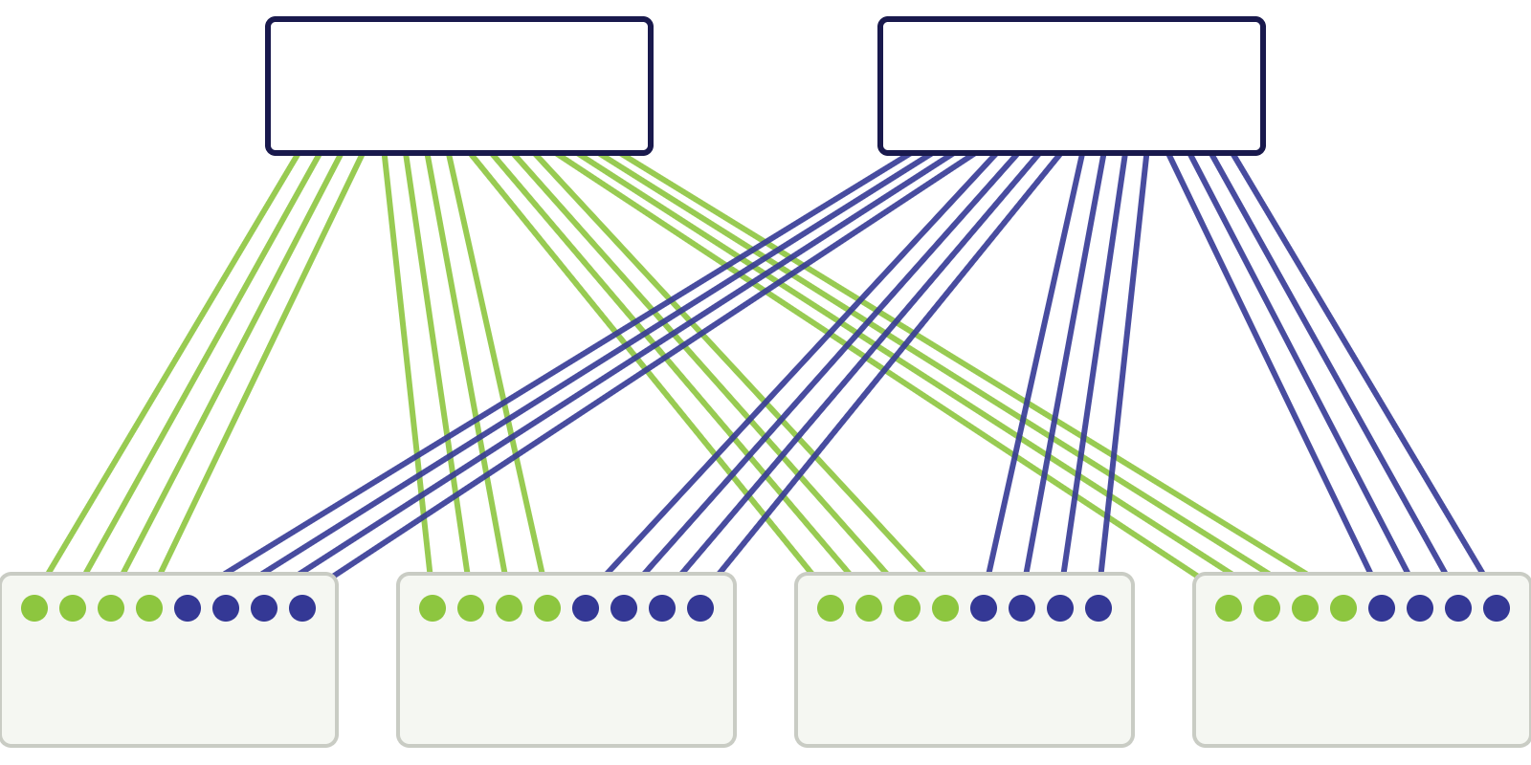
SAME SWITCHES, DIFFERENT WIRING
TOPOLOGY
Single-homed Clos
Rail-optimized
Leaf 1
Leaf 2
Leaf 1
Leaf 2
Node 1
Node 2
Node 3
Node 4
Node 1
Node 2
Node 3
Node 4
All 8 NICs of a node on one leaf. All traffic between co-located nodes stays local.
Rails 1–4 of every node on Leaf 1, rails 5–8 on Leaf 2. Intra-rail traffic stays local.
Green = rails 1–4 · blue = rails 5–8 · leaf and spine counts, ports and oversubscription are identical
06
Notes:
A rail is GPU-to-NIC affinity: NIC 1 on every node is rail 1, and so on through rail 8. Both of these are Clos fabrics with exactly the same switches; only the server-to-leaf cabling differs. On the left, single-homed: every NIC of a node lands on the same leaf, so a leaf holds eight nodes, a first-hop domain, and all traffic among them, intra-rail and cross-rail, stays on that leaf. On the right, rail-optimized: rails are split across leaves, here rails 1 to 4 on leaf 1 and 5 to 8 on leaf 2, so intra-rail traffic stays local across many more nodes, but cross-rail traffic can cross the spine. With the DS5000 at 1x400G, the mapping is rails per leaf equals 64 divided by the server count: at 64 servers each rail gets its own leaf, the sweet spot, and a first-hop rail domain of 64 nodes. Single-homed wins when cross-rail traffic dominates and gives simpler, top-of-rack cabling; in a liquid-cooled rack, 8 nodes times 8 NICs is exactly the 64 ports of one leaf, all DAC or AEC. Rail-optimized needs end-of-row fiber and disciplined rail labeling.

Slide 7

DUAL-PLANE DOUBLES THE RAIL DOMAIN
TOPOLOGY
LARGEST FIRST-HOP RAIL DOMAIN, XPU-NODES
Single-plane
1×400G · CX-7
64 nodes
Dual-plane
2×200G
128 nodes
Dual-plane
2×400G · CX-8
64 per plane
Same bandwidth
Plane isolation
Not transparent
2×200G is still 400G per NIC; NCCL drives both planes
Roll changes to Plane A, validate, then Plane B
A plane down halves bandwidth; tenants need notice
DS5000 LEAF: 64 × 400G OR 128 × 200G DOWNLINKS · NO EXTRA SWITCHES FOR THE LARGER DOMAIN
07
Notes:
The paper calls this possibly dual-plane's most operationally impactful benefit. Single-plane at 1x400G: a DS5000 leaf has 64 downlinks at 400G, so at most 64 rail-n NICs share a leaf, and the first-hop rail domain caps at 64 nodes, 512 xPUs. Dual-plane at 2x200G: each NIC sends one 200G port to plane A and one to plane B, and the same leaf breaks out to 128 ports at 200G, so the domain doubles to 128 nodes, 1,024 xPUs, with no additional switches and the same 400G per NIC. The 2x400G ConnectX-8 variant keeps 64 nodes per plane but doubles bandwidth. You also get plane isolation and staged rollouts. But plane maintenance is not transparent: losing a plane halves bandwidth, so tenants need notice, and single-plane with Hedgehog is already resilient through ECMP, multi-homing, rolling upgrades and controller and data-plane separation.

Slide 8
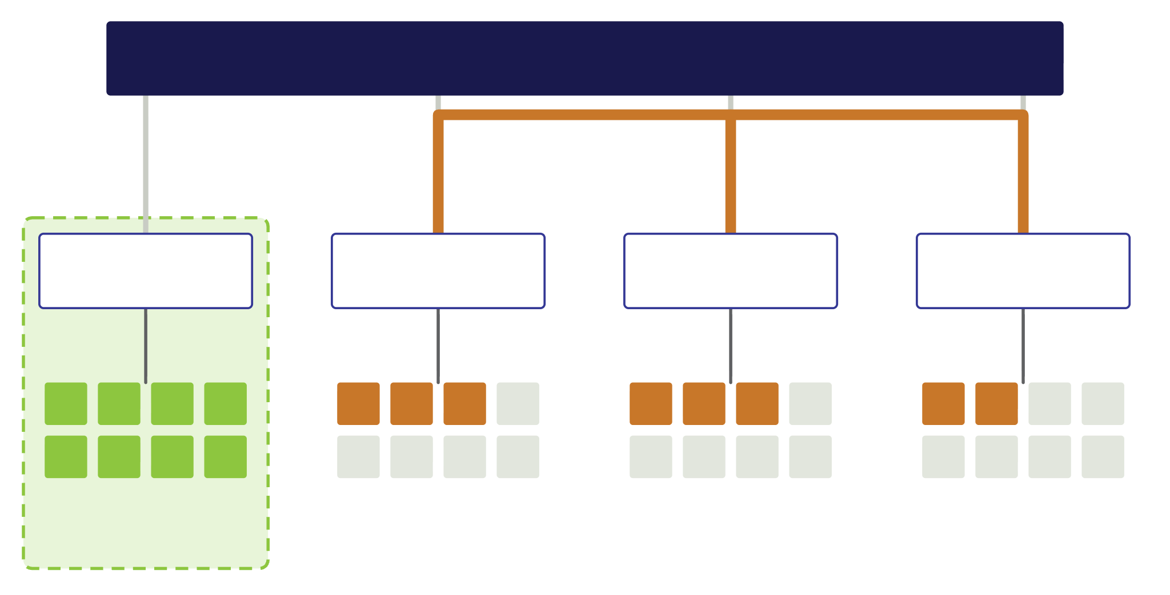
KEEP TRAFFIC OFF THE SPINE
TOPOLOGY
Spine layer
Tenant A
8 nodes on one leaf: zero spine traffic
Leaf 1
Leaf 2
Leaf 3
Leaf 4
Tenant B
Spread out, every exchange crosses the spine
Label nodes by domain so the scheduler places locally
Tenant A
one domain
Tenant B · same 8 nodes, spread over three leaves
Single-homed: 8-node domains, all traffic local · rail-optimized: up to 64 nodes, intra-rail local · choose by intra- vs cross-rail mix
08
Notes:
Congested uplinks and spines are behind most of the well-known AI networking problems: tail latency, incast, retransmissions. The cheapest fix is placement. Tenant A is eight nodes inside one single-homed first-hop domain, so all of its traffic, intra-rail and cross-rail, turns around at leaf 1 and adds zero spine traffic, whatever its communication pattern. Tenant B is the same eight nodes scattered across three leaves, so every exchange between them rides the spine. For a GPU-as-a-service provider where many leases are eight nodes or fewer, keeping them inside domains frees spine capacity for the jobs that genuinely span domains. In rail-optimized fabrics the unit is the first-hop rail domain, up to 64 nodes at single-plane, and larger domains bin-pack a mix of 2, 4, 8 and 16-node leases more easily. The deciding factor between the two wirings is the ratio of intra-rail to cross-rail traffic, not job size. Make the scheduler domain-aware with Kubernetes node labels or SLURM partitions, then measure spine utilization and p95 and p99 latency before and after.

Slide 9
DAY 0 TO DAY 2, NO SWITCH CLI
OPERATIONS & ADOPTION
ONIE boots; DHCP points to Hedgehog
Agent and SONiC image install
Agent registers with controller
Identity, ASN, switch profile set
DAY 0
Wiring and VPC CRDs in git
Webhooks and connectivity maps check
Controller computes desired state
Canary rollout; revert to roll back
DAY 1
Alloy telemetry into LGTM
Drift or fault detected
Minimal delta reconciled
Upgrade per OPG or per plane
DAY 2
Swap a failed switch, give it the old identity, and reconciliation rebuilds its config.
ONIE IS AN OCP PROJECT · INTENT IS AUTHORITATIVE, SO RECOVERY IS DETERMINISTIC
09
Notes:
The lifecycle end to end. Day 0: switches ship with ONIE. On power-up, DHCP options point them at the Hedgehog controller; the switch installs the agent and the right SONiC image, registers, and gets its identity, ASN, management parameters and a switch profile describing ports, breakout, FEC and RoCE capabilities. No CLI, no hand-placed keys. Day 1: intent is Wiring and VPC CRDs versioned in git. Admission webhooks catch structural errors, and the connectivity-map generator checks port and NIC mapping before anything is cabled. Roll out canary first; rollback is reverting the commit. Day 2: Alloy streams telemetry into LGTM, the controller detects drift or faults and reconciles only the minimal delta. Upgrade one OPG at a time, or plane by plane in dual-plane, treating OPG boundaries as leaf-layer failure domains. And because intent is authoritative, replacing a switch is a physical swap plus re-associating its identity.

Slide 10
IN PRODUCTION, READY TO DEPLOY
OPERATIONS & ADOPTION
20
FARMGPU · FEATURED PARTNER
variants, OPG-64 to XOC-1024, each with connectivity map, BoM, wiring CRDs, NetBox and diagrams
XOC-512
NVIDIA B200 on this exact Hedgehog and Celestica topology.
1
Pick a variant by traffic
2
Rehearse it in VLAB
SemiAnalysis: fabric outperformed several alternatives. Host and NIC tuning now in the repo.
3
Cable to the connectivity map
4
Feed wiring YAML to hhfab
github.com/opencomputeproject/OCP-OCDAI-training-fabric
OCP Open Cluster Designs · RA v1.2, CC BY-SA 4.0 · validated logically, at lab scale, in VLAB and in the field
Notes:
The RA is grounded in production. FarmGPU, a neocloud that co-leads the OCP Scaling AI Clusters at Neoclouds workstream, deployed and operates an XOC-512 cluster of NVIDIA B200 nodes on exactly this Hedgehog and Celestica topology, and the paper names it the featured partner and public reference. SemiAnalysis independently found the fabric outperformed several other network solutions, and FarmGPU's bring-up is documented in its blog series; its host and NIC tuning is contributed to the companion repo. Other operators run compositions at other tiers. The paper is candid that it has not validated XOC-1k in house; large tiers are extrapolated from lab emulation, VLAB and field deployments. To adopt it: pick one of the 20 variants by your intra- versus cross-rail traffic mix, rehearse the whole lifecycle in Hedgehog VLAB with the XOC-Virtual composition, which runs the same controller and SONiC, cable to connectivity-map.csv after checking optics against real runs, and feed the wiring YAML to hhfab; the controller builds the fabric with zero touch. Thank you; questions.

Slide 11
THE BASELINE SETS THE MATH
ARCHITECTURE
51.2T
50%
8
DS5000: 64×800G, 128×400G or 256×200G
of leaf ports reserved as uplinks to spines
GPU-affinitized scale-out NICs per xPU-node
At 1×400G per NIC, one leaf serves 64 xPUs, eight xPU-nodes. At 200G per port it serves 128.
CX-7 1×400G · 1 plane
CX-7 2×200G · 2 planes
CX-8 2×400G · 2 planes
BF-3 2×200G · front-end
AI TRAINING FABRIC RA · V1.2
06
Notes:
The baseline assumptions that drive every number in the paper. The Celestica DS5000 represents the OCP-compliant 51.2 terabit switch from the OPG-M spec: 64 ports at 800G, which break out to 128 at 400G or 256 at 200G. Half the ports go up to spines, half down to servers. Each xPU-node is an eight-xPU server whose scale-up domain, NVLink or NVSwitch, is entirely inside the chassis, with eight GPU-affinitized scale-out NICs. So at 1x400G per NIC, one leaf has 64 downlinks at 400G and serves 64 xPUs, which is eight servers. At 200G per port, that's 128 downlinks per leaf. The repo provides assets for ConnectX-7 at 1x400G or 2x200G and ConnectX-8 at 2x400G, with BlueField-3 at 2x200G for the converged front-end and storage network. Cooling doesn't change any of this: the fabric is identical for air-cooled racks at about two nodes per rack and liquid-cooled at about eight.

Slide 12
WIRING DECIDES THE CABLE PLANT
TOPOLOGY
SINGLE-HOMED · LIQUID-COOLED
RAIL-OPTIMIZED
8 × 8 = 64
1 → 8
Eight nodes per rack, eight NICs each, exactly one DS5000 leaf. Top-of-rack, DAC or AEC to every server: a one-rack, 64-xPU block.
Each node fans out to eight leaves: end-of-row, mostly optics. Put leaves near spines and leaf-to-spine can run on DAC or AEC.
Reliability
Power and heat
Simpler operations
No transceiver to fail
Far less than optics, times thousands of links
Fewer spares, firmware versions and failure modes
Why DAC and AEC matter beyond price · validate optic choices against measured cable runs
12
Notes:
The wiring choice shows up physically. Single-homed Clos in a liquid-cooled rack is an exact fit: eight xPU-nodes per rack times eight NICs is 64 ports, precisely the downlink capacity of one DS5000 leaf. So you get true top-of-rack, every server-to-leaf link short enough for DACs or AECs, and a single-rack building block of 64 xPUs and one leaf where all traffic in the rack stays leaf-local. Rail-optimized, say an OPG-512 with an 8-leaf rail domain, has every node fanning out to eight different leaves, which means end-of-row and fiber for most server-to-leaf links. Air-cooled racks at about two nodes each would need optics anyway. The trick there is placing the leaves near the spines so leaf-to-spine can use copper; with a 50/50 uplink/downlink split, the paper says the cabling tradeoff ends up roughly equivalent. And the reason to care about copper isn't just acquisition cost: no optic to fail, much less power and heat across thousands of links, and fewer spares, firmware versions and failure modes to manage.

Slide 13
SAME SWITCHES, DIFFERENT WIRING
TOPOLOGY
Aspect | Single-homed Clos | Rail-optimized
Switch counts | Leaves = nodes ÷ 8, spines = leaves ÷ 2 | Identical; non-blocking 1:1
Wiring | All 8 NICs of a node to one leaf | NICs spread across leaves by rail
First-hop domain | 8 nodes; all traffic leaf-local | Up to 64 nodes; intra-rail leaf-local
Best for | Heavy cross-rail traffic | Mostly intra-rail traffic
Cabling | Lower complexity, top-of-rack | Track rail-to-leaf, end-of-row
Rail-optimized is a cabling constraint, not a new topology: stage structure, port budgets and oversubscription are unchanged.
SINGLE-PLANE, 1×400G PER NIC · AI TRAINING FABRIC RA · V1.2
10
Notes:
Both patterns are Clos; the only difference is server-to-leaf cabling. The OPG-M spec calls the first one "Clos topology", and the RA uses "single-homed Clos" because several cabling patterns are valid Clos. Switch counts, port budgets and oversubscription are identical: leaves equal nodes divided by eight, spines equal leaves divided by two for minimum non-blocking. In single-homed, all eight NICs from a node go to one leaf, so a leaf holds eight nodes, 64 xPUs, and every byte between those nodes, intra-rail and cross-rail, stays in the leaf. In rail-optimized, NICs are spread by rail, so the first-hop rail domain can be as large as 64 nodes, but only intra-rail traffic stays leaf-local; cross-rail traffic may cross the spine. So single-homed suits workloads with heavy cross-rail traffic and lower cabling complexity; rail-optimized suits predominantly intra-rail traffic and needs disciplined rail-to-leaf tracking.

Slide 14
WHAT THE RA DELIVERS
BACKGROUND
Open fabric
Kubernetes control
RoCE-oriented QoS
SONiC on OCP 51.2T switches, Celestica DS5000 as reference. Multi-vendor via switch profiles.
Hedgehog (Apache 2.0): topology and overlays as CRDs, continuously reconciled, GitOps-ready.
One parameter turns on the lossless class, PFC, ECN and RDMA-aware hashing.
Day 0 / 1 / 2
Deployable assets
Try it in VLAB
ONIE zero-touch provisioning, connectivity-maps-as-code, LGTM observability.
Every variant: connectivity map, BoM, wiring CRDs, NetBox inventory, diagrams.
XOC-Virtual runs the same controller and Broadcom SONiC, no hardware.
AI TRAINING FABRIC RA · V1.2
03
Notes:
Six things the RA gives an operator. First, an open fabric: SONiC as the NOS on OCP-compliant 51.2 terabit switches, with the Celestica DS5000 as the reference platform, but portable to other switches through switch profiles. Second, a Kubernetes-native control plane, Hedgehog, Apache 2.0: physical topology and logical overlays are Kubernetes custom resources, continuously reconciled, so it fits GitOps. Third, RoCE-oriented QoS where a single toggle configures the lossless class, PFC, ECN and RDMA-friendly ECMP hashing. Fourth, a full lifecycle: ONIE-based zero-touch provisioning on Day 0, connectivity-maps-as-code validation on Day 1, and continuous observability on Day 2. Fifth, ready-to-deploy assets for every composition variant. And sixth, an XOC-Virtual composition so you can run the whole lifecycle in Hedgehog's virtual lab before buying anything.

Slide 15
THE FABRIC WAS LEFT TO IMPLEMENTERS
BACKGROUND
Switch management
NOS, provisioning, upgrades
The OPG-M and XOC-N system architectures (January 2026) define modular building blocks for AI clusters, then stop at the network.
Multi-tenancy & overlays
Isolation and overlay policy
Without a prescriptive, network-centric reference, operators get fragmented vendor guidance, ad-hoc tooling and inconsistent operations that slow deployment and add risk.
Quality of service
Lossless RoCE without per-device tuning
Lifecycle automation
Day 0 through Day 2, repeatably
AI TRAINING FABRIC RA · V1.2
02
Notes:
Why this paper exists. The OCP Open Cluster Designs system architecture papers, OPG-M and XOC-N, published in January 2026, define how to compose AI clusters out of modular pods. But they leave the network fabric to implementers: switch management, multi-tenancy, overlay policy, QoS and lifecycle automation. In practice that means every operator stitches together guidance from multiple vendors, picks tooling ad hoc, and ends up with operational practices that differ site to site. That slows deployment and increases risk. This RA fills that gap with a prescriptive, network-centric reference.

Slide 16

OVERLAYS AND LOSSLESS ROCE
OPERATIONS
One-parameter RoCE
Overlay model
VPC
VRF, the tenant routing context
PFC
ECN
802.1Qbb on the RDMA class
Marking tuned for collectives
Subnet
VNI, symmetric IRB
DSCP
QPN hashing
EVPN Type-2 and Type-5 over BGP, VXLAN in the data plane. Isolation by default; VPCPeering opens scoped paths.
Hosts pick the class; queues match
Spreads RDMA flows over ECMP
TH5 leaves are L3VNI only: Broadcom Enterprise SONiC has no L2VNI on DS5000.
Host and NIC tuning from FarmGPU's XOC-512 ships in the companion repo.
AI TRAINING FABRIC RA · V1.2
14
Notes:
Overlays use Hedgehog's VPC abstraction. A VPC is a VRF, each subnet is a VNI, with symmetric IRB; route distinguishers and targets are allocated deterministically. EVPN Type-2 routes carry MAC/IP reachability and Type-5 carries prefixes, distributed by BGP, with VXLAN in the data plane. Isolation is the default; VPCPeering and external peering open scoped connectivity under explicit policy. One platform caveat: on Tomahawk 5 leaves like the DS5000, Broadcom Enterprise SONiC doesn't support L2VNI, so all overlay traffic is Layer 3. For RoCE, a single toggle enables the lossless queue for the RDMA class, PFC thresholds, ECN marking thresholds, and appropriate ECMP hashing including queue-pair-number-aware hashing; hosts select the class with DSCP. Fabric QoS is only half the story though. Host and NIC settings, NIC firmware, interrupt affinity, memory registration, kernel parameters, materially affect collective throughput and tail latency. FarmGPU contributed its production host and NIC tuning from the XOC-512 B200 deployment to the companion repo as a starting point.

Slide 17
RUNNING IN PRODUCTION TODAY
VALIDATION & ADOPTION
FARMGPU · FEATURED PARTNER
Independent
Fast bring-up
XOC-512
SemiAnalysis found the fabric outperformed several alternative network solutions.
The declarative, ZTP-driven model, documented in a public blog series.
NVIDIA B200 nodes on this RA's Hedgehog and Celestica topology, operated by a neocloud that co-leads the OCP Scaling AI Clusters at Neoclouds workstream.
Contributed back
Not alone
Production host and NIC tuning, now in the companion repo.
More operators run compositions from this RA at other size tiers.
RA references [12] hedgehog.cloud blog · [13] blog.farmgpu.com/b200-cluster · [14] FarmGPU 17-day crash course in open networking
16
Notes:
The RA is grounded in production. FarmGPU deployed and operates an XOC-512 cluster of NVIDIA B200 nodes using exactly this Hedgehog/Celestica topology, and the paper names FarmGPU as the featured partner and public reference. SemiAnalysis analyzed FarmGPU's infrastructure independently and reported that the network fabric outperformed several other network solutions they tested; the RA cites the Hedgehog performance blog and FarmGPU's B200 cluster post for that. The bring-up speed is documented in FarmGPU's blog post on the 17-day crash course in open networking, which is the paper's evidence for the operational efficiency of the declarative, ZTP-driven model. FarmGPU also contributed its host and NIC tuning to the companion repo. And it's not a single-operator design: the paper notes additional operators deploying compositions at various size tiers.

Slide 18
TWENTY VARIANTS, ONE NAMING SCHEME
VALIDATION & ADOPTION
20
composition variants: 10 OPG building blocks from OPG-64 to OPG-512, and 10 XOC clusters from XOC-64 to XOC-1024.
<topology>--<scale-out NIC>--<front-end NIC>--[planes]--<storage>
XOC-512/4x-OPG-128/clos-ro--cx7-1x400g--bf3-2x200g--storage-conv-2x200g
Topologies
Assets per variant
clos-ro · clos-sh · dual-plane · mesh-conv · collapsed-conv
connectivity-map.csv · topology-map.yaml · wiring CRDs · NetBox inventory · draw.io
github.com/opencomputeproject/OCP-OCDAI-training-fabric · RA Appendix A
18
Notes:
The companion repo is where the RA becomes deployable. Twenty variants: ten OPG building blocks from OPG-64 to OPG-512 and ten XOC cluster compositions from XOC-64 to XOC-1024, across rail-optimized and single-homed Clos, dual-plane, mesh-converged for one to three leaves, and collapsed-converged, the simplest single leaf pair. Variant names are tokenized so they're greppable: topology, scale-out NIC, front-end NIC, optional planes, storage. The example is XOC-512 as four OPG-128 pods, rail-optimized Clos, ConnectX-7 at 1x400G, BlueField-3 2x200G front-end, converged storage. Every variant folder is self-contained: connectivity-map.csv as the single source of truth for cabling, labeling and validation; topology-map.yaml as the authoring plan; a wiring directory of Hedgehog CRDs that is the complete initial fabric config; NetBox-importable inventory; and draw.io diagrams. Defaults across variants: BlueField-3 2x200G front-end with HostBGP across two leaves, converged SO-C and storage, Celestica DS5000.

Slide 19
THREE WAYS TO VALIDATE
VALIDATION & ADOPTION
Logical
Lab scale
VLAB
CRD schema and admission checks, connectivity-map rules, VRF and redistribution policy checks.
OPG-64 and OPG-128 emulation, NCCL-like traffic, link, node and controller failure drills.
Same controller and SONiC, about 95% command coverage. For correctness and training, not benchmarks.
PASS IF
No map violations
EVPN routes as expected
Zero manual CLI
Deterministic recovery
Stated limit: no in-house validation at XOC-1k scale. Large-tier expectations come from lab emulation plus field deployments such as FarmGPU's XOC-512.
AI TRAINING FABRIC RA · V1.2
17
Notes:
The validation plan is network-centric and candid about scope. Logical validation: schema and admission checks on the CRDs, connectivity-maps-as-code to enforce port and NIC mapping, link roles and network separation, and policy checks for VRF isolation, import/export targets and external redistribution. Lab-scale emulation of OPG-64 and OPG-128 building blocks with SONiC devices and representative hosts, synthetic and NCCL/RCCL-like traffic, and failure drills: link and node failures, agent and controller restarts, maintenance events. And Hedgehog's VLAB, which runs the same controller and Broadcom Enterprise SONiC on virtual switches with about 95% command coverage; breakout isn't emulated and performance is constrained, so it's for configuration correctness, lifecycle practice, failure drills and training, not benchmarking. Success criteria: no connectivity-map violations, expected EVPN Type-2 and Type-5 routes with policy boundaries enforced, switches enrolling and applying intent with no manual CLI, explainable performance at lab scale, and deterministic recovery. The paper explicitly does not claim in-house XOC-1k validation; it extrapolates from lab scale and field references, including FarmGPU's XOC-512. Placement audits, spine utilization and p95/p99 latency tracking round it out.

