Slide 2

Colo Facility Guidelines and
OCP Ready TM Assessment Revision
Mark Dansie, OCP Ready TM Lead, OCP Foundation
DCF/MDC
DATA CENTER FACILITIES

Slide 3

Introduction
Why were the guidelines created?
What is the purpose of the OCP Ready TM program?
Why are we revising these documents?
DATA CENTER FACILITIES

Slide 4
Guidelines Revision Update
              Chapters
                Reference designs
                Appendices
DATA CENTER FACILITIES

Slide 5
Existing Chapters
              Architectural
                Cooling
                Electrical Systems
DATA CENTER FACILITIES

Slide 6
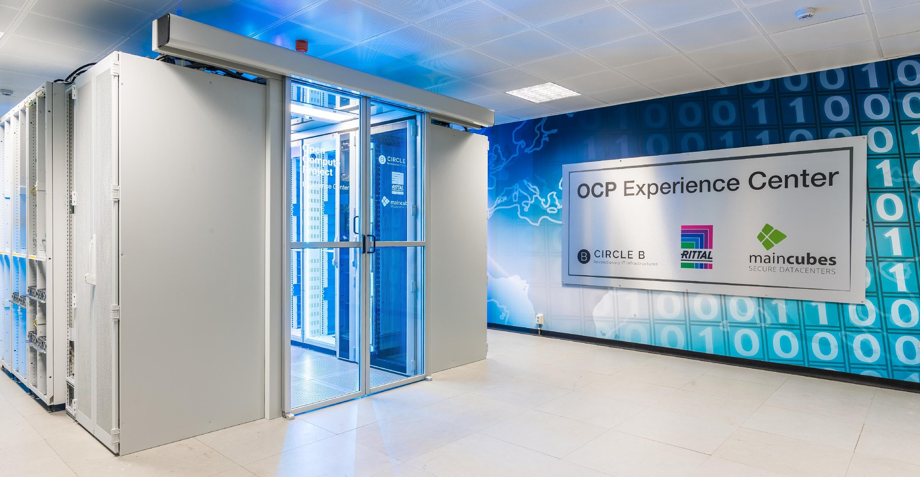
Architectural
DATA CENTER FACILITIES
Photo courtesy of Maincubes
Reference design for OCP Pods

Slide 7
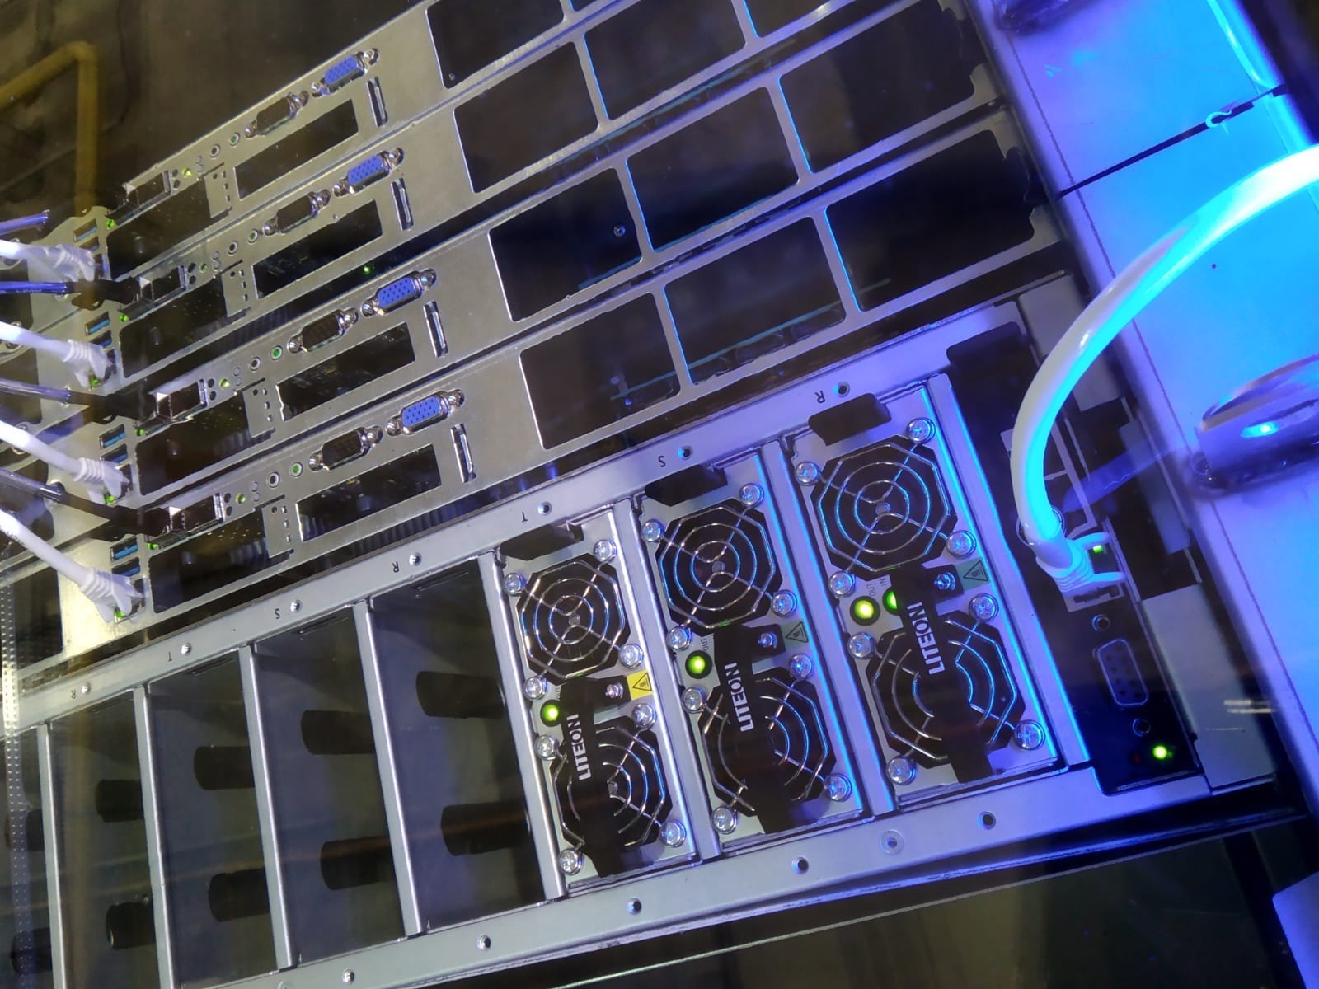
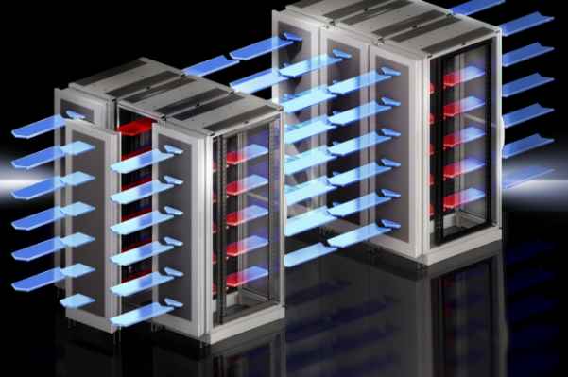
Cooling
DATA CENTER FACILITIES
Photo courtesy of Rittal
Photo courtesy of Submer
Door HEX
Immersion
Reference design for ACS

Slide 8
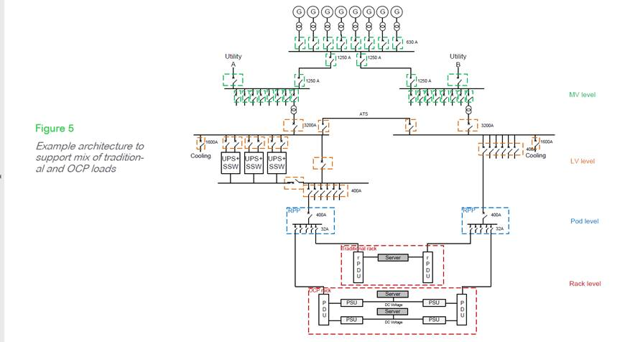
Electrical Systems
DATA CENTER FACILITIES
SLD courtesy of Schneider Electric
Reference design for electrical architecture

Slide 9
New Chapters
              Sustainability
                Safety and Compliance
                SLAs
DATA CENTER FACILITIES

Slide 10
Appendices
                Highlight ‘Requirements’ matrix
                Add and retire rack types
                Add references to related sub-projects
                Add references to other OCP projects
DATA CENTER FACILITIES

Slide 11
OCP Ready TM Site Assessment
Revision Update
                Add Site Operations Standards to ‘Considerations’
                OCP CFOPS Framework
                BICSI 009-2019
                Other framework or standard
                Proprietary or in-house processes

Slide 12
Questions?

Slide 13
Call to Action
Links
    DCF Project
    DCF Mailing List
    Membership - How to Join
    Facility Recognition Program
    Marketplace
OCP Foundation Contacts
OCP Ready TM Lead: mark.dansie@opencompute.org
VP of Channel: steve.helvie@opencompute.org
Data Center Facility Project - Volunteer Leader Contacts​
    Project Lead: Jim.Gordon@ocproject.net​
    Incubation Committee Representative: Brevan.Reyher@ocproject.net​

