Slide 2

Eco-System Enabling of Liquid Cooling Ingredients
Jessica Gullbrand, Tech Lead Engineer, Intel
Mark Sprenger, Tech Lead Engineer, Intel
Advanced Cooling Solutions

Slide 3

Outline
Introduction
Eco-System Enabling
Technology Cooling System (TCS) Loop Ingredients
Cooling Fluid
Universal Quick Disconnects (UQDs)
Coolant Distribution Unit (CDU)
Summary
ADVANCED COOLING SOLUTIONS

Slide 4
Introduction Liquid Cooling
Continued demand for increased compute performance result in increased power and power density
Liquid cooling advantages
- More efficient cooling than air cooling
- Greater cooling capability
- Higher density
Intel working with suppliers to enable liquid cooling ingredients to:
- Increase availability
- Lower risk
- Generational and system supplier compatibility
- Faster time to market opportunity

Slide 5
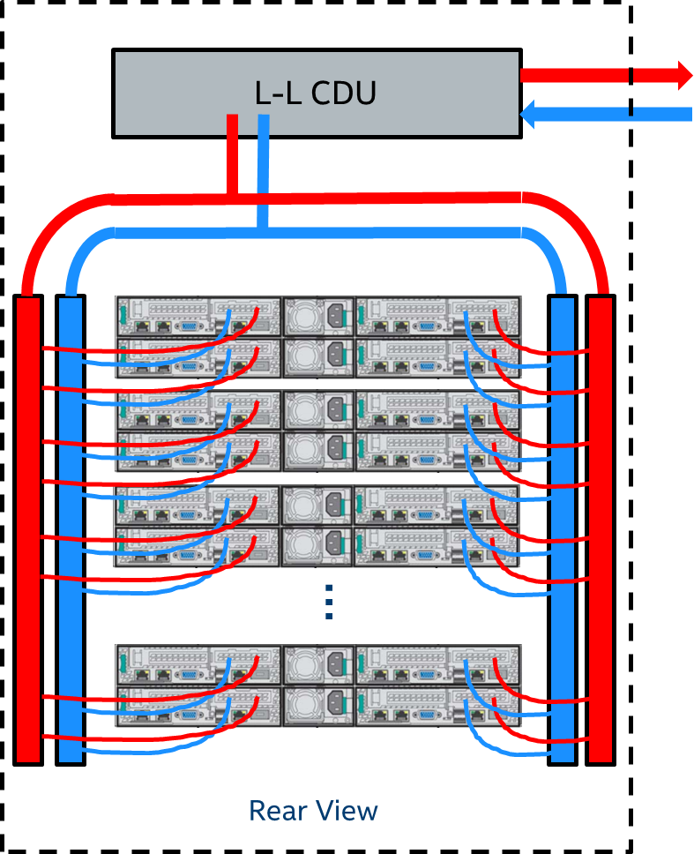
Intel’s Eco-System Enabling
Focus: Manifold Distributed Liquid Cooling Ingredients
Technology Cooling System (TCS) =
Cooling Loop from CDU through the rack/IT equipment
Facility Water System (Primary Side)
Cooling Fluid
Coolant Distribution Unit (CDU)
Liquid-to-Liquid
TCS Cooling Ingredients:
Cooling Fluid
Universal Quick Disconnects (UQDs)
Cooling Distribution Units (CDUs)
Universal Quick Disconnects (UQD)
Server Rack

Slide 6
Intel’s Eco-System Enabling Caveats
Although significant amount of work has been carried out by Intel and the suppliers to ensure the robustness of the ingredients, one should not treat these ingredients as being fully validated by Intel
Ultimately, it is the responsibility of the OEM and/or ODM to ensure the quality and reliability of the systems that utilize these ingredients
Intel targets to contribute test methodologies to OCP

Slide 7
Cooling Fluid
Wetted materials and cooling fluid compatibility extremely important
  - Wetted materials = All materials in contact with the cooling fluid
Quality requirements of cooling fluid needs to be determined
- Corrosion, fouling, scale, microbial, …
Maintenance of fluid as required by manufacturer
Cooling Fluid Choice:
  - Glycol based: Propylene Glycol – PG 55 & PG 25
Fluid Operating Range:
Parameters | Value | Comments
Shipping & Storage Temperature | - 40ºC to 70ºC | - 40ºC is commonly used for shipping/storage temp
Operating Temperature | 17ºC to 65ºC | ASHRAE recommendation 17ºC dew point

Slide 8
Cooling Fluid - Suppliers
Intel has worked with multiple fluid vendors and test houses to have confidence that corrosion will not be a concern over a reasonable product life cycle
Both PG 25 & both PG 55 fluids offered in 47 countries globally
Fluids are NOT interchangeable
Documented wetted materials compatibility
Cooling Fluids | Operational | Storage/Shipping
Fluid Suppliers | Fluid Names (PG 25) | Fluid Names (PG 55)
DOW | DOWFROST® LC-25 | DOWFROST® LC-55
Huntsman Chemical | JEFFCOOL® ISF-25 | JEFFCOOL® ISF-55
Notes:
New.

Slide 9
Cooling Fluid – Wetted Materials
Wetted Materials in TCS loop compatible with the PG 25/55 fluids
Wetted Materials
Copper
Stainless Steels
Ethylene Propylene Diene Monomer (EPDM)
Fluoroelastomer (FKM) (Viton GF, Viton ETP)
Fluorinated Ethylene Polypropylene (FEP)
High Density Polyethylene (HDPE)
Polyphenylene Sulfide (PPS) 40% Fortron reinforced
Polytetrafluoroethylene (PTFE)
Polyether Ether Ketone (PEEK)
Polypropylene (PP)
Polysulfone
Teflon (PTFE) based Thread Sealant
Wetted materials to be updated & brazing materials to be added Q3’2020
Notes:
PEEK was added and Stainless Steels were summarized instead of pointing out several stainless steels
Elastomers: EPDM, Viton GF, Viton ETP
Plastics: FEP, PTFE, HDPE, PTFE, PP,
Metals: Copper, Stainless Steel
Potential Brazing materials: BCuP-3, BCuP-5, TF-H600F
Thread Sealant: PTFE = Teflon

Slide 10
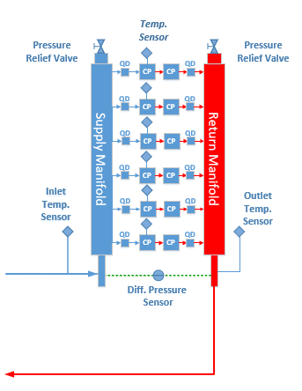
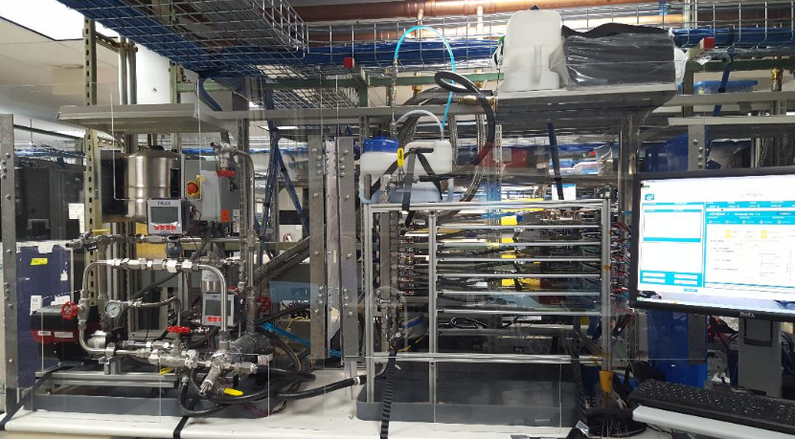
Cooling Fluid - Test Methodology
Wetted material compatibility being tested & monitored
Time: 180 days (ongoing)
Materials:
- Stainless Steel, Copper, FEP, Viton, EPDM, brazing materials
Parameters:
- Pressure, Fluid & Case Temperatures, Flow rate
- Fluid characteristics: pH, conductivity, concentrations (corrosion
inhibitors, particles, etc)

Slide 11
Universal Quick Disconnects (UQDs)
IT Equipment is connected to the cooling fluid manifold using Quick Disconnects (QD’s) hand mated or blind mated
Develop in collaboration with industry experts universal connectors that allow for interchangeability to simplify installations of liquid cooled IT equipment in Data Centers
Objective of UQD Initiative:
  Specify the interface dimensions for interchangeability
  Defining minimum acceptable performance for a no-drip fluid coupling
  Work with multiple suppliers to ensure global availability

Slide 12
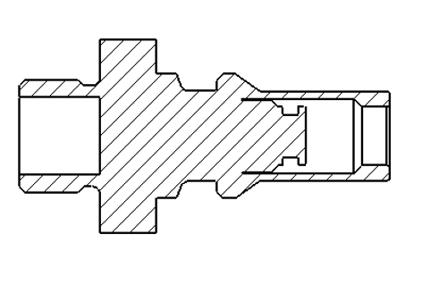

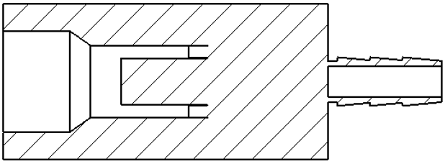
UQD - Hand Mate Design
UQD Plug
UQD Socket
Identification
Plug Termination
Socket Body
Every Universal QD plug and socket will be marked to identify it as a Universal connector and color coded (red or blue) for ease of use:
Plug Body
Socket Stem
A
Socket Termination
Marking | A (mm) | ØB (mm)
UQD02 | 21.0 | 6.65
UQD04 | 29.0 | 11.1
UQD06 | 32.5 | 14.3
UQD08 | 36.5 | 17.5
Lock Feature
Universal Interface Definition
Purpose: Obvious & Interchangeable

Slide 13
UQD - Suppliers
5 Hand Mate Suppliers:
UQD Supplier Names
AVIC Jonhon
CPC - Colder Products Company
Fujikura
Parker Hannifin Corporation
Staubli
Suppliers may offer customized tubing size terminations on the UQD, contact suppliers for options
Notes:
New

Slide 14
UQD - Interchangeability Validation
Test interchanged parts for fit form and function.
Validate that the parts meet the minimum flow coefficient (Cv)
      - Create pressure drop versus flow curves for each
      interchanged part at multiple flow rates from socket to plug
      - Calculate Cv from data and compare to Cv requirements
Validate locking mechanisms of interchanged parts
- Ramped pressure test to exceed maximum rated burst pressure
UQD04 Cv Averages for Interchanged Parts
 |  | Socket
 |  | A | B | C | D | E
Plug | A | X | 1.37 | 1.38 | 1.23 | 1.37
 | B | 1.14 | X | 1.30 | 1.15 | 1.29
 | C | 1.10 | 1.19 | X | 1.08 | 1.19
 | D | 0.89 | 0.92 | 0.93 | X | 0.91
 | E | 0.96 | 1.04 | 1.05 | 1.01 | X
All interchanged parts meet
minimum Cv of 0.8
UQD04 CV Requirement is 0.8 MIN
Note: A refers to supplier A, B to supplier B and so on
Notes:
New.

Slide 15
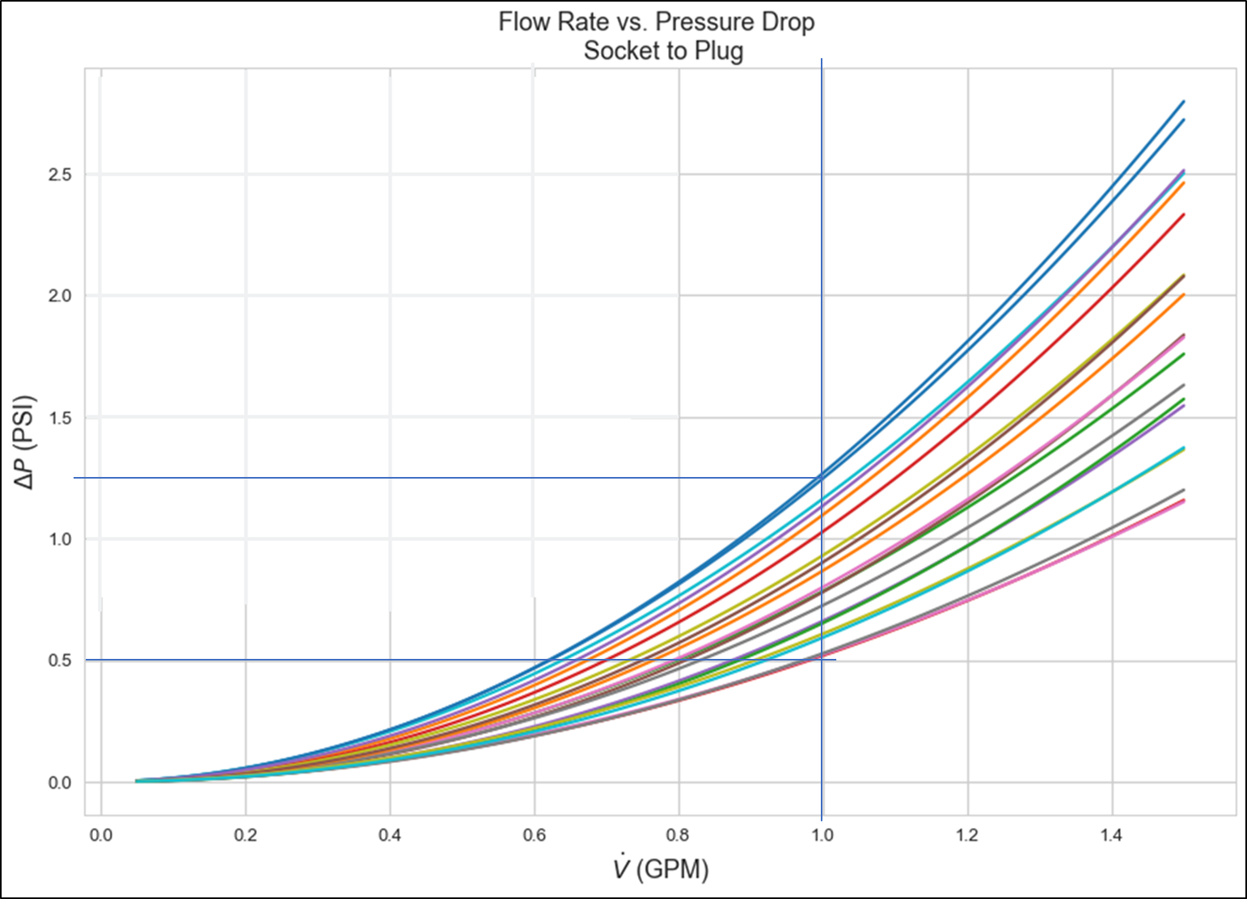
UQD - Flow Distribution Sensitivity
UQD04 Tested Range Cv = 0.89 min, 1.38 max
Analysis assumptions:
8 1U chassis manifolded with UQD04’s,1 LPM per chassis, 2 Cold Plates
UQD Cv(min) 0.89 & UQD Cv(max) 1.38
        Cv of upstream and downstream loop same for all chassis
      Show impact of switching out UQD Cv(max) for UQD Cv(min) on one chassis
      Result:
      One chassis with UQD Cv(min) 0.8 showed an insignificant overall system pressure drop difference resulting in a 0.2% flow rate change
      Result < 0.5C difference in Tcase cooling performance

Slide 16
UQD - Deliverables and Timeline Targets
Hand Mate:
Contribute UQD hand mate requirements document : UQD02, 04, 06, 08
Complete system level analysis showing effect of Cv for representative systems
Deliver interchangeability test data for UQD02 and 04
Status: UQD02 assemblies inhouse and interchangeability has been initiated
Target date for contribution by Q2’2020
Blind Mate:
Ongoing efforts to define blind mate design with industry partners
Targeting contributing:
  UQD blind mate requirements documents: UQD02b, 04b
  Interchangeability test data for UQD04b
Target date for contributions by Q3’2020

Slide 17
Coolant Distribution Unit (CDU)
CDU options:
  Liquid-to-Liquid In-rack CDU
Important to work with CDU suppliers to ensure material compatibility with cooling fluid
Notes:
Same

Slide 18
CDU - Suppliers
2 CDU Suppliers:
CDU Information
CDU Suppliers | CDU Model Examples
Nortek | MCD5U
CoolIT | CHX80
Ongoing work with 4 APAC & 1 NA CDU Suppliers (target Q3’2020 update)
Material compatibility checked with the two PG 25 fluids

Slide 19
Summary
Eco-system Enabling of Liquid Cooling Ingredients in TCS Loop
Cooling Fluid
- Wetted materials
- Wetted materials test methodology
Universal Quick Disconnects (UQDs)
- UQD interchangeability validation
- UQD flow distribution sensitivity
Cooling Distribution Units (CDUs)
- Supplier update

Slide 20
Call to Action
How to get involved!
Join the Mailing Lists:
Advanced Cooling Solutions: https://ocp-all.groups.io/g/OCP-ACS
Cold Plate Work Stream: https://ocp-all.groups.io/g/OCP-ACS-Cold-Plate
Project Wiki:
https://www.opencompute.org/projects/acs-cold-plate-sub-project
https://www.opencompute.org/wiki/Rack_%26_Power/Advanced_Cooling_Solutions
Call Calendar:
Meeting every 2nd Wednesday of the Month at 8 am (PST)
https://www.opencompute.org/projects/rack-and-power
ADVANCED COOLING SOLUTIONS

