Slide 2

Takeaways after two years of Immersion
Michaël HELEZEN, Research Engineer, 2CRSi mhe@2crsi.com
ACS

Slide 3

Outline
ADVANCED COOLING SOLUTIONS
Introduction
Material compatibility
Mechanical and thermal
Electrical
Software
Conclusion

Slide 4
Introduction
ADVANCED COOLING SOLUTIONS
2CRSi group is designing and manufacturing servers
In order to provide more energy-efficient solutions, 2CRSi started designing servers specifically for immersion cooling two years ago

Slide 5
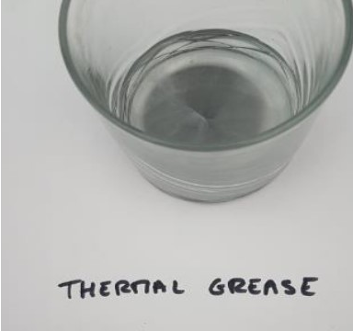
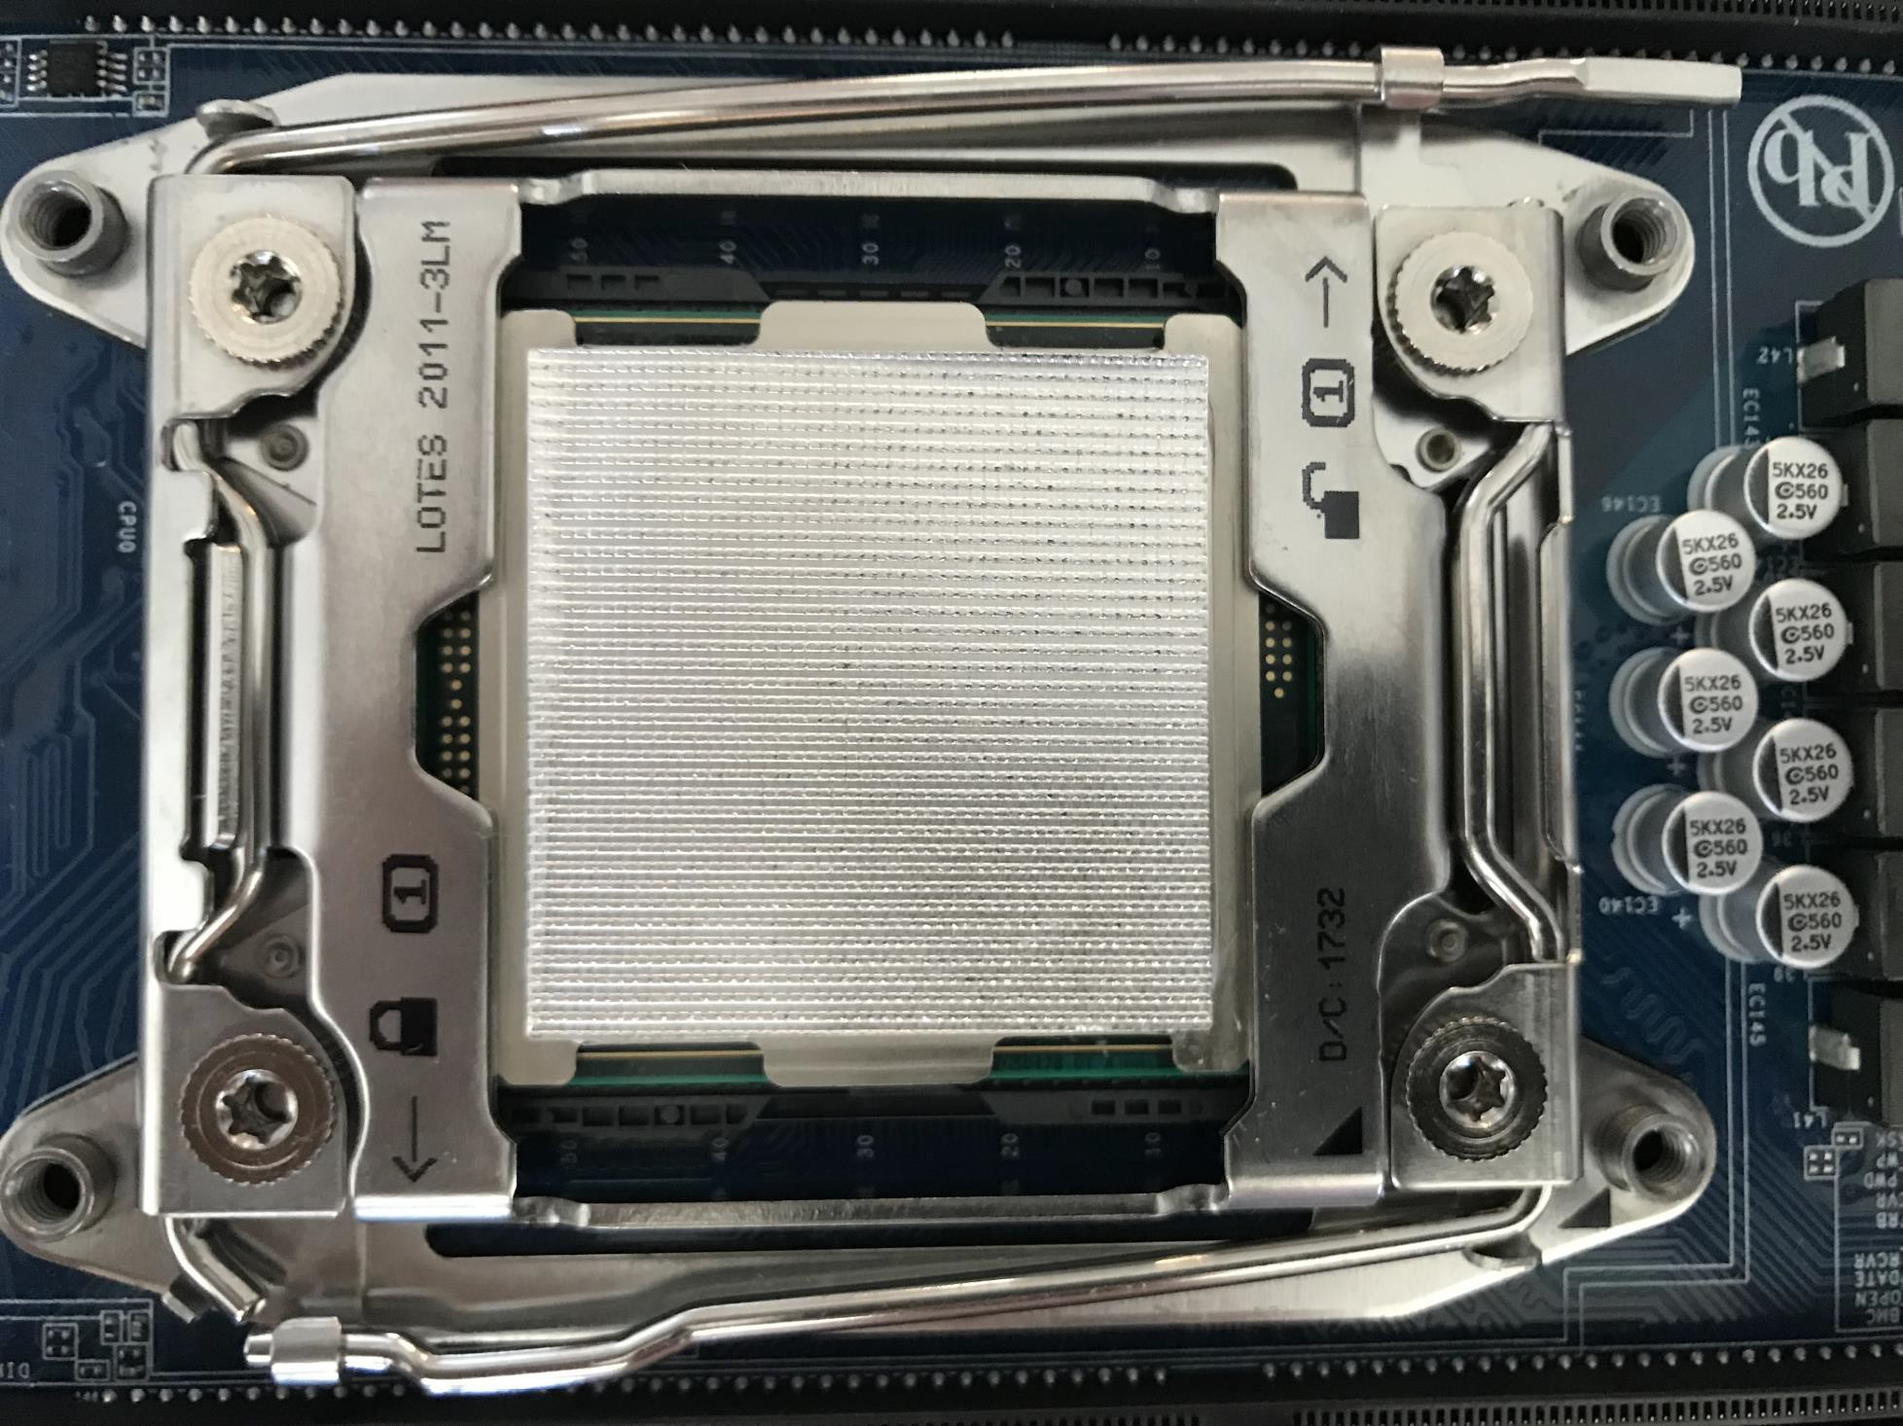
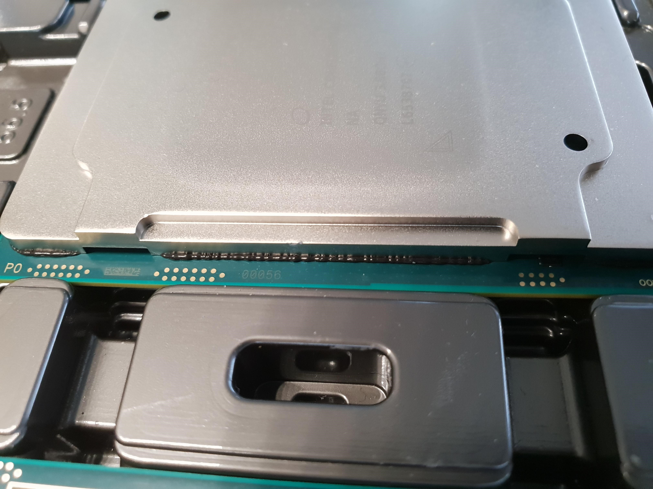
Material compatibility
ADVANCED COOLING SOLUTIONS
Thermal paste for CPU or GPU :
Processor case potentially not compatible with immersion→ Tests in progress
Test
Indium Foil

Slide 6
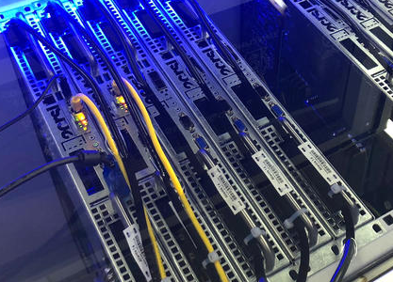
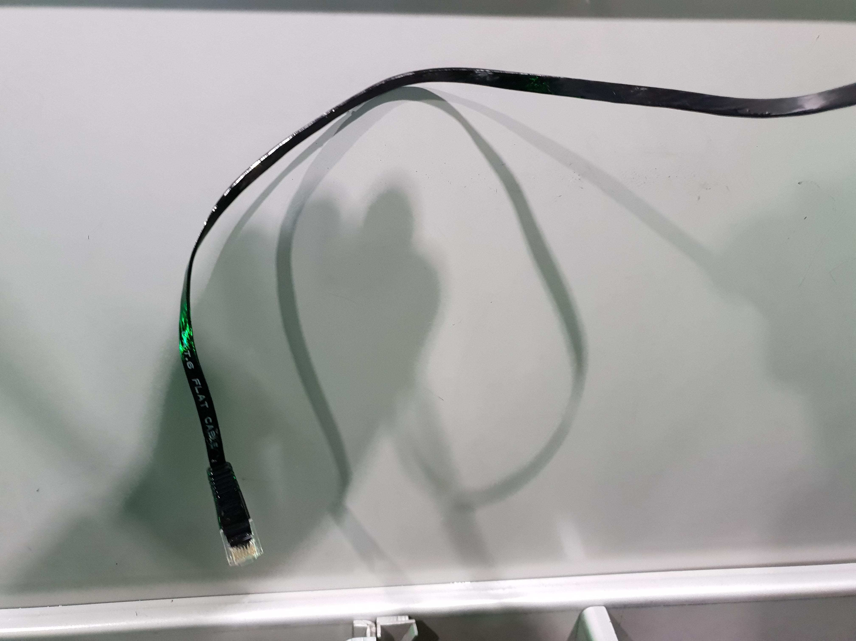
Material compatibility
Cables compatibility (Network or power) in dielectric liquid
ADVANCED COOLING SOLUTIONS
incompatibility possible between cable / liquid
standard fiber optics not compatible within immersion
Example of Cables connection in immersion
cables stiffens with liquid

Slide 7
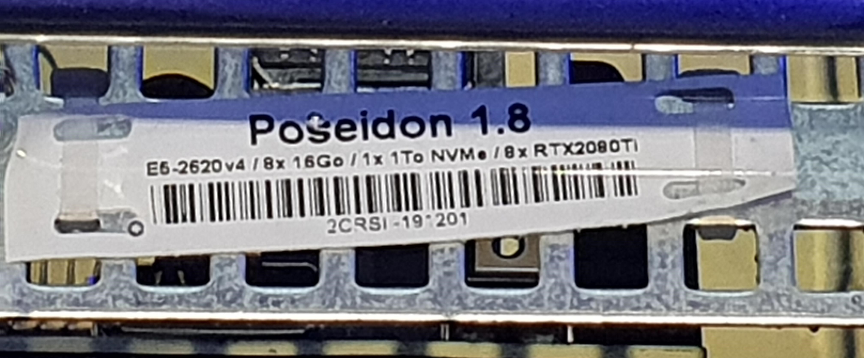
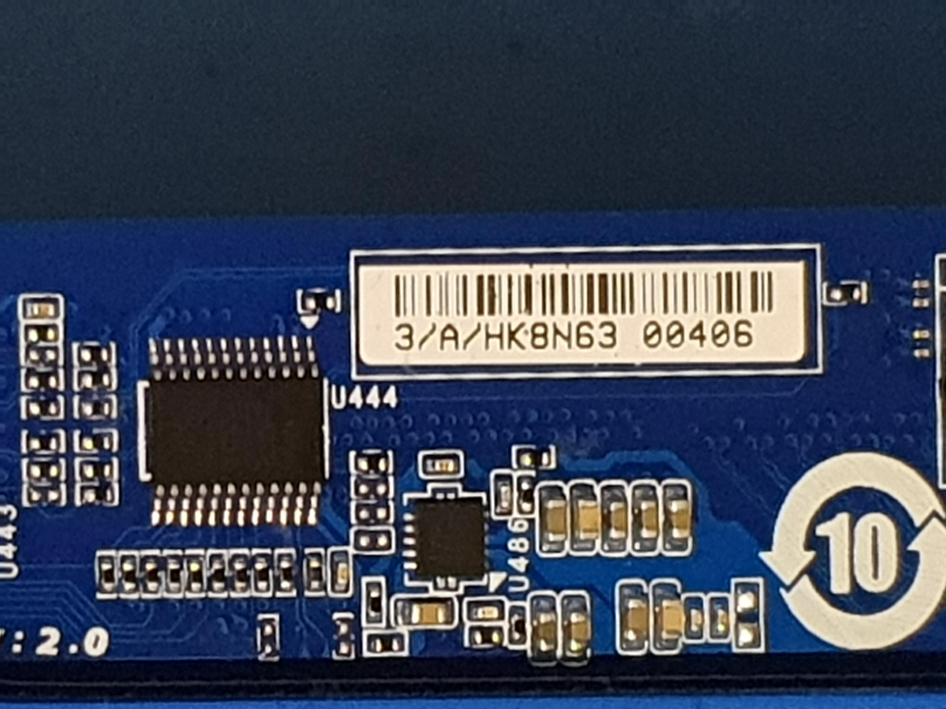
Material compatibility
Issues with labels and warranty implication
ADVANCED COOLING SOLUTIONS
In immersion, glued labels may peel off, driving :
→ tank cleanliness modification
→ difficult components identification
→ warranty implications
Alternative solutions
plastified label
cover the label with transparent epoxy resin

Slide 8
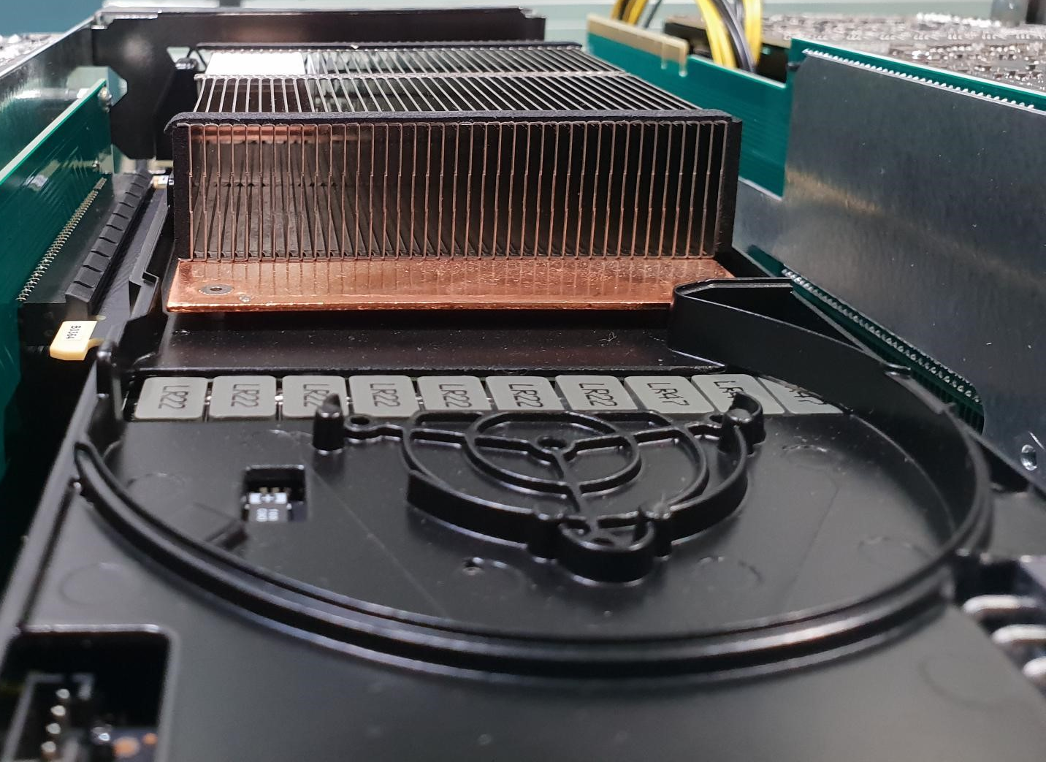
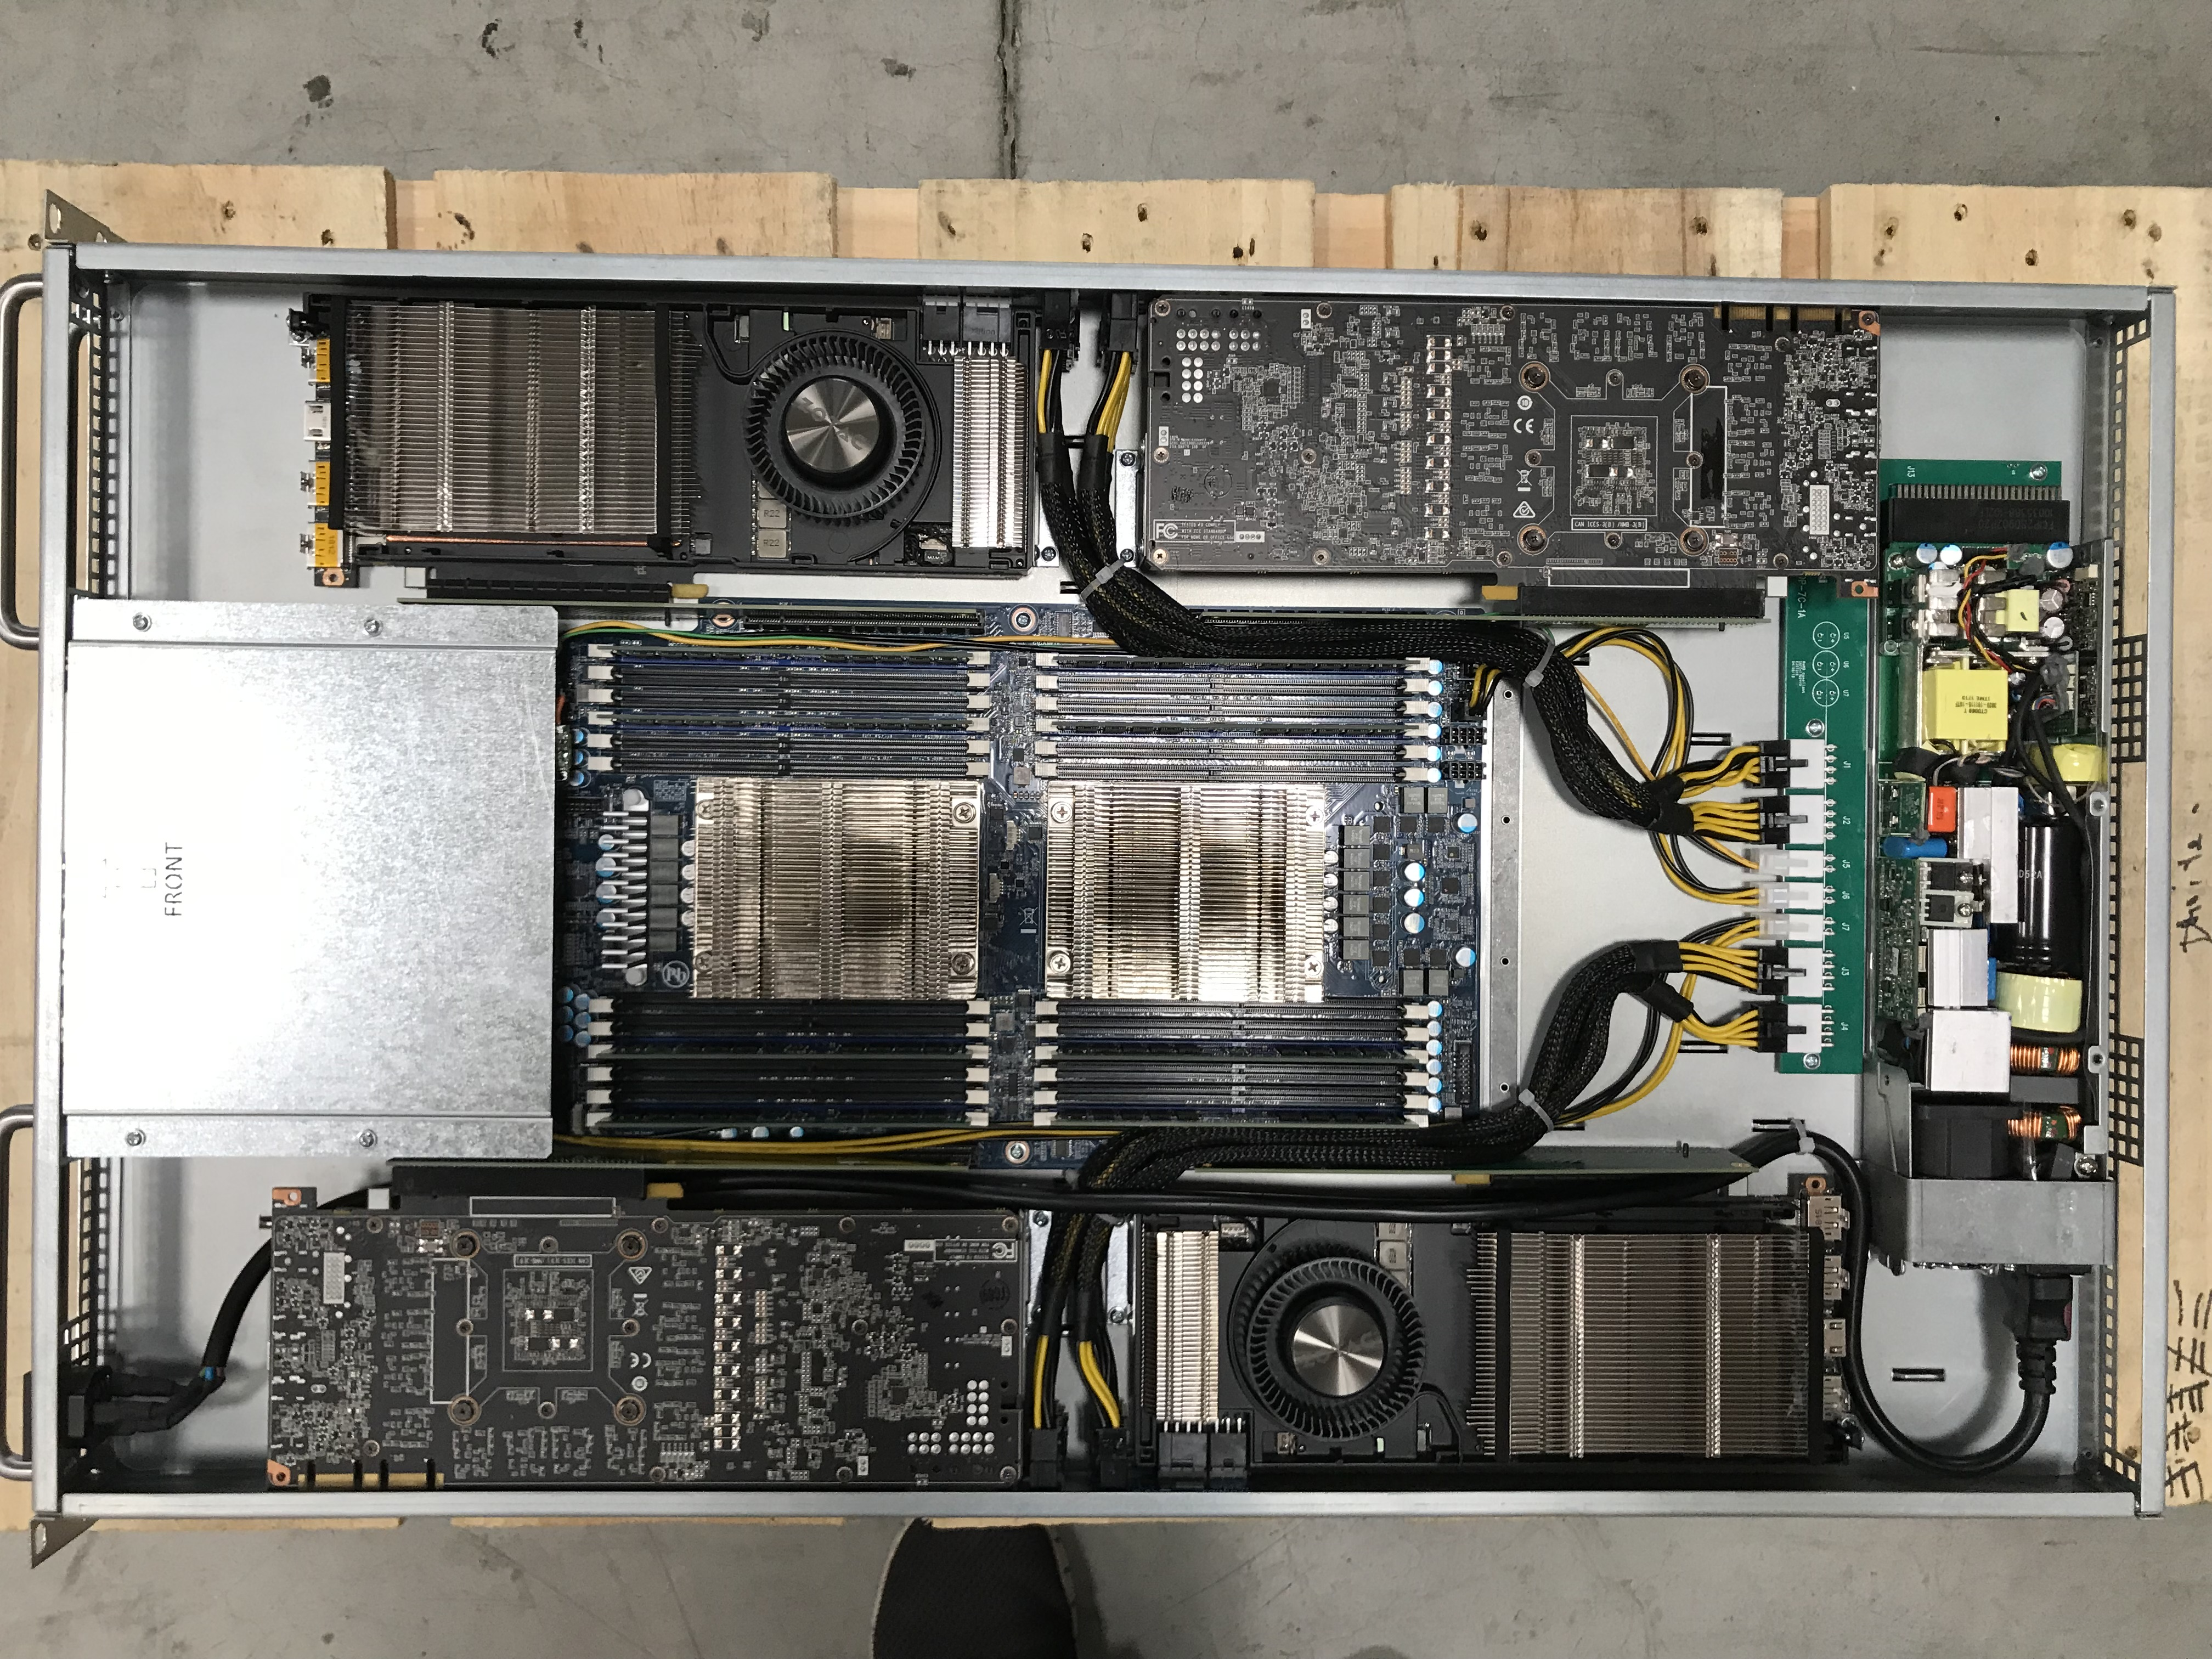
Mechanical and thermal
Position of components in the server
ADVANCED COOLING SOLUTIONS
According to the typology of convection (natural or forced):
Direction of heating flow
Key principle:
Hottest components at the bottom of the tank and the coldest at the top
Do not block the movement of the liquid
Heatsink fins parallel with heat flow

Slide 9
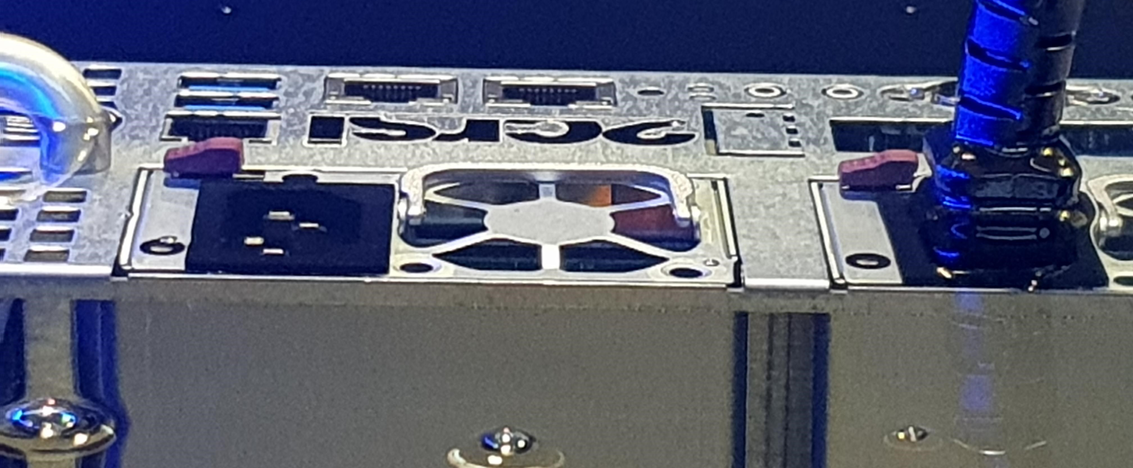
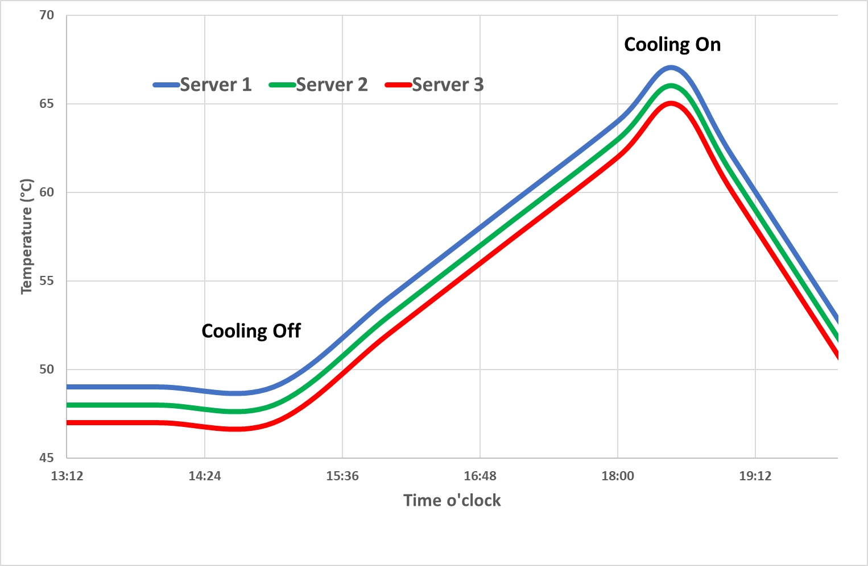
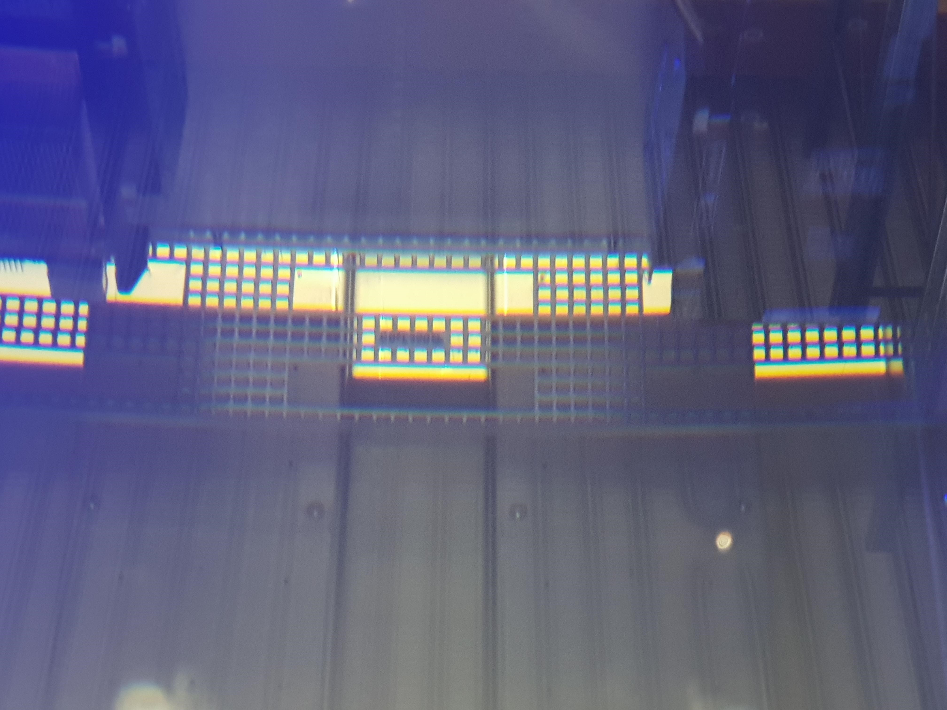
Mechanical and thermal
Servers cooling
ADVANCED COOLING SOLUTIONS
Location of the chassis in the tank -> facilitate the thermal flow
Temperature evolution after cooling shut down

Slide 10
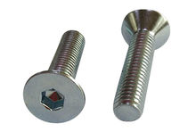
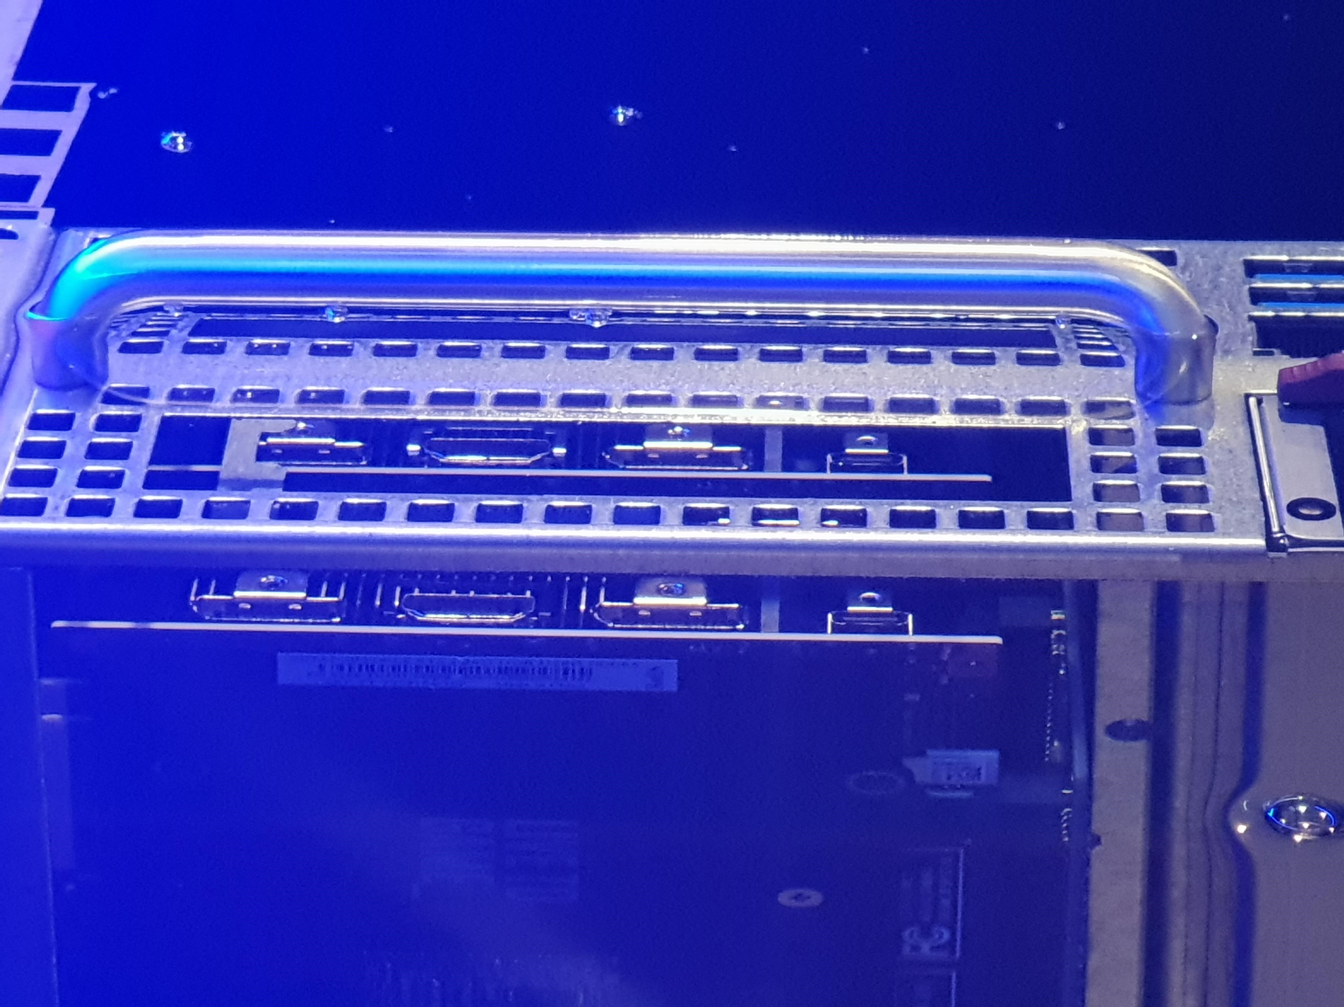
Mechanical and thermal
Specific to submerged servers
ADVANCED COOLING SOLUTIONS
Fixing suitable for submerged components
Use of hex socket screws → metal chips
Chassis reinforcement for easier extraction
Handles added to servers

Slide 11
Electrical
Change of environment for electrical components
ADVANCED COOLING SOLUTIONS
Physical properties between air and dielectric liquids are different (ex : electrical permittivity or conductivity) and could change passive values of components.
To be assessed
Homogeneity of temperature of the components :
service life improvement
failure rate reduction
risk to be identified -> temperature too high for specific components

Slide 12
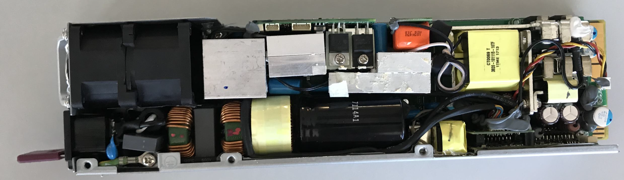
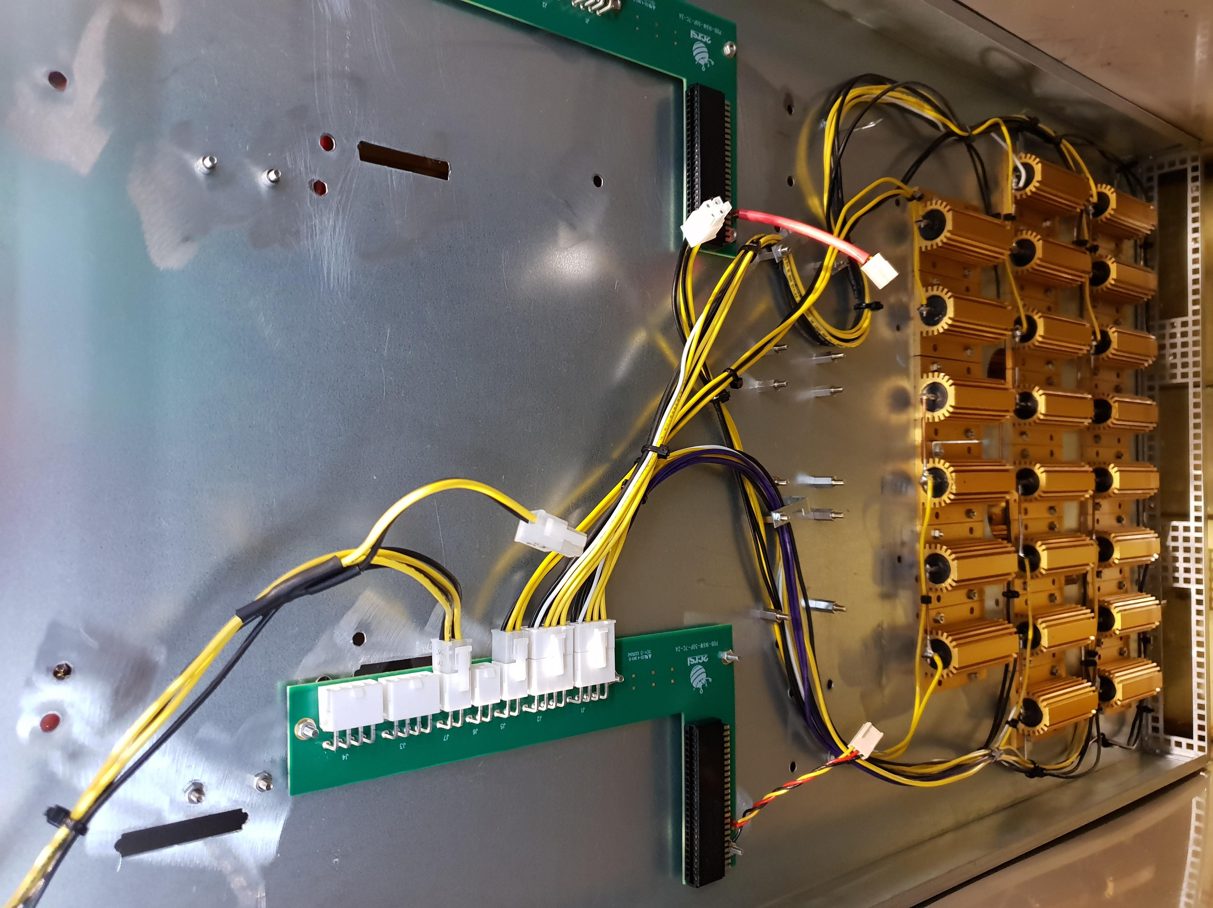
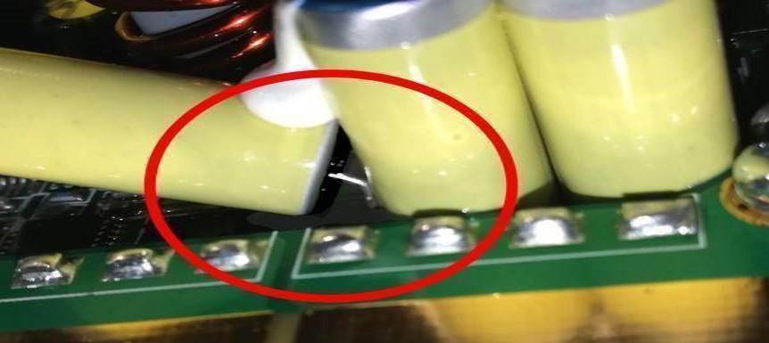
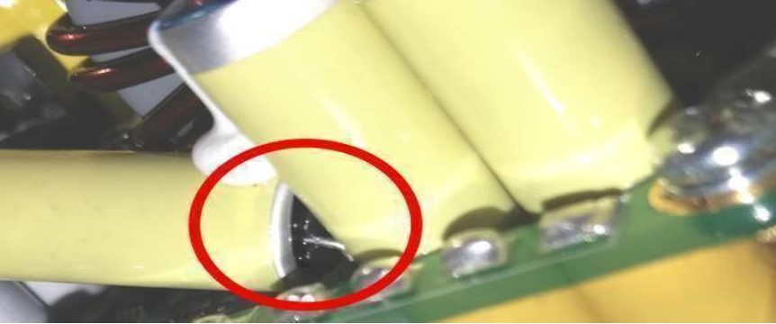
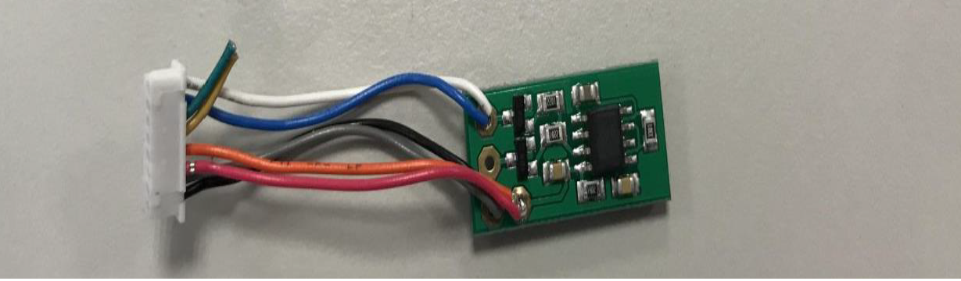
Electrical
Immersion of Power supply units
ADVANCED COOLING SOLUTIONS
Electrical relay → must be sealed
Capacitor chemically compliant
Thermal paste
Turn off the fans
Tests PSUs
capacitor
Inflated capacitor
disconnect the fan and add a fan simulator
test device for PSU

Slide 13
Software for PSU
ADVANCED COOLING SOLUTIONS
By changing the firmware in the PSU, we can:
Deactivate the fan and prevent a fault signal
Ensure weak ventilation for test in air / turn it off in immersion
Modify the Over Temperature Protection (OTP) to adapt to immersion

Slide 14
Conclusion
After two years working with immersion, 2CRSi wanted to share with the OCP community our experience, the specifics of the servers made for immersion observed
So, in conclusion, there are many points to consider when immersing servers in a dielectric liquid but once they are mastered, there is no problem to use immersed servers.
We know that by taking the appropriate precautions, it is possible to transpose the majority of air servers to immersion
That is why, we are confident in immersion cooling technology for its main advantages like significant money savings, component failure rate reduction, components life cycle increase or IT densification.
ADVANCED COOLING SOLUTIONS

Slide 15
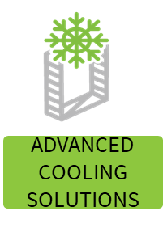
Call to Action
We are participating and will continue to participate in the OCP project:
Rack and power / advanced Cooling solutions.
You can find a lot of information on immersion and several practical guides with the link below.
If you have any questions about immersion, feel free to ask questions of members of this group or ourselves and we will be happy to help.
Project Wiki with latest specification : https://www.opencompute.org/wiki/Rack_%26_Power/Advanced_Cooling_Solutions

