Slide 2




Development of System Specification for UPS
Mauricio Cespedes, Ph.D., Facebook Inc.
UPS Industry Collaborators:
DCF/MDC

Slide 3

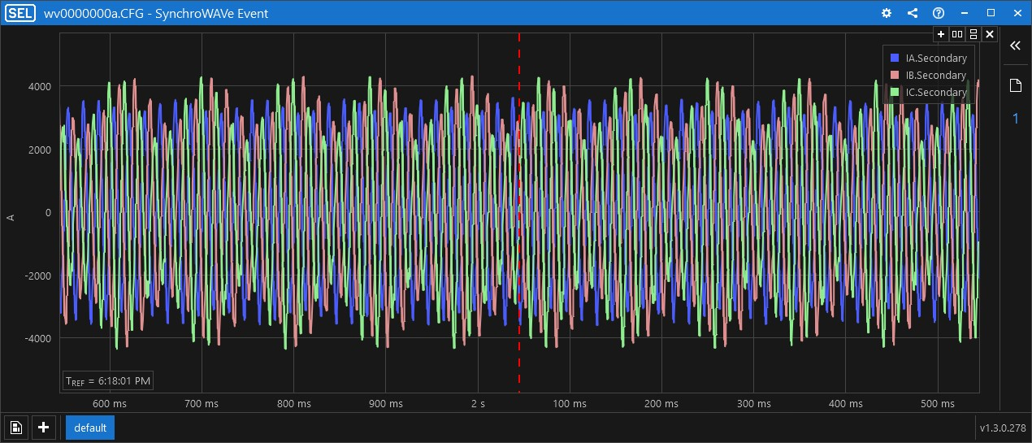
Main Switch-Board (MSB) Currents
IA
IB
4000
IC
2000
A
0
−2000
−4000
0.1
0.2
0.3
0.4
0.5
0.6
0.7
0.8
0.9
1.0
(s)

Slide 4
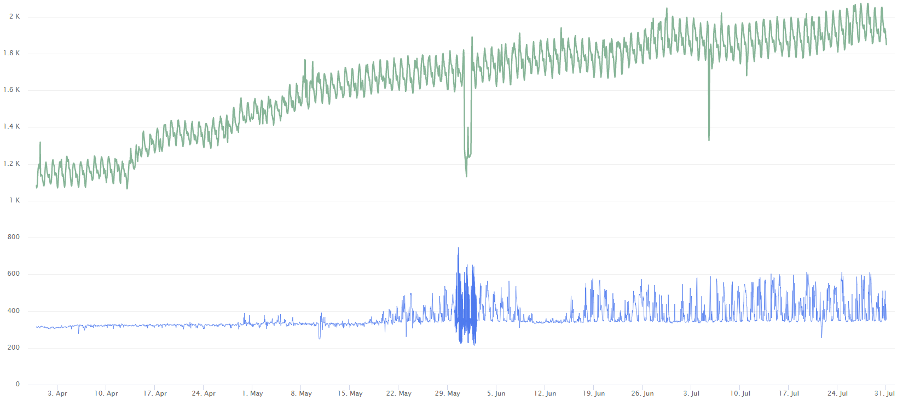
Origin of the Resonance
2000
Total MSB Load (kW)
1600
1000
MSB Neutral Current (A)
MSB Neutral Current Spikes
0
April 2017
May 2017
June 2017
July 2017
August 2017
Notes:
https://fburl.com/ods/qianqmom

Slide 5
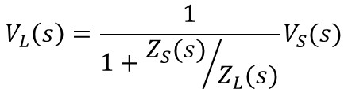
Stability Theory
Interconnection of Data Center and Rack Power Supply Unit (PSU) Creates a Feedback Loop
Z_{S}
Z_{L}
Z_{S}
+
Data Center Building
PSU
+
V_{S}
V_{L}
Z_{L}
−
For a Stable System, the Impedance Ratio Must Not be −1
Magnitude Constraint: Prevent Impedances Being Equal when Phase is 180º Apart
Phase Constraint: When Impedances are Equal, Prevent Phase Difference of 180º

Slide 6
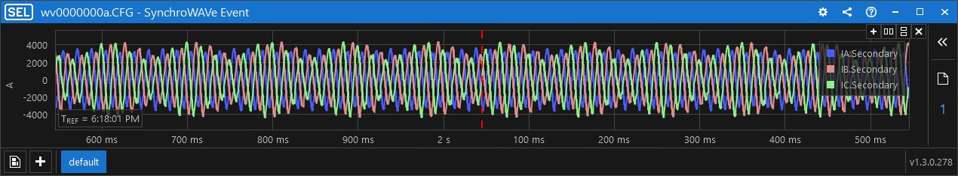
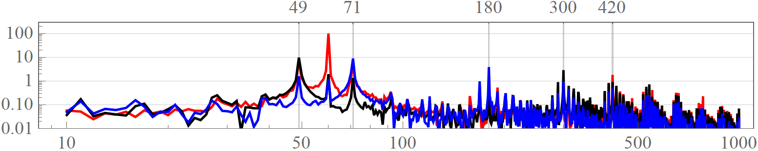
Low-Frequency Resonance
4000
IA
IB
A
0
IC
−4000
0.1
0.2
0.3
0.4
0.5
0.6
0.7
0.8
0.9
1.0
(s)
Zero Sequence
Positive Sequence
Negative Sequence
Percent of I₁
Frequency (Hz)
Notes:
310%,

Slide 7
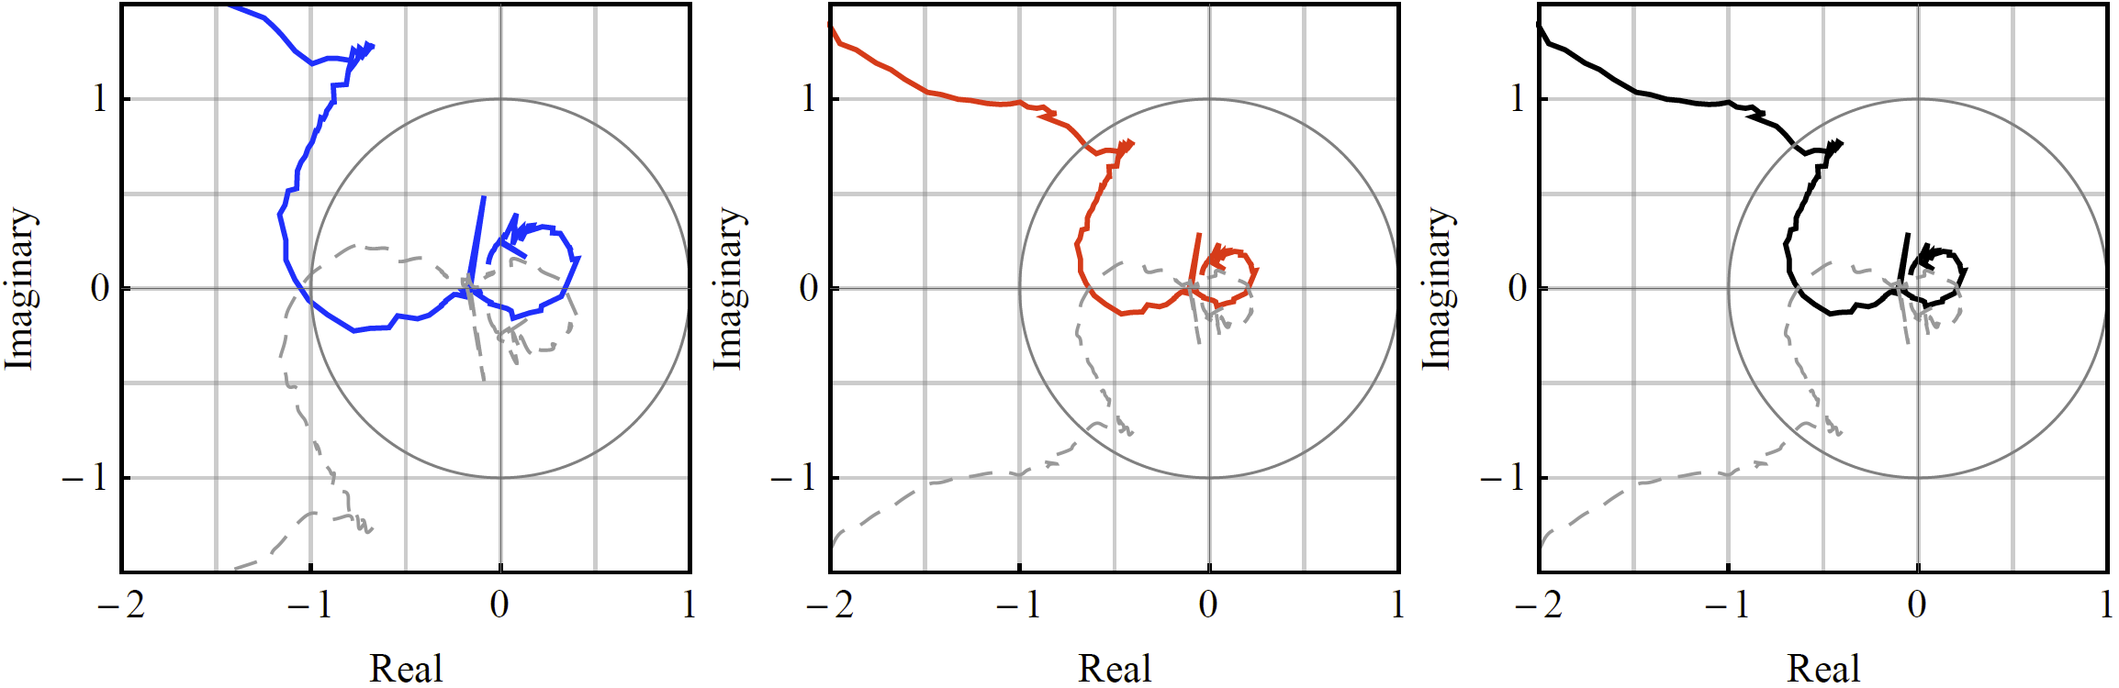
Nyquist Plot of the Impedance Ratio
Z_{S}/Z_{L}
Z_{S}/Z_{L}
Z_{S}/Z_{L}
f
f
f
f
f
f
Zero-Sequence Ratio
Positive-Sequence Ratio
Negative-Sequence Ratio
Unstable
Stable
Stable

Slide 8
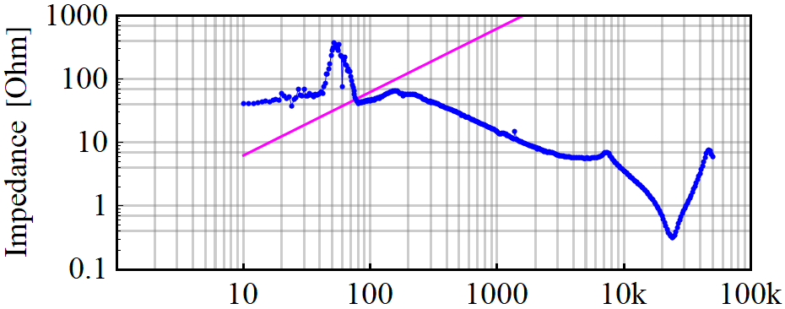
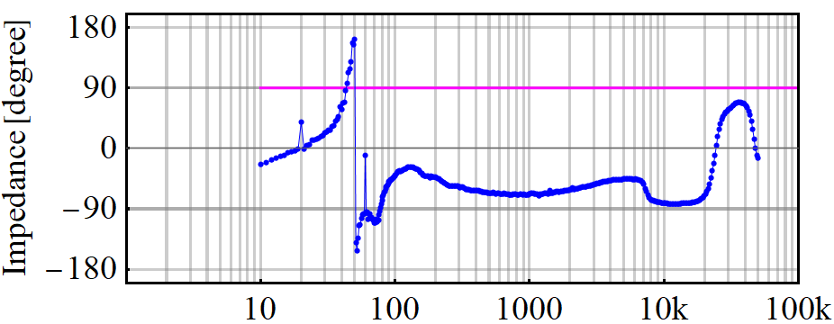
Impedance Analysis
Z_{S}/Z_{L}
f
Z_{L}
Z_{S}
f
Z_{S}
Z_{L}
Zero-sequence impedance ratio predicts system resonance around 70 Hz
Frequency (Hz)

Slide 9
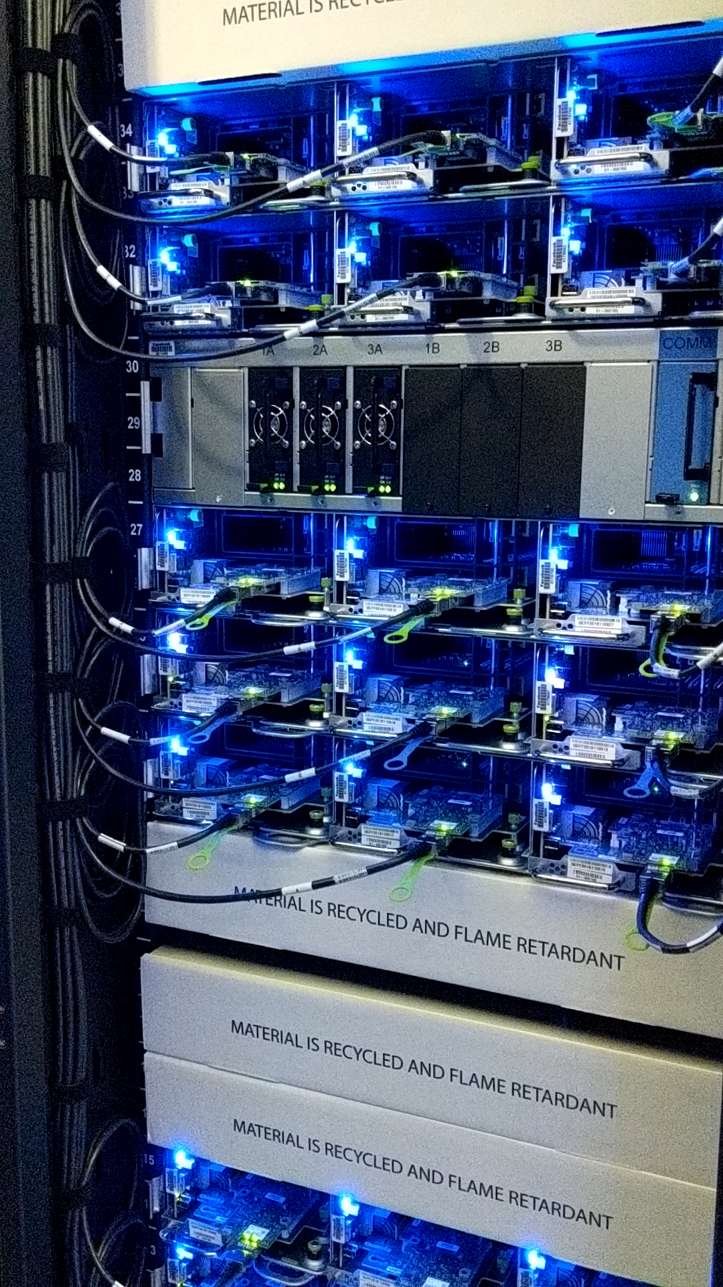
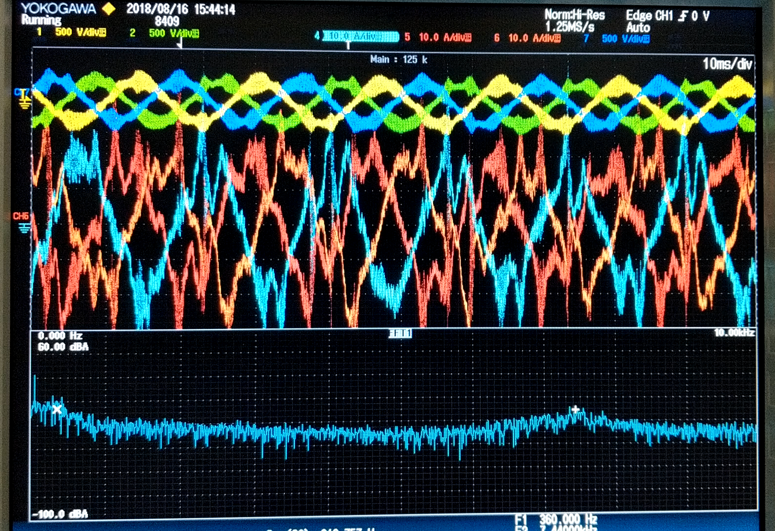
High-Frequency Resonance
10
20
30
40
50
60
70
80
90
ms
360 Hz
7.4 kHz
Notes:
To the left, there is a video capture of a rack suffering from harmonic resonance at the data center. When we connected an oscilloscope at the input of the rack, we captured the voltages and currents in the video to the right. During resonance, there is a large 7.4 kHz distortion of what is supposed to be clean sinusoidal waveforms. You will see in the video, that as the operating condition of the data center changes, the resonance may come and go.

Slide 10
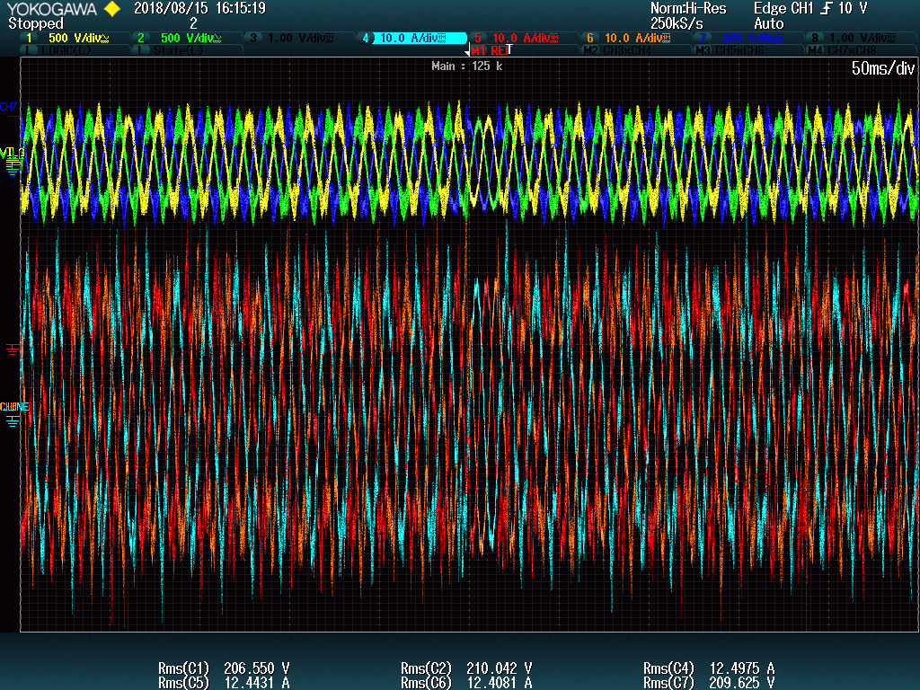
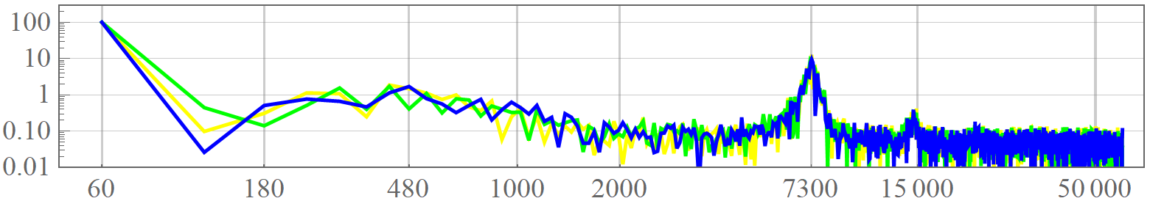
DFT Analysis of the Resonance
Percent of V₁
Frequency (Hz)

Slide 11
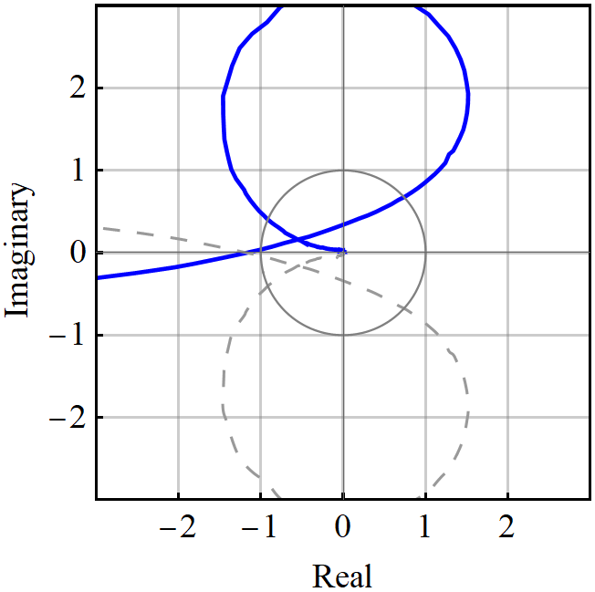
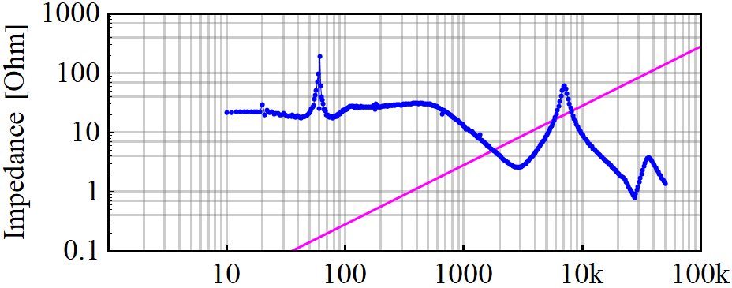
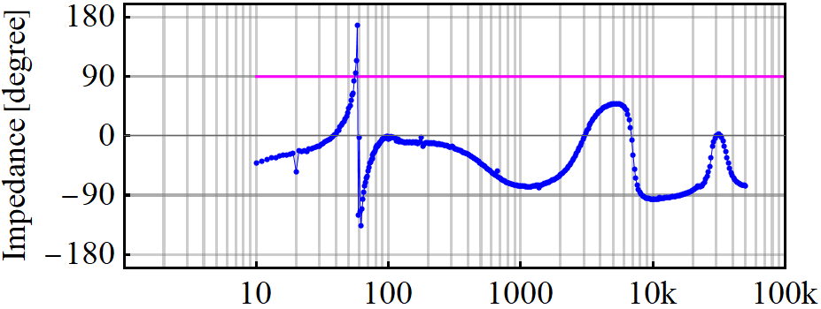
Impedance Analysis
f
Z_{S}/Z_{L}
Z_{L}
Z_{S}
Z_{S}
Z_{L}
Impedance ratio predicts system resonance around 7 kHz
Frequency (Hz)

Slide 12
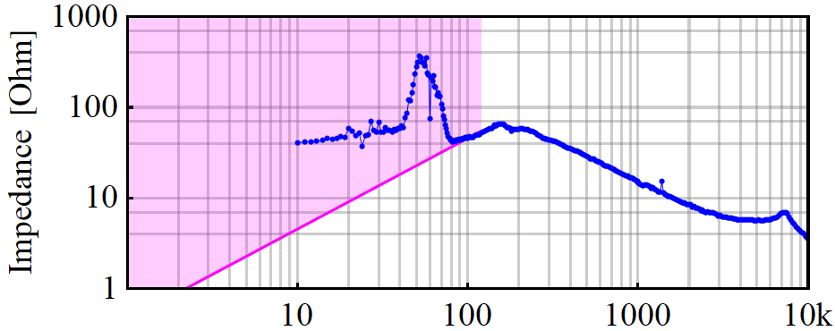
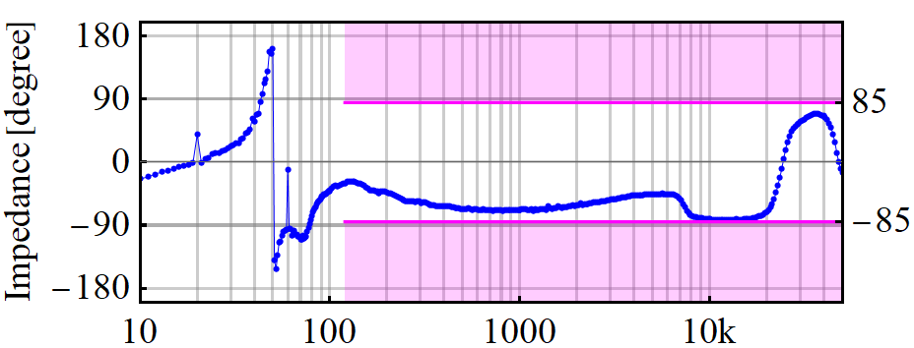


Impedance Constraints
Z_{L}
Z_{L}
Z_{S}
Frequency (Hz)
Frequency (Hz)
Magnitude Constraint: Prevent Impedances Being Equal when Phase is 180º Apart
Phase Constraint: When Impedances are Equal, Prevent Phase Difference of 180º
L_{n} is the nominal or base inductance of the PSU, f₁ is the fundamental frequency of the system

Slide 13
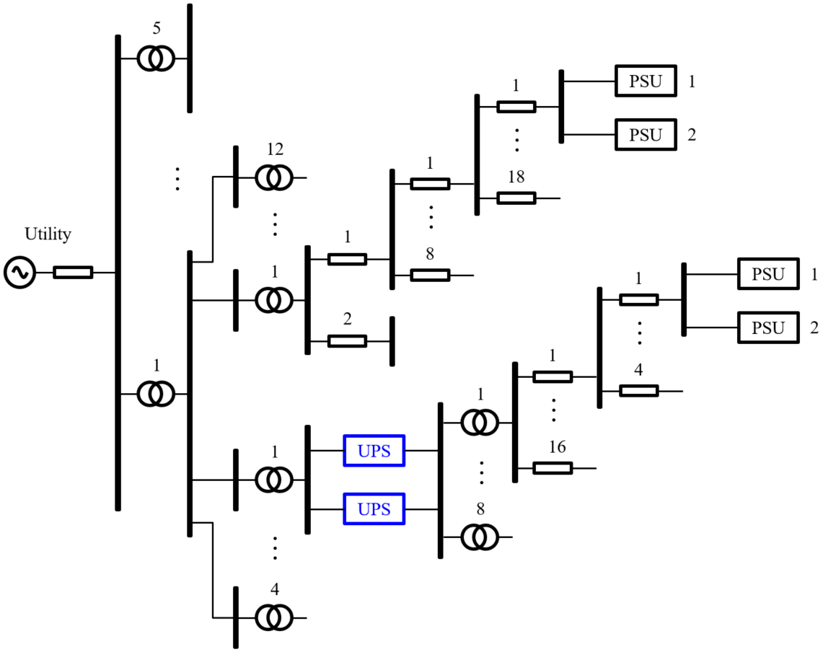
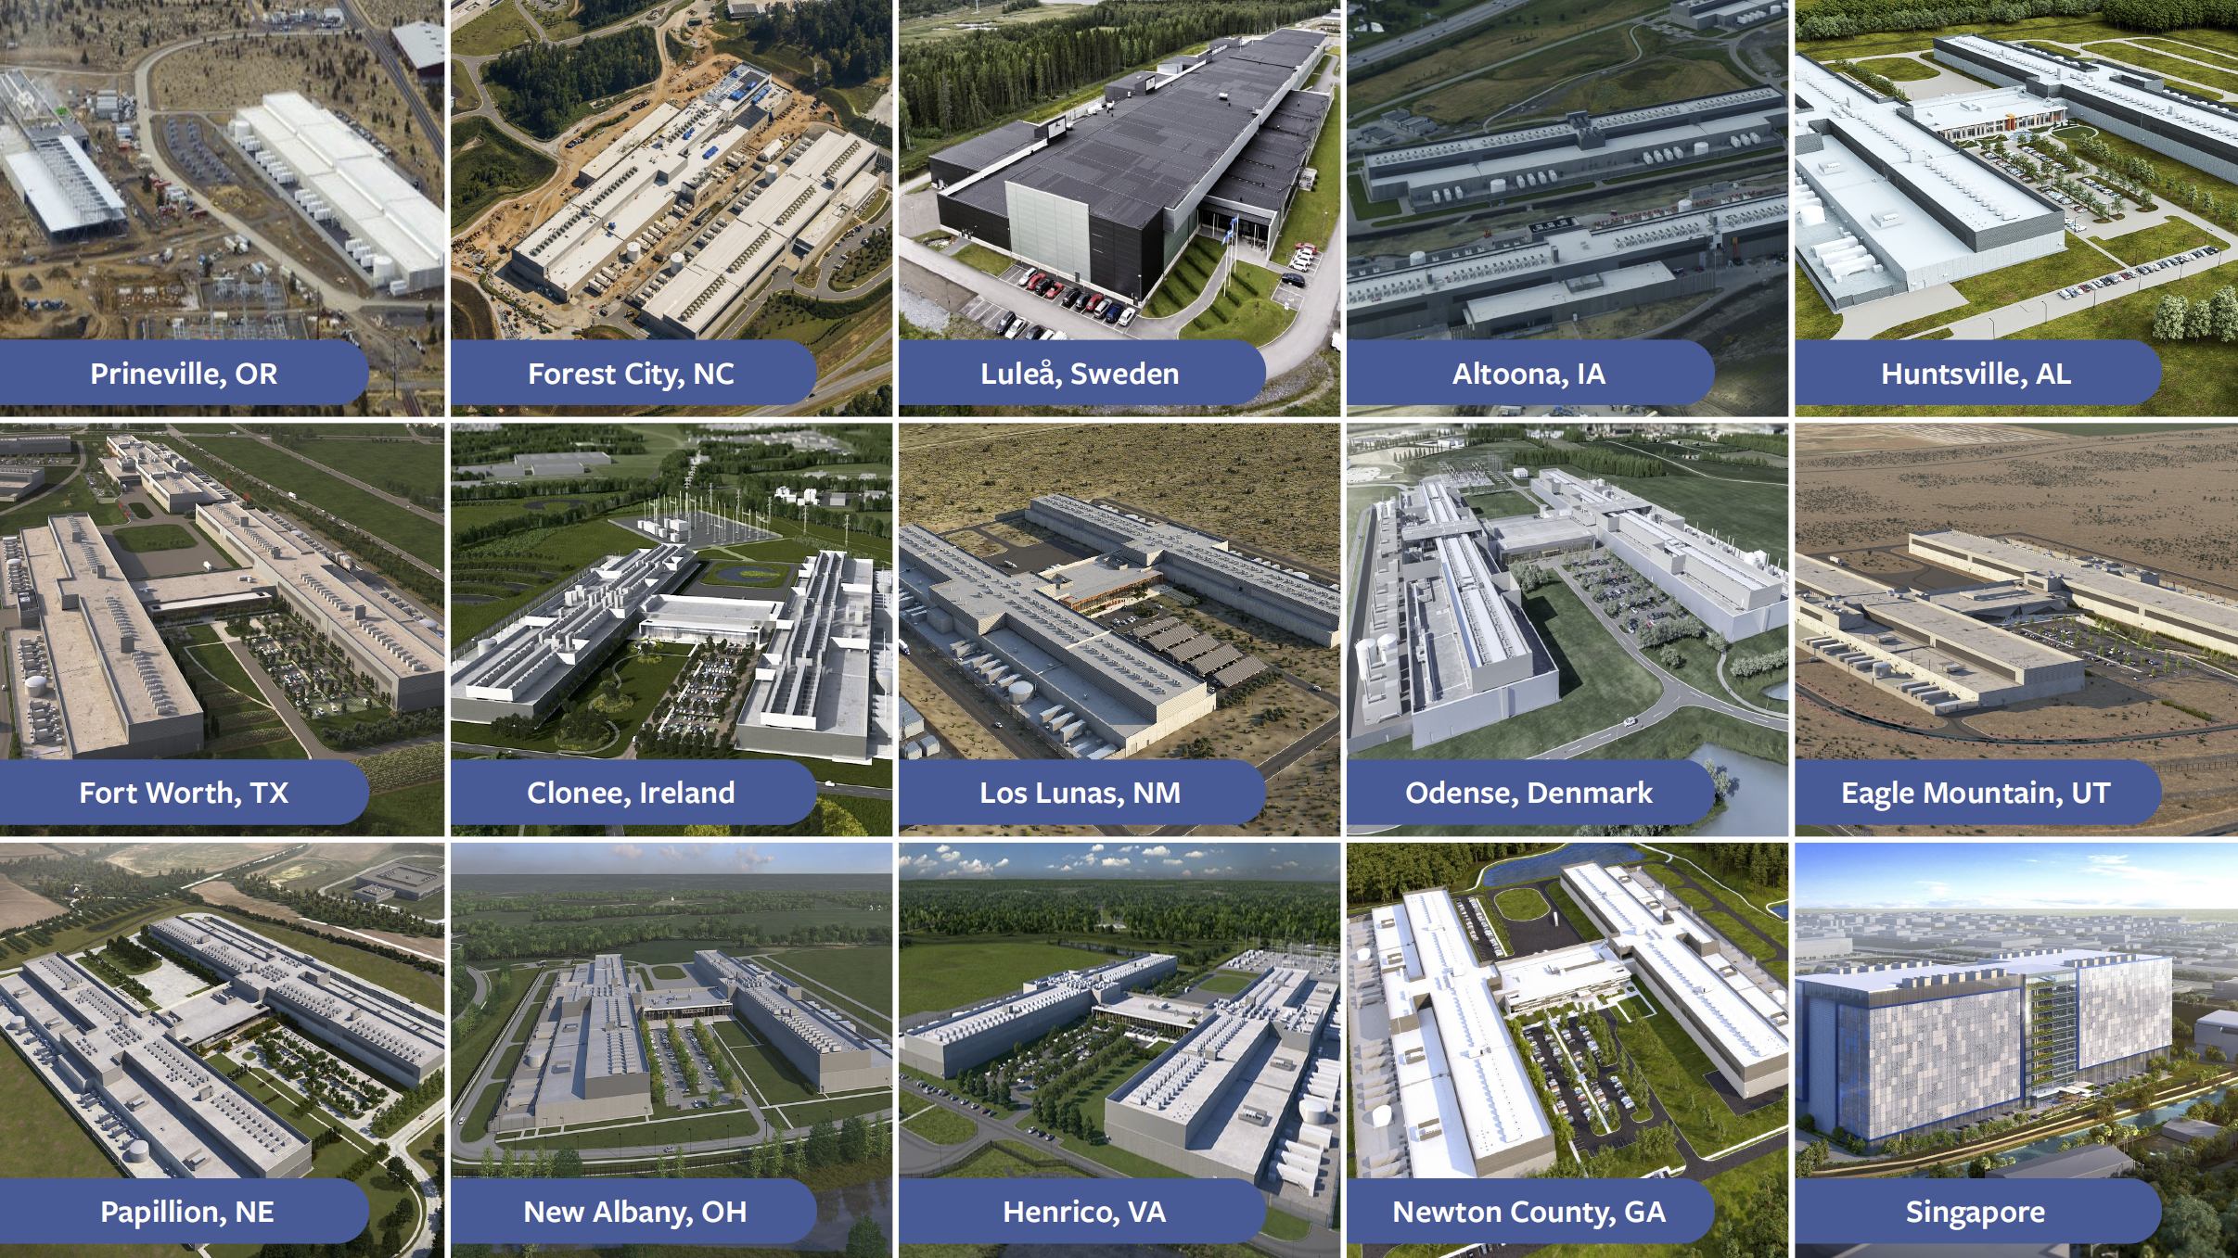
The New Facebook Data Center
Development of System Specification for UPS | Thursday 9:00 am
Data Center Electrical Specification for System Stability | Thursday 9:45 am
Data Center System Stability Requirements for Power Supplies | Thursday 3:05 pm
Notes:
The new Facebook data center, is required to comply with new impedance specifications. From the input transformer or PTX, the switch gear, cable interconnections and down to the rack power supplies, there are impedance specifications for each of them. If there are in-line UPS, they also are subject to impedance specifications.
At this OCP we have three talks dealing with these impedance specifications, this one we currently are at is on UPS. The next is on the system in general, and the afternoon talk is on Power Supplies.

Slide 14
UPS in the Facebook Data Center

Slide 15
Model Reduction
L₁
PSU
N₁
L₀
L₂
UPS
L₃
PSU
N₂

Slide 16
UPS Components and Modes
PSU
N₁
Bypass
Rectifier
Inverter
PSU
N₂
Dc-Dc
−
+
Batteries

Slide 17
Bypass Mode
PSU
N₁
PSU
N₂
−
+

Slide 18
Double-Conversion Mode
PSU
N₁
PSU
N₂
−
+

Slide 19
Stored-Energy Mode
PSU
N₁
PSU
N₂
−
+

Slide 20
Line-Interactive with Bypass
PSU
N₁
PSU
N₂
−
+

Slide 21
Bypass Mode
PSU
N₁
PSU
N₂
−
+

Slide 22
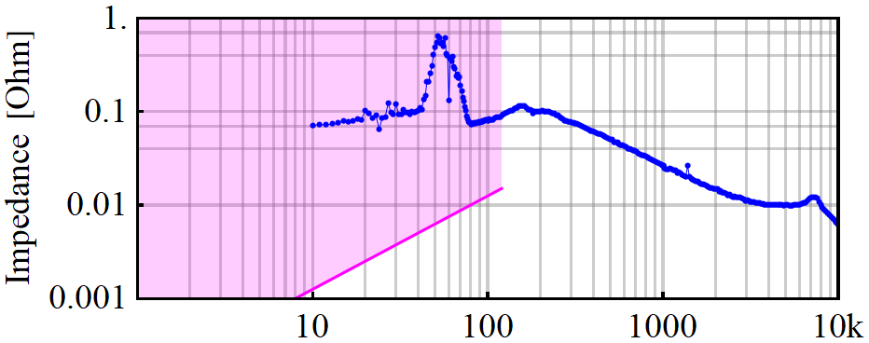
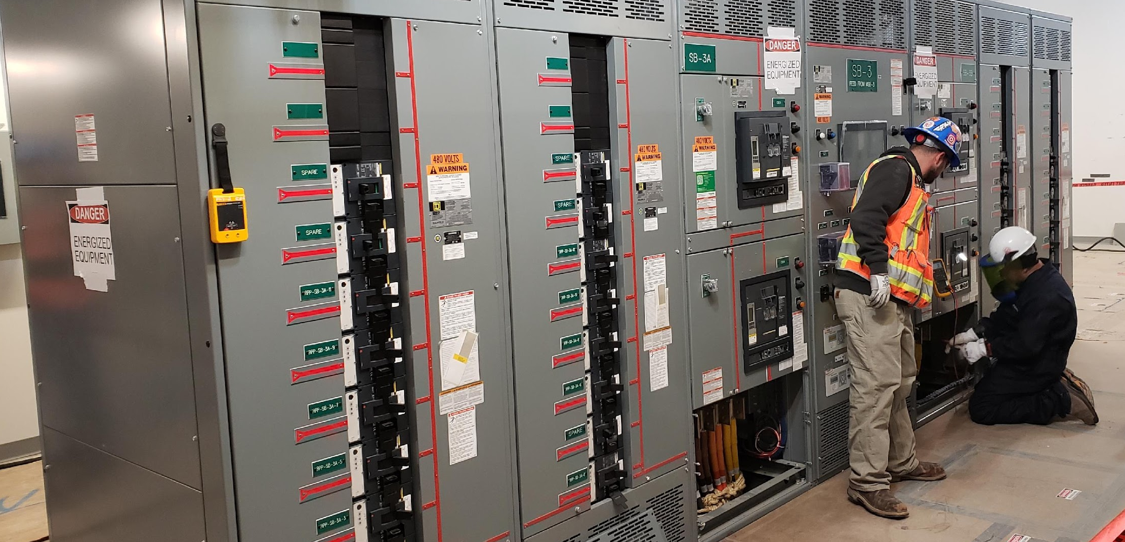

Stability Requirement in Bypass
L₁
@1 MW
L₀
PSU
N₁
Z_{L}
L₂+L₃
L_{b}
PSU
N₂
←20 μH
For every MW of power in the UPS, bypass impedance must not be larger than 20 μH:
2 MW switchboard
~6 μH
At 480 V and 1 MW, L_{n} = 600 μH, hence L_{b} < 0.03 p.u.

Slide 23
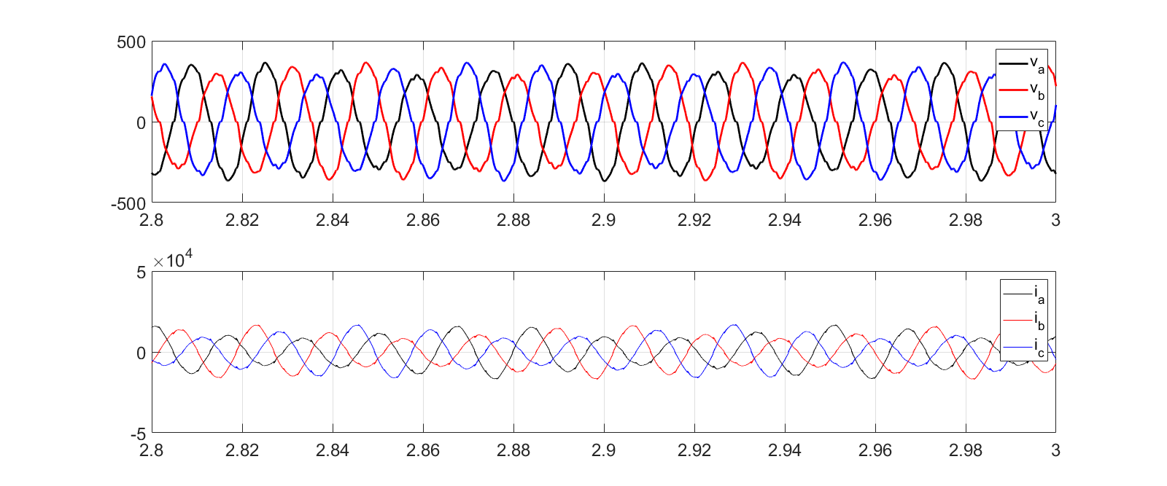

Unstable Simulation in Bypass Mode
Voltage (V)
12 Hz
Current (A)
Time (s)

Slide 24
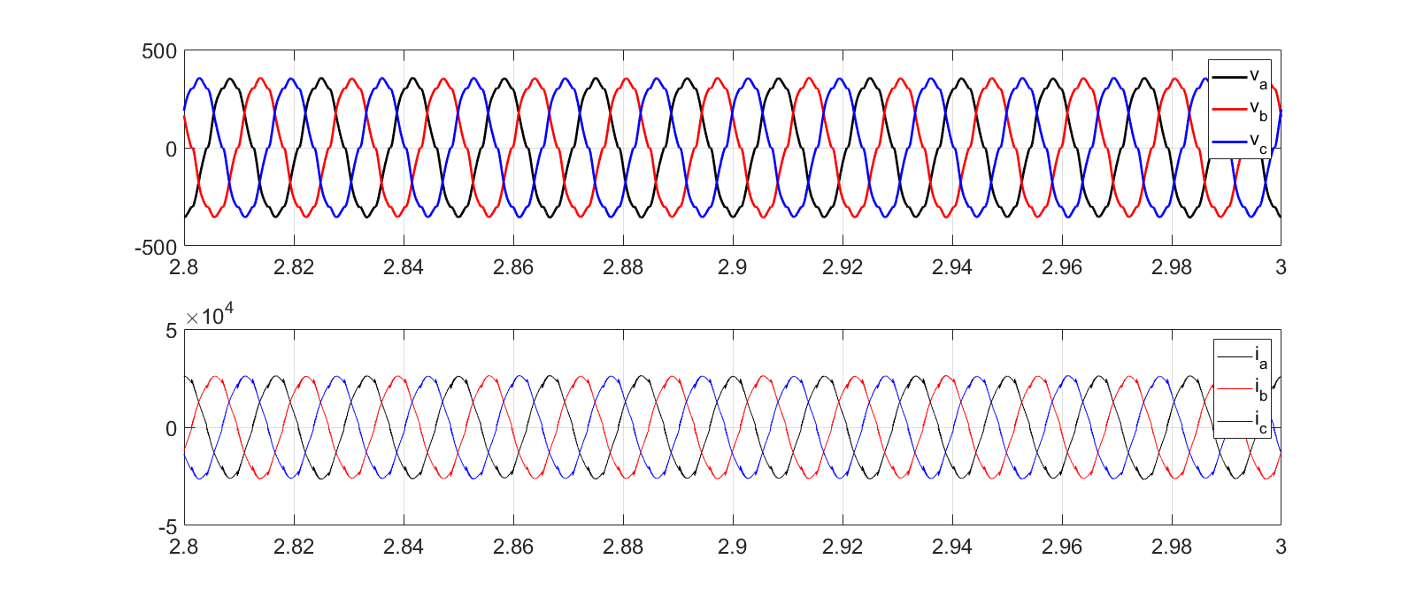

Stable Simulation in Bypass Mode
Voltage (V)
Current (A)
Time (s)

Slide 25
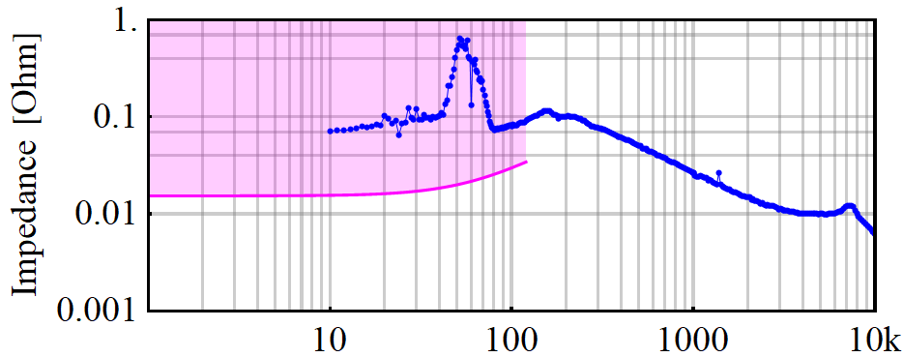

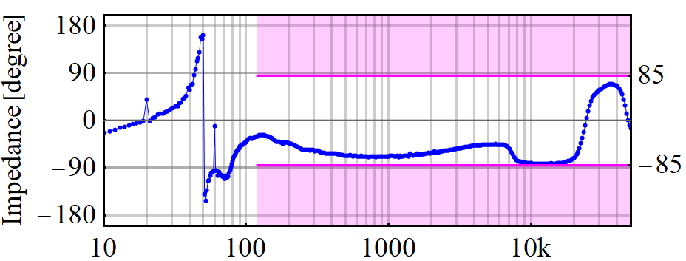




Inverter Stability Requirement
Z_{i}
@1 MW
L₃
Z_{L}
PSU
N₂
Magnitude Requirement:
Frequency (Hz)
where
Z_{L}
Phase Requirement:
Frequency (Hz)

Slide 26
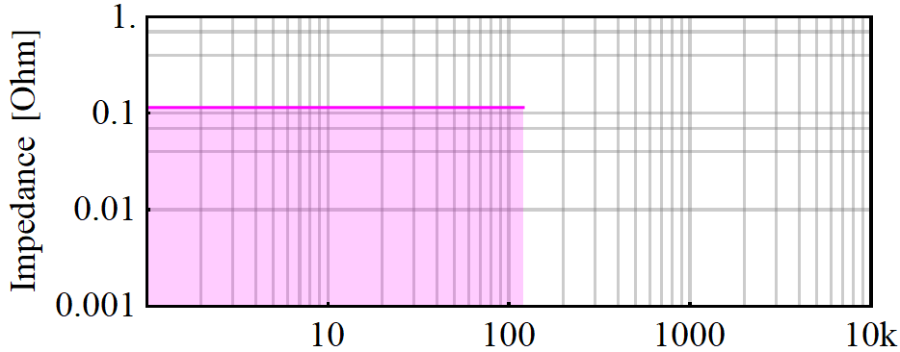

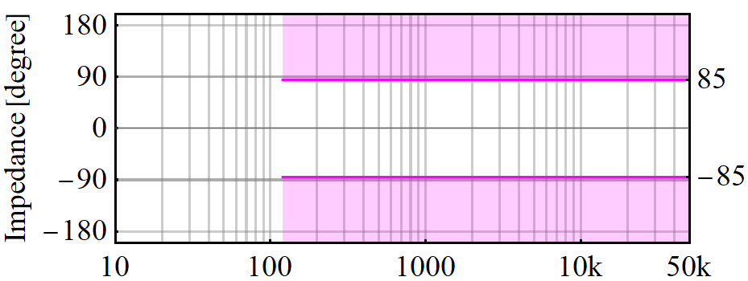

Rectifier Stability Requirement
L₁
@1 MW
L₀
PSU
N₁
L₂
Z_{r}
Magnitude Requirement:
Frequency (Hz)
Phase Requirement:
Additional Requirement:
Rectifier must be stable with L_{eq} = 0.33 p.u.
Frequency (Hz)

Slide 27
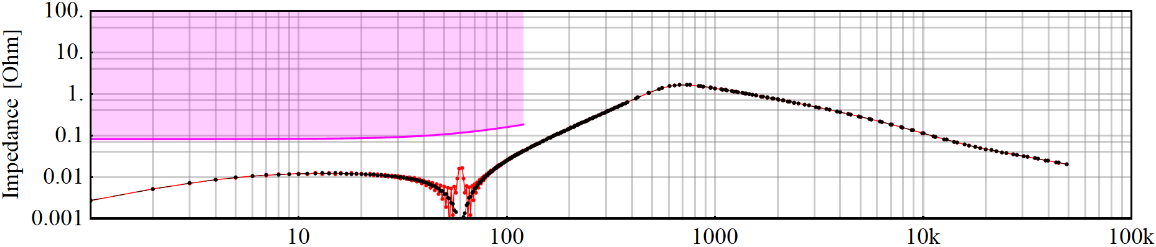
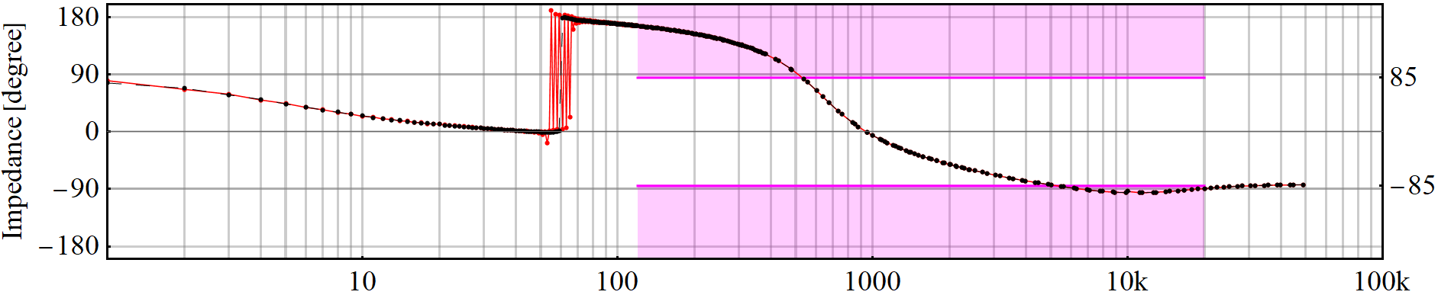
Inverter Impedance from Simulation
@250 kW
Z_{i}, positive Sequence
Z_{i}, negative Sequence
Frequency (Hz)

Slide 28
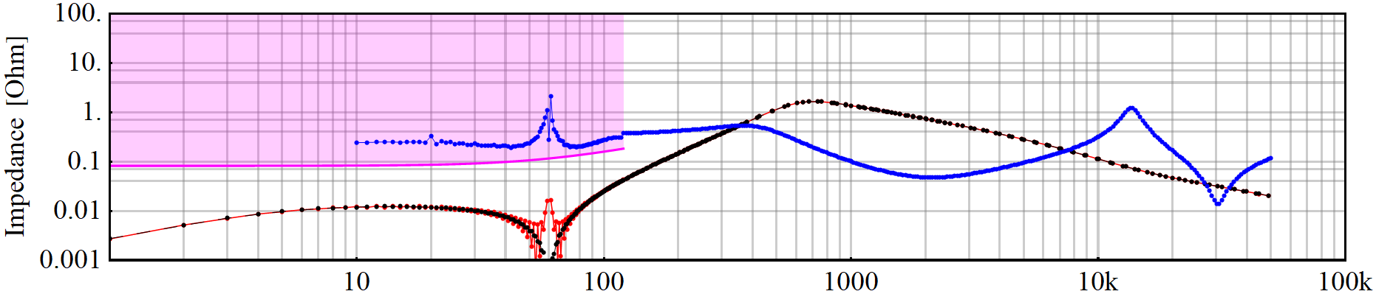
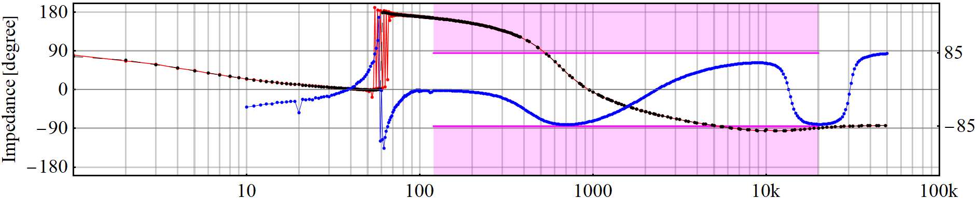
Inverter Impedance from Simulation
@250 kW
Z_{L}
350 Hz
7.4 kHz
Z_{L}
Frequency (Hz)

Slide 29
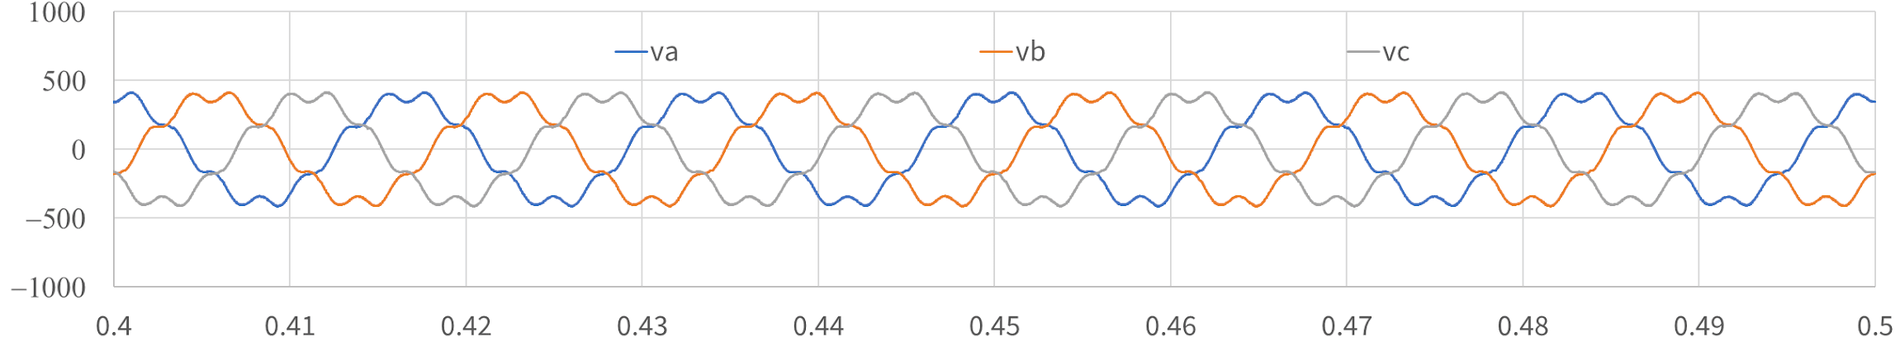
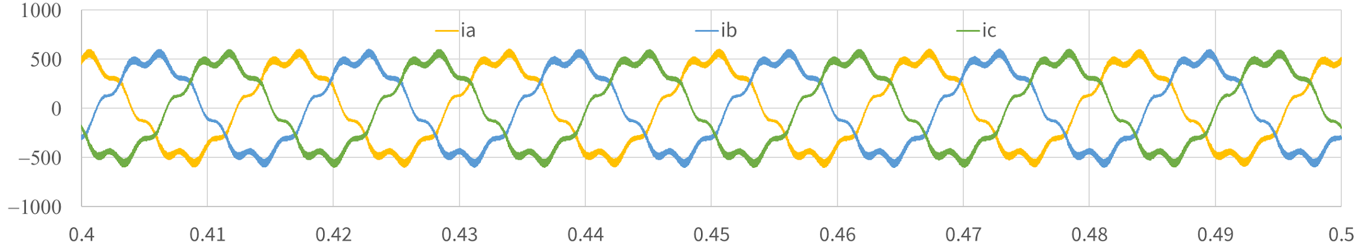
Unstable Simulation with Inverter
Voltage (V)
Current (A)
Time (s)

Slide 30
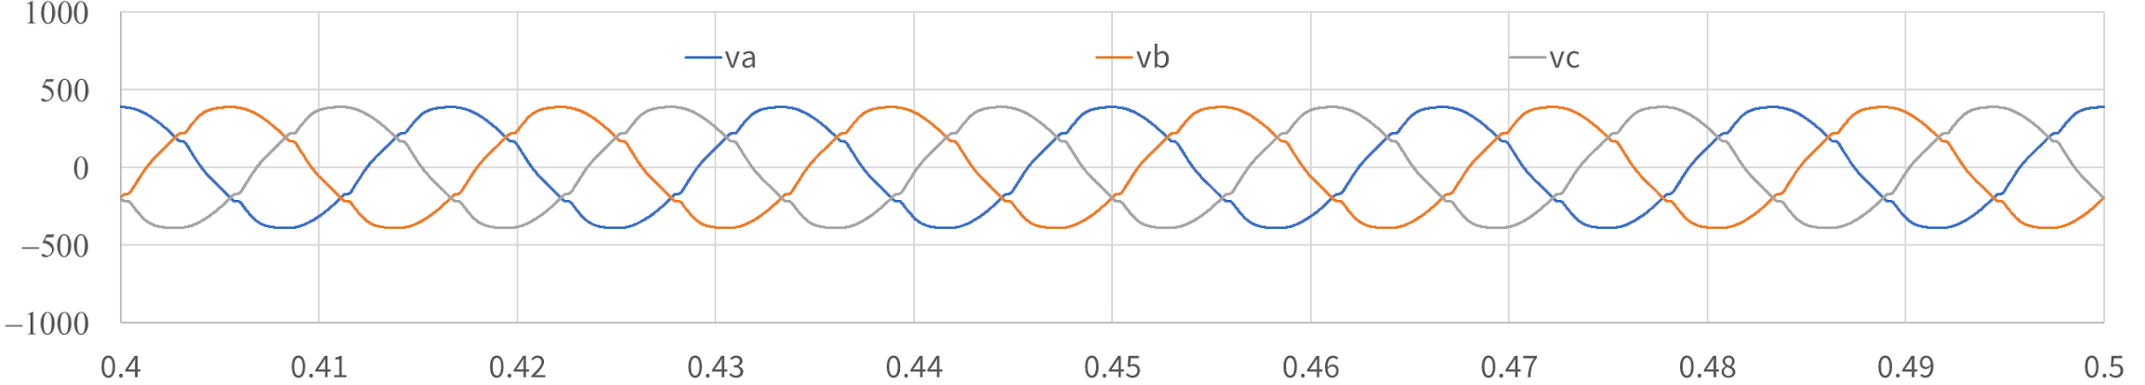
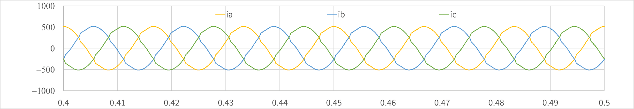
Stable Simulation with Inverter
Voltage (V)
Current (A)
Time (s)

Slide 31






Summary of Requirements
Conditions |  | Rectifier | Bypass | Inverter
 |  |  |  | Stored-Energy & Double-Conversion | Line-Interactive with Bypass
Below 2f₁ | Test with Source L
 | Magnitude Limit
Above 2f₁
γ is maximum charge rate in percent of nominal power; Z_{n}, L_{n} and R_{n} are, respectively, the nominal (or base) impedance, inductance and resistance at the fundamental frequency f₁.

Slide 32
Call to Action
https://www.opencompute.org/projects/data-center-facility
Technical Team:
Dr. Jian Sun, Professor, Rensselaer Polytechnic Institute
Facebook: Data Center Design, Strategic Design and Engineering, Site Engineering
UPS Industry Collaborators:

