Slide 2
Whitepaper: Design guidelines for
Immersion-Cooled IT Equipment
Rolf Brink – Asperitas
Jessica Gullbrand – Intel
Rick Payne – Flex
Leonard Ciubotaru – 2CRSI
Jimil M. Shah – 3M
ACS-Immersion

Slide 3

Focus Areas
The presentation highlights key areas for IT gear designed for immersion:
        Thermal design considerations
        Mechanical guidelines
        Software
        Electrical validation
        Material Compatibility
ADVANCED COOLING SOLUTIONS

Slide 4
Thermal Design
Single-phase: Forced and/or Natural Convection
        Enhancements by turbulent or unsteady flow
        Maximizing flow through heat sink
        Cold liquid to the hot components
Two-phase: Boiling (liquid to gas) and Condensations (gas to liquid)
Boiling surface with nucleation sites used as heat sink
Rewetting of the boiling surface
Low power components may not require heat sinks
ADVANCED COOLING SOLUTIONS

Slide 5
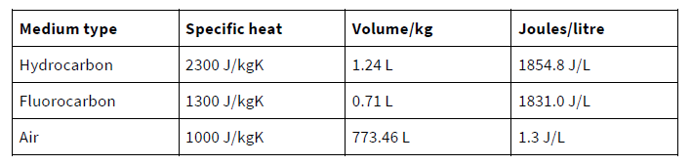
Thermal Design
Liquids much more efficient heat transfer medium than air
Specific heat comparison
Not only specific heat of importance also flow rate
ADVANCED COOLING SOLUTIONS

Slide 6
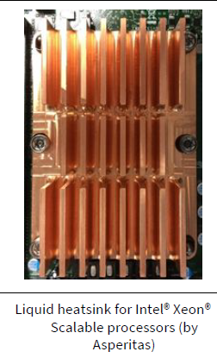
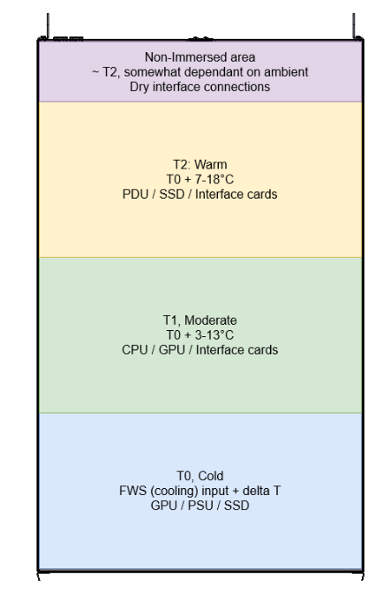
Thermal Design for Single-Phase
Immersion Heat Sink Design Parameters:
Fin pitch
Fin specification (width, height, thickness)
Heat sink base (spreading the heat)
Liquid/Flow characteristics
Component Placement in Tank:
Thermal shadowing effect
Bottom of tank: High power components and components with stringent temperature requirement
Top of tank: Low power components
ADVANCED COOLING SOLUTIONS

Slide 7
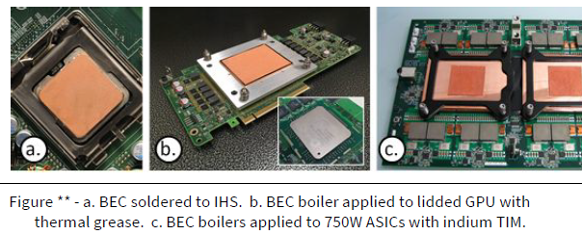
Thermal Design for Two-Phase
Immersion Heat Sink Design Parameters:
Boiling enhancement coating (BEC)
Coating thickness & particle size
BEC base (IHS or BEC)
ADVANCED COOLING SOLUTIONS
Component Placement in Tank:
Constant temperature in bath
No thermal shadowing

Slide 8
Mechanical Design Guidelines
Key considerations for the chassis design:
Chassis dimensions: primarily depends on the size of the tank and the type of immersion;
ADVANCED COOLING SOLUTIONS
size and ergonomics → allow fluid circulation and easy extraction
Total mass: → 34 Kg (75 lbs.) max
        → From 18 Kg (40 lbs.), 2 people advised
Handling: Provide handles or attachment points
Reinforce front of chassis

Slide 9
Mechanical Design Guidelines
Considering the vertical orientation of the chassis :
Implementing fixation features for the IT gear installed
Concerning the orientation of the components :
Do not block the thermal flow → the heatsink fins parallel to the thermal liquid flow.
ADVANCED COOLING SOLUTIONS
Cable or busbar for power :
Cable : Ensure that the cables have enough length and space to pull out the chassis
Upper side cables are highly recommended
Busbar : The blind-mate busbar clip must be floating
Guiding features to facilitate the alignment tolerance (chassis/busbar)

Slide 10
Mechanical Design Guidelines
PSU / Power shelf :
ADVANCED COOLING SOLUTIONS
PSU: Installed in the chassis and fully immersed
→ optimization cooling, PSU near the bottom of the tank
→ accessibility in first, PSU in the upper part of the chassis
Power shelf: Easy access and removal of the power modules
Power modules accessible from the top of the tank.
Busbars: Positioning them out of reach of the operator
Protect them from possible falling debris.

Slide 11
Software – Thermal optimization
ADVANCED COOLING SOLUTIONS
  Increased heat capacity allows for higher thermal tolerances
  Higher temperature settings
  Optimized thermal protections
  Increased heat capacity allows for higher thermal tolerances
  CPU turbo boost capabilities
  Increased CPU performance (“overclocking”)

Slide 12
Software – System management/BMC
ADVANCED COOLING SOLUTIONS
  Fan control and detection
  No fan support in immersion
  Detection that fans are removed/disconnected
  Immersion optimized management reporting possibilities
  Liquid temperatures
  Flowrates
  Liquid quality

Slide 13
Firmware
ADVANCED COOLING SOLUTIONS
  BIOS possibilities
  Option to disable thermal protections
  Option to select pre-defined set of immersion-optimized settings
  Immersion optimization switch (safety, temperatures, boost etc)
  Custom firmware
  Released to vendors and integrators
  Custom SKU’s

Slide 14
Electrical
ADVANCED COOLING SOLUTIONS
  Immersion can enable the use of CPU’s with high TDP for overclocking or turbo = higher performance
  Improved component reliability by managing the thermal range the components cycle through
  Component placement can be optimized to reduce loss or improve latency
  Fans are not required and should not be used or disabled
  Sensor placement and management to measure liquid temperature top to bottom

Slide 15
Electrical
  Any equipment designed for immersion should include a detailed and robust test plan to ensure the any effects of immersion is manifested and validated:
ADVANCED COOLING SOLUTIONS
Signal Integrity & loss measurements
Power consumption and loss
Etc.
  Learn from others – OCP community is growing

Slide 16
Material Compatibility
Determining compatibility with immersion.
Not all parts of the end-user supply chain will be tasked with ascertaining compatibility, i.e. CPU thermal interface material (TIM) is present between the chip die and the Integrated Heat Spreader (IHS) and can therefore only be researched or qualified by the original manufacturer.
But, a network extension cable can be practically validated and selected by a system integrator or end user.
High level distinctions exist between the requirements for single-phase Hydrocarbons/Fluorocarbons and for two-phase Fluorocarbons.
ADVANCED COOLING SOLUTIONS

Slide 17
Material Compatibility
1.1 Wetted Material
  Servers
  Cables
  Connectors
  Power Supply
  Storage
  High Speed Network
ADVANCED COOLING SOLUTIONS

Slide 18
Material Compatibility
1.2 Components to Check for Compatibility and Material Source of Contaminant
1.3 Material Compatibility for Single-Phase Immersion Cooling (Hydrocarbon Fluids)
Test # 1: General material compatibility
Test # 2: Thermal aging of PCBs, PVCs, Optical Fibers and Passive Components
ADVANCED COOLING SOLUTIONS

Slide 19
Material Compatibility
1.4 Material Compatibility for Single-Phase Immersion Cooling (Fluorochemical Fluids)
Secondary incompatibility
1.5 Material Compatibility for Two-Phase Immersion Cooling (Fluorochemical Fluids)
The Soxhlet Extraction Material Compatibility Test
ADVANCED COOLING SOLUTIONS

Slide 20
Call to Action
Join the immersion workstream and contribute!
ACS Immersion schedule:
Each 3rd Tuesday of the month
Docs:
https://www.opencompute.org/wiki/Rack_%26_Power/Advanced_Cooling_Solutions
Mailing list:
http://lists.opencompute.org/mailman/listinfo/opencompute-acsimmersion
Email: Rolf.Brink@OCProject.net

Slide 21
Q&A
ADVANCED COOLING SOLUTIONS
Rolf Brink – Asperitas
Jessica Gullbrand – Intel
Leonard Ciubotaru – 2CRSI
Rick Payne – Flex
Jimil M. Shah – 3M

