Slide 2

Optimized immersion servers
(SPEC community presentation)
Rolf Brink, CEO, Asperitas
Rolf.Brink@Asperitas.com
+31889600000
ACS

Slide 3
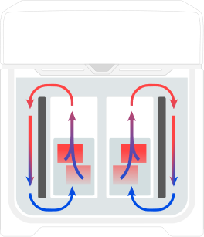

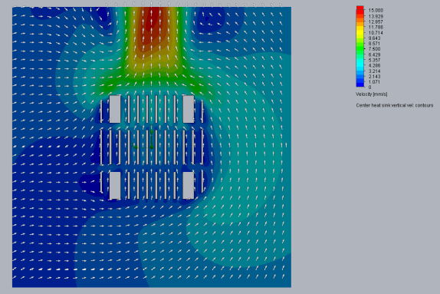
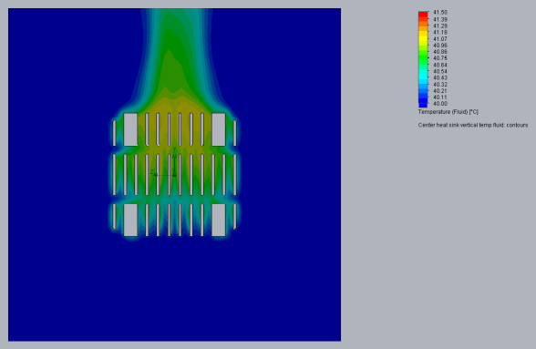

Technology background
ADVANCED COOLING SOLUTIONS
Asperitas AIC24-15/19/21”
Passive immersion technology
Power density:
        Unit power (rack footprint): 43 kW, 60 kW/chilled water
        (2n: 3-phase 400V/63A or 125A)
Compute density: 45-67 kW/m2@32°C
Solution footprint: 23-34 kW/m2 @32°C (ASHRAE W3)
Passive immersion technology:
Common flowrates of 10-20 mm/s
Only heated liquid is circulated

Slide 4
Solution integration
Electrical
43 kW power delivery
Rack level switchgear
Power management
Cooling
Direct connection to FWS
Flow control
Thermal and pressure monitoring
Management
Monitoring
(FWS, DECS and IT thermal, Power)
Alarming
Logging (including IT thermal information)
Containment
Dual hull
Liquid level monitoring
Cable management (capillary action)
Thermal (insulated)
Serviceability
Redundant switching
Automatic lifting (no manual handling)
Containment (leak trays)
IT optimisation
Liquid design servers (based on air design)
Full material compatibility research
Full performance research
Fully tested
ADVANCED COOLING SOLUTIONS

Slide 5
Shell Immersion Cooling Fluid S5 X
Joint development Shell / Asperitas
Specifically developed for immersion cooling application / conditions, with special focus on:
ADVANCED COOLING SOLUTIONS
Safety and Purity
Synthetic and base oil meets purity requirements of the EU and US Pharmacopoeias
Extremely low volatility
Non-halogenated, food-grade and free from allergen
Performance
Excellent thermodynamic properties
Non-evaporating
Low density
High flash point
Protection and Reliability
High compositional consistency
Very high oxidation and thermal stabilities
Virtually no sulphur, nitrogen or aromatics
Noncorrosive
Notes:
Describe research focus

Slide 6
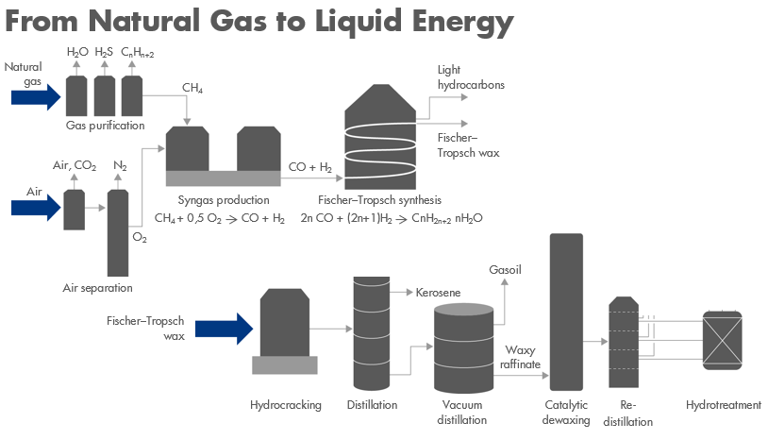
Shell Immersion Cooling Fluid S5 X
ADVANCED COOLING SOLUTIONS
Synthetic, single-phase immersion cooling fluid is made with Shell GTL from Natural Gas
Designed for data server liquid cooling solutions (in natural convection and pump/forced systems)
Notes:
Fluids description
Technical data, images, graphs, analysis etc is highly preferred and appreciated.
I.e., how there is a focus on thermal stability or oxidation stability

Slide 7
Shell Immersion Cooling Fluid S5 X
Properties |  |  | Method | Shell Immerison Cooling Fluid S5X
Colour | - | - | ASTM D156 | +30
Density | @15°C | kg/m³ | ISO 12185 | 806
Flash Point | - | °C | EN ISO 2592 | 200
Pour Point | - | °C | ISO 3016 | -36
Kinematic Viscosity | @40°C | mm²/s | ISO 3104 | 9.8
Total Sulphur Content | - | mg/kg | ASTM D5185 | <1
Total Acid Number | - | mgKOH/g | IEC 62021 | <0.01
Breakdown Voltage | - | kV | IEC 60156 | 42
D. C. Resistivity | @60°C | T Ohm m | IEC 60247 | 9.9
Specific Heat | @40°C | J/kg*K | ASTM E 1269 | 2 274
Thermal Conductivity | @40°C | W/m*K | ASTM D 7896 | 0.142
Relative Permittivity | @90°C | - | IEC 60247 | 2.02

Slide 8

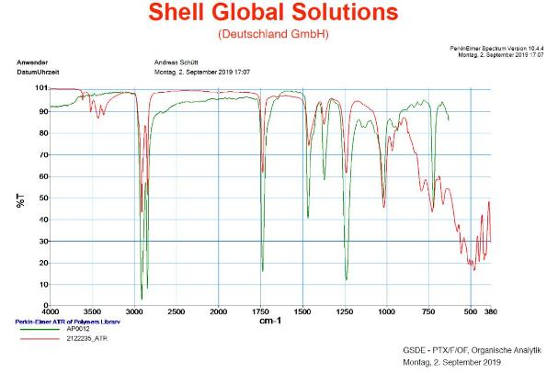
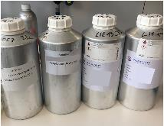

Shell Immersion Cooling Fluid S5 X
ADVANCED COOLING SOLUTIONS
Analysis capabilities for R&D
Technology Centers in Amsterdam, Hamburg, Houston, Shanghai and Bangalore
Compatibility tests
Oil and Equipment condition monitoring through Oil Analysis:
                ICP (Inductively Coupled Plasma) metals concentration analysis
              FTIR (Fourier-transform infrared spectroscopy)
    Oxidation and acidity tests
    Thermal functional tests
Notes:
Analysis capabilities for R&D
Focus on types or tests which Shell is doing together with Asperitas and what you can do in collaboration with other manufacturers.

Slide 9
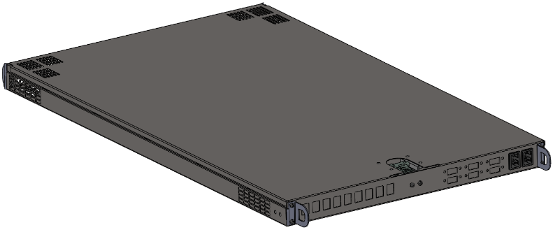
Optimized chassis SPEC
ADVANCED COOLING SOLUTIONS
SPEC ready for submission
Universal Cassette for single phase immersion
15”, 19” or 21”
1 or 2 U or OU
Optimized for liquid flow
Optimized for servicing
Flexible IT design
C13 or busbar power delivery

Slide 10
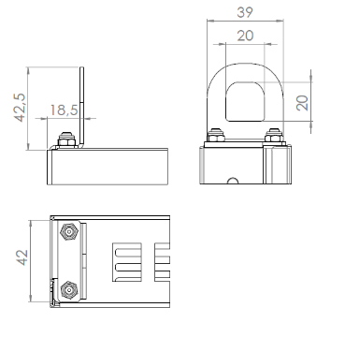
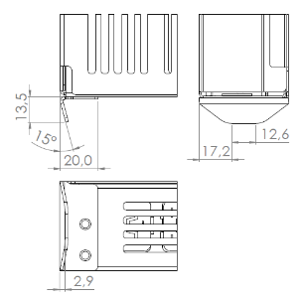
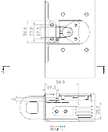
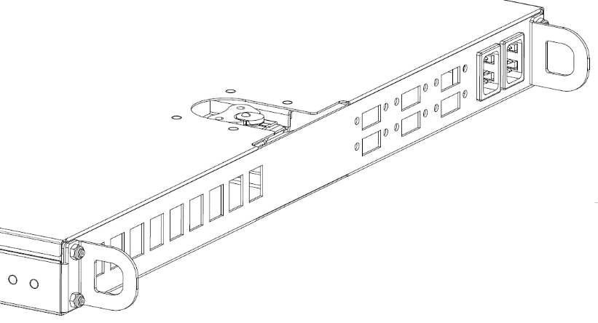
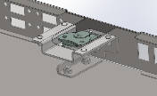
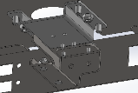
Serviceable design
ADVANCED COOLING SOLUTIONS
Mechanical lifting interfaces
Placement guidance system
Toolless protective lid

Slide 11
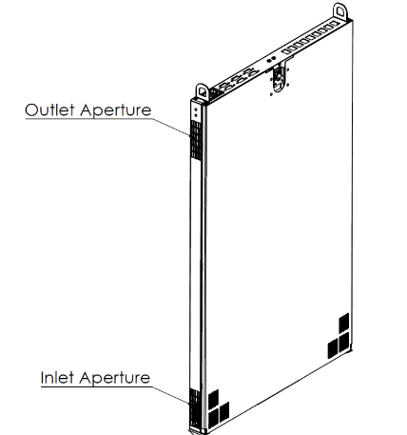
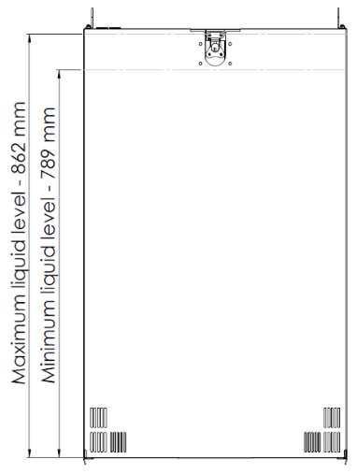
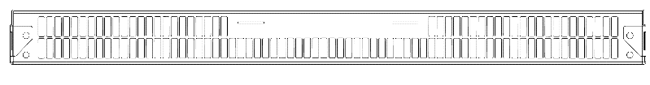
Liquid optimized
ADVANCED COOLING SOLUTIONS
Serviceable side above liquid levels
(dry interfaces)
Flow apertures for liquid
Sideways in- and outflow
Front-back horizontal balancing apertures (bottom)
Mechanical circulation-compatible bottom apertures

Slide 12
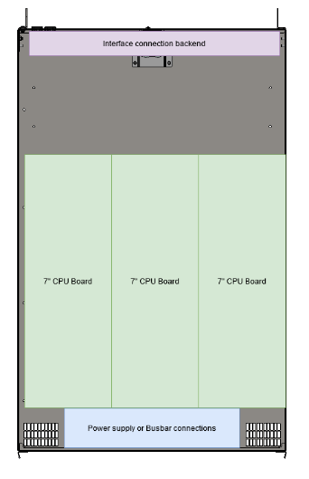
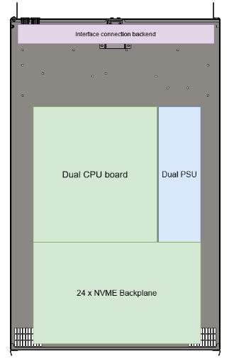
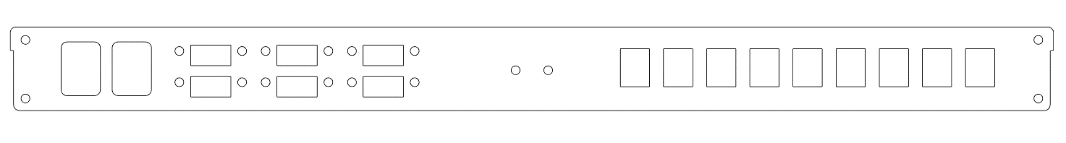
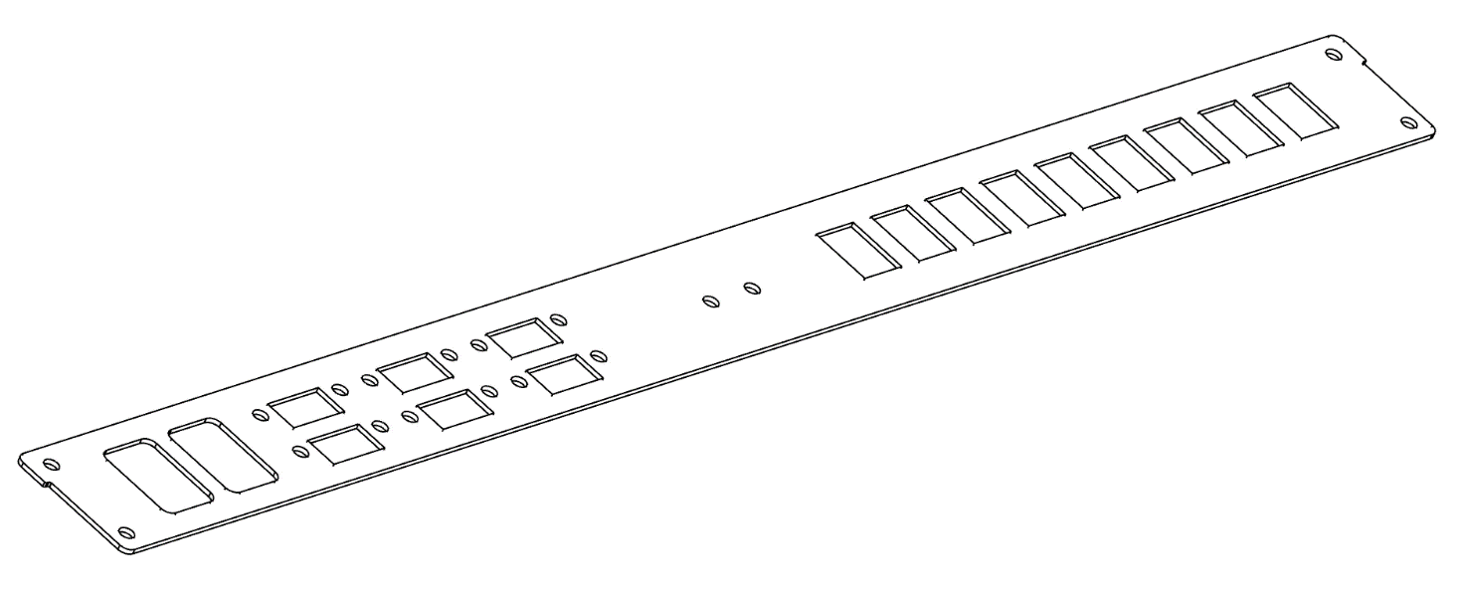
Flexible IT design
ADVANCED COOLING SOLUTIONS
Any IT spec which fits OCP chassis
Flexible interface design

Slide 13
IT design guidelines
IT selection / Research
Material compatibility information/studies
Thermal tolerances
Concept mechanical design
Existing assembly vs optimised (depending on requirements)
15”/19”/21”, U/OU, component lay-out, accessibility PSU’s, etc.
Build/test
Full spec certification testing
Full thermal analysis
Material compatibility study
ADVANCED COOLING SOLUTIONS

Slide 14
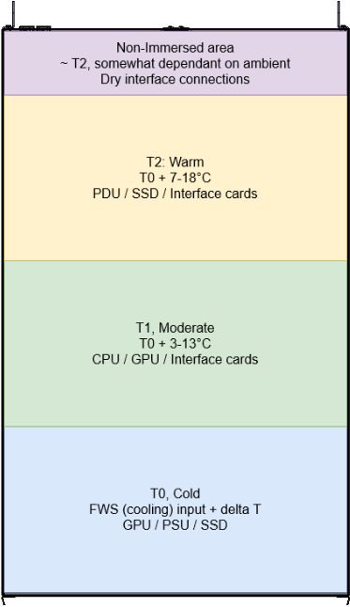
Thermal design guidelines
ADVANCED COOLING SOLUTIONS
Asperitas validated up-to 2 kW/1U

Slide 15
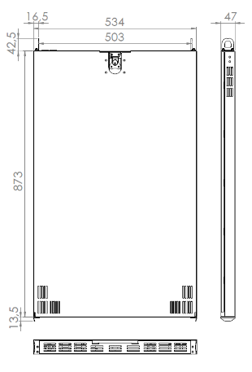
Construction
304 stainless steel (Asperitas)
Plastic isolation film (Asperitas)
Any other materials must comply with:
    Temperature operation between 10-100° without excessive change in dimensions
    Tolerant to dielectric liquid
    May not contaminate dielectric liquid
    Rigid enough to support IT components
    Able to protect IT components (physical AND electrical damage)
    Electrochemical potential difference of NO MORE than 0,15V with guide rails
    Recommended manufacturing process
    Standard laser cutting process
    Press-brake bending process
    Brushed finish for aesthetics
ADVANCED COOLING SOLUTIONS

Slide 16
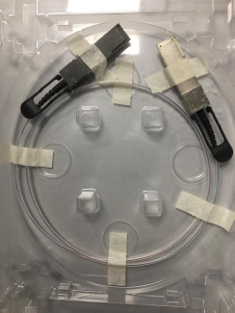
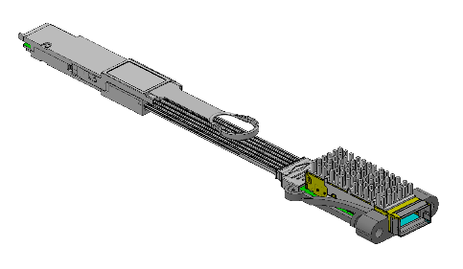
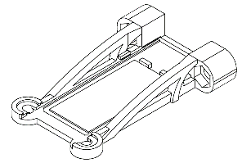
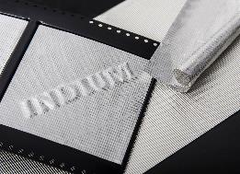
Recommended components
Evaluated/approved (proprietary) components:
Leoni Immersion Ready Active Optical Cables (AOC)
10G-tek (Q)SFP extenders (Asperitas versions tested to 100Gb@70°C)
Asperitas (Q)SFP extenders chassis mounts
Indium foil as thermal interface material
ADVANCED COOLING SOLUTIONS

Slide 17
Open chassis collaborations
ADVANCED COOLING SOLUTIONS
Open chassis projects:
SuperMicro, various Intel and AMD configurations
Wiwynn, 3x dual Intel Scaleable compute nodes
Penguin Computing & Gigabyte, 3x dual Intel Scaleable compute nodes
Penguin Computing & Gigabyte, Intel Scaleable, GPU nodes
Dell Technologies, 3x dual AMD EPYC compute nodes
AIC 2x AMD EPYC immersion optimized storage
AMD Olympus platform
Example collaboration: SuperMicro and AMD for scalable climate independent edge computing solutions for telecom providers. (Project announcement mid-March).
Notes:
Logo’s approval in progress! All mentioned partners are approved for backdrop wall and other on booth branding, this slide to be approved seperately for logo’s.

Slide 18
Call to Action
Contribute to ACS Immersion
Use/Co-develop optimized IT platforms for immersion
More information: Asperitas.com/Marketing@Asperitas.com
Where to buy: https://www.Asperitas.com
Project Wiki with latest specification : To be announced
CAD files location : To be announced
ACS Immersion schedule:
Each 3rd Tuesday of the month
https://www.opencompute.org/wiki/Rack_%26_Power/Advanced_Cooling_Solutions
Mailing list: http://lists.opencompute.org/mailman/listinfo/opencompute-acsimmersion

