Slide 1
OCP Software Stack Projects Update
Rajeev Sharma
Director of Software
at Open Compute Project

Slide 2

OCP Software Ecosystem
Unlimited Public repositories
Allows code collaboration with anyone online around the world
Unlimited Private repositories
Issues and Bug tracking
Project Management

Slide 3
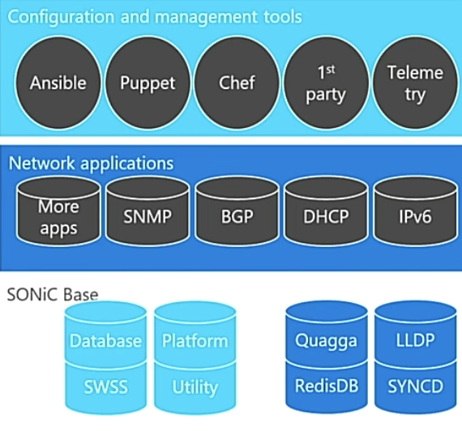

OCP Core Software Projects
ONIE
Open Network Install Environment
Provides an OS install environment
Makes writing and running installers easier
It is a small Linux based OS itself
https://github.com/opencomputeproject/onie
SAI
SAI
Switch Abstraction Interface
Provides the standardized C APIs to program the ASIC
ASIC is a microchip designed for a particular application
https://github.com/opencomputeproject/SAI
Linux distribution for bare metal switches
NOS that ONIE would install
Think of it as a collection of software
packages, utilities & drivers that is run on OCP HW
https://github.com/opencomputeproject/OpenNetworkLinux
ONL
Open Network Linux
SoNIC
Software for Open Networking in Cloud
Built on SAI
Containerized Open Source NOS (firmware that you run on the switch)
Enables failure recovery and upgrades with zero downtime.
https://github.com/Azure/SONiC

Slide 4
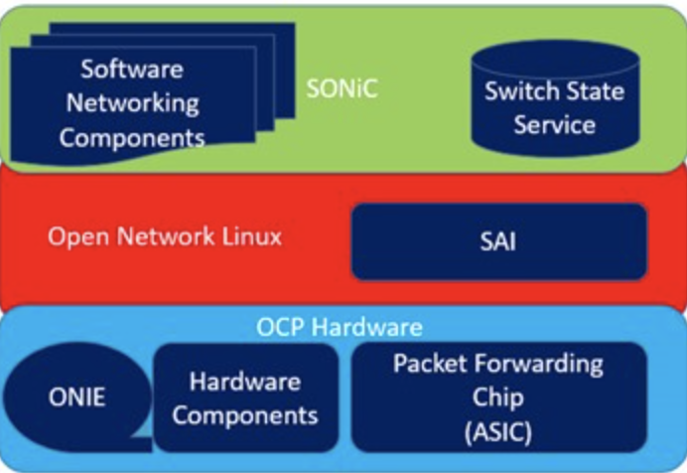
Layered Componets of Software
ONIE
Open Network Install Environment
SAI
SAI
Switch Abstraction Interface
ONL
Open Network Linux
SoNIC
Software for Open Networking in Cloud

Slide 5
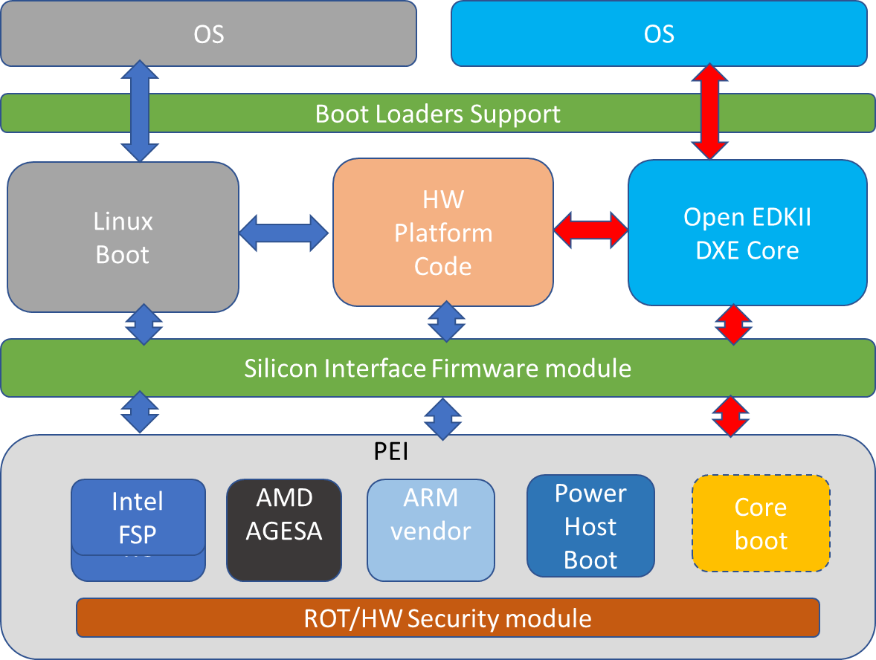
Open Systems Firmware - Vision
Mission: Develop an open source philosophy based ‘system firmware’ modules, to support different OS and different CPU silicon vendors.
Companies Contributing to OSF development: Intel, Microsoft, Google, Facebook, Lenovo, Two Sigma, Horizon, 9 Elements, Cavium, AMD, IBM, etc.
Work Streams: Open EDKII DXE core, Linux Boot, Core Boot, Intel FSP, AMD AGESA, ARM boot code, HW platform module, Build tools, Automated test support, HW requirements, etc.
GitHub Repositories Collateral link:
https://github.com/opencomputeproject/OSF
Bi-weekly OSF discussions : Architectural reviews, workstream progress, agenda setting and other collaborative discussions on OSF development. Contact the following to subscribe, participate and contribute:
gundrala.goud@ocproject.net
ron.minnich@ocproject.net
rajeev@opencompute.org

Slide 6
OSF – Workstreams progress updates…
Workstream name | Owner (Companies) | Progress update
PEI | Intel | Intel delivered as part of initial open EDKII based Mt.Olympus source tree; continue to refine and update PEI module capabilities
Intel FSP binary | Intel | Intel delivered as part of initial open EDKII based Mt.Olympus source tree.
AGESA RC binary | AMD | AMD is still working on this
ARM Boot code binary | Cavium | No update
Power Host boot | IBM? | No update
Core Boot | 9 Elements, FB | Need update ?? Contact Dave Hedricks…(FB)
Silicon Interface Firmware Module | Intel | Intel delivered initial document on challenges and various models to develop this architecture – under review with OSF members
Linux Boot | Google, FB, Two Sigma, Horizon | Initial tree developed and booting on xxx platforms and currently adding additional capabilities. More details in the Core boot/Linux boot progress update from Google?
Open EDK II DXE core | MSFT, Intel | Initial tree developed and booting on Mt.Olympus OCP HW and currently adding additional capabilities. More details in the open EDKII workstream progress update session from MSFT and Intel.
HW platform modules | HW supplier | Mt.Olympus platform module already uploaded as a open EDKII package from MSFT and Intel.
Boot loader support | OS vendor(s) | No update
Build tools | Two Sigma | Need update from Trammell
Automated test support | Horizon, Google | Need update from Google
Telemetry/Diags | Owner need to be identified | No update
FW variables standardization | Intel, MSFT | Intel, MSFT engineers working on architectural proposal
Bug tracking and GitHub source code control | Google, 9 Elements, OCP/Rajeev | GitHub based infrastructure was setup by OCP/Rajeev and continue to refine …
HW requirements to comply to OSF boot | Two Sigma, MSFT | Initial 0.5 version of document developed and OSF members reviewing it.
Security coding guidelines | Owner need to be identified | No update

Slide 7
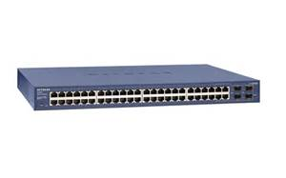

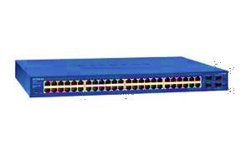
OpenRMC Hardware Options
OpenRACK
EIA, OpenRACK
Olympus
Rack Boundary
Rack Boundary
Rack Boundary
Switch
Rack
Manager
Power Shelf w/ RMC FW
Switch w/ RMC FW
Switch
Server
Server
Server
Server
Server
Server
Server
Server
Server
Server
Server
Server
Server
Server
Server
Server
Server
Server
Server
Server
Server
Server
Server
Server

Slide 8
OpenRMC Data Traffic Interfaces
REDFISH
OpenRMC
Rack
Manager
Fabric bound
REDFISH
Device bound
SWORDFISH
SWORDFISH
SSH
SSH
Legacy REST
IPMI
Web GUI
I2C

Slide 9
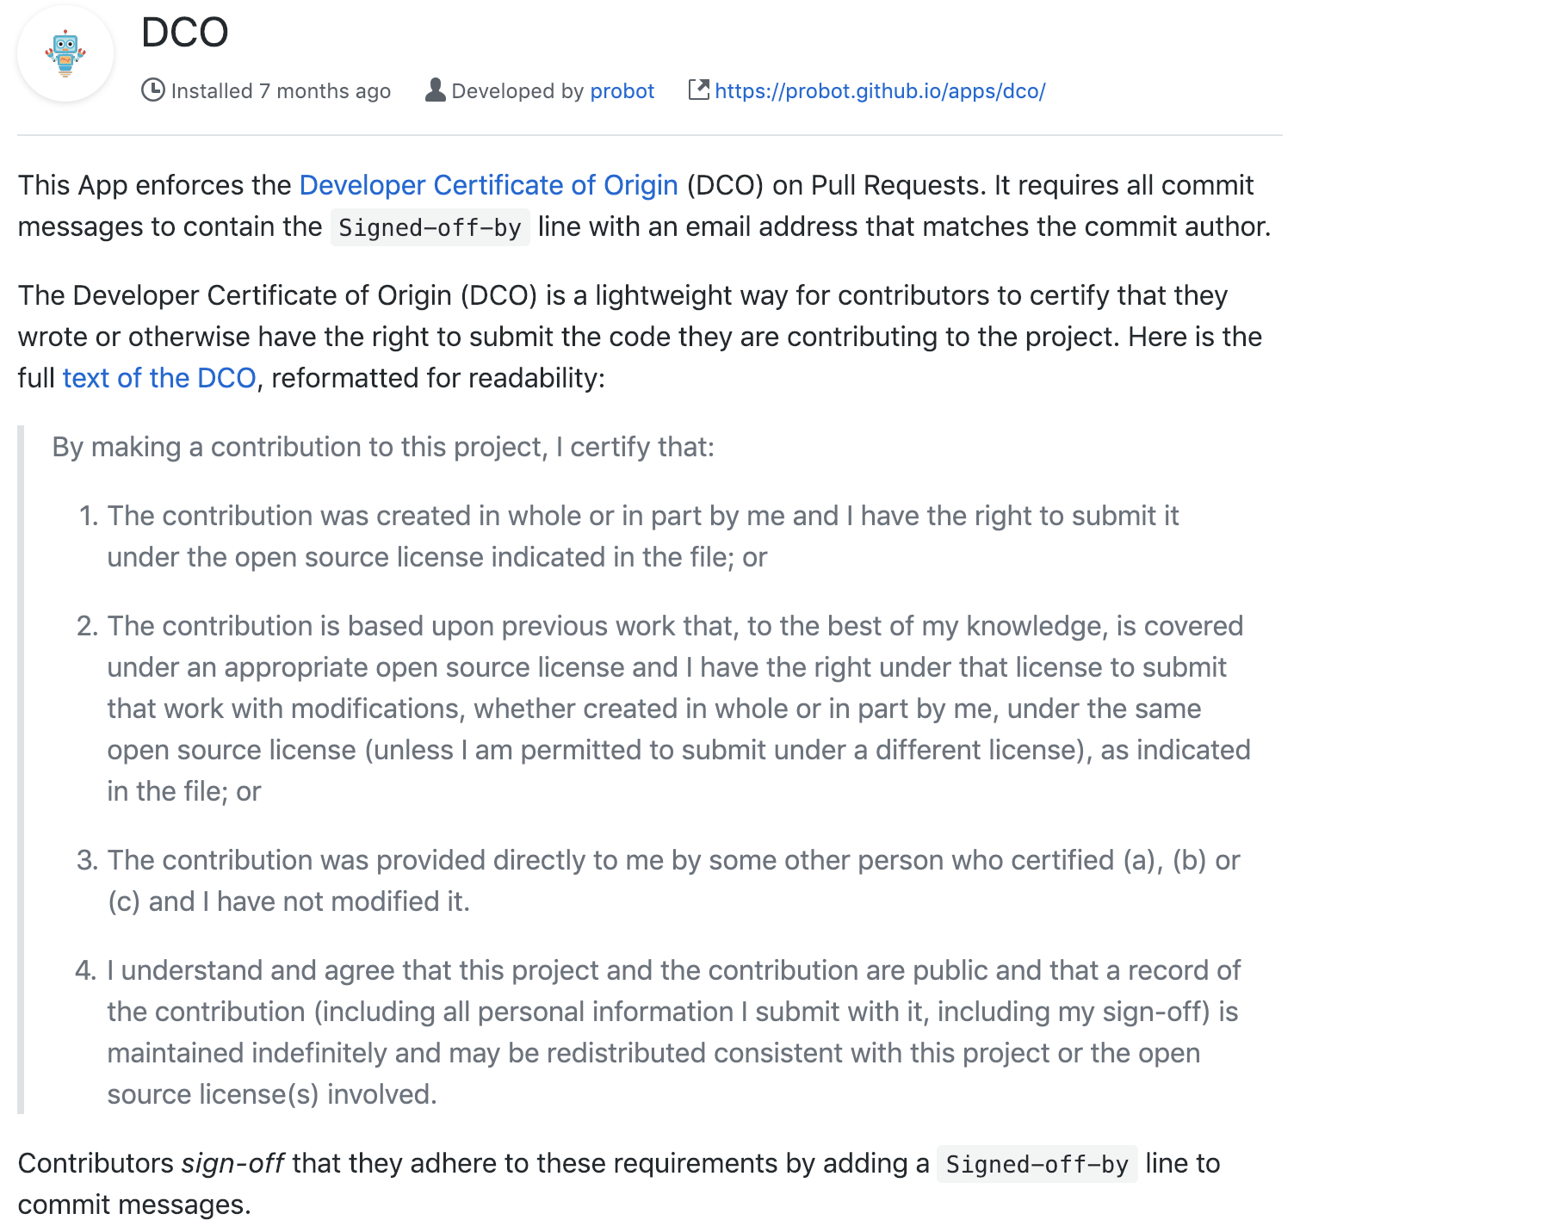
OCP GitHub uses DCO License

Slide 10
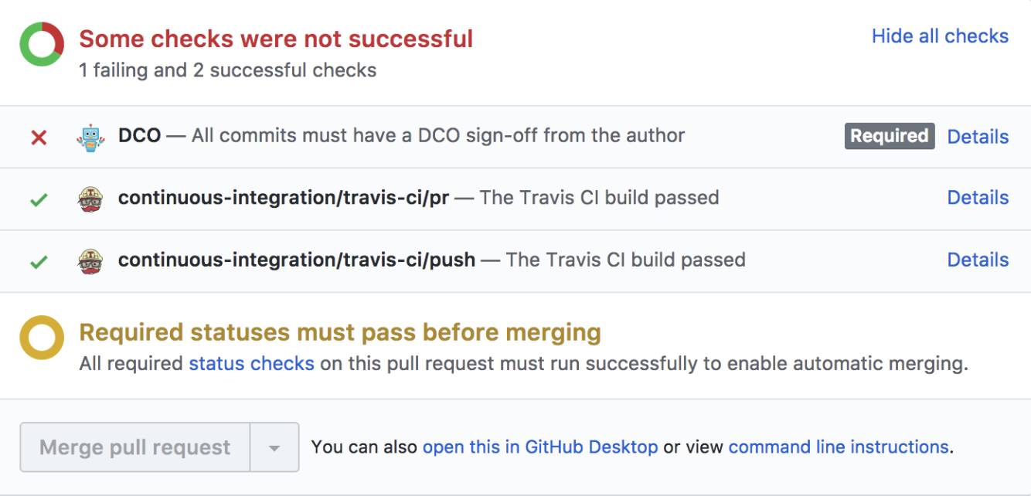
OCP GitHub uses DCO License…Cont’d

Slide 11
THANKS

