Slide 1
OCP Projects &
Technology Collaboration
Bill Carter
Chief Technology Officer, OCP Foundation

Slide 2



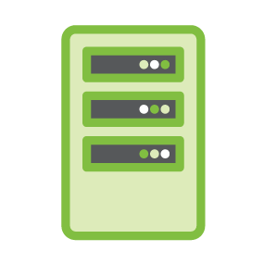






PROJECTS & SUB-PROJECTS
NETWORKING
RACK & POWER
STORAGE
SERVER
ONL, ONIE, SAI, SONiC, CAMPUS BRANCH WIRELESS
ADV COOLING SOLUTIONS POWER SHELF INTEROPERABILITY
JDA PROJECT ARCHIVAL
NIC 3.0 MEZZ
DC Facility
HPC
TELCO
HW MGMT
Open Sys FW
SECURITY
MODULAR DC
OPENEDGE
OPENRMC

Slide 3



Embedded Software Projects
Open Systems Firmware
SAI
openRMC

Slide 4
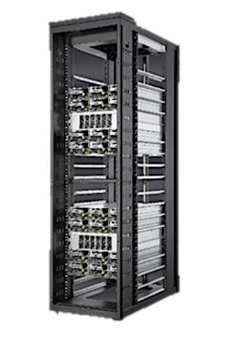
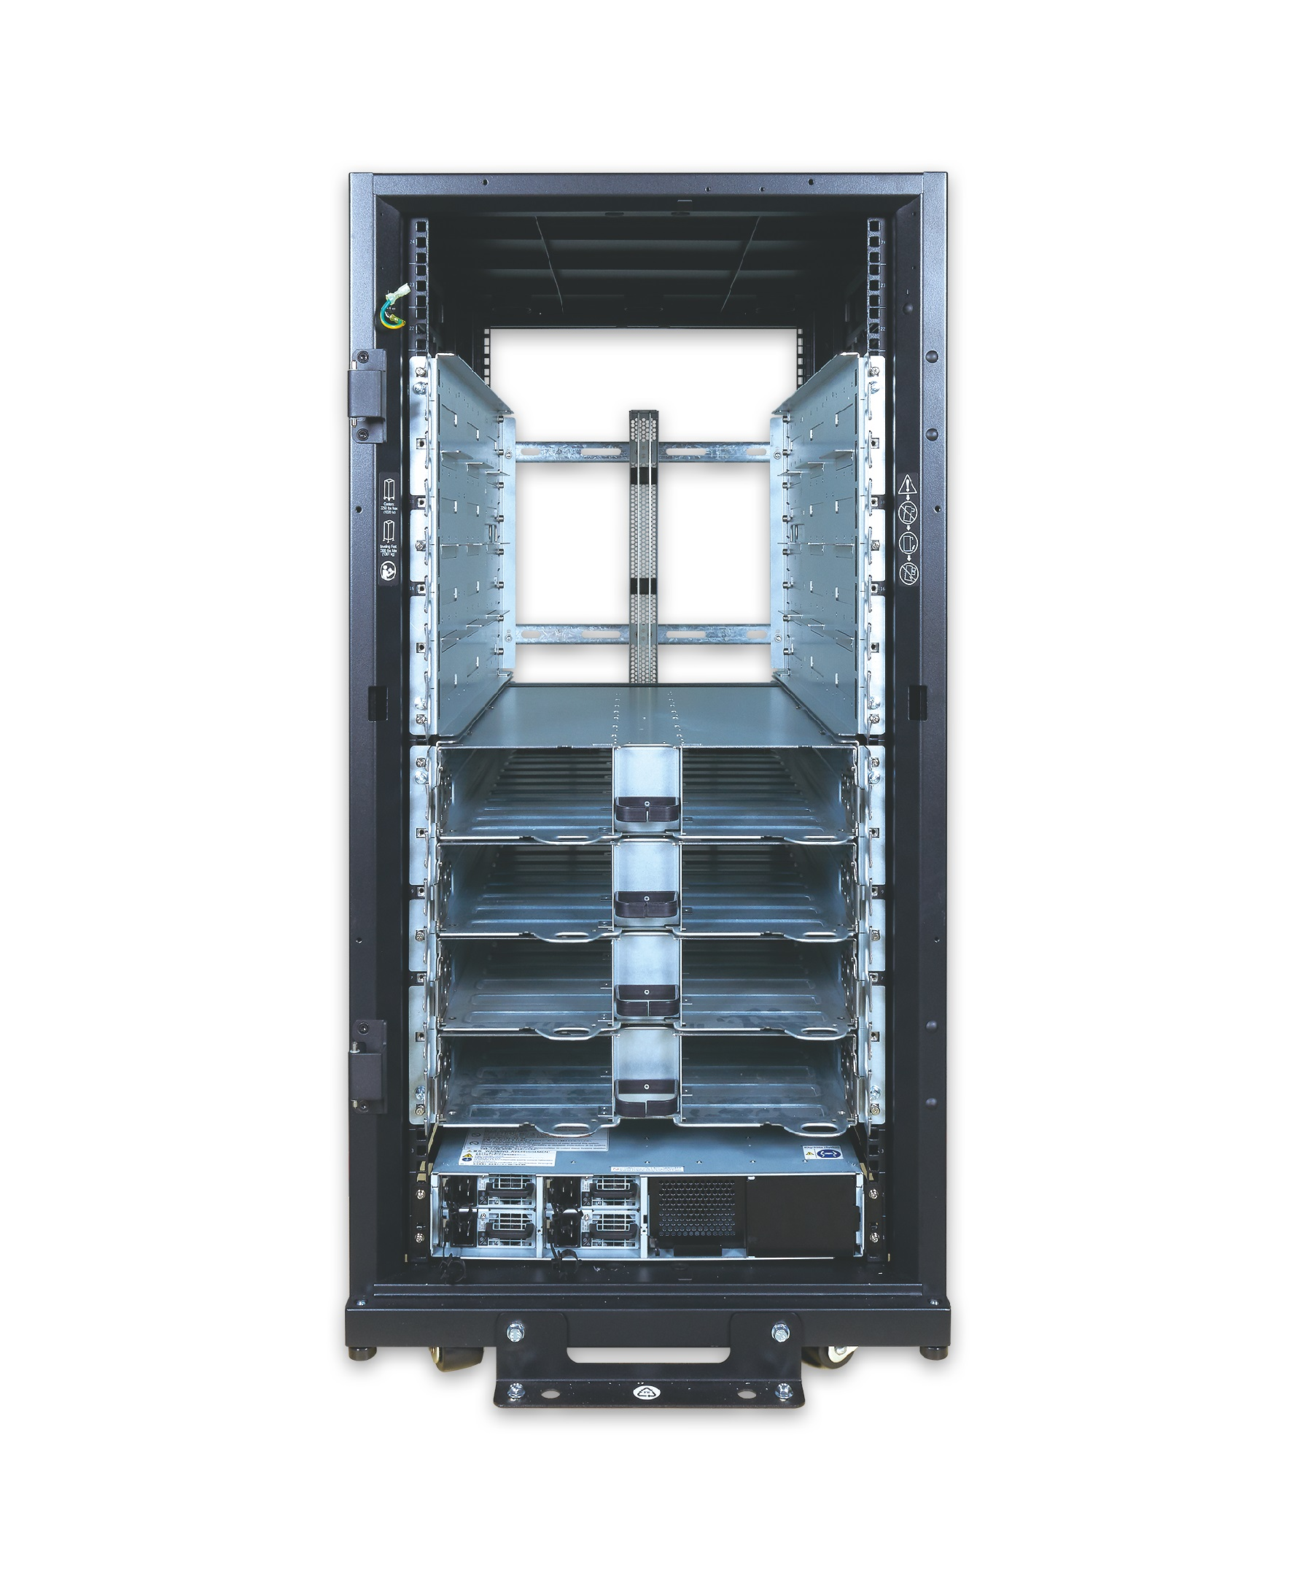
OCP Rack & Power Project
21” Open Rack Standard
Olympus EIA Rack
EIA-310 Equipment
12VDC or 48VDC bus bars
Power & Resiliency options
12VDC & 48VDC Rectifiers
In-Rack Battery Backup
RACK & POWER

Slide 5
Rack & Power Sub-Projects
Advanced Cooling Solutions
Cold Plate
Immersion
RDX
Harmonization of critical interfaces, operational parameters, and environmental conditions to enables a non-proprietary, multi-vendor supply chain for ‘warm water’ cooling.
Power Shelf Interoperability
Interoperable rectifier and
BBU modules

Slide 6
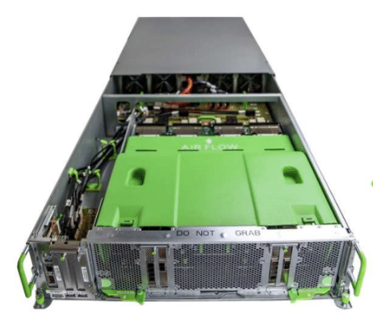
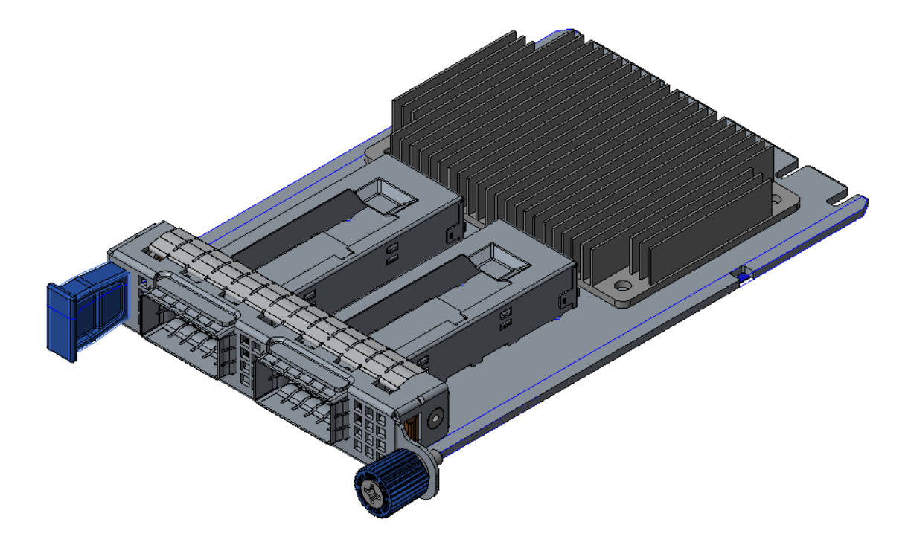
OCP Server Project
GPU
Appliances
openRACK Sleds
GPU Appliances
NIC 3.0 Mezz Spec.
SERVERS
Mezz 2.0 Spec.
EIA-310

Slide 7
OCP Network Project
10/25 GbE Switches
100GbE Switches
400GbE Switches
Power over Ethernet
Optical Transceivers
Telemetry
Campus Based Wireless
NETWORKING
SAI

Slide 8
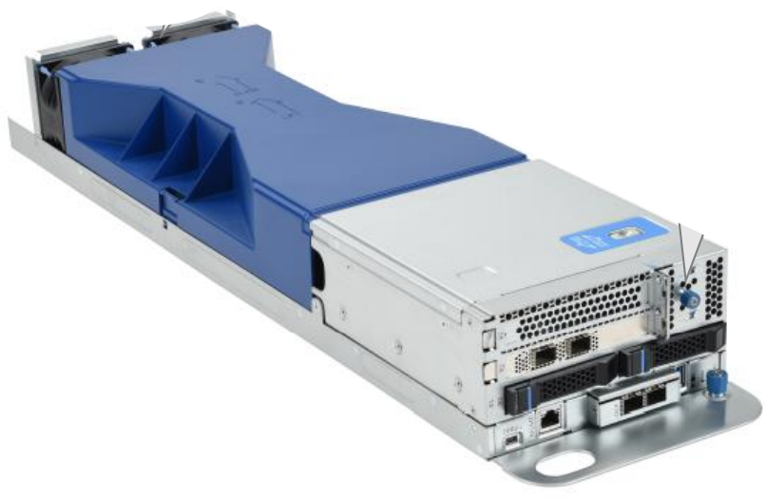
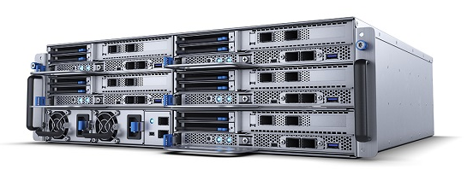
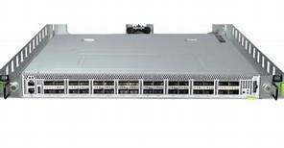
OCP Telecom Project
Hardened openRack
Telecom Compute Servers
Edge Solutions
Passive Optical NW Switches
Optical Line Terminators
TELCO

Slide 9
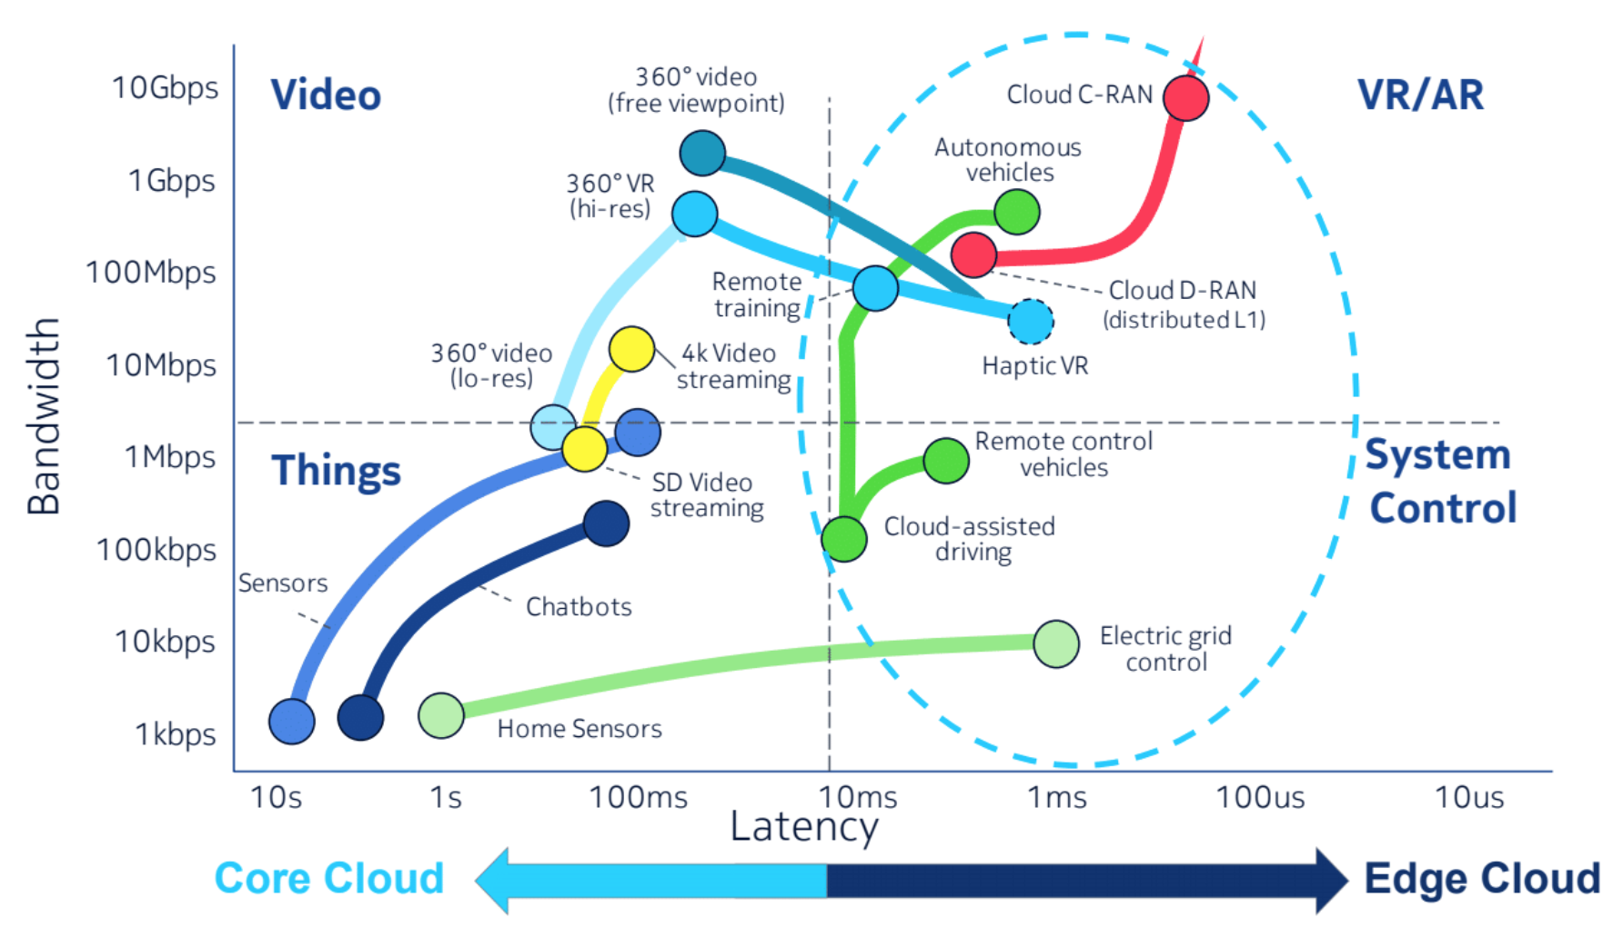
openEDGE Sub-Project

Slide 10







OpenEDGE Sub-Project
CORE CLOUD
EDGE CLOUD
Central
Regional
Central Office
MEC
Goal to Harmonize requirements, multi-source, interoperability

Slide 11
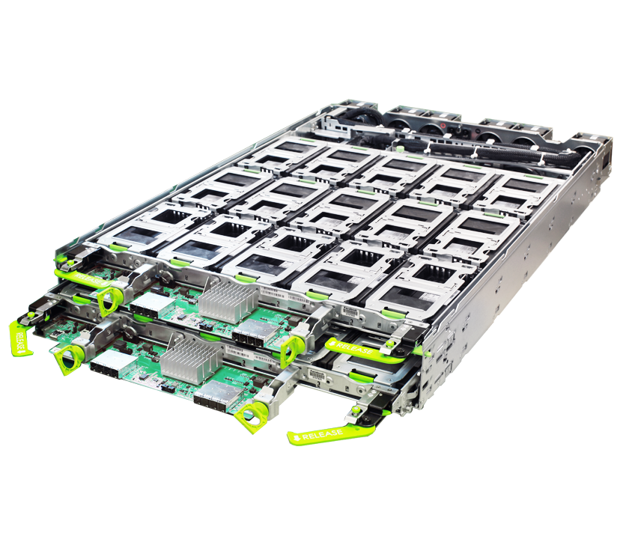
OCP Storage Project
JBOD & JBOF Appliances
Cloud Use APIs
Archival Storage
Health Monitoring
M.2 Specs
STORAGE

Slide 12
HW Management - openRMC
Open Sourced RACK MANAGEMENT
OpenEDGE
BASELINE PROFILE
Server Profile
Network Profile
Storage Profile
POWER Profile
EDGE Profile

Slide 13
Open Systems Firmware
Boot Loaders Support
Platform
Code
UEFI
Silicon Interface Support
Intel
AMD
arm
Power
Core
boot
Root of Trust /Hardware Security

Slide 14
Security Project
Hardware Root of Trust
Chain of Custody
Secure & Measured
Boot
Threat Landscape
Attestation
Recovery
Secure Execution

Slide 15
Thank You

