Slide 2

An Advanced Liquid Cooling Rack Design for JD.COM Data Center
James Chen, Engineering Director, JD.COM
Nishi Ahuja, Sr.PE ,Intel
Jun Zhang, Platform Architect, Intel
ACS

Slide 3

Agenda
ADVANCED COOLING SOLUTIONS
Overview of JD.COM liquid cooling rack system architecture and design;
Key learnings of the proved liquid cooling engineering practice for the ecosystem has been shared in a white paper contribution to OCP on wiki.

Slide 4
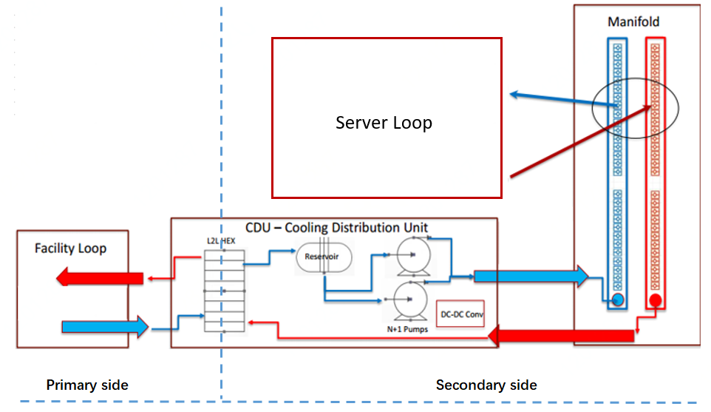
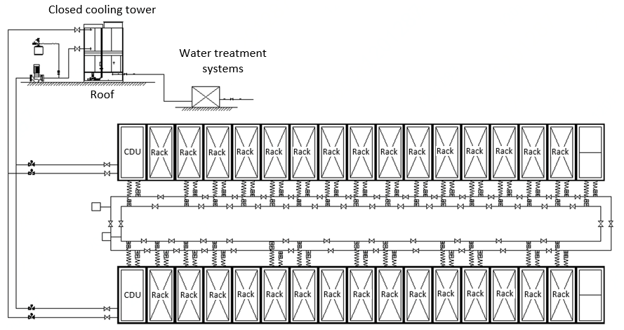
Liquid Cooling System Architecture
ADVANCED COOLING SOLUTIONS
Liquid Cooling System Topology ( Dual CDU with single bump)
Liquid Cooling Loop Overview
Dual CDU redundancy with single bump CDU selection for JD.COM system

Slide 5
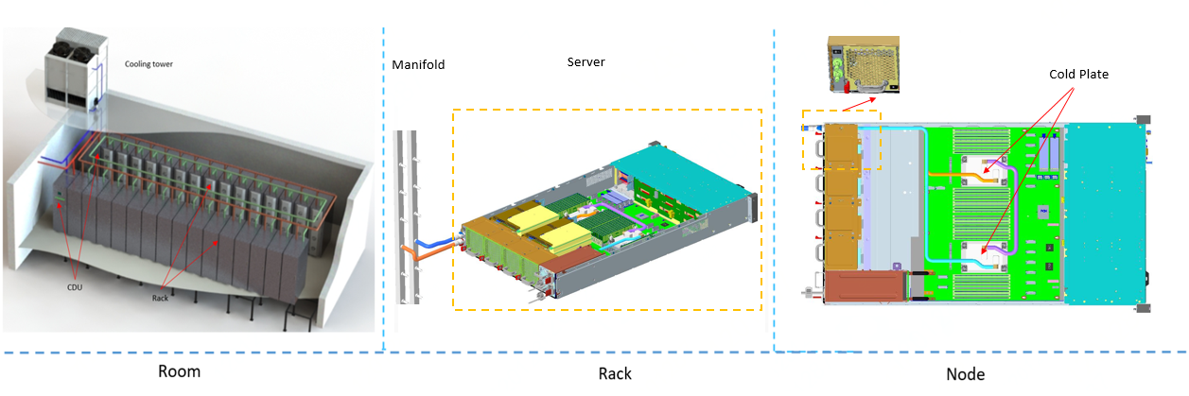
Liquid Cooling Rack System Design
ADVANCED COOLING SOLUTIONS
Quick Connection design friendly for both rack and node maintenance in JD design.

Slide 6
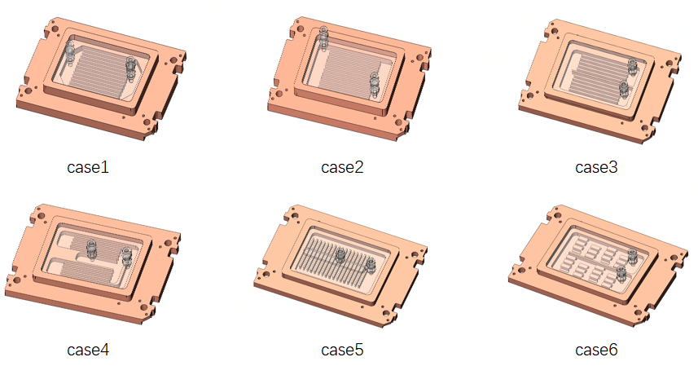
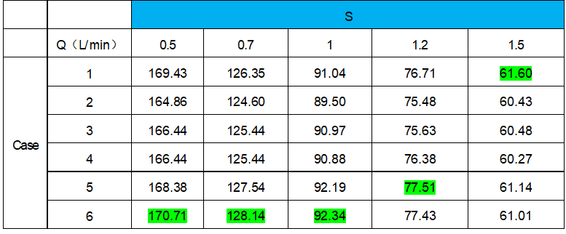
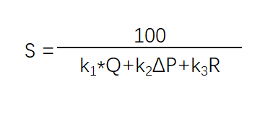
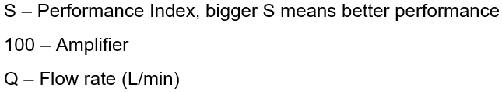
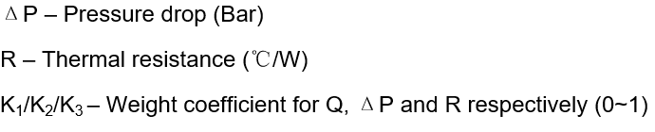
Engineering Practice Key Learnings: CPU Cold Plate
New methodology of “S” parameter for cold plate performance formulation in liquid cooling engineering practice.
ADVANCED COOLING SOLUTIONS
Table: Performance Data of 6 Types’ Cold Plate
Case 6 is optimal with 0.5~1L/min flow rate;
Case 5 is optimal with 1.2L/min;
Case 1 is optimal with 1.5L/min.

Slide 7
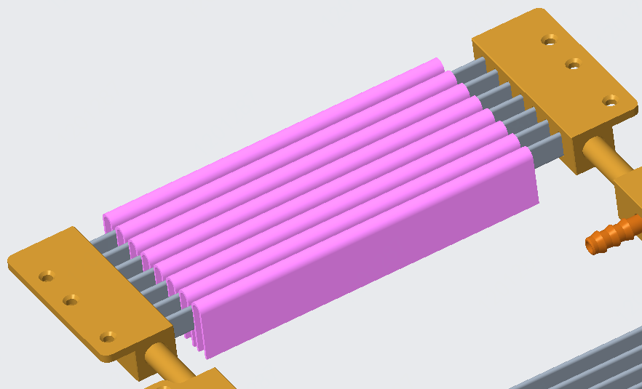
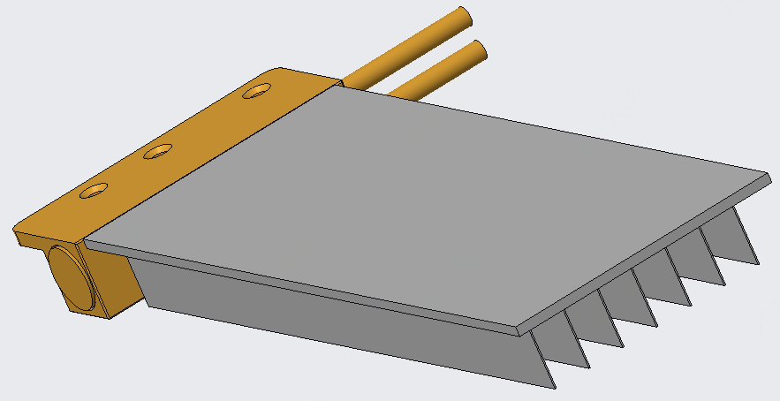
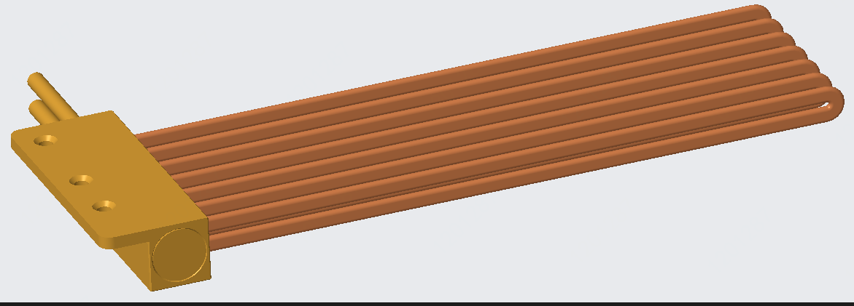
Engineering Practice Key Learnings: Memory Cold Plate
Memory cold plate solutions optimal for different DIMM pitch
ADVANCED COOLING SOLUTIONS
Flattened Liquid Loop Type
DIMM pitch >0.35”
Heatpipe Loop Type
0.3” <DIMM pitch <0.35”
Fin-type
0.2” <DIMM pitch <0.3”
Notes:
Liquid loop: flattened liquid pipe is implemented on the cold plate. This type of solution needs DIMM pitch >0.35” (0.37” as best case).
Heatpipe Loop: flattened heat pipe is attached to memory case with TIM in the middle. Heat pipes are connected to water loops to take away the heat. This solution works for the tighter DIMM pitch design.
Fin-type: the cold plate is on the top of memory section and fins contact with memory case. This solution is dedicated for extreme tight DIMM pitch scenario. To ensure the effective contact with memory surface, this solution requires vertical force onto the memory which might impact the memory reliability which needs special attention.

Slide 8
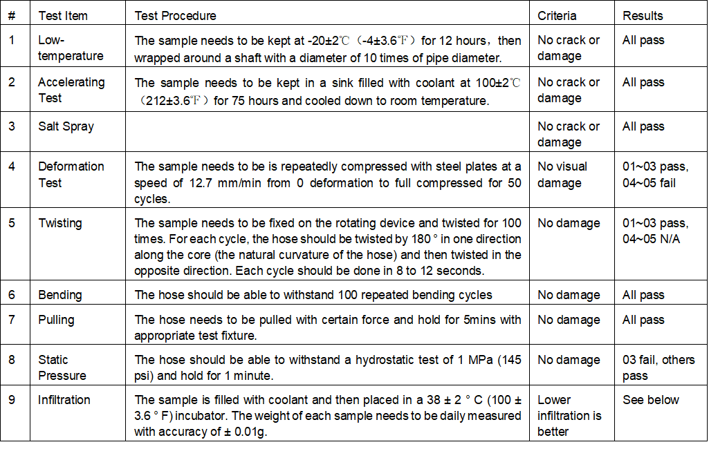
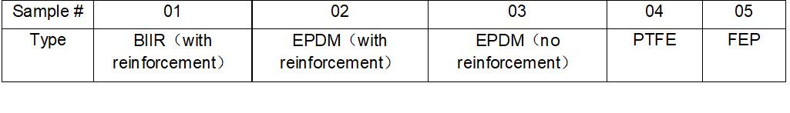

Engineering Practice Key Learnings: Pipeline
Test and Verification Spec defined by JD.COM for Liquid Cooling Pipeline Selection
ADVANCED COOLING SOLUTIONS
5 Types Pipeline Tested by JD.COM
For Liquid cooling loop higher than 0.45MPa, need
plastic pipe or rubber pipe with reinforcement layer;
Plastic pipe performs better from infiltration perspective.
Items 1~7 for material reliability test; Item 8~9 for functional reliability test.

Slide 9
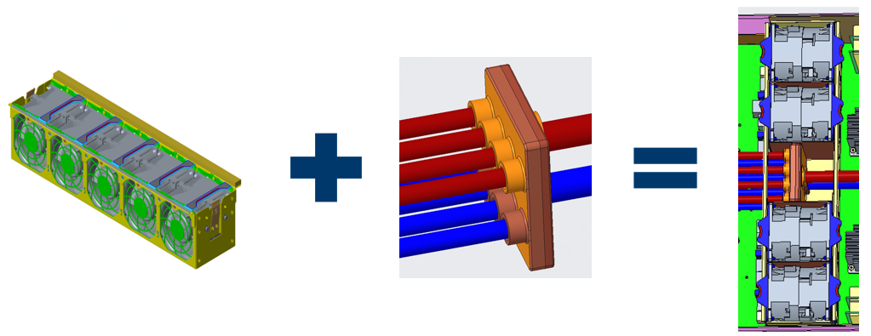
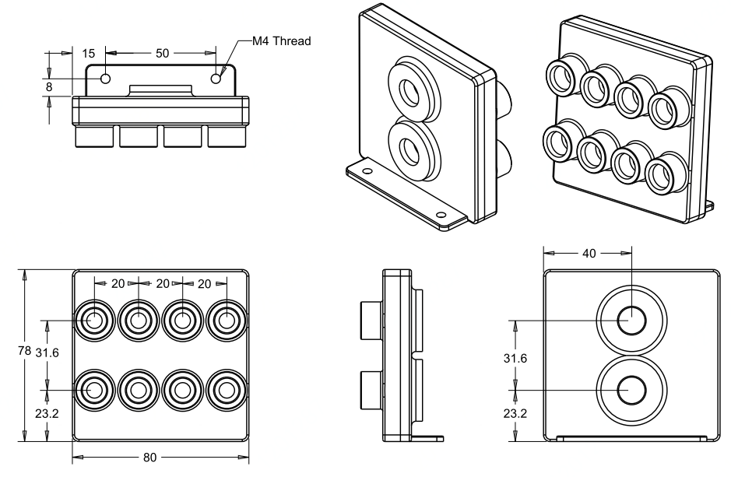
Engineering Practice Key Learnings: Mini-manifold
Manifold and fan cage mechanical compatible design
for server system TCO saving
ADVANCED COOLING SOLUTIONS
Seamless implementation between liquid cooling and air cooling solution;
Optimal for air flow recirculation avoidance in hybrid cooling of liquid and air.

Slide 10
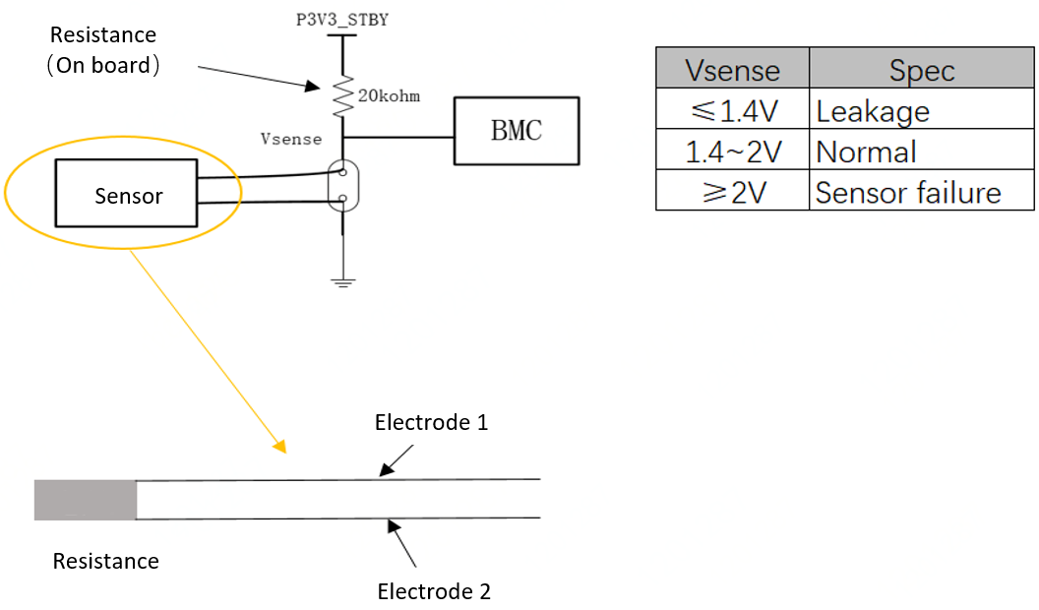
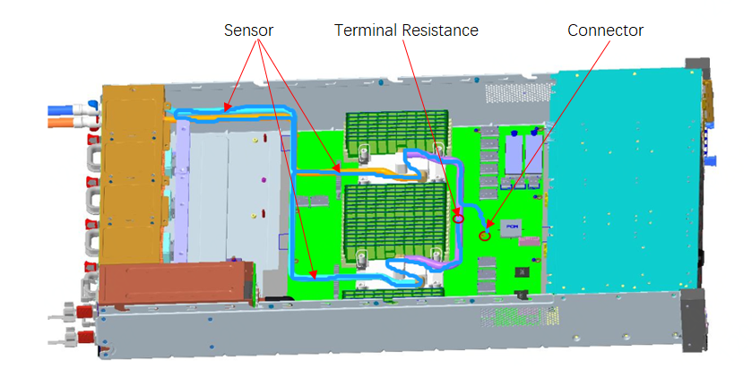
Engineering Practice Key Learnings: Leakage Detection
Engineering proved design for leakage detection in Server Node
ADVANCED COOLING SOLUTIONS
Integrating liquid leakage detection design into motherboard for cost efficiency.

Slide 11
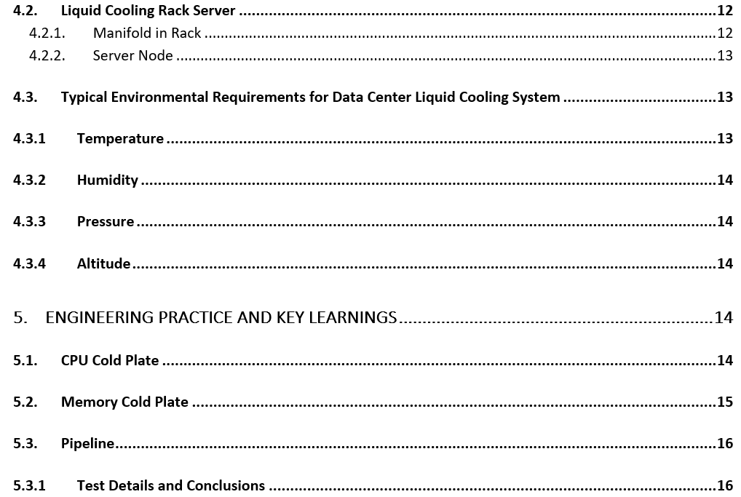
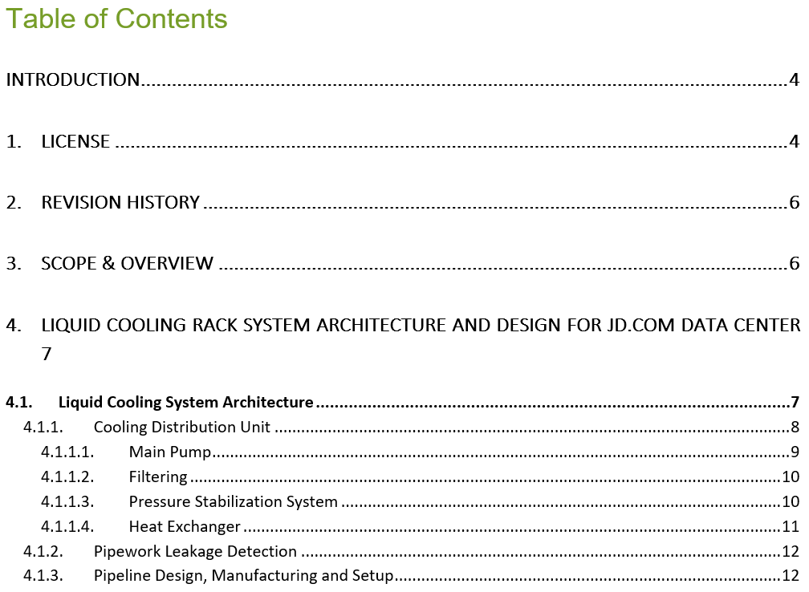
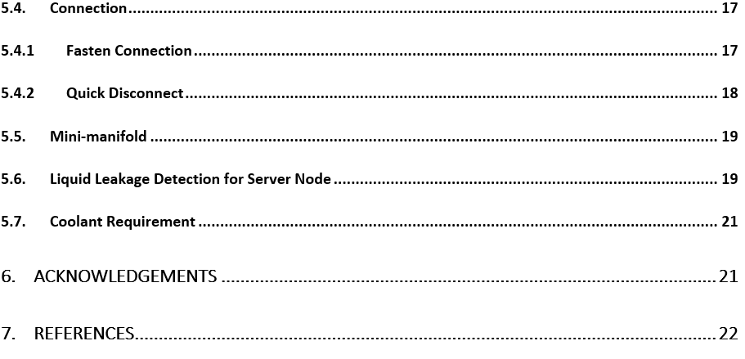
White Paper: Key Learnings and Design Reference
ADVANCED COOLING SOLUTIONS

Slide 12
Call to Action
Call for ecosystem collaboration on liquid cooling design standardization in OCP ACS Working Group.
Where to find whitepaper (URL links)
Project Wiki with latest specification white paper of An Advanced Liquid Cooling Rack Design for JD.COM Data Center
http://www.opencompute.org/wiki/ACS/
ADVANCED COOLING SOLUTIONS

