Slide 2

ACS Immersion Standards Revision 2
Jimil M. Shah, Application Development Engineer, 3M EMSD jshah2@mmm.com
Rolf Brink, Immersion Stream Leader, OCP rolf.brink@ocproject.net
ACS Immersion

Slide 3

ACS Immersion goals
ADVANCED COOLING SOLUTIONS
Define requirements and specifications to stimulate immersion technologies in OCP
Most immersion technologies are unique in shape, size and solution approach
Standards must be inclusive to most solution types
Prevent limitations on new innovations

Slide 4
Contributors
Rolf Brink, Asperitas
Jessica Gullbrand, Intel
Nigel Gore, Iceotope
John Bean, Schneider Electric
Rick Payne, Flex
Jimil M. Shah, 3M
ADVANCED COOLING SOLUTIONS

Slide 5
2019 Publication Summary
Technology styles
Enclosed chassis, Tank-style and Hybrid
Feature Classifications (Standards, thermal optimized, high safety
Certification Compliancy
Liquid Management
DCIM/Redfish integration

Slide 6
2019 Publication Summary - Continue
Solution description specs
Comparable metrics based on SI
Required documentation
Data center Interface requirements
Dielectric Fluid Requirements

Slide 7
Comparable metrics based on SI
Density per square meters: kW/m² @ #°C
Compute density
Solution density
Solution footprint
*ASHRAE W3 solution footprint: kW/m² @ 32°C
Power/fluorocarbon volume (kW/litre)
Facility design information
Static load, height clearance, dT, cooling tolerance, etc.
ADVANCED COOLING SOLUTIONS

Slide 8
Outline: Revision 2 headlines
Document split: Immersion best practices vs SPEC
High Availability requirements
Dielectric fluid quality management guidelines
Immersion related uptime factors
Immersion qualification checklist
ADVANCED COOLING SOLUTIONS

Slide 9
Document split
Immersion best practices white paper
Common context (metrics, terminology)
Design guidelines (safety, form factor, shape etc)
Advisories (Liquid management, EMC, containment etc)
New availability insights
SPEC
Qualifiable minimum specifications
Potential OCP recognition for meeting SPEC (in discussion)
ADVANCED COOLING SOLUTIONS

Slide 10
High availability requirements
Compliance with all thermal optimized and high safety classifications
Dual power delivery and full selectivity of critical features
Certified/confirmed by independent 3rd party
Ability to distribute redundant power to all electronics
N+1 or 2N cooling ability (at least dual heat exchanging)
N+1 can be supplemented with specific ride through capabilities

Slide 11
Dielectric fluid quality management guidelines
Hydrocarbons
Mineral oils should be avoided. Only synthetic liquids should be used.
The properties of the oil in operation should be tested for oxidation stability, interfacial tension, particle count, flash point, viscosity, break down voltage, density and corrosive Sulfur at regular intervals to monitor fluid quality ensuring consistent performance over time.
Fluorochemical
The fluid conditioning system should be designed to remove water, oils, acids and thermal decomposition products from Fluorochemical fluids.
ADVANCED COOLING SOLUTIONS

Slide 12
Hydrocarbons:
Contaminants | Sources/Cause | Prevention/Remediation
Particles or fiber | Oil or equipment e.g. metallic, fiber, sludge in mechanical circulated systems. | A continuous filter system
Moisture | Atmosphere/manufacturing process | Any open bath solution should contain a lid to limit ventilation of the air to liquid interface.
Sludge | Oxidation in oil | Oxidation could be detected by acidity and color appearance monitoring. It could be mitigated by moisture level, overheating and contamination control.
Corrosive Sulfur | Introduced by IT materials | Monitor for Sulfur contents on a regular basis
Degradable products and soluble polar contaminants | Incompatibility | Check interfacial tension
Generation of low molecular hydrocarbons | Produced by overheating or electrical discharge/cause lowering in flash point of oil Low molecular hydrocarbons could also come from cables and other IT materials after overheating and degradation., eg.EVA and PE are used in different types of cables. | Avoid completely
Contamination by plasticizers, grease, adhesive, ink, elastomers, rubber, solder flux, coatings, etc. | Server components | Check material compatibility. Refer to upcoming OCP whitepaper “IT gear for immersion strategies” for more details.

Slide 13
Fluorochemical fluids:
Contaminants | Sources/Cause | Prevention/Remediation
“Inert” hydrocarbon such as DOP, PDMS, etc. | Wire insulation, silicone rubber, solder flux, etc. | Activated Carbon
Chemically “active” hydrocarbon such as solder flux | Printed Circuit Boards | Activated Carbon
Water | Condensation. Heat Exchanger Leak | Silica Gel or Metal Sulfate
Particulate | Manufacturing Residue | Mechanical Filtration to <1 µm
Decomposition Products: COF2, Unsaturates, HF, etc. | Electrical Failure resulting in Arc or Red-hot burn | Activated Alumina or Base Wash

Slide 14
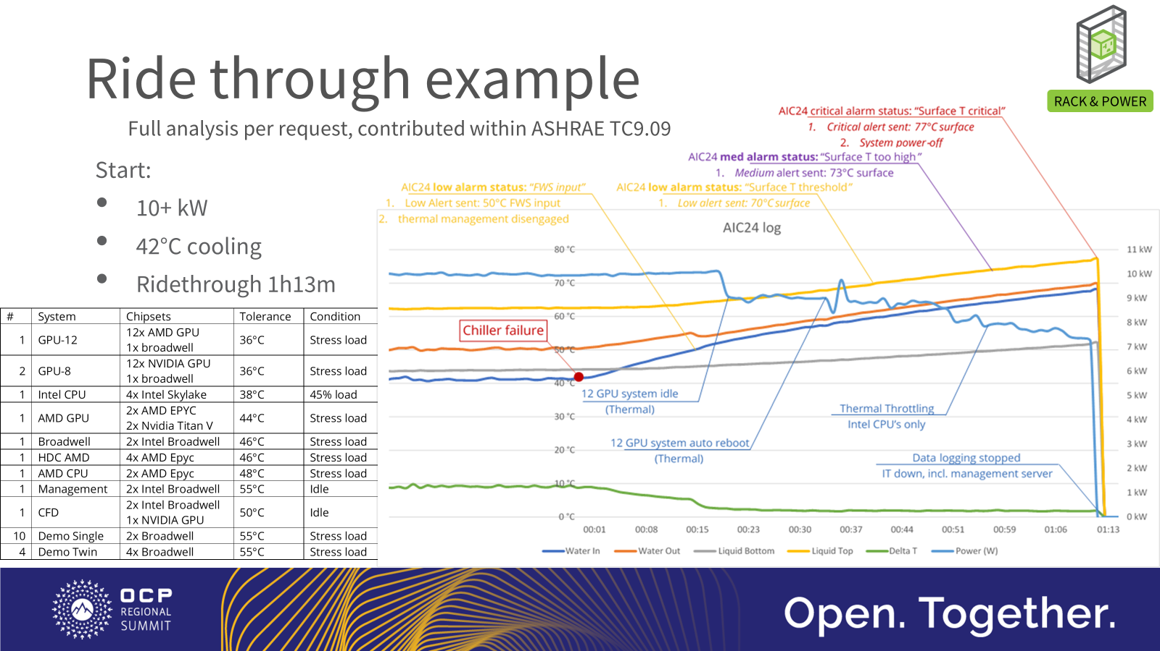
Immersion related uptime factors
1- Ride through
ADVANCED COOLING SOLUTIONS
Dielectric ride through
Thermal buffer of the liquid
Partial dielectric ride through
N+1 or 2N like systems
FWS ride through
Built-in buffer in the FWS

Slide 15
Immersion related uptime factors
2- Thermal design
ADVANCED COOLING SOLUTIONS
Dependent on immersion solution
Dampening effect by liquid
Minimize thermal stress on (micro) components
Thermal stability by controlled or predictable flow
More stable chip temperatures

Slide 16
Immersion related uptime factors
3- Other factors
ADVANCED COOLING SOLUTIONS
Alternate cooling sources as backups (river, pools, etc)
High temperature cooling allows reuse as primary cooling (traditional circuit as back-up)
Insulation against oxygen (oxidation protection)

Slide 17
Upcoming ACS Immersion activities
IT Gear
Design guidelines for IT
Material compatibility
Thermodynamics
Immersion components
Future designs
Immersion systems
New technology reviews
  Solutions
  Liquids
Industry standards optimization
ADVANCED COOLING SOLUTIONS

Slide 18
ACS – Immersion workstream
Join the immersion workstream and contribute!
ACS Immersion schedule:
Each 3rd Tuesday of the month
https://www.opencompute.org/wiki/Rack_%26_Power/Advanced_Cooling_Solutions
Mailing list: http://lists.opencompute.org/mailman/listinfo/opencompute-acsimmersion
On-going project: Document split and IT Gear specs, guidelines and best practices

