Slide 1
Computational Storage: Big Confusion Around a Simple Idea
Tong Zhang
Chief Scientist @ ScaleFlux, Professor @ RPI

Slide 2


Beautifully Simple Rationale, But …
CPU
CPU
SSD
CSD
DRAM
DRAM
DRAM
DRAM
Higher performance
Lower power
Lower cost
An active research topic in academia for over 20 years, especially in the past 10 years
Hundreds of millions of dollars of R&D investment over the past ~5 years
Papers only

Slide 3
Beautifully Simple Rationale, But …
CPU
CPU
SSD
CSD
DRAM
DRAM
DRAM
DRAM
Is it just another academic fantasy like many others?
Any fundamental flaws here?
Does this idea really make sense?
OS
VFS
File system
Block layer
Driver
Computational storage drive (CSD)
POSIX
NVMe
Applications
➔ Very high abstraction-breaking cost

Slide 4
Beautifully Simple Rationale, But …
CPU
CPU
SSD
CSD
DRAM
DRAM
DRAM
DRAM
Is it just another academic fantasy like many others?
Any fundamental flaws here?
Does this idea really make sense?
Very high abstraction-breaking cost
Ambiguous & fragmented benefit proposition
Block Chain
Benefit
AI/ML
Cost
NLP
Search
Compress
RSA
RDBMs
Video
EC

Slide 5
Computational Storage
Benefit
Cost
Higher abstraction-breaking cost
Ambiguous & fragmented benefit proposition
Why you guys still try to commercialize computational storage today?
Not necessarily an inherent problem of computation storage!
Conventional computation offloading only mindset

Slide 6



“Computation Offloading Only” Mindset
GPU
SmartNIC
FPGA
Video codec
TPU
Computation offloading
OS
VFS
File system
Block layer
Driver
Computational storage drive (CSD)
POSIX
NVMe
Applications
Drop the “computation offloading only” mindset?

Slide 7
Drop the “Computation Offloading Only” Mindset
OS
VFS
File system
Block layer
Driver
Computational storage drive (CSD)
POSIX
NVMe
Applications
Transparent
Native in-storage computation
Abstraction-breaking cost
Computation function
Wide applicability
Low efficiency of CPU-based implementation
Ambiguous & fragmented benefit proposition
Lossless data compression

Slide 8
Computational Storage
Computational Storage Drive (CSD)
SoC
Storage Media
NVMe
Per-4KB compression
Encryption
Flash Control
TLC/QLC
NAND Flash
Host-side Driver
Per-4KB decompression
Decryption
Auxiliary fabric (e.g., ARM, RISC-V)
Native in-storage transparent compression (& encryption)
Higher abstraction-breaking cost
Benefit
Cost
Cost
Benefit
Ambiguous & fragmented benefit proposition

Slide 9


Benefit of In-storage Transparent Compression
Transparently reduce the data storage cost
Transparently improve storage IOPS performance
Big but largely unexplored software innovation design space

Slide 10



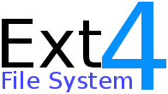
Where Does the Innovation Potential Come From?
4KB
fixed-size block I/O
User Data
4KB
Data Management SW
Data
0’s
Transparent compression
4KB
Virtually variable-size block I/O
Compressed data
Data
0’s
Unnecessary to completely fill each 4KB sector with user data
Arbitrary data size

Slide 11
Software Innovations Enabled by Transparent Compression
OS
VFS
File system
Block layer
Driver
POSIX
NVMe
Applications
CSD
Unchanged
Stage 1
Stage 2
Stage 3
Zero App modification
Modest App modification
Ground-up App development
Entire Design Space
Modify B-tree to reduce write amplification by 10x
A table-less hash-based key-value store

Slide 12
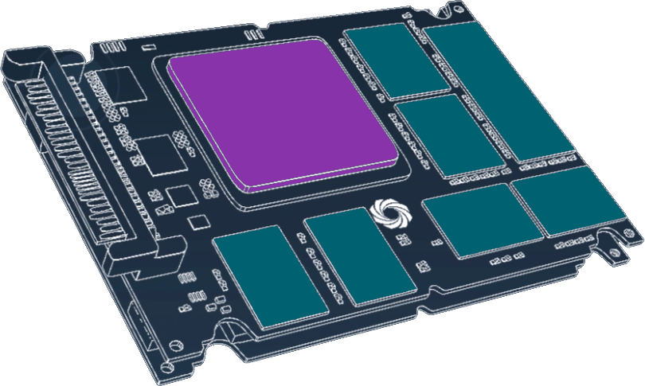
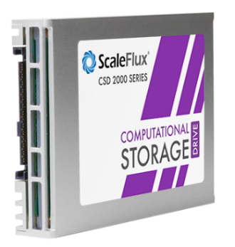
Computational Storage Drive
Computational Storage Drive
(CSD)
Transparent compression
+ SSD controller
NAND Flash Memory
Thousands of drives already shipped to customers world-wide!
Now: Xilinx FPGA (UltraScale) ➔ 2022: ScaleFlux SoC
Notes:
Our computational storage drive has a standard U.2 form factor, just like normal NVMe SSD. It integrates TBs of 3D NAND flash memory and a single chip that is responsible for both flash control and computation. Our current product use a single Xilinx FPGA, and later this month we will tape out a 16nm SoC that will power our next-generation product.

Slide 13

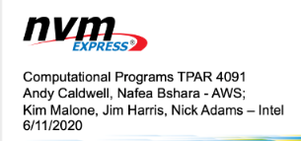
Computational Storage Drive
Transparent compression is of course NOT ALL about computational storage
The best way to commence the journey of commercializing computational storage
5+ years
Computational Storage
Heterogeneity-ready SW/HW ecosystem
5.0/6.0
Notes:
Our computational storage drive has a standard U.2 form factor, just like normal NVMe SSD. It integrates TBs of 3D NAND flash memory and a single chip that is responsible for both flash control and computation. Our current product use a single Xilinx FPGA, and later this month we will tape out a 16nm SoC that will power our next-generation product.

Slide 14
The Next Step
Computational Storage Drive (CSD)
OS
PCIe (16~32GB/s)
Accel.
Applications
4~8GB/s
CSD Ctrl SoC
(w/ trans. comp.)
NAND Flash
I/O stack
Computational Storage Drive (CSD)
PCIe (16~32GB/s)
Accel.
CSD Ctrl SoC
(w/ trans. comp.)
4~8GB/s
NAND Flash
I/O stack
Parasitic accelerator
. . .
. . .
Computational Storage Drive (CSD)
PCIe (16~32GB/s)
Accel.
CSD Ctrl SoC
(w/ trans. comp.)
4~8GB/s
NAND Flash
I/O stack
➔ Parasitic computation offloading without changing I/O stack
Well aligned with CXL and chiplet technology

Slide 15
Ultimate Computational Storage
Computational Storage Drive (CSD)
OS
PCIe (16~32GB/s)
Accel.
Accel.
Applications
4~8GB/s
CSD Ctrl SoC
(w/ trans. comp.)
NAND Flash
I/O stack
Computational Storage Drive (CSD)
PCIe (16~32GB/s)
Accel.
Accel.
CSD Ctrl SoC
(w/ trans. comp.)
4~8GB/s
NAND Flash
I/O stack
. . .
. . .
Computational Storage Drive (CSD)
PCIe (16~32GB/s)
Accel.
Accel.
CSD Ctrl SoC
(w/ trans. comp.)
4~8GB/s
NAND Flash
I/O stack
Transparent computation
Parasitic acceleration
I/O-path acceleration
Computational Storage
Heterogeneity-ready SW/HW ecosystem
High abstraction-breaking cost

Slide 16
Conclusion
Computation offloading
GPU
SmartNIC
DPU
Break the principle of abstraction
Video codec
TPU
CSD
Heterogenous Computing
Higher abstraction-breaking cost
Ambiguous benefit proposition
Phase 2
Transparent/Parasitic Computation
Phase 3
Transparent/Integrated Computation
Transparent Computation
Evolutionary Path
Parasitic Accel.
Parasitic & I/O-path Accel.
Chiplet technology is the key

