Slide 1

AT&T Open GPON
NFV OLT Line Card Specification
Tom Anschutz, DMTS, AT&T
Architecture & Planning
1057 Lenox Park Blvd.
Room A473
Atlanta, GA 30319
+1.404.499.7003
tom.anschutz@att.com
Tom Anschutz

Slide 2
Contributors and License Agreement
Submitter
  AT&T submits the contribution, as a Platinum member of OCP in good standing.
Contributors
  AT&T has authored the contribution, with some content contributed from Celestica.
  Feedback has been received and incorporated into the spec from the Telco WG
  Both AT&T and Celestica have licensed the contribution using OFWa 1.0
Spec and Design
  AT&T has authored the specification and is contributing that to OCP.
  Celestica has developed a design to meet that spec and is evaluating contributing the design.
License Agreement
  Both AT&T and Celestica have licensed the spec contribution using OFWa 1.0

Slide 3
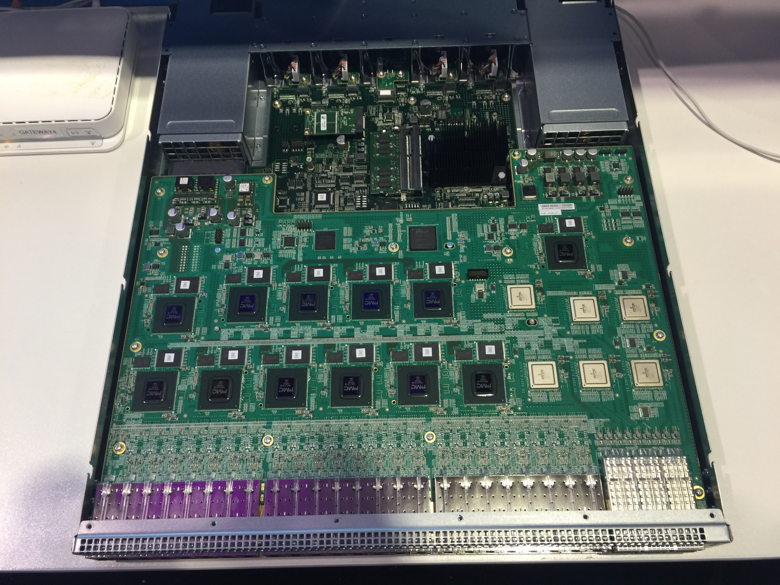
SKU
Celestica
  Model: Ruby vOLT S1010
  Meets criteria in specification (see next chart)
  Available for purchase since November 2015

Slide 4
Specification Criteria
Met by SKU
  Form factor, size
  Redundancy for fans / power supplies as well as options for power feed and airflow
  Specified merchant silicon and system block diagram
  Number, speeds, and layout of interfaces. Optics and DAC options
  BMC, ONIE, local CPU
  R-CORD system support
  Environmental requirements for power, mechanicals, safety, electromagnetics, ROHS
Not met by SKU
  The SKU has a modular CPU component, but it does not use the specified ComExpress connector.

Slide 5
OCP Principles
  Efficiency – Spec uses the lowest power ASIC for GPON OLT functions, and achieves additional power efficiency through removal of aggregation, memory, and flash compared to conventional designs. The result is a device with the lowest known watts-per-port for GPON. Deployment granularity is also made more efficient compared to common chassis-centric solutions deployed today. The architecture has proven to be low cost and extremely competitive to legacy approaches.
  Scale – The Spec is a disaggregated network peripheral for NFV Infrastructure. In contrast to previous chassis-centric designs, the spec is designed to scale-out similar to data center fabrics, and can scale both down to a single box as well as out to a 16 rack deployment. The system is ONIE loaded and management is performed using SDN (NETCONF and OpenFlow).
  Openness– The spec builds toward an open system approach with community support. The spec espouses the common form factor, layout and operational paradigms from ToR switch designs. Espouses ONIE, BMC, and Linux OS. Re-uses common power supply and fan components. Standard, non-locked, SFP and QSFP optical ports. The software stack is similarly open and is the R-CORD project in the Linux Foundation. R-CORD software is open-source with FRAND IP rules. (N.B. like most cases, the silicon firmware and associated API libraries are proprietary and licensed with the sale of the silicon.) Lastly, not only hardware and software are open, but the process used to develop the spec was open and transparent, with the Telco WG having numerous presentations and feedback sessions to help guide the work and make it useful to the larger community.
  Impact – This is the first telco project specification. This is the first disaggregated network element. The spec sets an entirely new bar for efficiency & scale and opens the path to developing more meaningful use of data center infrastructure in telco environments and for communications workloads. The architecture described in the spec launches disaggregated networking and provides a basis for many follow-on specs and designs to be developed in shorter intervals and with less effort than legacy network elements or VNFs. It could even be said that development of this spec led to the formation of the Telco Project at OCP.
See long form principles: http://opencompute.org/about/mission-and-principles/

